Slide 1
Electrical grid planning in Morocco
Micro-Project 1
Repository link
Jonathan Espedal
04 OCT 2026

Slide 2
Problem Statement
This project analyzes high-resolution smart meter data from four Moroccan cities (Laâyoune, Boujdour, Foum Eloued, and Marrakech) to classify electricity load readings as peak-demand or normal-demand periods. Because Laâyoune, Boujdour, and Foum Eloued are metered in Amperes while Marrakech is metered in Kilowatts, load values will be converted to a common unit using a standard voltage assumption before peak-demand magnitude is compared across cities. The goal is to identify when, how often, and how intensely peak-demand periods occur in each region, to inform infrastructure and demand-response planning.

Slide 3
Hypothesis Formulation
After converting all readings to a common unit (kW) and defining peak demand as load exceeding the 90th percentile of each city's own distribution, the timing, frequency, and relative intensity of peak-demand periods will differ significantly across cities/zones, and these differences will correlate with season and zone type (domestic vs. industrial) rather than occurring uniformly across regions.

Slide 4
Acquire
Looked through the datasets offered by the course, none of them seemed interesting and all were rather basic. Again, I went to UCI to see what they had and looked for the most recently added. The selected dataset piqued my interest as it was utility services, just electricity rather than water.
Reference:
Bensalah, M. & Hair, A. (2025). High-Resolution Load Dataset from Smart Meters Across Various Cities in Morocco [Dataset]. UCI Machine Learning Repository. https://doi.org/10.24432/C5FC8R.

Slide 5
Prepare
Merged the four city sheets from the provided .xlsx on DateTime after sorting each index (Marrakech was not sorted on DateTime) and removing duplicate timestamps.
Standardized time resolution: resampled the other 3 cities from 10-minute to Marrakech’s 30-minute interval so all four cities align on the same timestamp grid.
Identified a units mismatch: Laâyoune, Boujdour, and Foum Eloued are recorded in Amperes, while Marrakech is recorded in Kilowatts. This will be a known limitation for a direct cross-city magnitude comparison unless we do a unit conversion per row.
Since Laâyoune, Boujdour, and Foum Eloued are metered in Amperes, converting to kW requires a voltage assumption (the dataset doesn't include voltage directly, only the meter read, ie total consumption):
Morocco's standard domestic supply is 220V AC single-phase; industrial connections are commonly 380V AC three-phase. Since the dataset does not separate domestic and industrial profiles, and we will state our assumed voltage explicitly as a limitation in our report to be 220V AC single-phase.
There is a coverage gap. Marrakech data spans Jan 2023 – Jan 2024, which is less overall time than the Sep 2022 – May 2024 range for the other three cities. This will produce NaNs outside that window after the outer join.

Slide 6
Analyze data
Applied a 90th-percentile-per-zone threshold to convert continuous kW readings into binary Peak/Normal labels — a data-driven definition that avoids assuming a fixed kW cutoff across cities with very different scales (e.g., Laâyoune's 90th percentile is 145 kW vs. Marrakech's 1,635 kW)
Used comparative visual EDA such as boxplots (distribution shape per zone), an hour-of-day heatmap (when peaks occur), a seasonal peak-rate heatmap (whether peaks cluster by time of year), and a zone-to-zone correlation matrix (whether zones move together) as the primary analytical techniques for this phase.

Slide 7
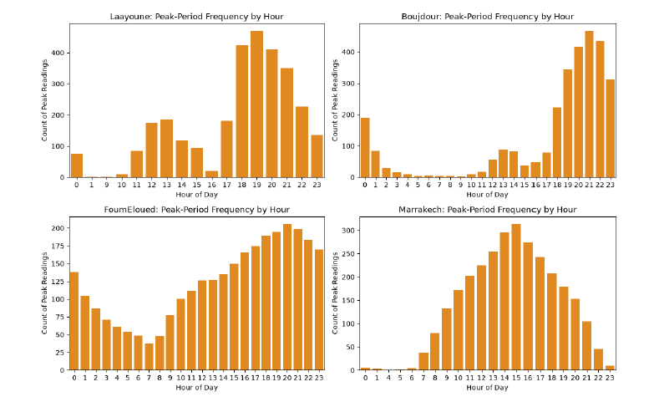
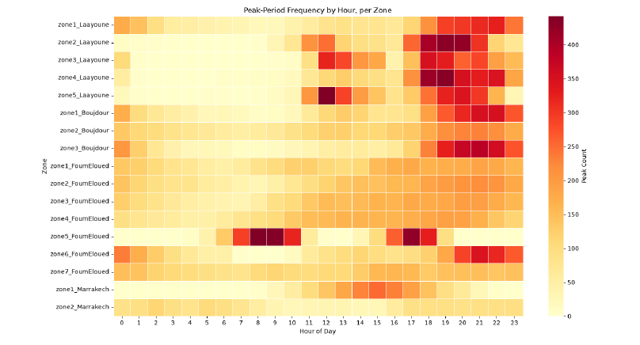
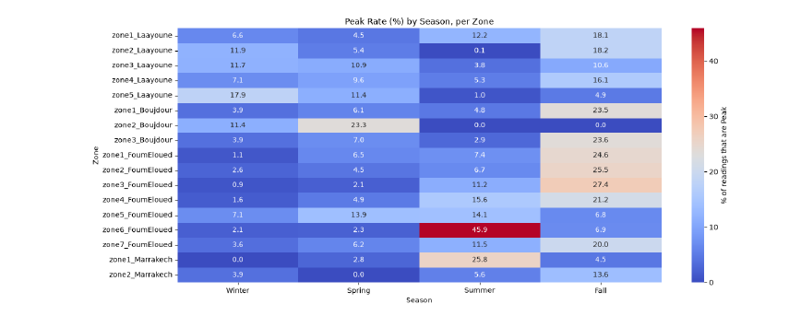
Report
Figure 1. Peak by hour distribution
Figure 2. Seasonal Peak Rate Heat Map
Figure 3. Peak-Period Frequency by Hour, per Zone
Figure 1: Laâyoune and Boujdour peak in the evening (6–11 PM), consistent with residential usage; Marrakech peaks during business hours (8 AM–6 PM) with near-zero activity from 11 PM–6 AM, consistent with commercial/institutional load rather than residential
Marrakech is a daytime bell curve peaking around 2-3 PM, with almost nothing from 10 PM to 6 AM. That fits office or commercial load, and probably afternoon cooling.
Figure 2: Laâyoune's zones 2–5 correlate at 0.71–0.88 with each other, and Foum Eloued's zones 1–4 similarly cluster (0.72–0.86), while cross-city correlations stay mostly under 0.3, this supports the idea that each region behaves independently.

Slide 8
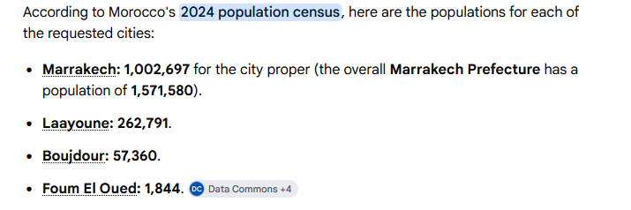
Report
Figure 4.
Marrakech's totals are far higher than the other three cities, but this likely reflects the fact the population of the cities are so vastly different. (See Figure 4)
Foum Eloued's zone 6 spikes to a 45.9% peak rate in summer (vs. ~2% the rest of the year); Marrakech's zone 1 also peaks in summer (25.8%), both plausibly cooling-driven, while most Laâyoune and other Foum Eloued zones instead peak in fall
Peak timing and seasonal patterns clearly vary by region, supporting the hypothesis statement; direct intensity comparisons across cities remain confounded by unit/aggregation differences and are noted as a limitation for future work

Slide 9
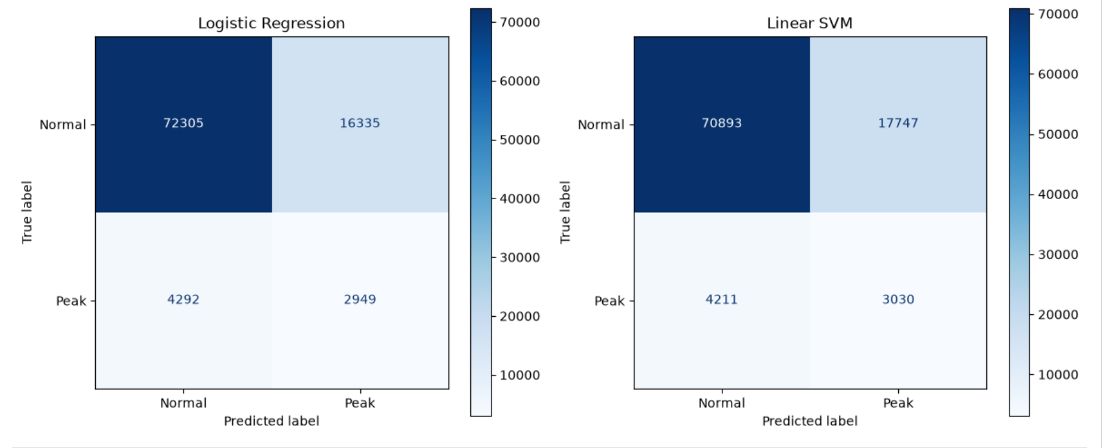
Act I – Regression and SVM
A linear decision boundary is a genuinely limited tool for this problem as we can see in our confusion matrices above. Peak behavior varies by city, by season, and by hour simultaneously — a three-way interaction a linear model struggles to represent even with a two-way interaction term added.
A linear classifier captures some zone/hour structure but underperforms at identifying peak periods, motivating a sequence-aware deep learning approach to build off of in Act II.

Slide 10
Act II – Recurrent Neural Networks
Micro-Project 4 will apply RNN-based deep learning to model the sequential/time-series structure directly.

