Slide 1
Hurricanes and Typhoones

Slide 3
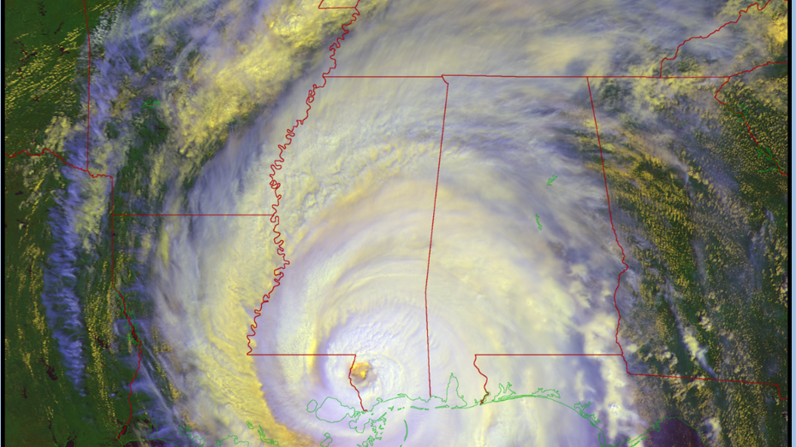

Slide 4
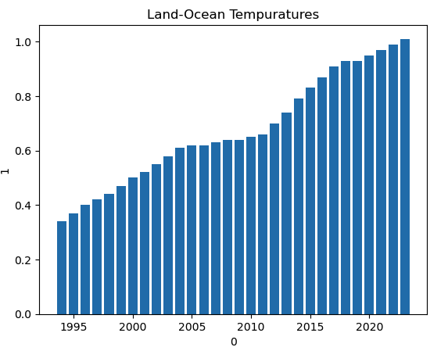

Slide 5
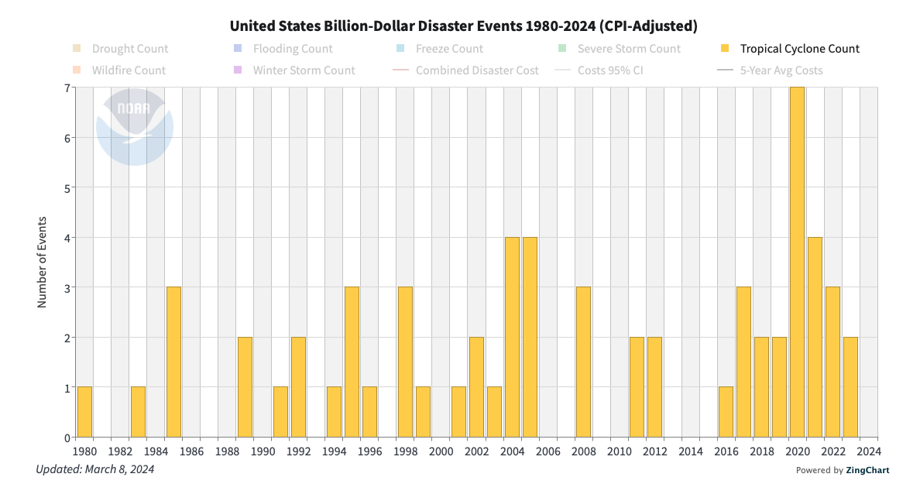

Slide 6
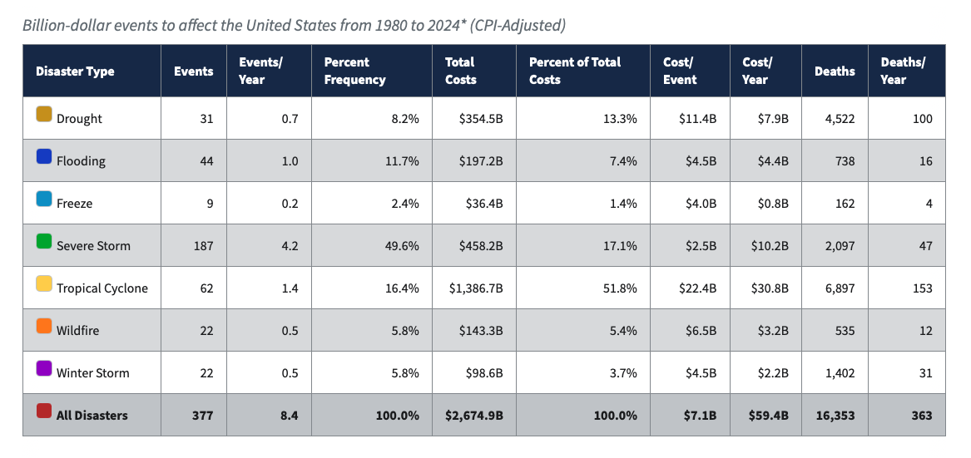

Slide 7
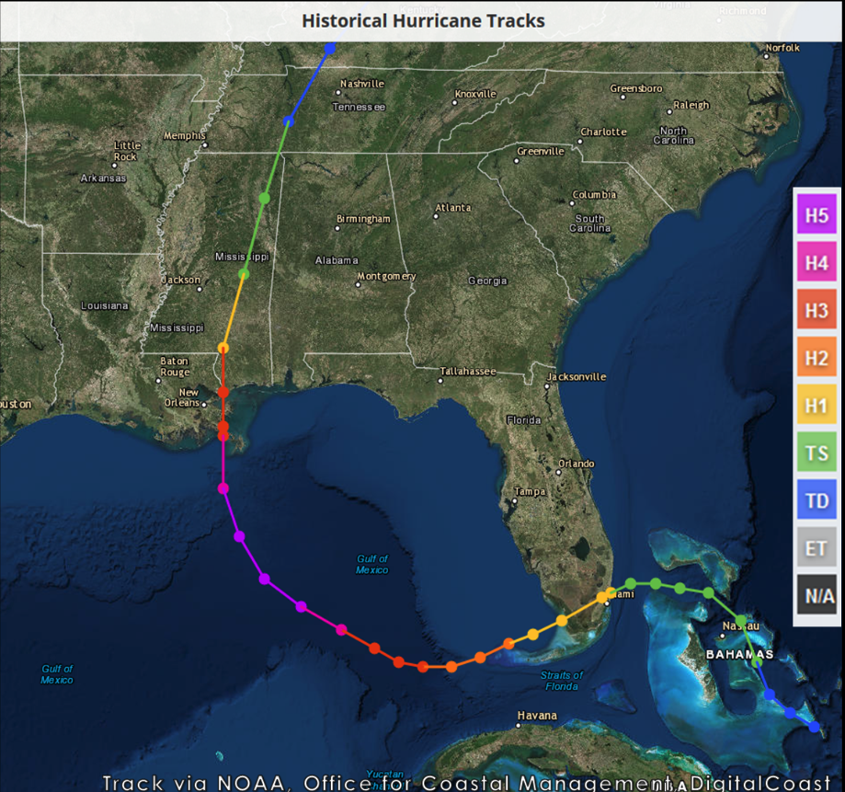

Slide 8
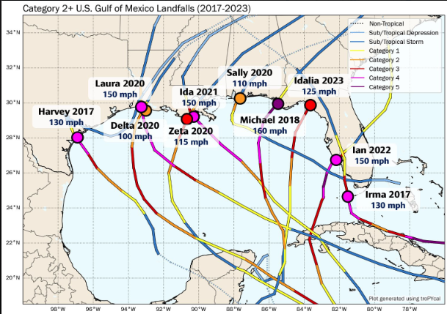

Slide 9
REFERENCES
https://climate.nasa.gov/vital-signs/global-temperature/?intent=121
https://www.weather.gov/mob/katrina
https://www.ncei.noaa.gov/access/billions/state-summary/US

