Slide 1
United States Adoption Statistics
General Assembly – Data Science
Matthew Reese

Slide 2
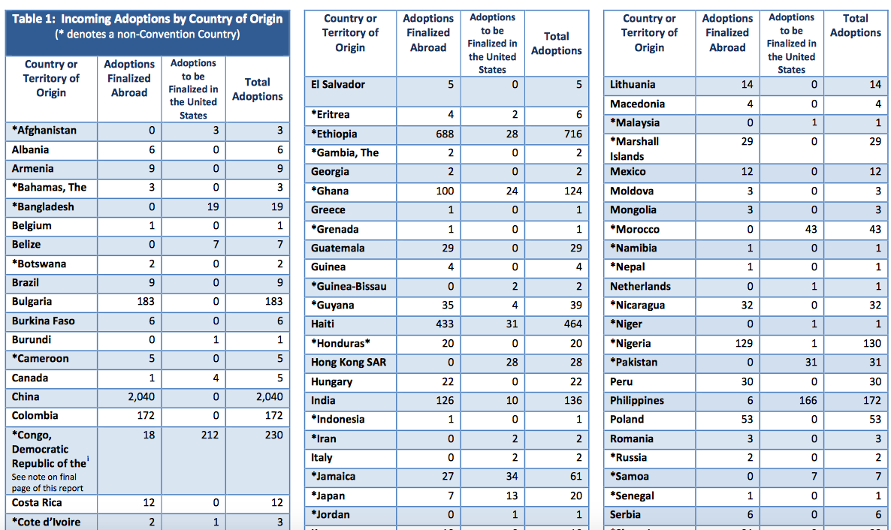
Data Sources
International Adoption Statistics
US Department of State
Spread horizontally, difficult for PDF parsers to read.

Slide 3
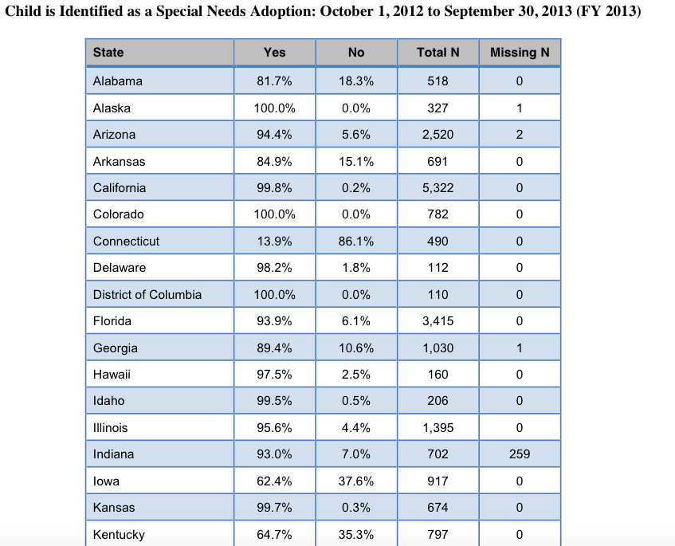
Data Sources
Domestic Adoption Statistics
US Department of Health & Human Services
Simpler tables, much easier to parse

Slide 4
Cleaning Data
Convert PDFs to CSV, manually or through a parser
Read all relevant data into large dataframes
Clean titles (e.g. remove spaces, remove duplicates)

Slide 5
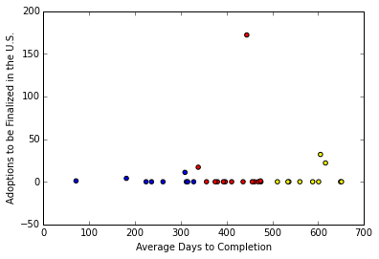
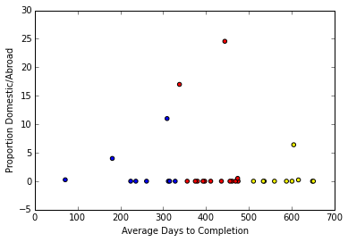
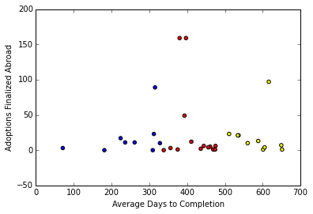
Data Exploration
Finalized Domestic, Abroad, vs Avg Days to Completion

Slide 6
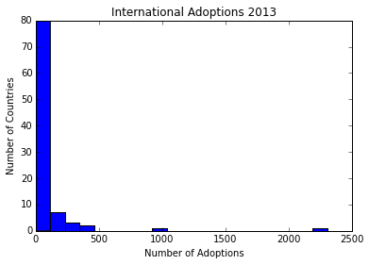
International Adoption
Country, Adoptions Finalized Domestically, Adoptions Finalized Abroad
Hague Convention Countries also have:
Average Days to Completion, Median Fees

Slide 7
The Hague Convention
“Provides a formal international and intergovernmental recognition of intercountry adoption to ensure that adoptions under the Convention will generally be recognized and given effect in other party countries.”
More data available for some of these countries: Average Time to Completion & Median Fees

Slide 8
Data Cleanup
Greece, Togo, and Guinea had null values for median fees. Replaced with the mean value.
Scaling is off between fees and other variables. We’ll come back to this later

Slide 9
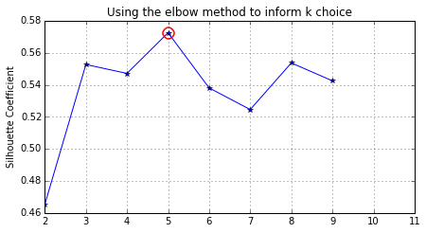
Intl Analysis
Not sure how to group these countries, so let the computer do it.
Kmeans Clustering
Used proportion finalized domestically, proportion finalized abroad, median fees, average days to completion, and total number of adoptions.
Calculated silhouette coefficients for a range of K.
Recommended we use 5.

Slide 10
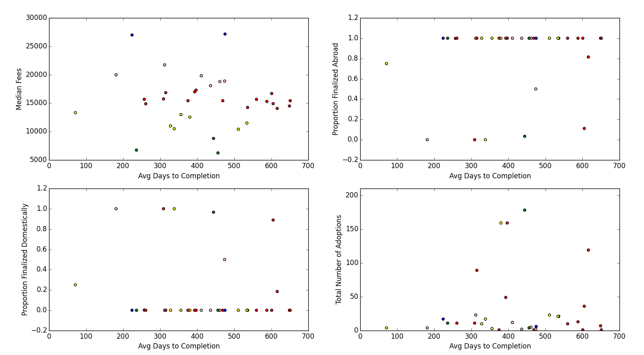
Intl Analysis Continued

Slide 11
Evaluation
Silhouette Coefficient:
We got ~.57, but it seems like the only data that mattered was the median cost
Scaling issue. When data was rescaled, silhouette coefficient came out to be -.3
This implies that clusters overlap, which is not particularly helpful.

Slide 12
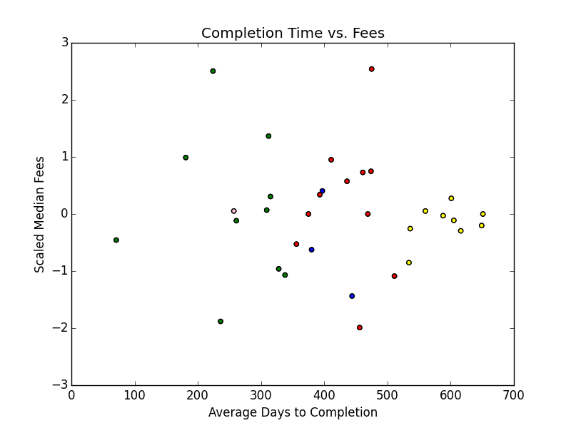

Slide 13
Domestic Adoption
Much more data available from Department of Health & Human Services
Age
Gender
Special Needs
Subsidy
Involvement of Relatives
Time between termination of parental rights & adoption

Slide 14
Cleanup
Replace spaces in column headers
Multiple CSVs had a “totals” column.
Numerical data is in string form
Data is given in percentages, making each “totals” column important, as they’re not all the same
Ultimately opted to just eliminate totals and focus on proportions, add Totals back in later.

Slide 15
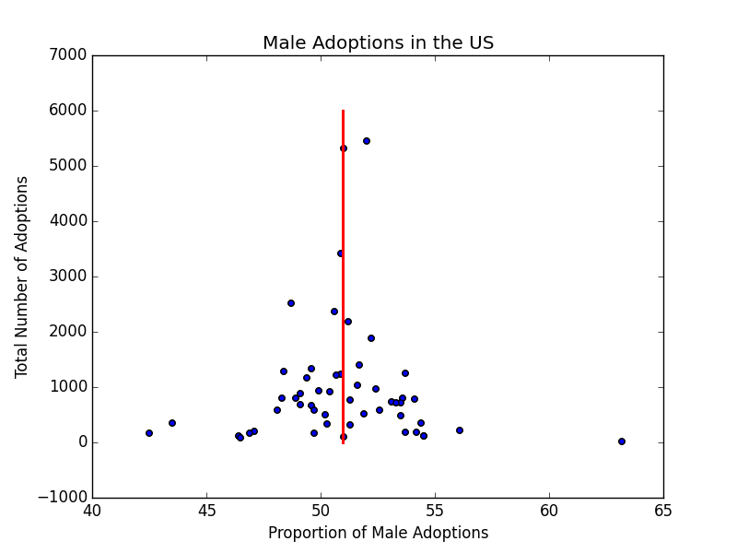
Preliminary Exploration

Slide 16
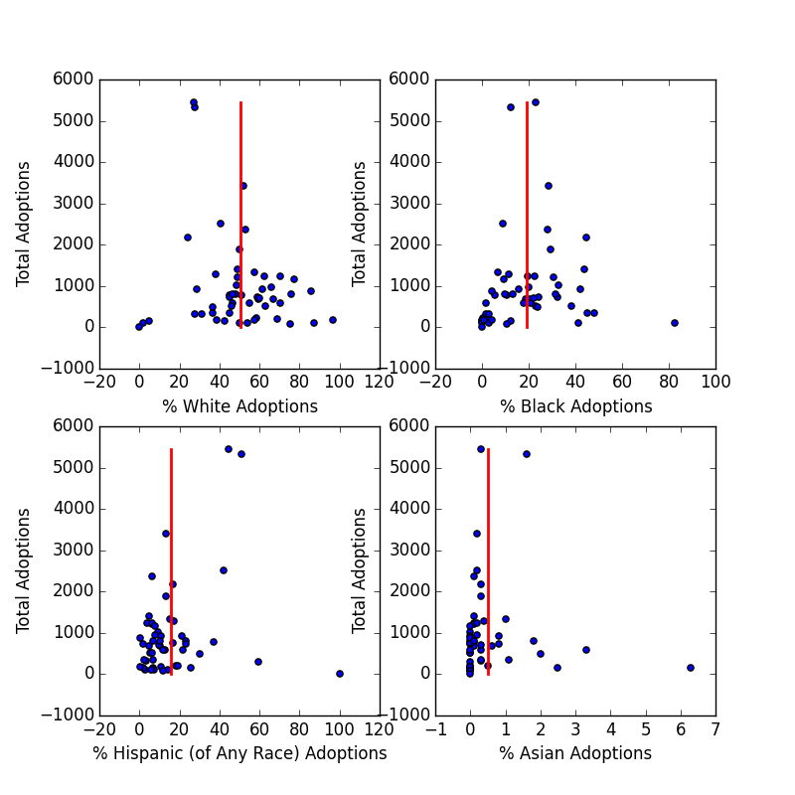
By Race

Slide 17
Ideas to Investigate
Census Data
Multi-year data
Domestic Information
Subsidies
Relation to adoptive parent
Foster, blood, nonrelated
Disability

