Slide 1
DATA SCIENCE Class 2: Getting data
Notes:
~15-20 min on initial stuff
Note: example DS problem…write down some features, how could you build a predictive model from these?

Slide 2
I. Getting data II. Regex / requests Iii. Api / wrappers IV. Ethics
AGENDA
Notes:
All of our classes will involve some hands-on work (in the exercises section)

Slide 3
i. Getting data
INTRO TO DATA SCIENCE
Notes:
~15-20 min for this section?

Slide 4
GETTING DATA
Data lives all over the internet
The question is whether or not the author of the data makes it easy for us to grab it.
Notes:
~15-20 min for this section?

Slide 5
GETTING DATA
We will look at three different ways of getting data
Using an HTML Parser
Using an API
Using an API wrapper
Notes:
~15-20 min for this section?

Slide 6
GETTING DATA
Using an HTML Parser
Pattern recognition
Regular Expressions
Notes:
~15-20 min for this section?

Slide 7
GETTING DATA
Using an API
API Documentation
JSON vs. XML
JSON – Javascript Object Notation (more common)
XML – Extensible Markup Language
Notes:
~15-20 min for this section?

Slide 8
GETTING DATA
Using an API wrapper
Wrapper Documentation
Usually hosted on Github
Still will probably use JSON
Example: https://github.com/tweepy/tweepy
Notes:
~15-20 min for this section?

Slide 9
ii. REGEX / Requests
INTRO TO DATA SCIENCE
Notes:
~15-20 min for this section?

Slide 10
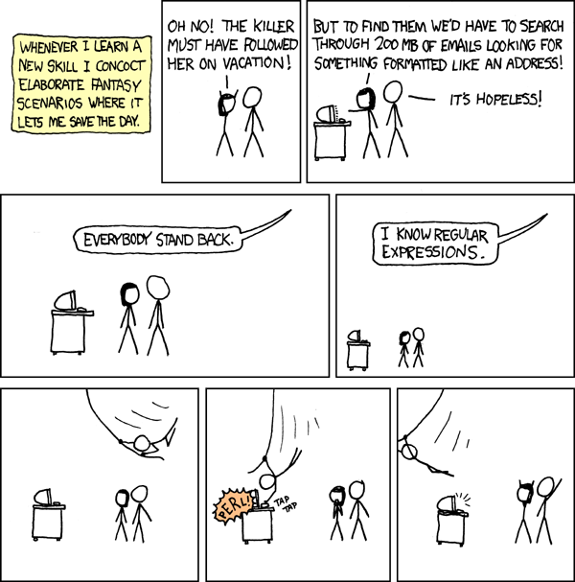

Slide 11
Regex / requests
REGular EXpressions
are how we capture patterns in text
Notes:
~15-20 min for this section?

Slide 12
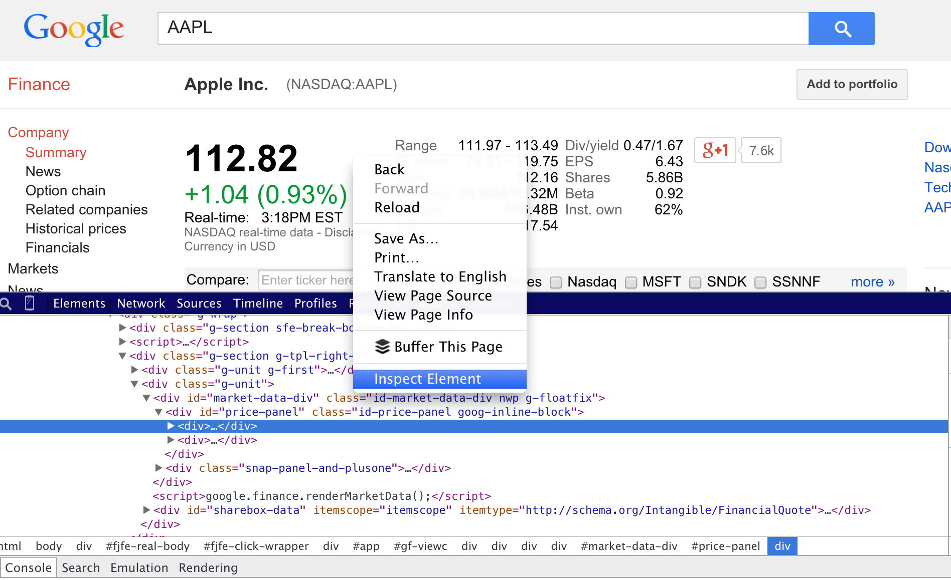
WHO IS A DATA SCIENTIST?
Notes:
~15-20 min for this section?

Slide 13
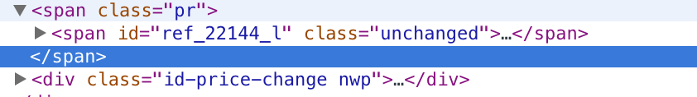
REGEX / Requests
What regex can we use to capture this?

Slide 14
beautifulsoup
REGEX / Requests
Is a python based HTML parser.

Slide 15
beautifulsoup
REGEX / Requests
Is a python based HTML parser.
Let’s try it!

Slide 16
Web crawlers
REGEX / Requests
We just built one!

Slide 17
Web crawlers
REGEX / Requests
We just built one!
But be careful….
Hacking OKCupid: http://www.wired.com/2014/01/how-to-hack-okcupid/all/

Slide 18
Iii. APIs and Wrappers
INTRO TO DATA SCIENCE
Notes:
~15-20 min for this section?
So what does data science look like?

Slide 19
API / Wrappers
HTML Parsing vs. API
Must call using requests and BeautifulSoup (imitate human behavior)
Makes the call for us (the author is “allowing us” to access the data)
http://www.pythonforbeginners.com/api/list-of-python-apis

Slide 20
API / Wrappers
API (n):
Application Programming Interface
Easing access into a web based software

Slide 21
API / Wrappers
Examples of API’s:
Amazon (price data)
Twitter (tweets)
Facebook (social network)
Sentiment Analysis

Slide 22
API / Wrappers
Examples of API’s:
Amazon (price data)
Twitter (tweets)
Facebook (social network)
Sentiment Analysis
Mashape.com has an extensive collection

Slide 23
API / Wrappers
API vs. API wrapper
May still be a bit confusing how to call the right page
Puts the API into a specific programming language. Gives us python functions.
http://www.pythonforbeginners.com/api/list-of-python-apis

Slide 24
IV. ethics
INTRO TO DATA SCIENCE
Notes:
~15-20 min for this section?
So what does data science look like?

Slide 25
API / Wrappers
Facebook Experiment vs. Dunkin Donuts
Facebook running psychological experiments on us
Dunkin Donuts offering promos to areas with negative tweets

Slide 26
API / Wrappers
Conclusion
Data is all over the web, but we must be polite and conscious of what data is available to us.

