Slide 1
Restaurant Revenue Prediction
Data science project - May 2, 2015
Tom Bailey

Slide 2
Background & Objective
The project is from the Kaggle competition, “Restaurant Revenue Prediction,” hosted by Tab Food Investments.
http://www.kaggle.com/c/restaurant-revenue-prediction
Predict annual restaurant revenue for a set of Turkish restaurants based on characteristics such as location, restaurant type, and other demographic, real estate, and commercial data.

Slide 3
Data
137 records (each record represents one restaurant)
Field Name | Field Description
Id | Restaurant ID
Open Date | Opening date for the restaurant
City | City the restaurant is in
City Group | Type of the city (Big City or Other)
Type | Type of the restaurant. FC: Food Court, IL: Inline, DT: Drive Thru, MB: Mobile
P1-P37 | There are three categories of these obfuscated data. Demographic data are gathered from third party providers with GIS systems. These include population in any given area, age and gender distribution, development scales. Real estate data mainly relate to the m2 of the location, front facade of the location, car park availability. Commercial data mainly include the existence of points of interest including schools, banks, and other QSR operators.
Revenue | The revenue column indicates a (transformed) revenue of the restaurant in a given year and is the target of predictive analysis. Please note that the values are transformed so they don't mean real dollar values.

Slide 4
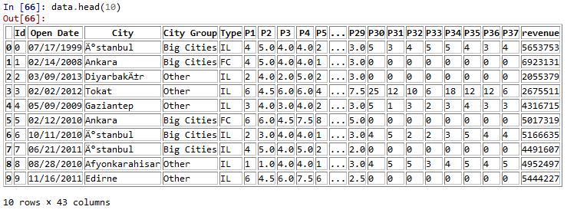
Data, cont’d

Slide 5
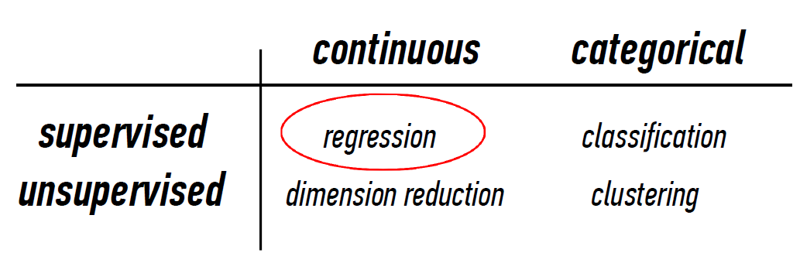
Problem Type?

Slide 6
Prepare Data
Basic linear regression
First, transform some of the data:
Open Date → Days Open
Create dummies for City Group
Create dummies for Type

Slide 7
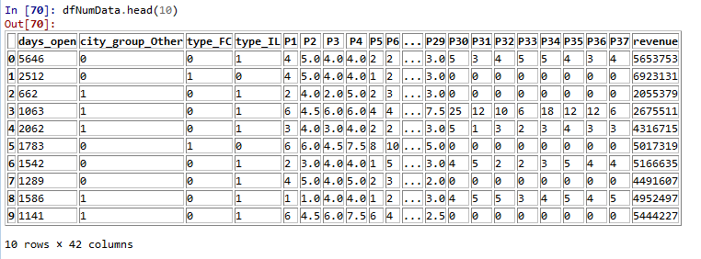
Prepare Data, cont’d
Store all the numerical data that we need to run regressions

Slide 8
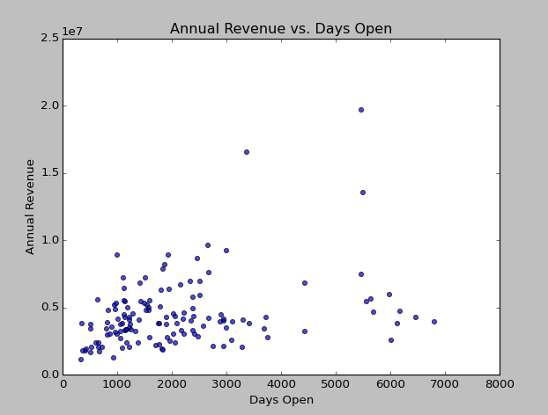
Days Open
The number of days a restaurant has been open appears to positively affect annual revenue.

Slide 9
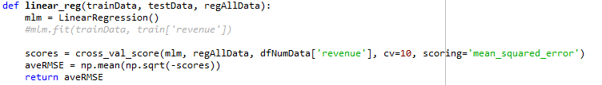
Approach
Goal of competition is to find model that minimizes RMSE
Split all prepared/numerical data into train and test sets
Build function that takes training set, test set, and all numerical data and returns the average RMSE

Slide 10
Approach, cont’d
Use function (linear_reg) to try to different variable combinations and see their effect on average RMSE
Using all numerical data
Code:
Ave RMSE = 3,569,327.30
Using just city group type and type of establishment ('IL', 'FC', 'DT')
Code:
Ave RMSE = 9.58564195308e+18
Using just days open, city group type, and type of establishment ('IL', 'FC', 'DT')
Code:
Ave RMSE = 2303897.4013288841

Slide 11
Approach, cont’d
Go through as many combinations of demographic variables as possible and add to previous model to try to reduce average RMSE
Use combinations from itertools
Combinations of 2 demographic variables:
Smallest RMSE is 2285908.7316228701 for combo of P25 and P32
Combinations of 3 demographic variables:
Smallest RMSE is 2262813.5231390675 for combo of P23, P25, and P32
Combinations of 4 demographic variables:
Smallest RMSE is 2262813.5231390675 (exactly the same as with 3) for combo of P23, P25, P32, and P37

Slide 12
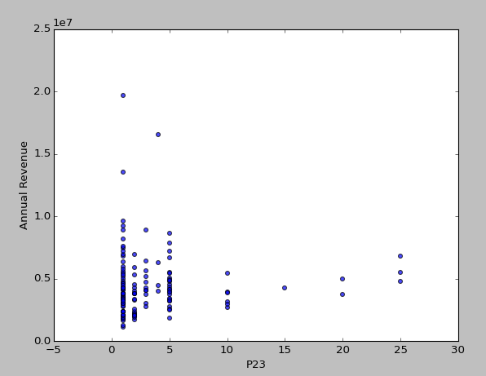
Examination of P23
Slight negative correlation between P23 and Annual Revenue

Slide 13
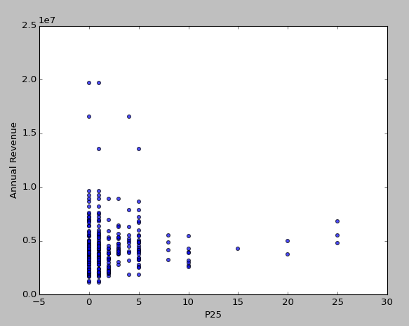
Examination of P25
Slight negative correlation between P25 and Annual Revenue

Slide 14
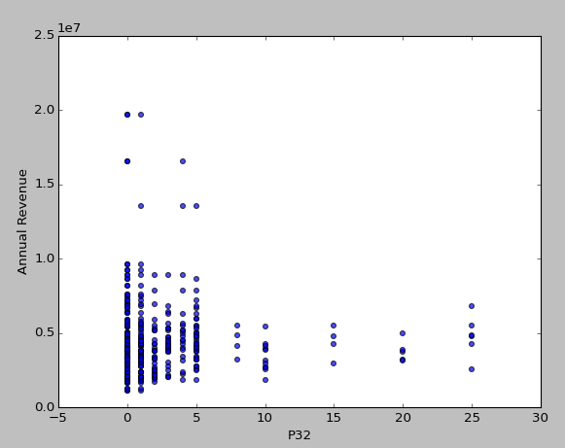
Examination of P32
Slight negative correlation between P32 and Annual Revenue

Slide 15
Approach, cont’d
Try regression with the following variables: days_open, city group dummies, type dummies, P23, P25, & P32 (this is the model with the lowest average RMSE)
Variable | Coefficient (i.e., effect on Annual Revenue)
Days_open | 627.811442106
city_group_Other | -1281475.9686
type_FC | 569595.536121
type_IL | -569595.536121
P23 | 79744.7118623
P25 | 225526.742642
P32 | -106508.194718

Slide 16
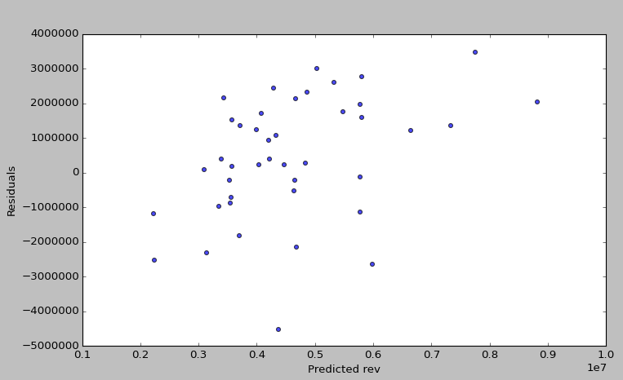
Predictions
Use coefficients to come up with predictions

Slide 17
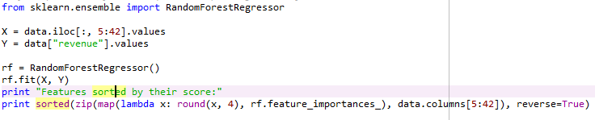
Another Approach – Random Forest
Use Random Forest to select best features

Slide 18
Another Approach – Random Forest
Use Random Forest to select best features

Slide 19
Approach, cont’d
Try regression with the following variables: days_open, city group dummies, type dummies, P29
Average RMSE is 2319914.0381488604 (not as low as previous model)

