Slide 1
Applying Benford’s Law to the FX Market
March 21, 2015

Slide 2
Objective
Detect market manipulation in currency trades
The hunch is that traders manipulate the prices of currencies right around 4pm (Greenwich time)

Slide 3

Benford’s Law
The distribution of first non-zero digits p^{k} will be:
Benford’s distribution is not uniform
Probability for digit 9 is 4.6%
Probability for digit 1 is 30.1%

Slide 4
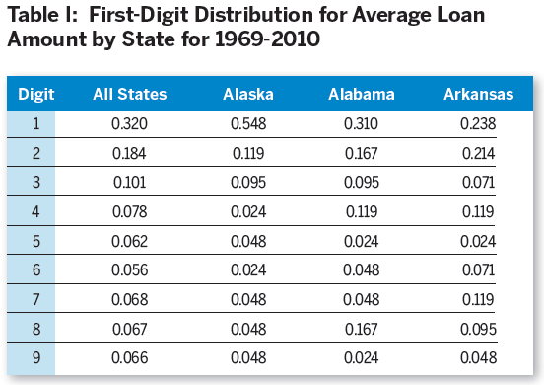
Benford’s Law example

Slide 5
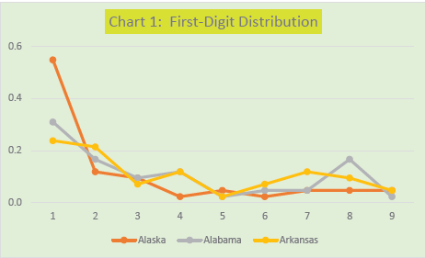
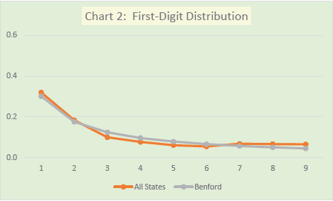
Benford’s Law example

Slide 6
Getting the Data
CSV files for the 15 major currency pairs
From http://www.truefx.com/?page=downloads
Each CSV file contains data for each month for each currency pair
Each CSV file is approximately 700,000 records with the following fields:
Currency pair
Timestamp
Bid
Offer

Slide 7
Analysis
Analyze bid, offer, and spread for 30 minute period from 3:45 pm to 4:15 pm
Also look at behavior of these amounts around 8:30 am on day when Non-Farm Payroll numbers are released.
We would expect that this data would not be truly random (i.e., it would not obey Bedford’s Law)

Slide 8
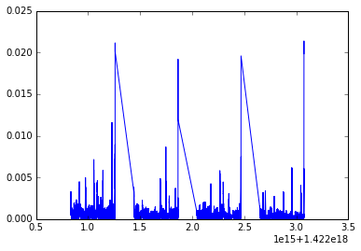
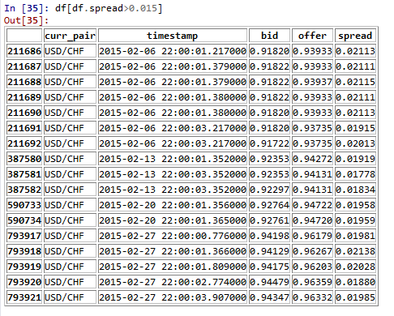
Initial exploratory analysis of data
Data from CSV file for USD-CHF from February 2015

