Slide 1
Sentiment Analysis on Movie Reviews
Shannon Jones

Slide 2
Rotten Tomatoes Data
The data was comprised of Rotten Tomatoes reviews with given sentiment labels from 0 to 5
Train dataset = 39,015 phrases
The sentiment labels were given by Standford’s NLP study
0 - negative
1 - somewhat negative
2 - neutral
3 - somewhat positive
4 – positive
The goal was to correctly label the reviews from 0 to 5

Slide 3
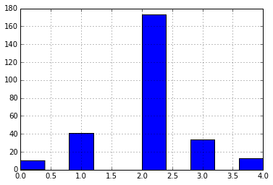
Distribution of Data
Majority of the data was classified as neutral

Slide 4
Naïve Bayes
Instead of binary prediction like in class, predicting value of 0 to 5
Used the CountVectorizer to get a count for each token
Example:
Used sklearn Naïve Bayes to fit model
Predicting the test data gives an accuracy of 61.3%
Count | Token
6 | Adage
3 | Aggressive
6 | All
11 | Amounts
7 | Amuses

Slide 5
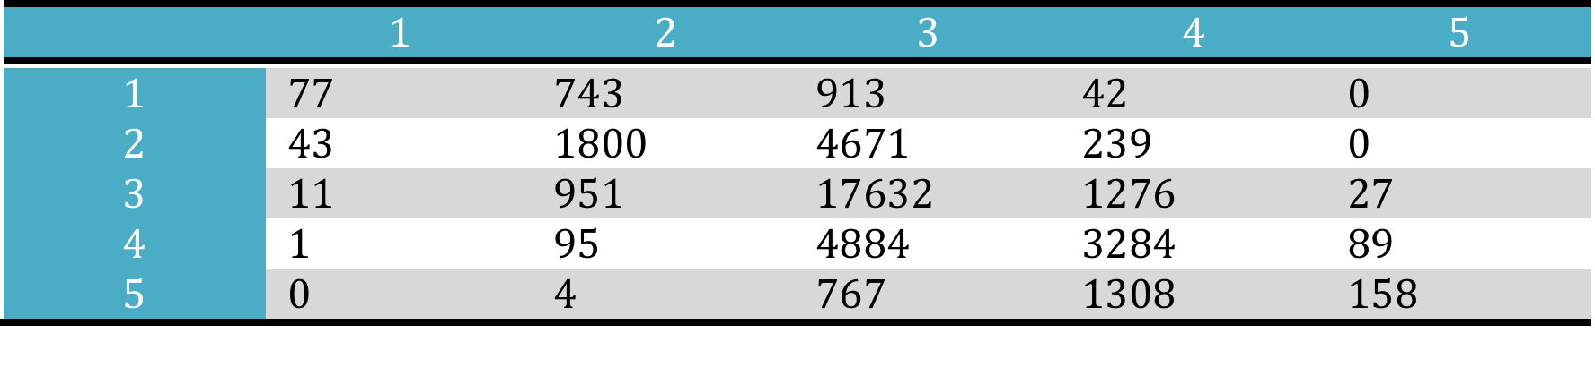
Naïve Bayes Cont.
Confusion Matrix
Example of False Positives:
A sleep-inducing thriller with a single
Friday After Next is a lot more bluster than bite
Example of False Negatives:
be accused of being a bit undisciplined
will be Greek to anyone not predisposed to the movie 's rude and crude humor

Slide 6
Other Things Tried
TfidfVectorizer to hopefully take weight off of certain tokens (i.e. actors), but got worse accuracy (~57%)
Ngrams to create tokens such as “not good”, but got worse accuracy (~58%)
Random Forest Classifier

Slide 7
If Given More Time…
Create own sentiment analysis engine
Predict Rotten Tomatoes rating based on sentiment

