Slide 1
United States Adoption Statistics
General Assembly – Data Science
Matthew Reese

Slide 2
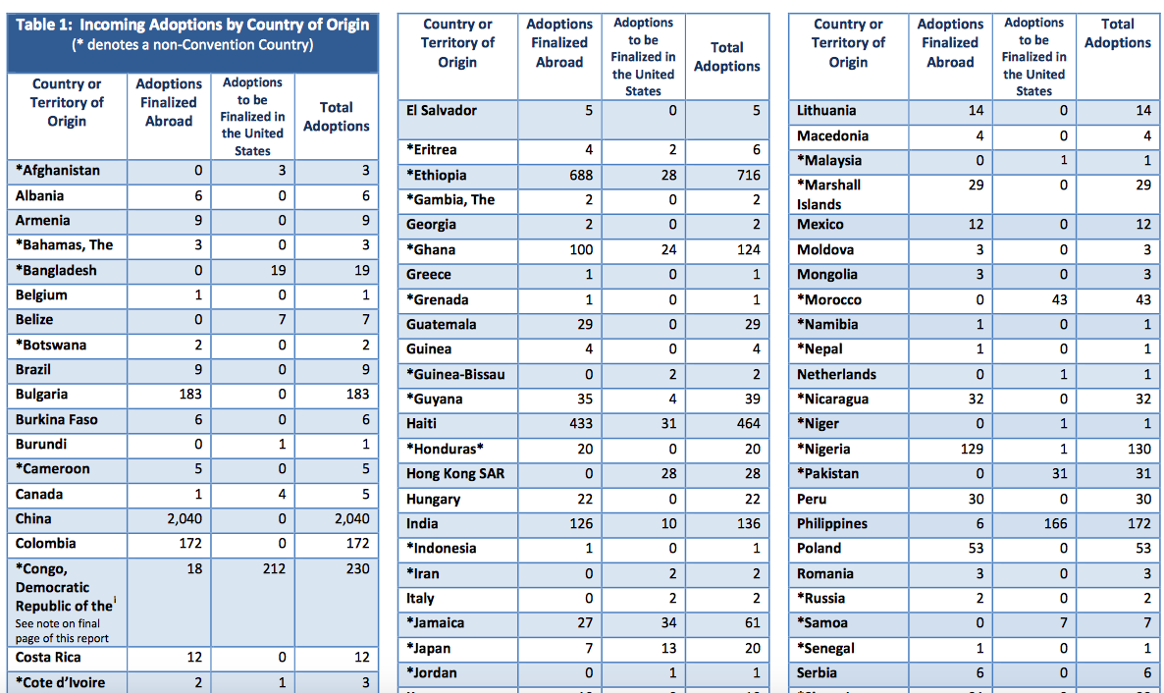
Data Sources
International Adoption Statistics
US Departmentt of State
Spread horizontally, difficult for PDF parsers to read.

Slide 3
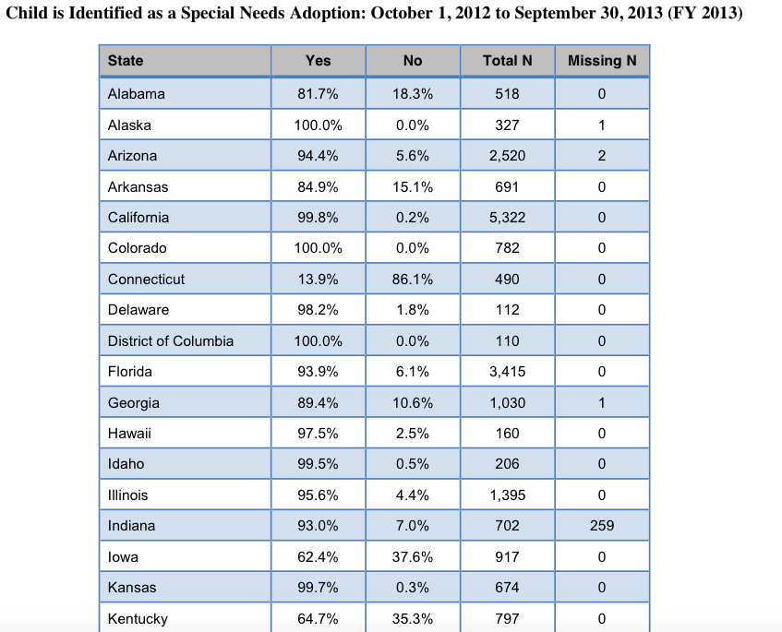
Data Sources
Domestic Adoption Statistics
US Department of Health & Human Services
Simpler tables, much easier to parse

Slide 4
Cleaning Data
Convert PDFs to CSV, manually or through a parser
Read all relevant data into large dataframes
Clean titles (e.g. remove spaces, remove duplicates)

Slide 5
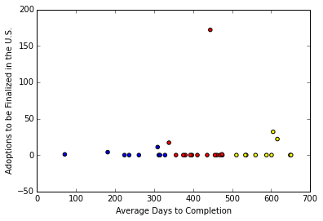
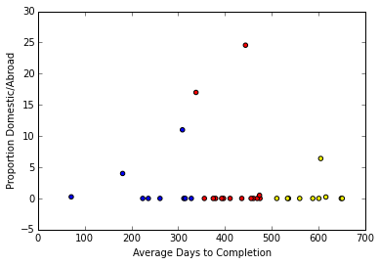
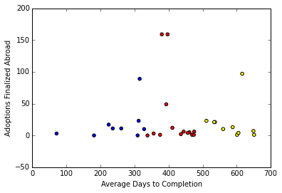
Data Exploration
Finalized Domestic, Abroad, vs Avg Days to Completion

Slide 6
Ideas to Investigate
Hague vs. Non-Hague statistics for intl
Average cost for adoption
Multi-year data
Domestic Information
Race, gender, age
Disability
Relation to adoptive parent

