Slide 1
What is the variance among ticket prices for the same event/seating?
Is there more or less variance based on the type of act (hip hop, pop, rock, geezer rock)?
Is there a geographic or temporal variance?

Slide 2
The event file The ticket file

Slide 3
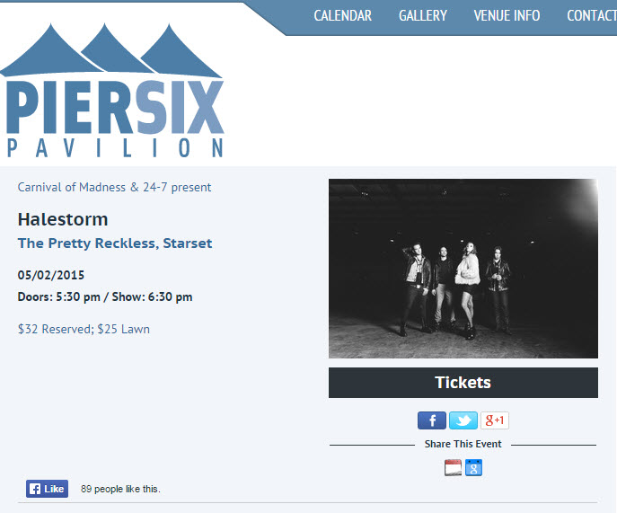

Slide 4
Problem:
StubHub knows I’m a robot
: “My goodness! The number of requests you’ve made is positively inhuman – so, from one robot to another – this system is blocking you for ten minutes.”

Slide 5
Solutions
Timer (still blocking)
API key (too slow without use-case approval)
IP address: (tried Tor)
Random timer (still shutting off)
Selective events
Multiple computers

Slide 6
Known assumptions:
Scraping only 50% of the market; will not capture seats sold other ways (Ticketmaster’s TM+)
Cannot be sure seat is sold (could be withdrawn)
Will not capture tickets sold in < a day
Need to complete concert cycle

