Slide 1

THE WAVE EQUATION
A Short Presentation of the Game

Slide 2
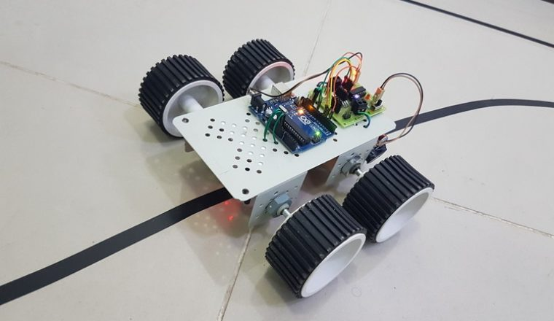
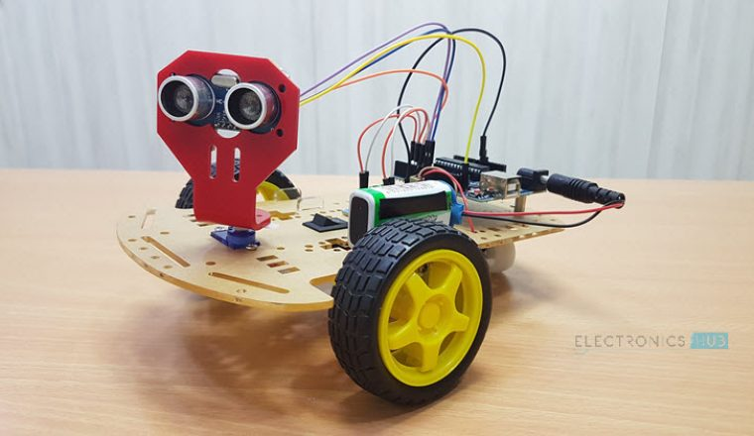
seg-Wave into the Game
Electronics Hub

Slide 3
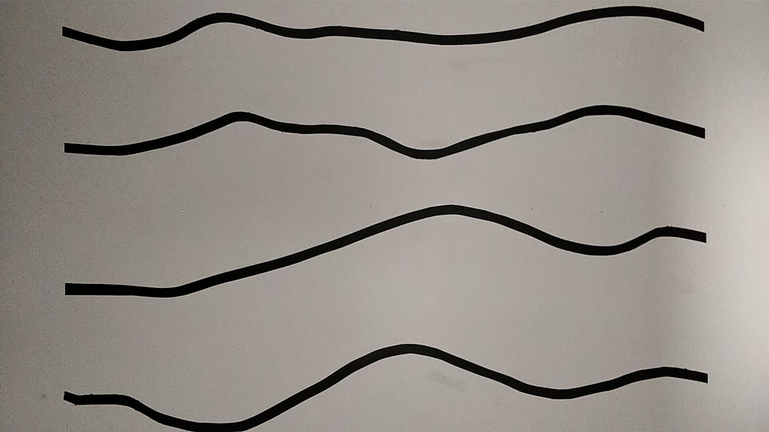
Rules
Navigate from one end of a line to the other
Avoid the obstacle in the way
That's It!!
Notes:
describe t

Slide 4
Hardware
Base components and tools are provided
Sensors and additional materials can be bought
100 ₿ budget for every team
Ultrasonic and IR line tracking sensor are available

Slide 5
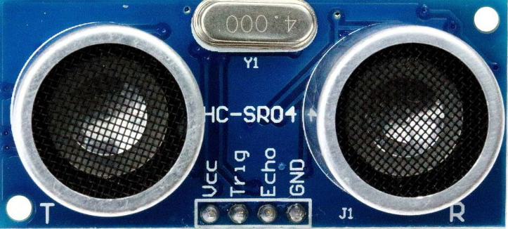
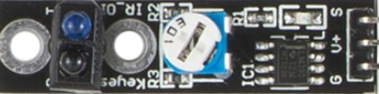
Documentation
And a lot more available on Google!!!
Ultrasonic Sensor:
https://playground.arduino.cc/Code/NewPing
IR Sensor:
https://www.sunfounder.com/learn/sensor_kit_v1_for_arduino/lesson-24-tracking-sensor-sensor-kit-v1-for-arduino.html

Slide 6
Scoring
As many attempts as you want to set a score!
Score = 250 - (time_to_complete task + ₿_spent)
At the end of the competition, the 5 best teams will have one attempt each to set a best time.
Team with the smallest time will be the CHAMPION!!

Slide 7
Questions?
Don’t be shy!

Slide 8
Got distracted browsing memes?
Don’t Worry!

Slide 9
PRESENTATION & RULES
Available Online on your Dashboard

