Slide 1

Microprocessors Tutorial 1:
Arduino Basics

Slide 2
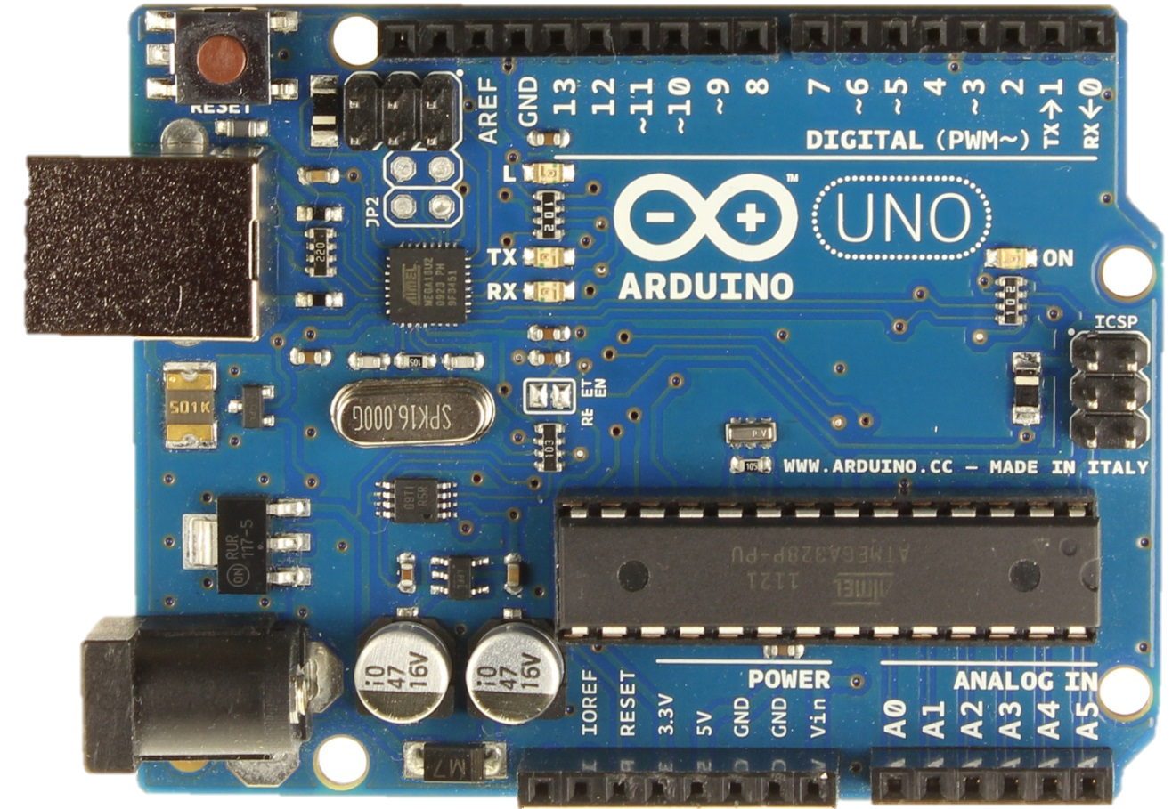
Arduino Hardware
Reset button
14 Digital Pins (6 PWM)
USB
Power
6 Analog Pins
Powering the board

Slide 3
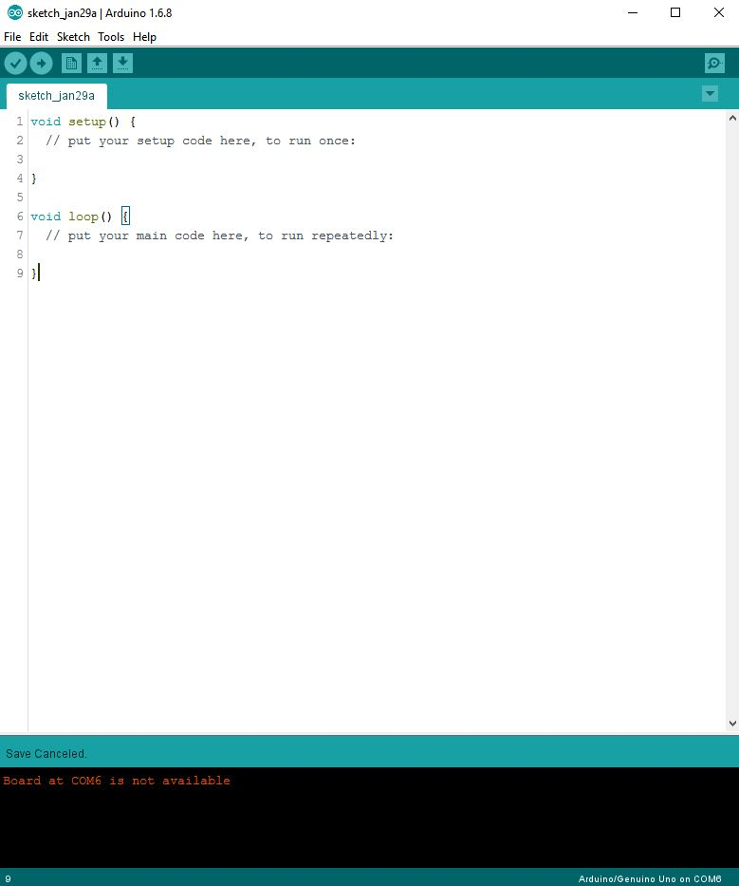
Arduino IDE
Lets go through it

Slide 4
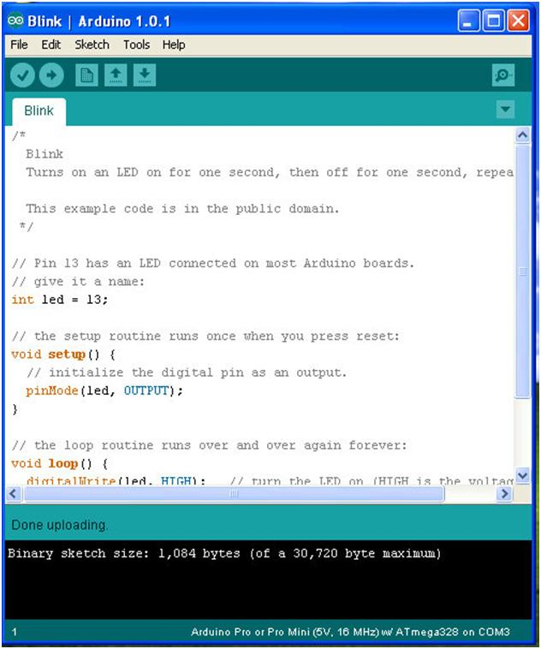
Void setup()
Runs once
Void loop()
Runs forever!

Slide 5
Lets Start:
Connect Arduino
Driver found?
Correct port? Tools → Port
Correct Board? Tools -> Board -> “Arduino/Genuino Uno”
Upload the blink Sketch
Does the light blink?
File → Examples → Basic → blink
Press Upload

Slide 6
Arduino syntax:
pinMode(pin,MODE);
OUTPUT, INPUT
delay(ms)
digitalWrite(pin,state);
Writes an int (0 or 1) to a pin
digitalRead(pin);
Returns an int (0 or 1)
Servo.attach(pin)
Digital Pin 1-13
Servo.write(degree)
-180 to 180 degree with stall at 90 degrees

Slide 7
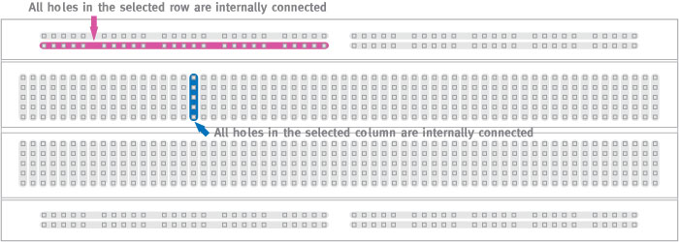
Breadboard:

Slide 8
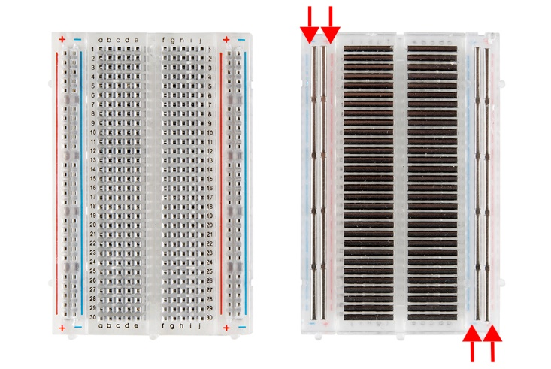

Slide 9
IF statements:
if a condition is true → then do something
if( a condition ){
//do something
}else{
//do something else
}
if( 4>1){
digitalWrite(pin0,HIGH);
}

Slide 10
Pseudo code
Declare four variable outside setup() to keep track of converted value to send to servo;
Attach the servo to digital pins using servo()
Create an temporary integer to store the analog value you are reading using AnalogRead(Pin);
Map the value from temporary integer
from 0-1023 and -180 to 180 to a fixed variable
5. Write the fixed variable to our servo

Slide 11
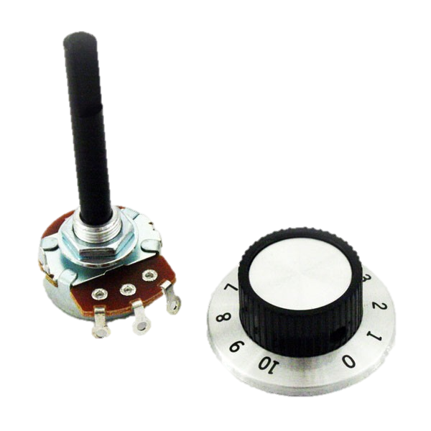
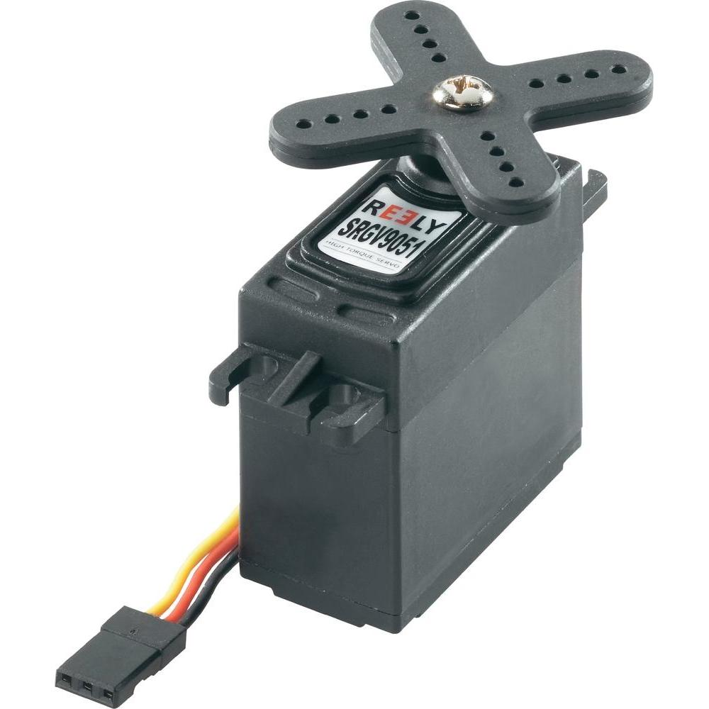
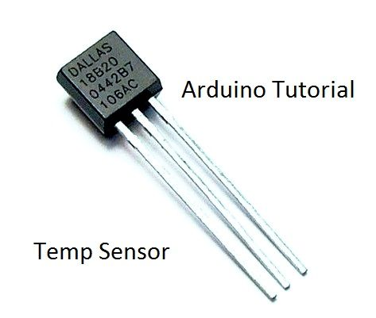
Analog
Analog: 0-1023
Potentiometer, sensor, motors
AnalogRead(), analogWrite()
+5v
to pin
Potentiometer: variable resistance

Slide 12
Examples:
Servo servo1;
Int result = 0;
Void setup()
{
servo1.attach(pin_number);
}
Void loop()
{
int temp1 = analogRead(pin_number);
result = map(temp1, 0, 1023, min_angle_range, max_angle_range);
servo1.write(result);
}

Slide 13
Useful Links
Questions? Comments? Suggestions?
Arduino Examples
http://arduino.cc/en/Tutorial/HomePage
https://www.arduino.cc/reference/en/ https://www.arduino.cc/en/tutorial/ping
https://www.arduino.cc/en/Tutorial/Sweep
ieee.concordia.ca
robowars.ca

