Slide 1
Case Study: Retail Store Customer Churn and Segmentation Analysis
Name: Fozan Mohammed Azhar

Slide 2
Introduction
What is Customer Churn ?
Customer churn is the percentage of customers who stop doing business with a company within a certain time period.
It’s a key metric that measures customer loyalty and retention
A high churn rate can indicate that the company needs to improve its services, customer support, or overall customer experience to retain more customers.
Why is Customer Churn Important?
Customer churn can have significant financial implications for a business. It can lead to:
Lost revenue and profits
Increased marketing and acquisition costs to replace lost customers
Damage to the company’s reputation and brand image

Slide 3
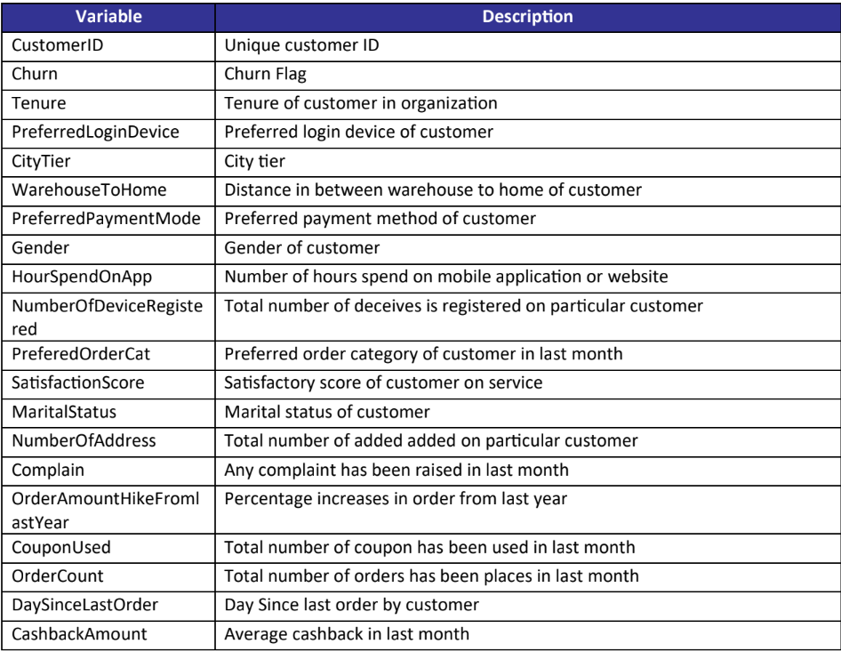
Dataset Overview
Dataset Description
Source: Retail Store Customer Churn
Total Records: 5,630 customers
Total Features: 20 attributes

Slide 4
Flow Chart

Slide 5
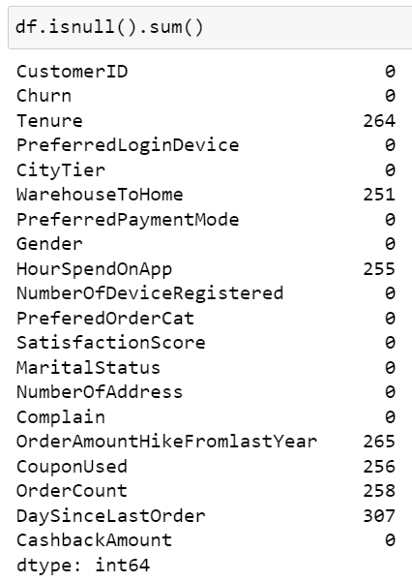
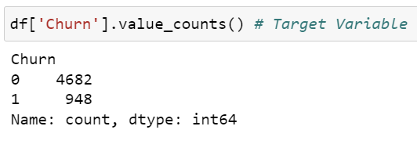
1) Data Loading and Inspecting
Load the dataset: Begins by loading the dataset.
Inspect data types and basic statistics: Check the data types and calculate basic statistics.(df.describe())
Check for missing values and imbalances: Identify any missing values and imbalances in the data.

Slide 6
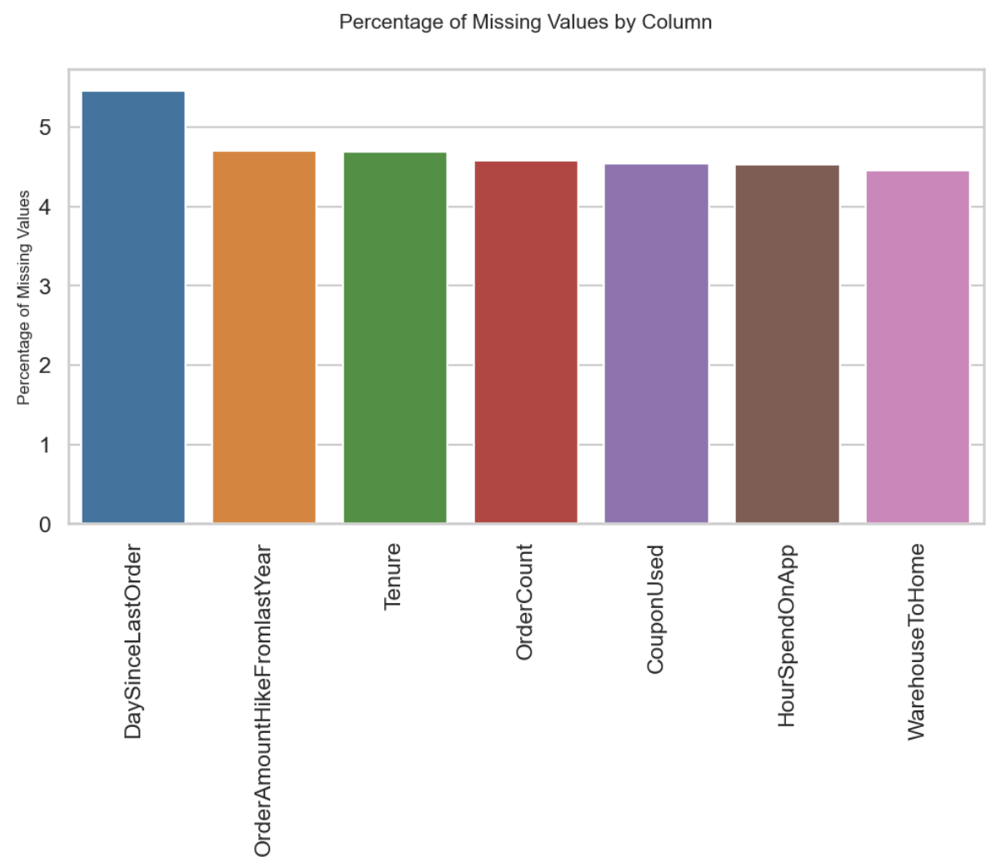
2) Data Cleaning and Preprocessing
Handle missing values: Address missing values in the dataset.
Merge similar categories: Combine categories that are similar.
Outlier detection and handling: Identify and handle outliers.
Feature engineering: Create new features from the existing data.

Slide 7
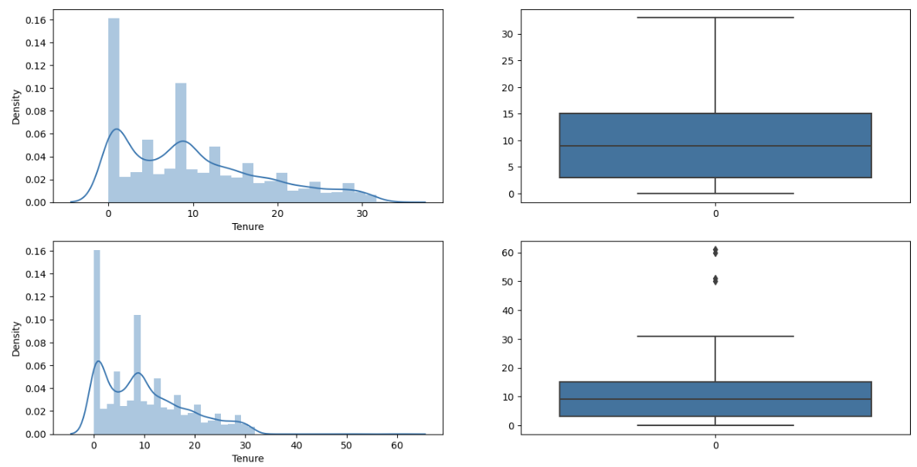
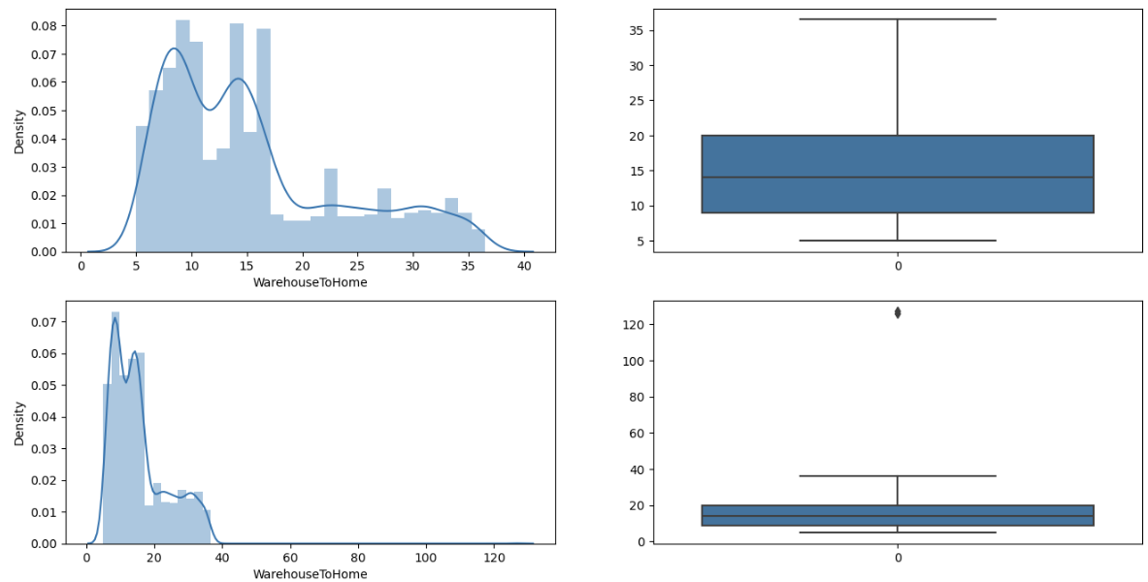
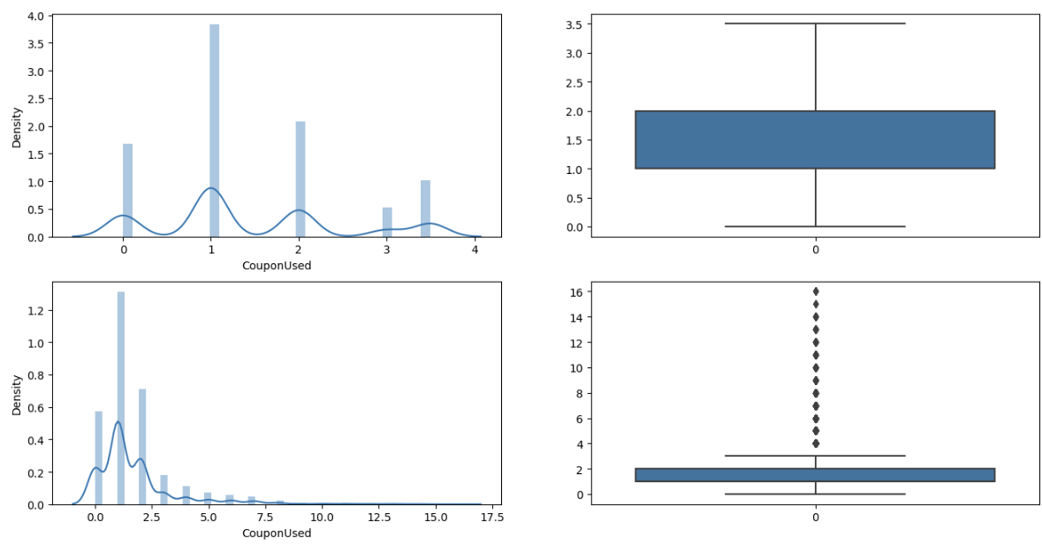
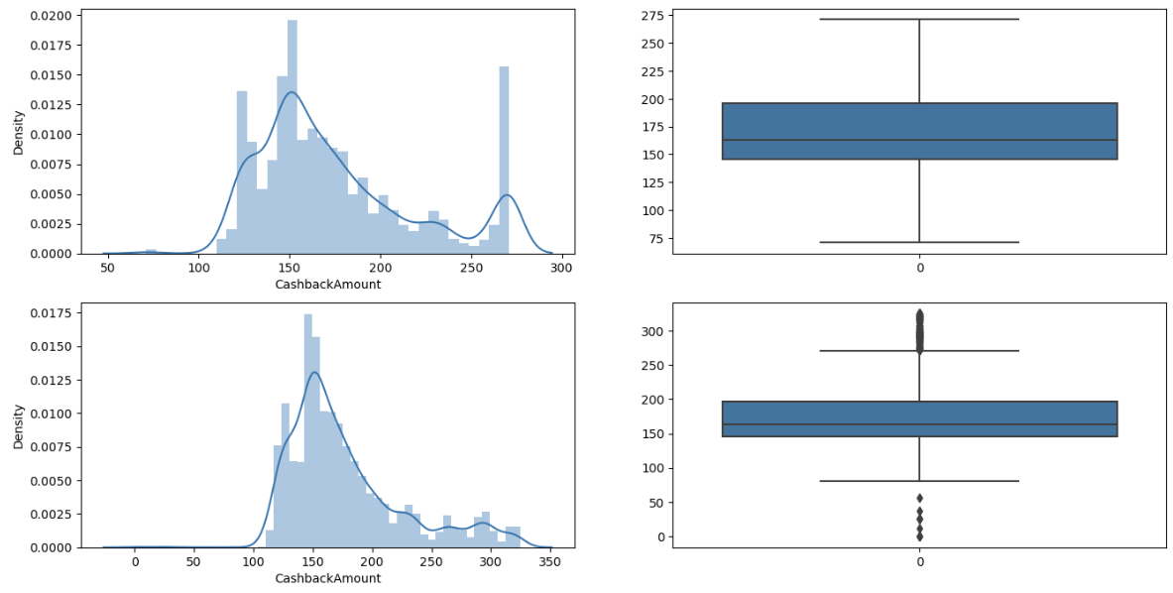

Slide 8
3) Exploratory Data Analysis (EDA)
Univariate Analysis: Analyze individual variables.
Distribution of categorical and numerical features, Examining the distribution of categorical and numerical features.
Bivariate Analysis: Analyze relationships between two variables.
Relationships between churn and other features, Understanding the relationships between churn and other features.
Multivariate Analysis: Analyze multiple variables simultaneously.
Correlation heatmap: Created a heatmap to show correlations between variables.

Slide 9
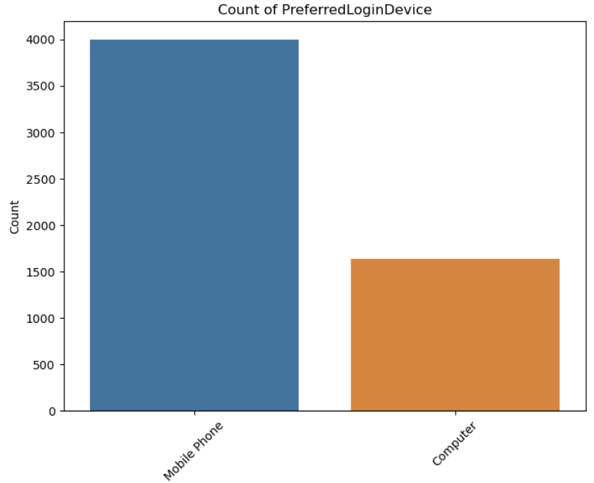
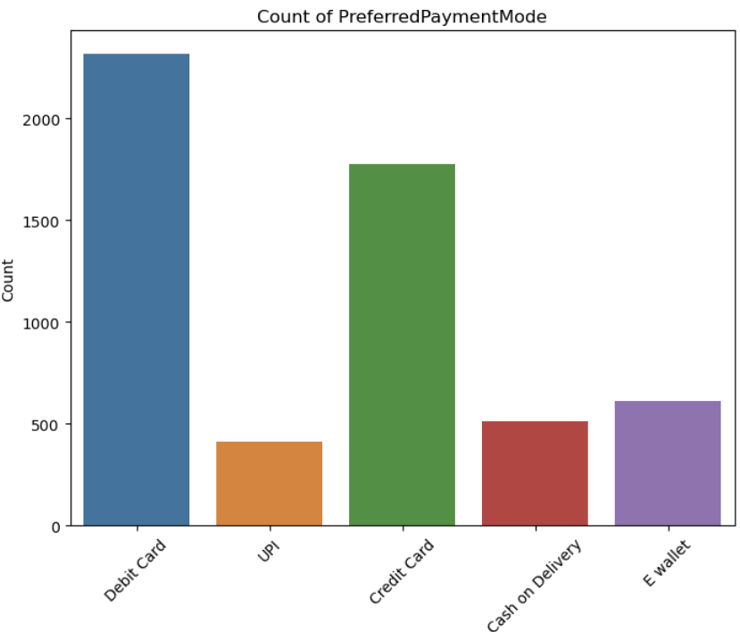
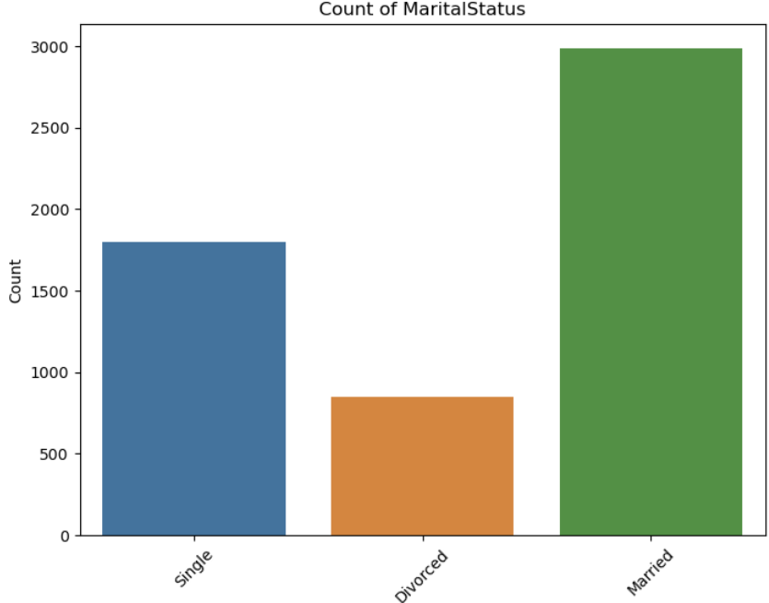
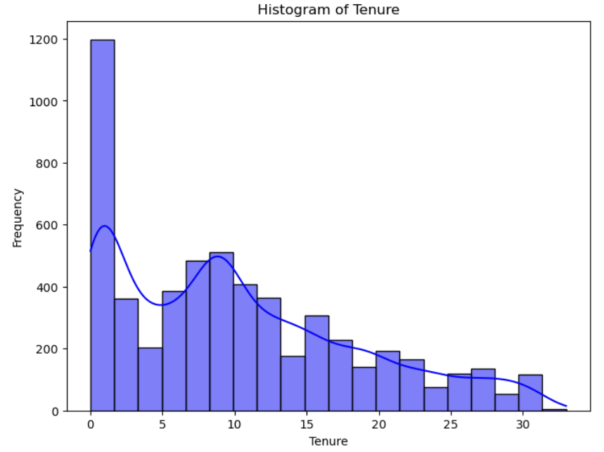
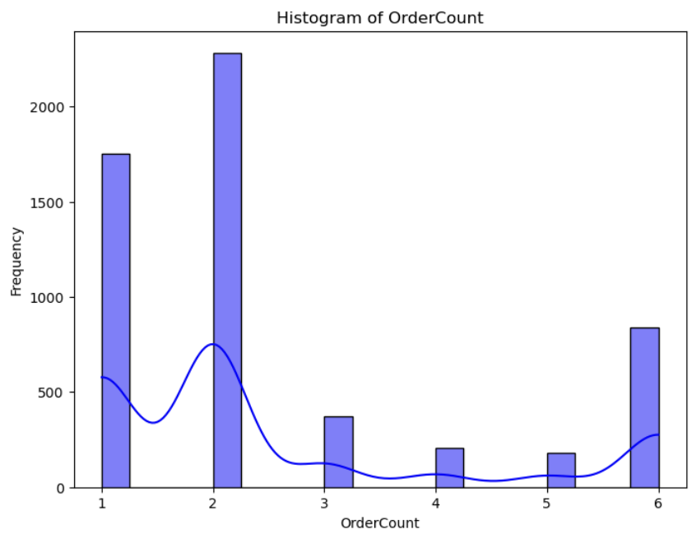
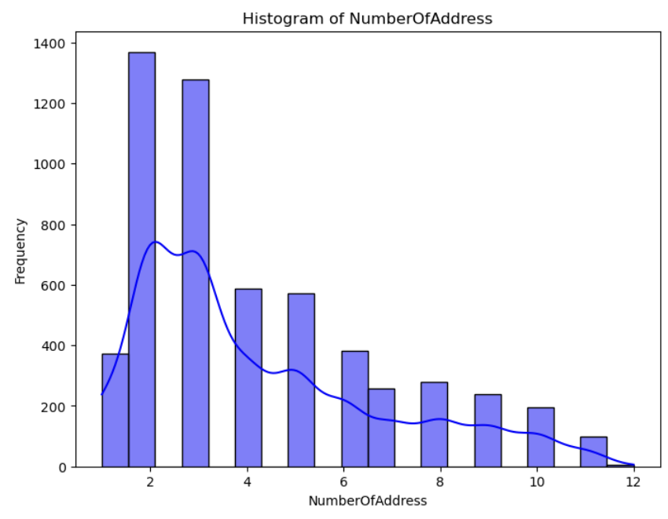
Univariate Analysis

Slide 10
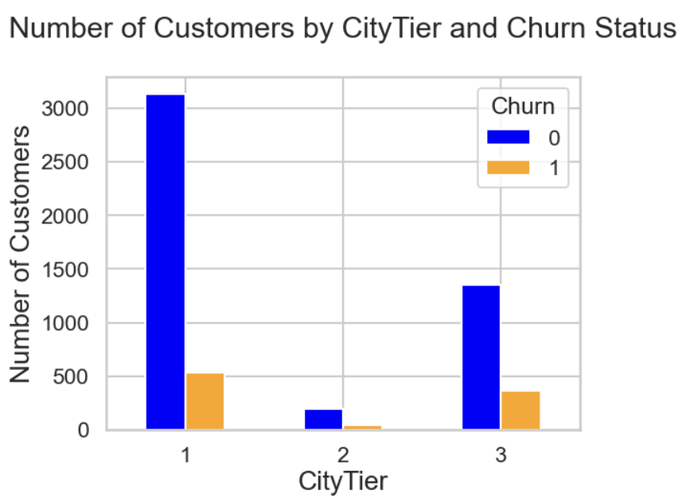
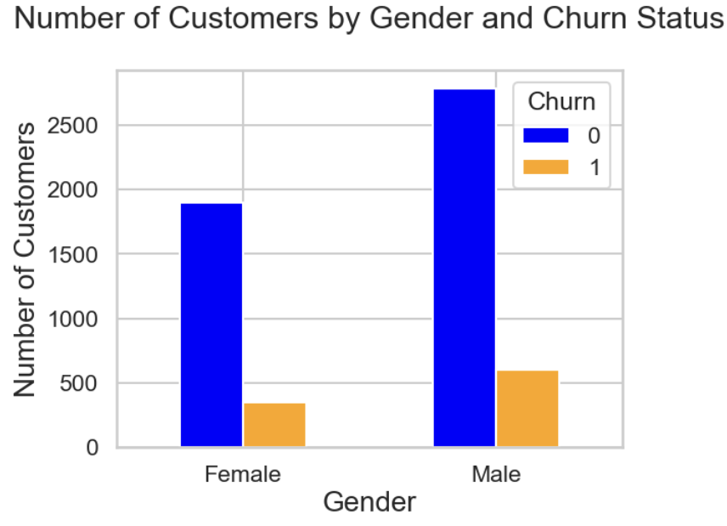
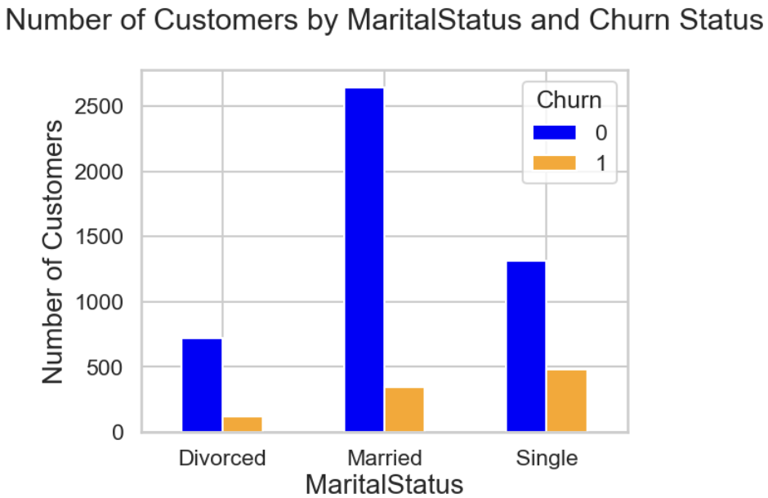
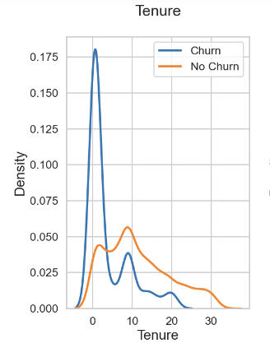
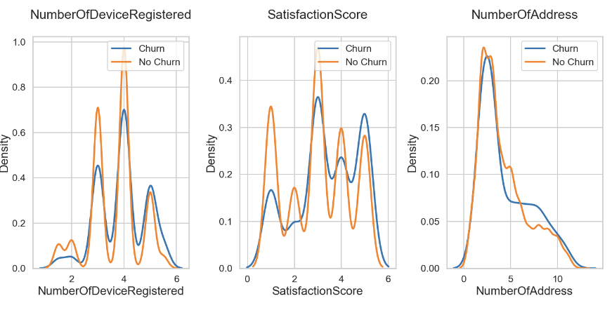
Bivariate Analysis

Slide 11
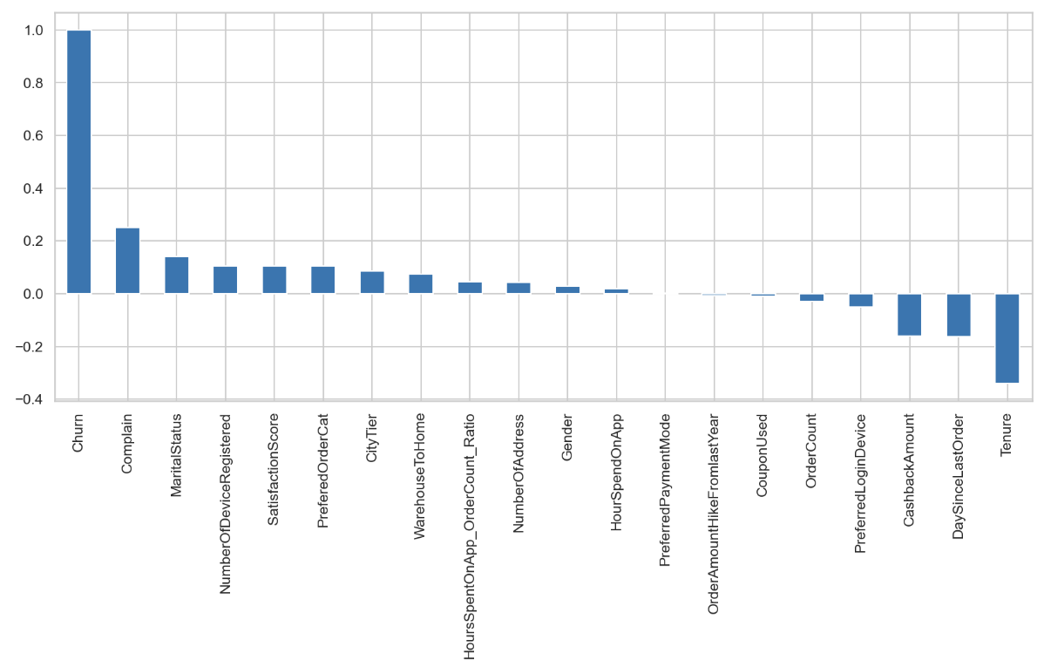
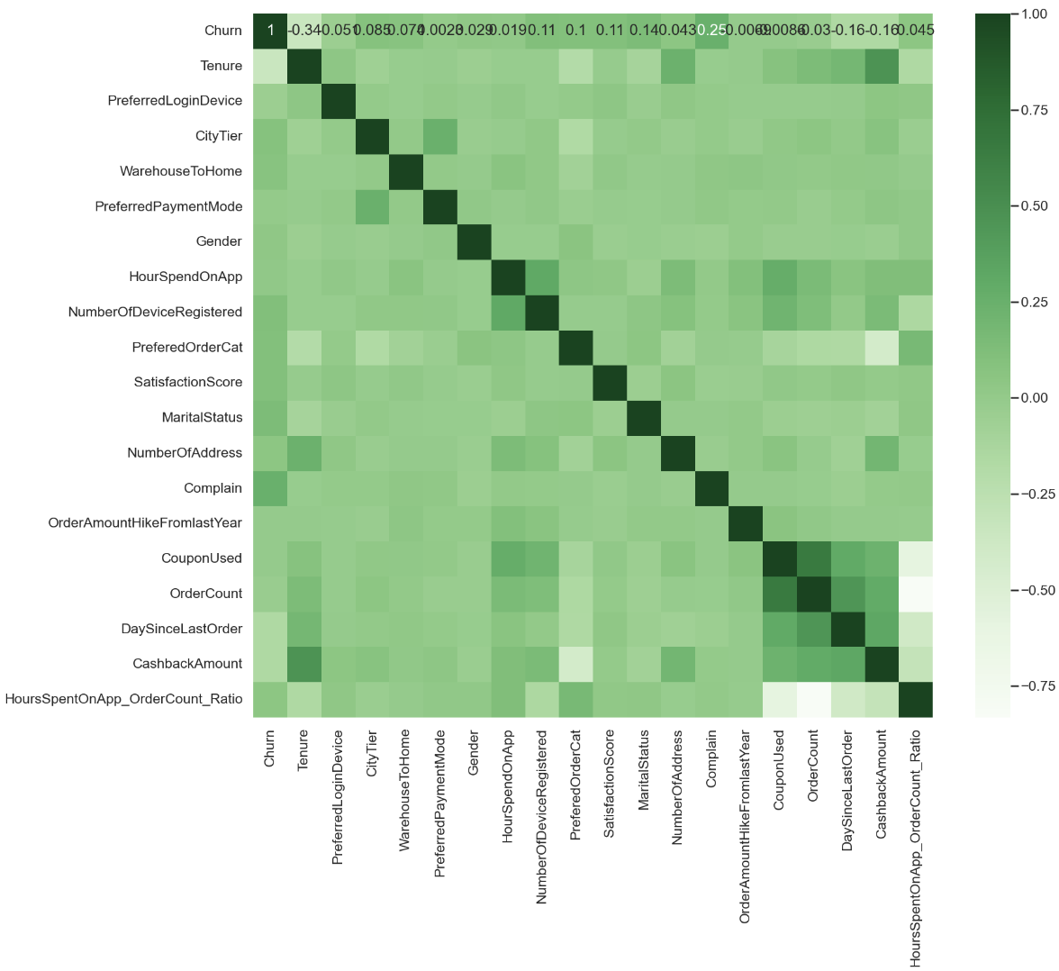
Multivariate Analysis
Derived Insight:
HIGH Churn seen in case of Complain, Marital Status, Number of Device Registered and Satisfaction Score.
LOW Churn is seen in case of Tenure, DaySinceLastOrder, CashBackAmount and PreferedLoginDevice.
Factors like Gender, NumberOfAddress, HoursSpentOnApp have almost NO impact

Slide 12
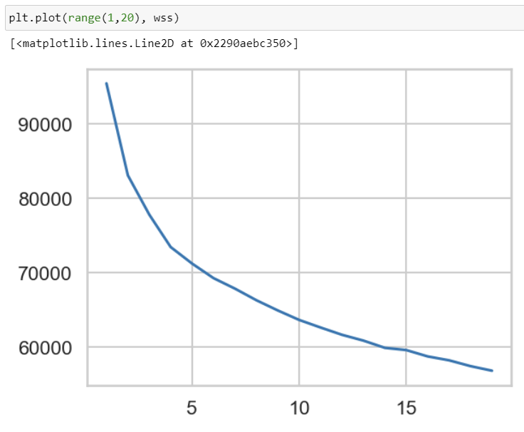
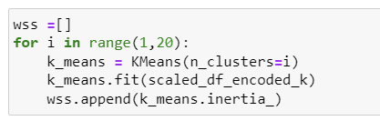
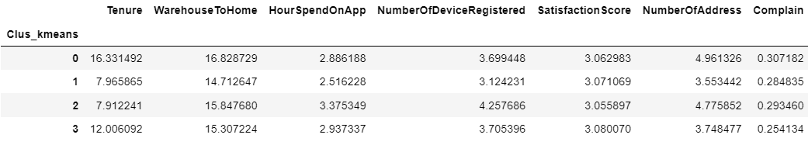
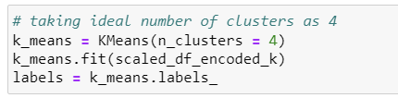
4) Clustering for Customer Segmentation
Apply K-means clustering
Determine the optimal number of clusters using the elbow method and silhouette score
Analyzing and interpreting cluster characteristics
2 Clusters: High inertia, suggesting poor fit.
3 Clusters: Significant decrease in inertia, indicating better clustering.
4 Clusters: Further decrease, potentially a good fit.
5 Clusters: Smaller decrease, suggesting diminishing returns.

Slide 13
Customer Segmentation Analysis
Cluster 0: Engaged Customers
Characteristics:
These customers exhibit high loyalty with long tenure and high satisfaction scores.
They are frequent shoppers with high order counts and significant cashback amounts.
Cluster 1: Digital Enthusiast Customers
Characteristics:
These customers are characterized by high engagement with the mobile app and multiple registered devices.
They have moderate tenure and satisfaction scores, with a moderate level of order activity.
Cluster 2: Moderately Engaged Customers
Characteristics:
These customers demonstrate moderate levels of engagement across various metrics, including tenure, satisfaction scores, and order activity.
They show a balanced approach to shopping, with average order values and coupon usage.
Cluster 3: New or Less Engaged Customers
Characteristics:
This segment comprises customers with the lowest levels of engagement, including shorter tenure, moderate satisfaction scores, and lower order activity.
They may represent new customers or those who have not yet fully engaged with the brand.

Slide 14
Implementation Plan
1. Timeline:
VIP loyalty program launch: 2 months.
Mobile app feature development: 3 months.
Customer feedback system implementation: ongoing.
Segmented email campaign rollout: 1 month.
2. Key Performance Indicators (KPIs):
VIP loyalty program: Increase in repeat purchases from VIP members, improvement in customer satisfaction scores, growth in average order value.
Mobile app enhancements: Increase in app engagement metrics (time spent, frequency of use), growth in app downloads and active users, improvement in customer retention rate among tech-savvy customers.
Customer service improvements: Increase in customer satisfaction scores, growth in repeat purchase rate, improvement in customer retention rate among moderately engaged customers.
New customer onboarding and referral program: Increase in conversion rate of new customers, growth in customer base, improvement in customer lifetime value (CLV) among new or less engaged customers.
3. Monitoring and Evaluation:
Regular tracking of KPIs to assess the effectiveness of retention strategies.
Continuous refinement of strategies based on customer feedback and market trends.
Quarterly reviews to evaluate progress and make necessary adjustments to the implementation plan.

Slide 15
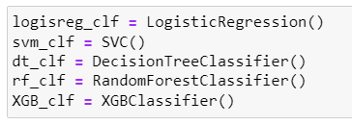
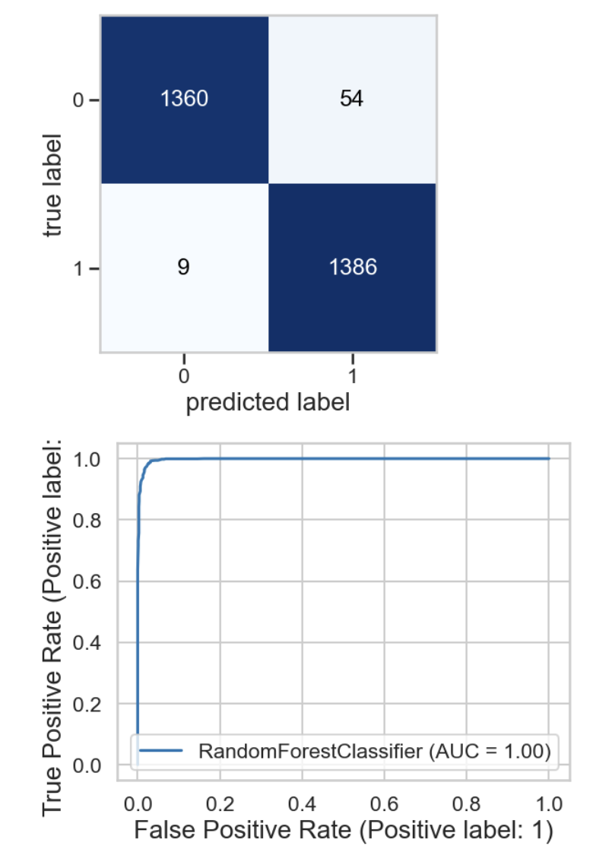
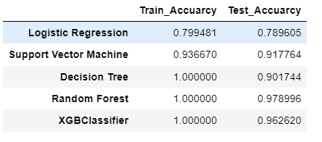
5) Predictive Modelling
Encode categorical variables
Scale numerical features
Split the data into training and test sets
Train models (Logistic Regression, SVM, Decision Tree, Random Forest, XGBoost)
Evaluate models using accuracy, precision, recall, F1-score, ROC-AUC
Random Forest appears to be the best algorithm for our use case, as it achieves the highest accuracy and ROC AUC. It also shows balanced precision, recall, and F1-score across both classes.

