Slide 1
is it a weekend?
yes no
< 12:00 PM
> 18:00 PM
yes no
yes no
< 3 miles?
...?
...?
yes no
yes no
yes no
YES!
NO!
NO!
NO!
YES!
NO!
YES!

Slide 2
Dutch Nationality?
yes no
< € 20.000,-
> € X0.000,-
yes no
yes no
< 3 km?
zipp code?
# kids?
yes no
1 2
YES!
NO!
NO!
NO!
YES!
NO!
YES!

Slide 3
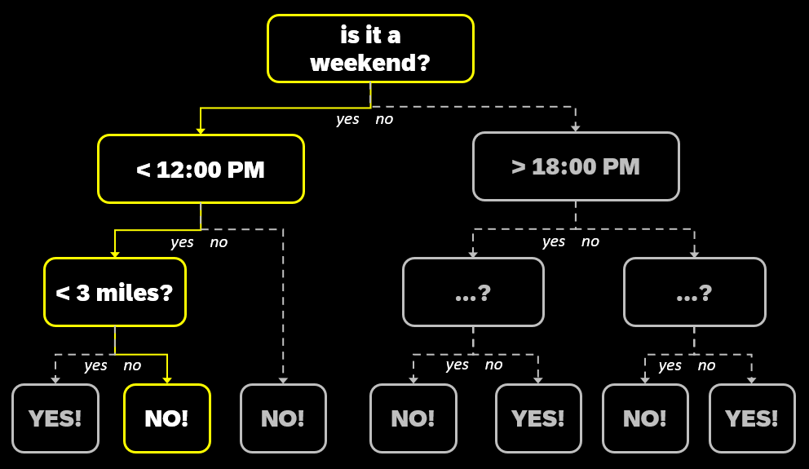

Slide 4
depth

Slide 5
width
depth

Slide 6
width
order
depth

Slide 7
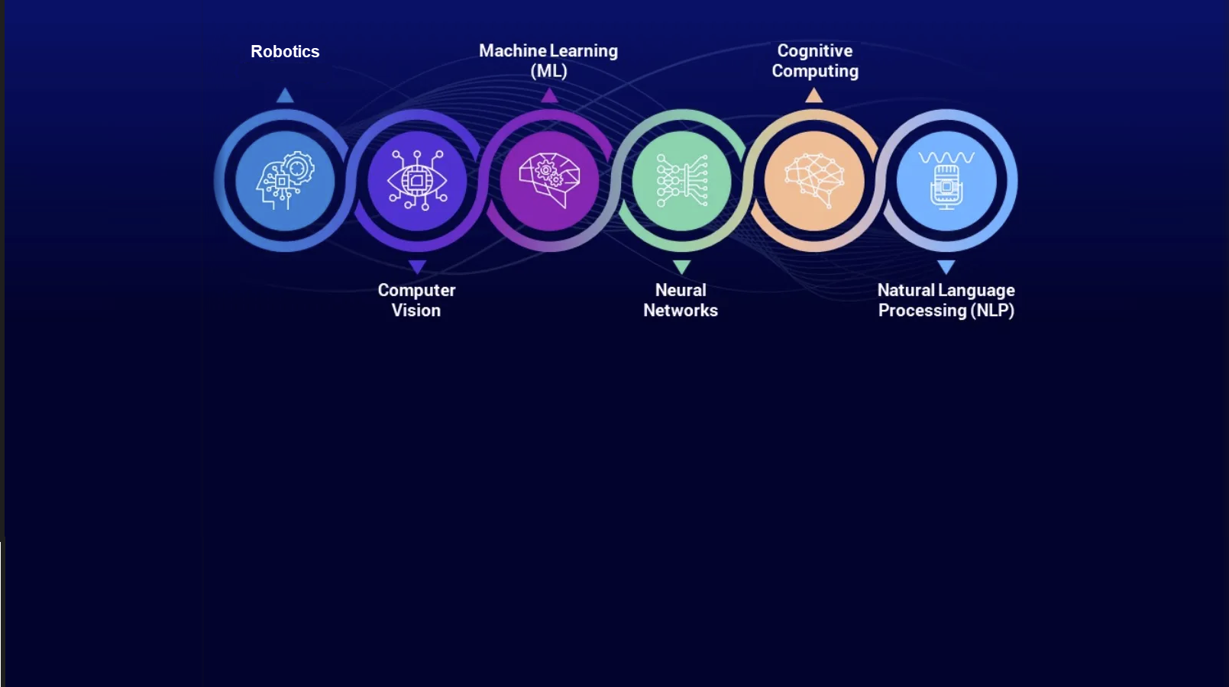
techniques
linear regression
1880
decision trees
CNN
RNN
Deep Learning
random forest
1956
1995
ai winter
2017
2023

Slide 8
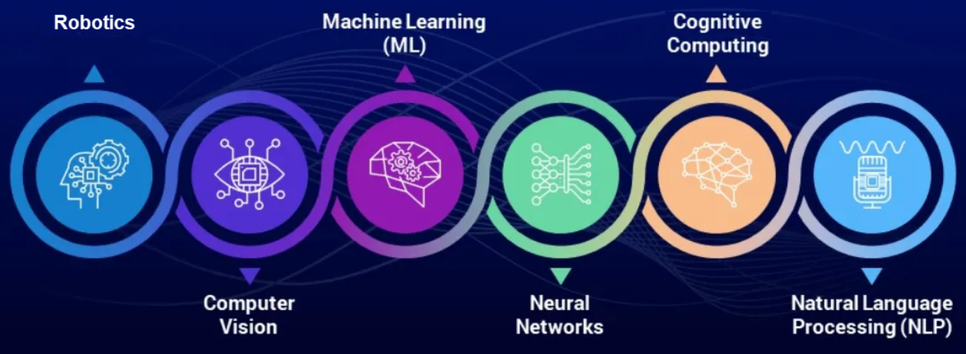

Slide 9

Artificial Intelligence
prediction
Deep Learning

Slide 11
2023

Slide 12
DATA
ALGORITHMS
COMPUTING
2023

Slide 13
DATA
ALGORITHMS
COMPUTING
linear regression 1880 -
2023

Slide 14
DATA
ALGORITHMS
COMPUTING
linear regression 1880 -
-1956 Artificial Intelligence ANN
-1974-1980 AI winter ❄
-1980 Image recognition CNN
-1980 IBM PC
-1987-1996 AI winter ❄ ❄
2023

Slide 15
DATA
ALGORITHMS
COMPUTING
linear regression 1880 -
-1956 Artificial Intelligence ANN
-1974-1980 AI winter ❄
-1980 Image recognition CNN
-1980 IBM PC
decision trees 1990 -
-1987-1996 AI winter ❄ ❄
Internet 1995 -
social media 2005 -
GitHub 2008 -
random forest 2001 -
-2006 NVIDIA CUDA/GPU
2023

Slide 16
DATA
ALGORITHMS
COMPUTING
linear regression 1880 -
-1956 Artificial Intelligence ANN
-1974-1980 AI winter ❄
-1980 Image recognition CNN
-1980 IBM PC
decision trees 1990 -
-1987-1996 AI winter ❄ ❄
Internet 1995 -
social media 2005 -
GitHub 2008 -
random forest 2001 -
-2006 NVIDIA CUDA/GPU
-2017 `Attention is All You Need`
-2016 Google TPU’s
-2023 NVIDIA gen. AI
2023

Slide 17
DATA
ALGORITHMS
COMPUTING
linear regression 1880 -
-1956 Artificial Intelligence ANN
-1974-1980 AI winter ❄
-1980 Image recognition CNN
-1980 IBM PC
Internet 1995 -
decision trees 1990 -
-1987-1996 AI winter ❄ ❄
-1999 NVIDIA GPU
social media 2005 -
-2006 NVIDIA CUDA
GitHub 2008 -
-2012 NVIDIA acc AI
-2017 TRANSFORMER LLM
`Attention is All You Need`
Generative Artificial Intelligence
2023
🔒 Data restrictions 202X -
-202X Multi Modality
-202X NVIDIA ... (80%)

Slide 18
DATA
ALGORITHMS
COMPUTING
Linear Regression 1880 -
Statistical Learning 1961-
-1956 Artificial Intelligence ANN
-1974-1980 AI winter ❄
-1989 handwritten digits CNN
-1980 IBM PC
Internet 1995 -
Decision Trees 1990 -
-1990-1996 AI winter ❄ ❄
-1999 NVIDIA GPU
social media 2005 -
-2006 NVIDIA CUDA
GitHub 2008 -
Random Forest 2008 -
-2012 AlexNet CNN
-2012 NVIDIA acc AI
-2017 TRANSFORMER LLM
Generative Artificial Intelligence
2023

Slide 19
DATA
ALGORITHMS
COMPUTING
Linear Regression 1880 -
Statistical Learning 1961-
-1980 IBM PC
Decision Trees 1990 -
Random Forest 2008 -
Generative Artificial Intelligence
2023

Slide 20
2023
-2023 AI Act / Privacy
-202X less open internet
-202x 10M questions 5K households
-2023 Licensing
-20??-???? AI winter ❄ ❄ ❄
narrow AI
Artificial General Intelligence
-203X Quantum Computing
Super intelligent AI
-2049 ....
-20XX Kern Fusion
LEGAL
DATA/ALGORITHMS/COMPUTING
ENERGY

Slide 21

Supervised Learning
Train
Y_{train} ≈ a X_{train} + b
Test
Y_{test} ≈ a X_{test} + b
Predict
? = a X + b

Slide 22
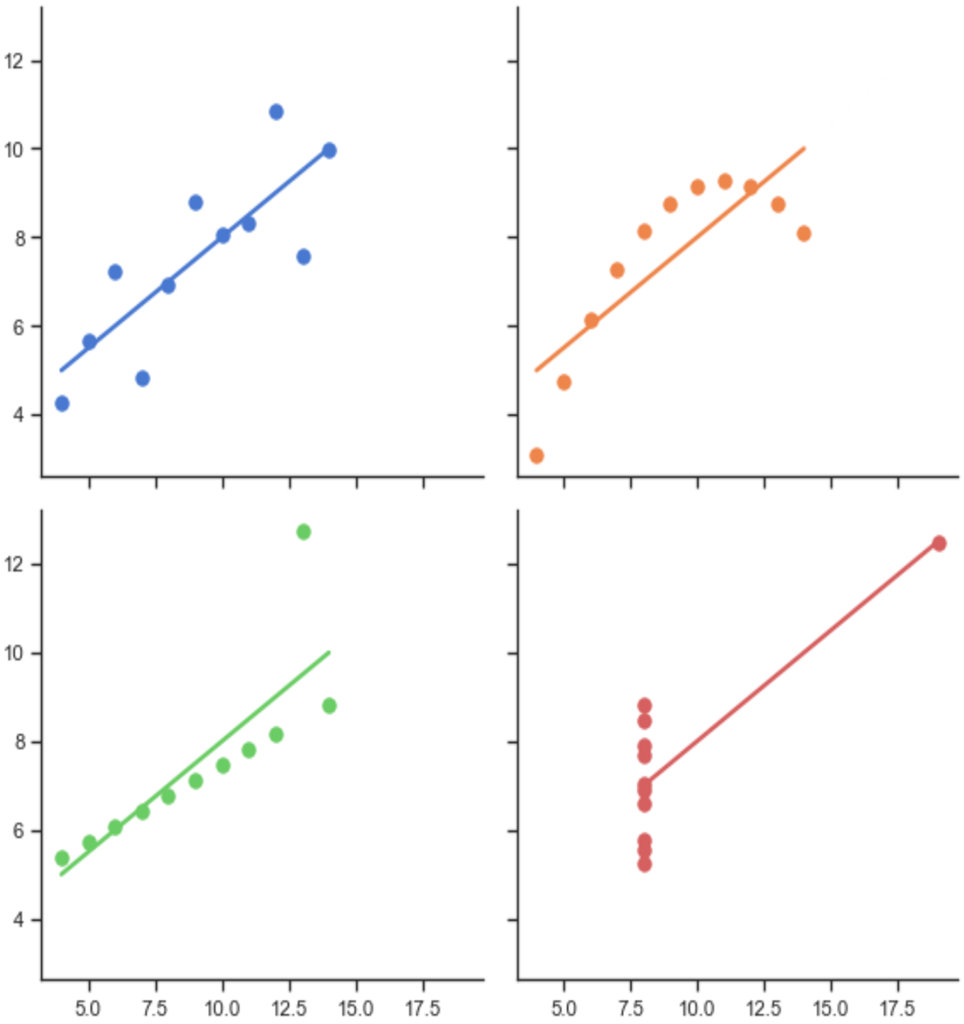
Data Quality

Slide 23
Conclusions
data collection is time consuming
data needs to be cleansed (outliers)
more data reduces impact of outliers

Slide 24
Supervised Learning
Known Input
Father’s Height
learn weights
Y ≈ a X + b
Known output
Son’s Height

Slide 25
Conclusions
data collection is time consuming
more metrics & combinations give better results
more data give better results

