Slide 1
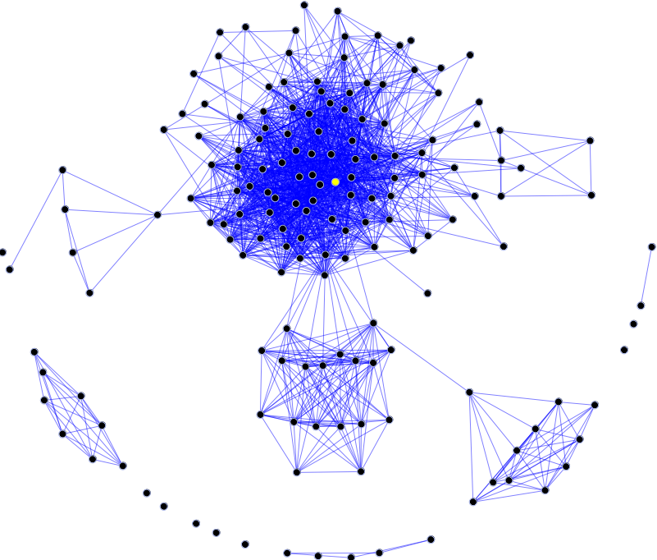
CUL8R (see you later) An Android application for real social networking
Francesco Paolo Culcasi
Mobile and Pervasive System, spring 2017
Computer Engineering, Università di Pisa
Image source: Wikipedia (Social graph)

Slide 2
Importance of social relationships
Human beings are innately social and are shaped by their experiences with others. There are multiple perspectives to understand this inherent motivation to interact with others.
Need to belong
Social exchange
Relational self
Types
Intimate relationships
Lovers, Significant other, Spouse
Family relationships
Egalitarian and Platonic friendship
Enemy or frenemy
Neighbor
Business relationships:
Partnership, Employer and employee, Contractor, Customer, Landlord and tenant
Official
Social Media are able to distinguish only among the first 3 categories (only partially the remaining ones)
Notes:
Need to belong
According to Maslow's hierarchy of needs, humans need to feel love (sexual/nonsexual) and acceptance from social groups (family, peer groups). In fact, the need to belong is so innately ingrained that it may be strong enough to overcome physiological and safety needs, such as children's attachment to abusive parents or staying in abusive romantic relationships. Such examples illustrate the extent to which the psychobiological drive to belong is entrenched.
Social exchange
Another way to appreciate the importance of relationships is in terms of a reward framework. This perspective suggests that individuals engage in relations that are rewarding in both tangible and intangible ways. The concept fits into a larger theory of social exchange. This theory is based on the idea that relationships develop as a result of cost-benefit analysis. Individuals seek out rewards in interactions with others and are willing to pay a cost for said rewards. In the best-case scenario, rewards will exceed costs, producing a net gain. This can lead to "shopping around" or constantly comparing alternatives to maximize the benefits or rewards while minimizing costs.
Relational self
Relationships are also important for their ability to help individuals develop a sense of self. The relational self is the part of an individual's self-concept that consists of the feelings and beliefs that one has regarding oneself that develops based on interactions with others.^{[4]} In other words, one's emotions and behaviors are shaped by prior relationships. Thus, relational self theory posits that prior and existing relationships influence one's emotions and behaviors in interactions with new individuals, particularly those individuals that remind him or her of others in his or her life. Studies have shown that exposure to someone who resembles a significant other activates specific self-beliefs, changing how one thinks about oneself in the moment more so than exposure to someone who does not resemble one's significant other.^{[5]}

Slide 3
Application structure
The application consist of two components:
Client:
An Android application used by users to search nearest events (conventions, exhibitions, concerts, fairs, excursions, ceremonies, etc…).
The nearness is computed through a localization system (GPS).
Each client register to one or more event they are participating.
(Optional) At the end of the event, a user can send an evaluation of the “harmony” with other participants, so that they can better describe the linking between them.
Server:
Takes trace of all the events and the respective participants.
(Optional) Analyze relationships and depicts personal relations of application users ^{[1]}.

