Slide 1
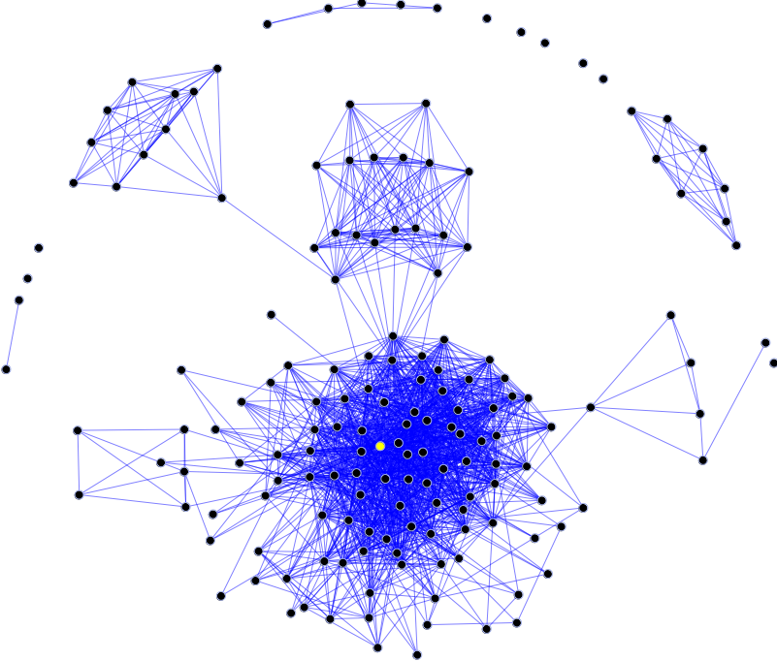

CUL8r (see you later) An Android application for real social networking
github.com/Fpculcasi/CUL8r
Francesco Paolo Culcasi
Mobile and Pervasive System, spring 2017
Computer Engineering @ University of Pisa
Image source: Wikipedia (Social graph)

Slide 2
Importance of social relationships
Human beings are innately social and are shaped by their experiences with others. There are multiple perspectives to understand this inherent motivation to interact with others.
Need to belong
Social exchange
Relational self
Types
Intimate relationships
Lovers, Significant other, Spouse
Family relationships
Egalitarian and Platonic friendship
Enemy or frenemy
Neighbor
Business relationships:
Partnership, Employer and employee, Contractor, Customer, Landlord and tenant
Official
Social Media are able to distinguish only among the first 3 categories (partially the remaining ones)
Notes:
Need to belong
According to Maslow's hierarchy of needs, humans need to feel love (sexual/nonsexual) and acceptance from social groups (family, peer groups). In fact, the need to belong is so innately ingrained that it may be strong enough to overcome physiological and safety needs, such as children's attachment to abusive parents or staying in abusive romantic relationships. Such examples illustrate the extent to which the psychobiological drive to belong is entrenched.
Social exchange
Another way to appreciate the importance of relationships is in terms of a reward framework. This perspective suggests that individuals engage in relations that are rewarding in both tangible and intangible ways. The concept fits into a larger theory of social exchange. This theory is based on the idea that relationships develop as a result of cost-benefit analysis. Individuals seek out rewards in interactions with others and are willing to pay a cost for said rewards. In the best-case scenario, rewards will exceed costs, producing a net gain. This can lead to "shopping around" or constantly comparing alternatives to maximize the benefits or rewards while minimizing costs.
Relational self
Relationships are also important for their ability to help individuals develop a sense of self. The relational self is the part of an individual's self-concept that consists of the feelings and beliefs that one has regarding oneself that develops based on interactions with others.^{[4]} In other words, one's emotions and behaviors are shaped by prior relationships. Thus, relational self theory posits that prior and existing relationships influence one's emotions and behaviors in interactions with new individuals, particularly those individuals that remind him or her of others in his or her life. Studies have shown that exposure to someone who resembles a significant other activates specific self-beliefs, changing how one thinks about oneself in the moment more so than exposure to someone who does not resemble one's significant other.^{[5]}

Slide 3
Application structure
The application consist of two components:
Client:
An Android application used by users to search nearest events (conventions, exhibitions, concerts, fairs, excursions, ceremonies, etc…)
The nearness is computed through a localization system (GPS).
Each client registers to one or more event they are participating
Server:
Takes trace of all the events and the respective participants
(Optional) Analyze relationships and depicts personal relations of application users

Slide 4
GPSTracker
public class GPSTracker extends Service implements LocationListener {
private final Context mContext;
// flag for GPS status
boolean isGPSEnabled = false;
// flag for network status
boolean isNetworkEnabled = false;
// flag for GPS status
boolean canGetLocation = false;
Location location; // location
double latitude; // latitude
double longitude; // longitude
// The minimum time between updates in milliseconds
private static final long MIN_TIME_BW_UPDATES = 1000*10; // 1000msec * 10sec
// The minimum distance to change Updates in meters
private static final long MIN_DISTANCE_CHANGE_FOR_UPDATES = 14; // 14 meters
// Many people tend to walk at about 1.4 m/s (14 meters in 10 seconds)
// Declaring a Location Manager
protected LocationManager locationManager;
public GPSTracker(Context context) {
this.mContext = context;
getLocation();
}
…

Slide 5
GPSTracker
public Location getLocation() {
try {
locationManager = (LocationManager) mContext
.getSystemService(LOCATION_SERVICE);
// getting GPS status
isGPSEnabled = locationManager.isProviderEnabled(LocationManager.GPS_PROVIDER);
// getting network status
isNetworkEnabled = locationManager.isProviderEnabled(LocationManager.NETWORK_PROVIDER);
if (!isGPSEnabled && !isNetworkEnabled) {
// no network provider is enabled
} else {
this.canGetLocation = true;
// First get location from Network Provider
if (isNetworkEnabled) {
locationManager.requestLocationUpdates(LocationManager.NETWORK_PROVIDER, MIN_TIME_BW_UPDATES, MIN_DISTANCE_CHANGE_FOR_UPDATES, this);
Log.d("***getLocation()", "Network");
if (locationManager != null) {
location = locationManager.getLastKnownLocation(LocationManager.NETWORK_PROVIDER);
if (location != null) {
latitude = location.getLatitude();
longitude = location.getLongitude();
}}}
// if GPS Enabled get lat/long using GPS Services
if (isGPSEnabled) {
if (location == null) {
locationManager.requestLocationUpdates(LocationManager.GPS_PROVIDER, MIN_TIME_BW_UPDATES, MIN_DISTANCE_CHANGE_FOR_UPDATES, this);
Log.d("***getLocation()", "GPS Enabled");
if (locationManager != null) {
location = locationManager.getLastKnownLocation(LocationManager.GPS_PROVIDER);
if (location != null) {
latitude = location.getLatitude();
longitude = location.getLongitude();
}}}}}} catch (Exception e) {
e.printStackTrace();
}
return location;
}
…

Slide 6
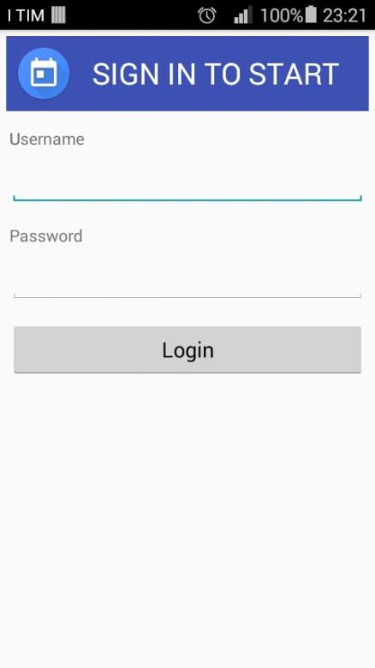
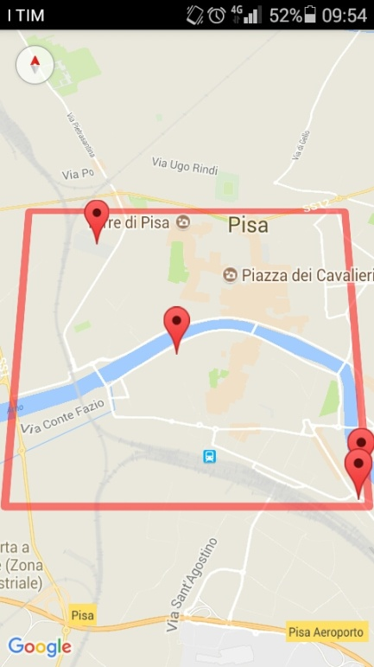
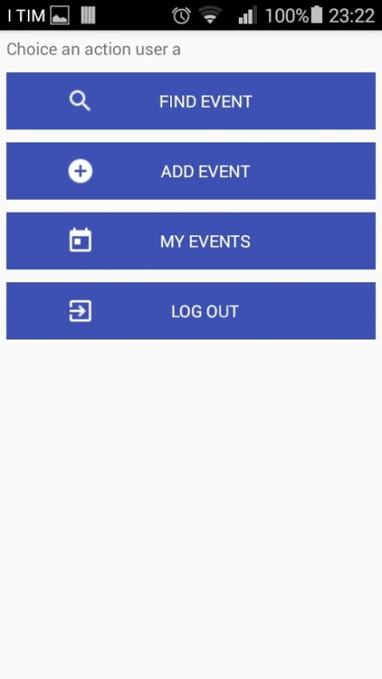
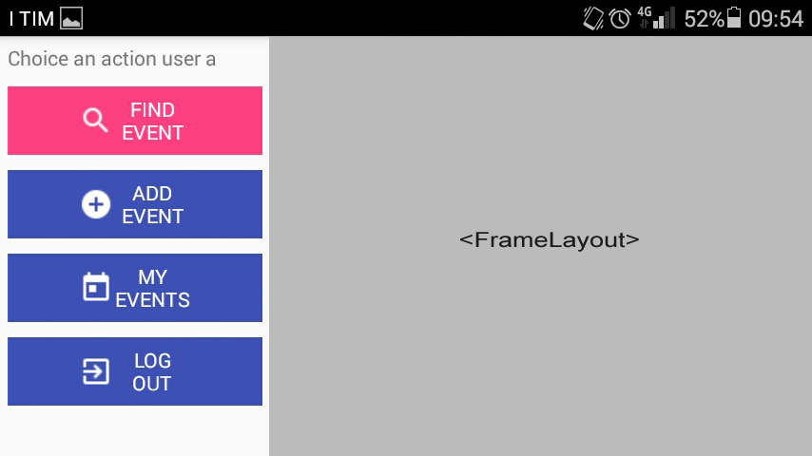
Client side: Android app
Activities:
LoginActivity
Checks credentials through AsyncTask
MainActivity
Single fragment if Portrait, two when Landscape
Index fragment
To choice the FrameLayout to be showed
FrameLayouts
Search not ended nearly Events & Participate (not confirmed if not started yet)
Create new Event
Show chosen Events & confirm Participation

Slide 7
ServiceHandler
class ServiceHandler {
private String getEncodedData(Map<String,String> data) {
StringBuilder sb = new StringBuilder();
for(String key : data.keySet()) {
String value = null;
try {
value = URLEncoder.encode(data.get(key),"UTF-8");
}catch (UnsupportedEncodingException e) {
e.printStackTrace();
}
if(sb.length()>0) sb.append("&");
sb.append(key).append("=").append(value);
}
return sb.toString();
}
String makeServiceCall(String my_url, Map<String, String> params) {
String response = null;
String encodedStr = getEncodedData(params);
BufferedReader reader;
HttpURLConnection con;
try {
String server_url ="http://fpculcasi.altervista.org";
URL url = new URL(server_url + "/" + my_url);
con = (HttpURLConnection) url.openConnection();
con.setRequestMethod("POST");
con.setDoOutput(true);
OutputStreamWriter writer = new OutputStreamWriter(con.getOutputStream());
writer.write(encodedStr);
writer.flush();
StringBuilder sb = new StringBuilder();
reader = new BufferedReader(new InputStreamReader(con.getInputStream()));
String line;
while((line = reader.readLine()) != null) {
sb.append(line).append("\n");
}
response = sb.toString();
reader.close();
con.disconnect();
} catch (Exception e) {
e.printStackTrace();
}
return response;
}
}

Slide 8
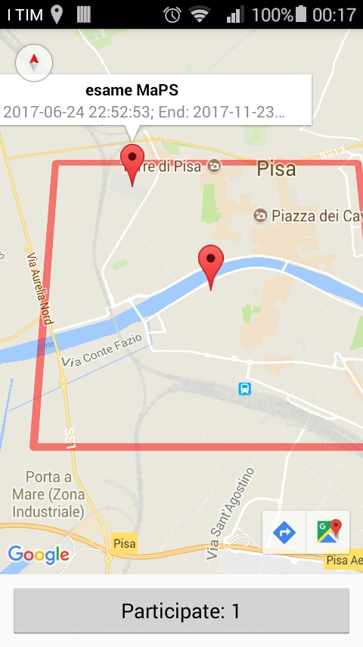
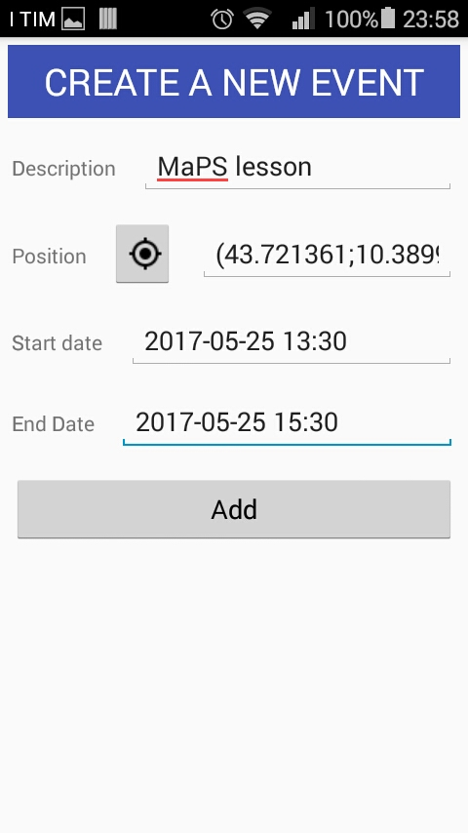
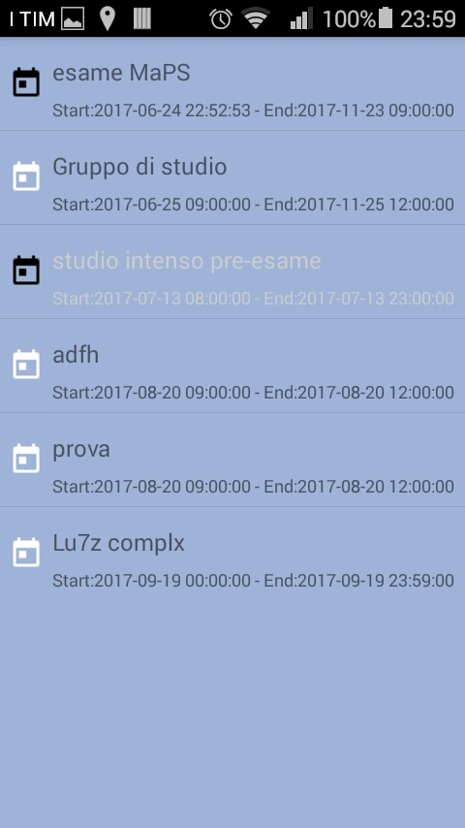
Fragments’ layout
Search nearest events
Add new event
Check event participation

Slide 9

Custom ListView
<?xml version="1.0" encoding="utf-8"?>
<RelativeLayout xmlns:android="http://schemas.android.com/apk/res/android"
android:layout_width="fill_parent"
android:layout_height="?android:attr/listPreferredItemHeight"
android:padding="6dip" >
<ImageView
android:id="@+id/icon"
android:layout_width="wrap_content"
android:layout_height="match_parent"
android:layout_alignParentBottom="true"
android:layout_alignParentTop="true"
android:layout_marginRight="6dip"
android:contentDescription="TODO"
android:src="@drawable/ic_search_white" />
<TextView
android:id="@+id/secondLine"
android:layout_width="match_parent"
android:layout_height="wrap_content"
android:layout_alignParentBottom="true"
android:layout_alignParentRight="true"
android:layout_toRightOf="@id/icon"
android:ellipsize="marquee"
android:maxLines="1"
android:text="Description"
android:textSize="12sp" />
<TextView
android:id="@+id/firstLine"
android:layout_width="match_parent"
android:layout_height="wrap_content"
android:layout_above="@id/secondLine"
android:layout_alignParentRight="true"
android:layout_alignParentTop="true"
android:layout_alignWithParentIfMissing="true"
android:layout_toRightOf="@id/icon"
android:gravity="center_vertical"
android:text="Example application"
android:textSize="16sp" />
</RelativeLayout>
class MyArrayAdapter extends ArrayAdapter<Event> {
private final Context context;
private final Event[] values;
private String now;
MyArrayAdapter(Context context, ArrayList<Event> values) {
super(context, R.layout.rowlayout, values);
this.context = context;
Log.d("***","values: "+values);
this.values = values.toArray(new Event[values.size()]);
Log.d("***","values[0]"+this.values[0]);
final Date nowDate = Calendar.getInstance().getTime();
SimpleDateFormat format1 = new SimpleDateFormat("yyyy-MM-dd HH:mm");
now = format1.format(nowDate);
}
@Override
public View getView(int position, View convertView, ViewGroup parent) {
LayoutInflater inflater = (LayoutInflater) context
.getSystemService(Context.LAYOUT_INFLATER_SERVICE);
View rowView = inflater.inflate(R.layout.rowlayout, parent, false);
TextView description = (TextView) rowView.findViewById(R.id.firstLine);
TextView date = (TextView) rowView.findViewById(R.id.secondLine);
ImageView image = (ImageView) rowView.findViewById(R.id.icon);
description.setText(values[position].getDescription());
date.setText("Start:"+values[position].getStart()+" - End:"+values[position].getEnd());
//expired events in light gray
if(values[position].getEnd().compareTo(now)<0) {
description.setTextColor(Color.LTGRAY);
date.setTextColor(Color.LTGRAY);
}
// Change the icon for verified events
if (values[position].isVerified()) {
image.setImageResource(R.drawable.ic_today_black);
} else {
image.setImageResource(R.drawable.ic_today_white);
}
return rowView;
}
}
rowlayout.xml

Slide 10
Server
Store in a database:
Users name & password
Events
Description, start/end date and time, location
Participations (including the confirmation)
Perform clustering computation
Cluster partition
Density-based method
Cluster location
Through GPS position of each user belonging to a cluster
Inter-cluster interaction
Detection of the social interaction among people belonging to different clusters
Intra-cluster interaction
Detection of the social interaction described in the first slide

Slide 11
Next steps
List a set of event categories to better distinguish social interactions
Add pop-up notification to signal the presence of highly correlated person or kindred events in the neighborhood
Filtering of the participation listView by
Category
Past/present/future events
Verified events

