Slide 1
























$$X= A^{[0]}$$
$$A^{[3]}=A^{[L]}$$
$$A^{[1]}$$
$$A^{[2]}$$
$$a^{(1)}$$
$$a^{(1)}$$
$$a^{(1)}$$
$$a^{(1)}$$
$$a^{(2)}$$
$$a^{(2)}$$
$$a^{(2)}$$
$$a^{(2)}$$
$$a^{(3)}$$
$$a^{(3)}$$
$$a^{(3)}$$
$$a^{(3)}$$
.
.
.
.
.
.
$$a^{(4)}$$
$$a^{(4)}$$
$$a^{(783)}$$
$$a^{(9)}$$
$$a^{(5)}$$
$$a^{(5)}$$
$$a^{(784)}$$
$$a^{(10)}$$

Slide 2

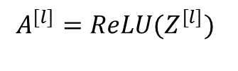


Forward propagation
$Z^{[l]}=W^{[l]}A^{[l−1]}$ + $b^{[l]}$
$Z^{[L]}=W^{[L]}A^{[L−1]}$ + $b^{[L]}$
$$A^{[l]}={ReLU(Z}^{[l]})$$
$$A^{[L]}={softmax(Z}^{[L]})$$
Repeat for L – 1 times
For output layer L

Slide 3



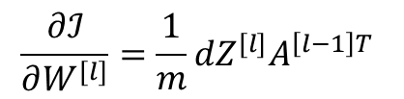


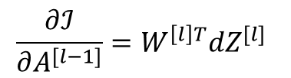

One step of back propagation
$$\frac{∂ℐ}{∂W^{[l]}}=\frac{1}{m}{dZ}^{[l]}A^{\left[l−1\right]T}$$
$${dW}^{[L]}$$
$$\frac{∂ℐ}{∂b^{[l]}}=\frac{1}{m}\sum_{i=1}^{m}{{dZ}^{[l](i)}}$$
$${dZ}^{[l]}$$
$${db}^{[L]}$$
$$cache (W^{\left[l\right]}, b^{\left[l\right]}, A^{\left[l−1\right]})$$
$${dA}^{[l−1]}$$
$$\frac{∂ℐ}{∂A^{[l−1]}}=W^{\left[l\right]T}{dZ}^{[l]}$$

Slide 4
Forward propagation
$Z^{[l]}=W^{[l]}A^{[l−1]}$ + $b^{[l]}$
$Z^{[L]}=W^{[L]}A^{[L−1]}$ + $b^{[L]}$
$$A^{[l]}={ReLU(Z}^{[l]})$$
$$A^{[L]}={softmax(Z}^{[L]})$$
Repeat for L – 1 times
For output layer L

Slide 5
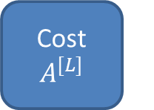
Model Schematic
Network architecture
Initialize parameters
Forward propagation
Cost $A^{[L]}$
cache
Final parameters
Update parameters
Backward propagation

Slide 6

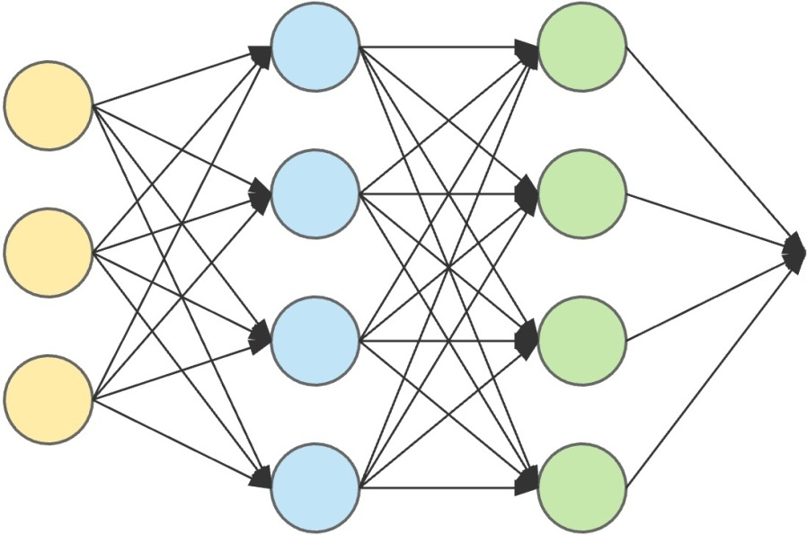
“This is six”

