Slide 1
01 / 11
JAPAN’S
E-WASTE
MANAGEMENT
SYSTEM
DEVICE
CIRCUIT BOARD
MATERIALS
RESOURCE
Recycling, Resource Recovery & Lessons for India
GLASS
PLASTIC
METAL
COMPONENTS
SAYALI ANDHALE 24101A0024
TE INFT (A)

Slide 2
WHEN ELECTRONICS
BECOME WASTE
02 / 11
GLASS
RECOVERABLE
HAZARDOUS
COPPER
ALUMINIUM
IRON
GOLD
PLASTICS
METAL
HEAVY METALS
CHEMICALS
REFRIGERANTS
BATTERY
CIRCUIT BOARD
PLASTIC
E-WASTE CANNOT BE TREATED
LIKE ORDINARY HOUSEHOLD WASTE.
SOURCE Ministry of the Environment, Government of Japan

Slide 3
WHY JAPAN?
03 / 11
Japan treats waste as a SYSTEM, not a single recycling step.
SOURCE
SEGREGATION
01
SEPARATE EARLY
RESOURCE
RECOVERY
RESOURCE
CIRCULATION
02
RECOVER VALUE
INDUSTRY
3R
03
MINIMIZE FINAL DISPOSAL
LAW
PUBLIC
SOURCE Ministry of the Environment, Government of Japan

Slide 4
BEFORE RECYCLING,
THERE IS REDUCTION.
04 / 11
REPAIR
REDUCE
REUSE
MOTTAINAI
RECOVER
REFILL
RESPECT WHAT
ALREADY EXISTS.
RECYCLE
REUSE
SOURCE Ministry of the Environment, Government of Japan

Slide 5
FROM DEVICE
TO RESOURCE
05 / 11
01
02
03
04
05
06
DEVICE
COLLECTION
DISMANTLING
SEPARATION
RECOVERY
NEW RESOURCE
COPPER
ALUMINIUM
PLASTIC
GLASS
COMPONENTS
NEW
PRODUCTS
SOURCE Ministry of the Environment, Government of Japan

Slide 6
WHO OWNS THE
END OF A PRODUCT’S LIFE?
06 / 11
CONSUMER
HOME APPLIANCE
RECYCLING LAW
SMALL HOME APPLIANCE
RECYCLING LAW
RESOURCE
RECOVERY
RECYCLER
RETAILER
SOUND MATERIAL-CYCLE
SOCIETY
RESPONSIBILITY
FOLLOWS THE PRODUCT.
MANUFACTURER
SOURCE Ministry of the Environment, Government of Japan

Slide 7
THE SYSTEM WORKS
BECAUSE THE PIECES CONNECT.
07 / 11
POLICY
PEOPLE
Clear rules
Correct segregation
E-WASTE
MANAGEMENT
INDUSTRY
TECHNOLOGY
Collection + recycling
Resource recovery
POLICY
BEHAVIOUR
SEGREGATION
CLEANER MATERIAL
RECOVERY
SOURCE Ministry of the Environment, Government of Japan

Slide 8
JAPAN’S WASTE SYSTEM
BY THE NUMBERS
08 / 11
FY2024 MUNICIPAL WASTE · NOT E-WASTE-SPECIFIC
38.11M
19.3%
99.2%
MUNICIPAL RECYCLING
WASTE REDUCTION
TONNES
0.8%
7.38M TONNES RECYCLED
DIRECT LANDFILL
991
INCINERATION
PLANTS
415
WITH POWER
GENERATION
THESE ARE MUNICIPAL WASTE FIGURES,
NOT JAPAN’S E-WASTE RECYCLING RATE.
SOURCE Ministry of the Environment, Government of Japan

Slide 9
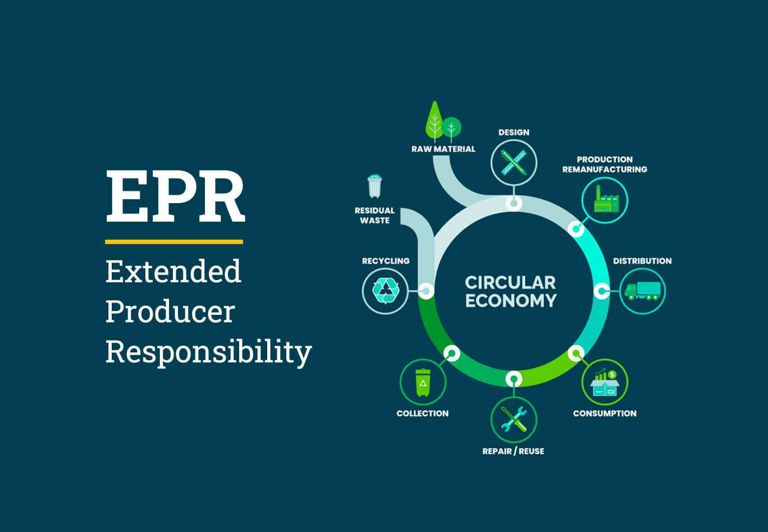
EPR
INDIA IS BUILDING
ITS OWN SYSTEM.
EXTENDED PRODUCER
RESPONSIBILITY
09 / 11
E-WASTE (MANAGEMENT) RULES, 2022
Producer is responsible for the product even after it becomes waste.
Ensures collection, recycling & safe disposal of e-waste.
Encourages repair, reuse and recyclable product design.
Makes manufacturers accountable for their e-waste generation.
India implements EPR through the E-Waste Management Rules, 2022.
MANUFACTURER
PRODUCER
REFURBISHER
DISMANTLER
RECYCLER
FORMAL RECYCLING
↔
EXISTING INFORMAL ECOSYSTEM
SOURCE Government of India — MoEFCC

Slide 10
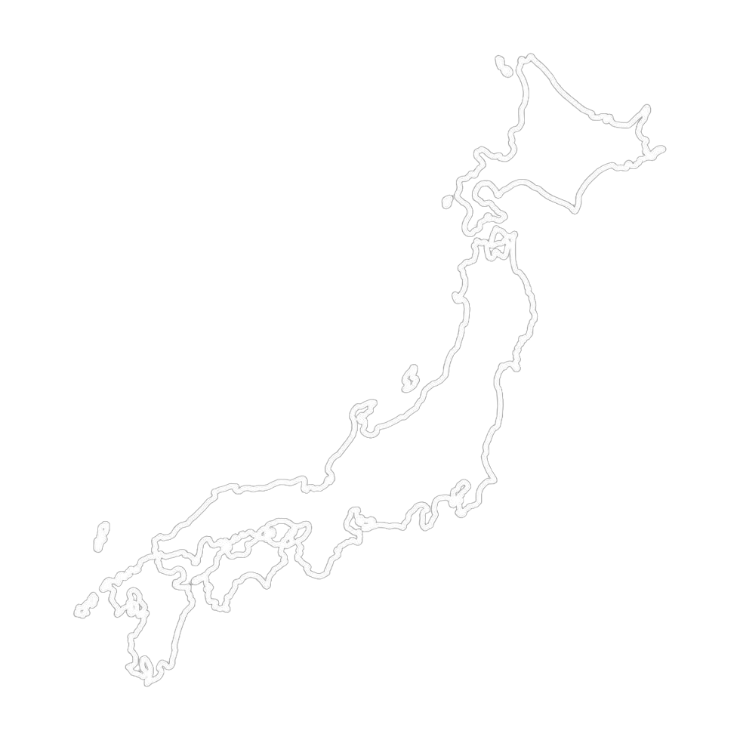
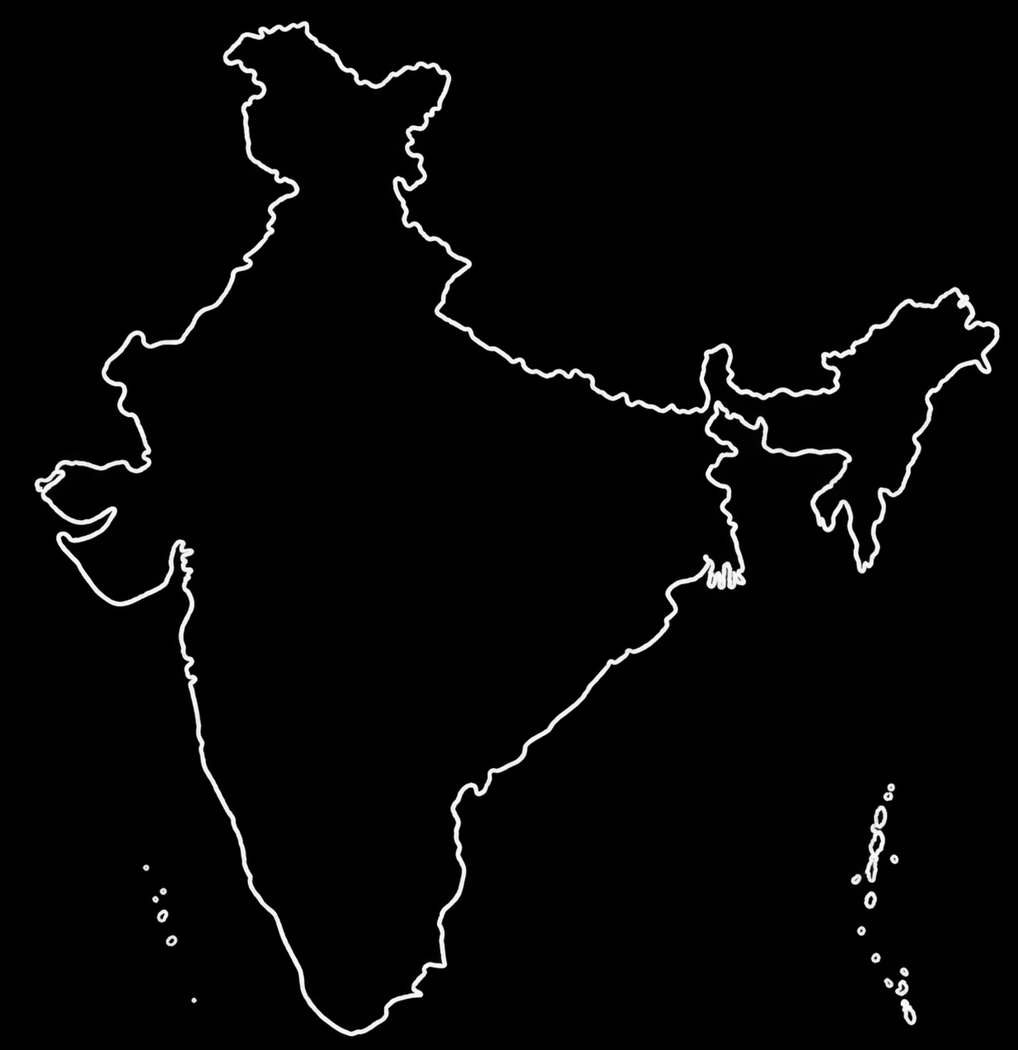
SAME PROBLEM.
DIFFERENT CONTEXT.
10 / 11
JAPAN
INDIA
3R
PRODUCT-SPECIFIC LAWS
STRUCTURED COLLECTION
MATURE INFRASTRUCTURE
EPR
FORMAL + INFORMAL
EXPANDING INFRASTRUCTURE
LARGE SCALE
ADAPT
≠ COPY
JAPAN → MATURE SYSTEM
INDIA → EXPANDING SYSTEM
PRINCIPLES CAN TRAVEL. INFRASTRUCTURE MUST FIT THE CONTEXT.
SOURCE Ministry of the Environment, Government of Japan · Government of India — MoEFCC

Slide 11
WHAT SHOULD INDIA
TAKE FROM JAPAN?
11 / 11
02
04
06
01
SEGREGATE
03
RECYCLE
05
RECOVER
Keep devices out of mixed waste
Expand authorized recycling
Return value to the economy
COLLECT
REPAIR
TRACK
Accessible collection
Extend product life
Digital lifecycle visibility
E-WASTE MANAGEMENT
IS NOT JUST RECYCLING.
JAPAN’S LESSON
ADAPT THE PRINCIPLES.
DESIGN FOR INDIA.
It is a connected system of behaviour, collection,
responsibility, treatment and resource recovery.
SOURCE Ministry of the Environment, Government of Japan · Government of India — MoEFCC

