Slide 1

INTRODUCTION TO ENTREPRENEURSHIP · GROUP PROJECT 1
yazılnow
Find a free time with Baku’s barbers and salons — and book it in one tap.
yazilnow.az · support@yazilnow.az
Notes:
Introduction. In the web deck the app’s opening animation plays here first. One sentence: what yazılnow does.

Slide 2
In Baku, booking a haircut still means a DM — and a wait
THE PROBLEM
S
Salon
Instagram DM
Salam! Sabah saat 6-da yer var?
6 / 10
salons take bookings through WhatsApp, Instagram DMs or phone calls.
Salam, baxıb yazaram 🙏
Our field check of 37 top-rated Baku salons (Google reviews, Instagram), Oct 2026
⏱ 2 saat sonra
0
apps show free times across the whole city. Salon tools like DIKIDI or Rezneed each show one salon.
Bəs?
Competitor review: DIKIDI, Arnica, Rezneed, Altegio, YCLIENTS, Fresha, Booksy
Bağışlayın, artıq dolmuşuq
20%
of a new client’s bill goes to Fresha. Booksy adds $20 a month for every extra master.
Fresha pricing (CostBench), Booksy pricing (Koalendar)
Notes:
Problem: booking in Baku happens in DMs. Walk through the three facts, then the chat.

Slide 3
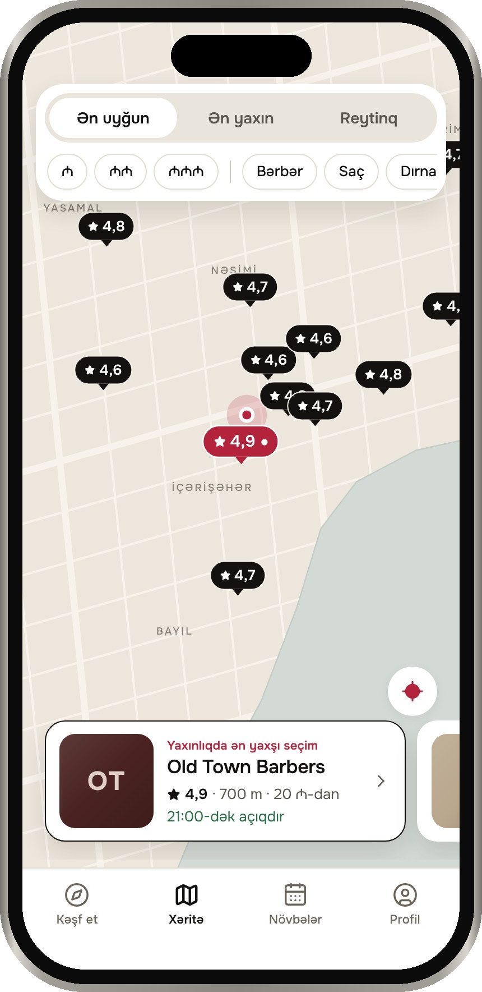
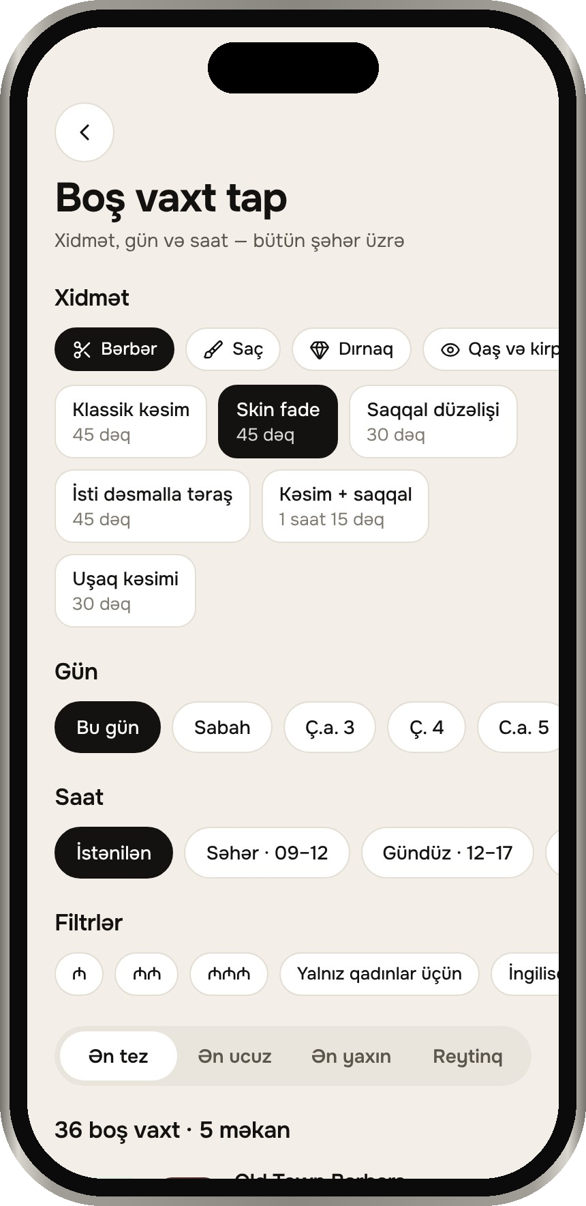
Every free time in the city, on one map
OUR SOLUTION
FOR CLIENTS
FOR SALONS
TRUST
Live free times across Baku
Compare salons side by side
Book in four steps, no calls
One flat monthly price
Unlimited masters, 0% commission
Clients find them on the map
Reviews only after a real visit
One-time QR codes at the chair
Azerbaijani, Russian, English
City-wide free-time search and side-by-side comparison: none of the nine booking tools we checked in Baku offer them.
Notes:
Solution: one map of every free time. Three groups of benefits, then what nobody else offers.

Slide 4
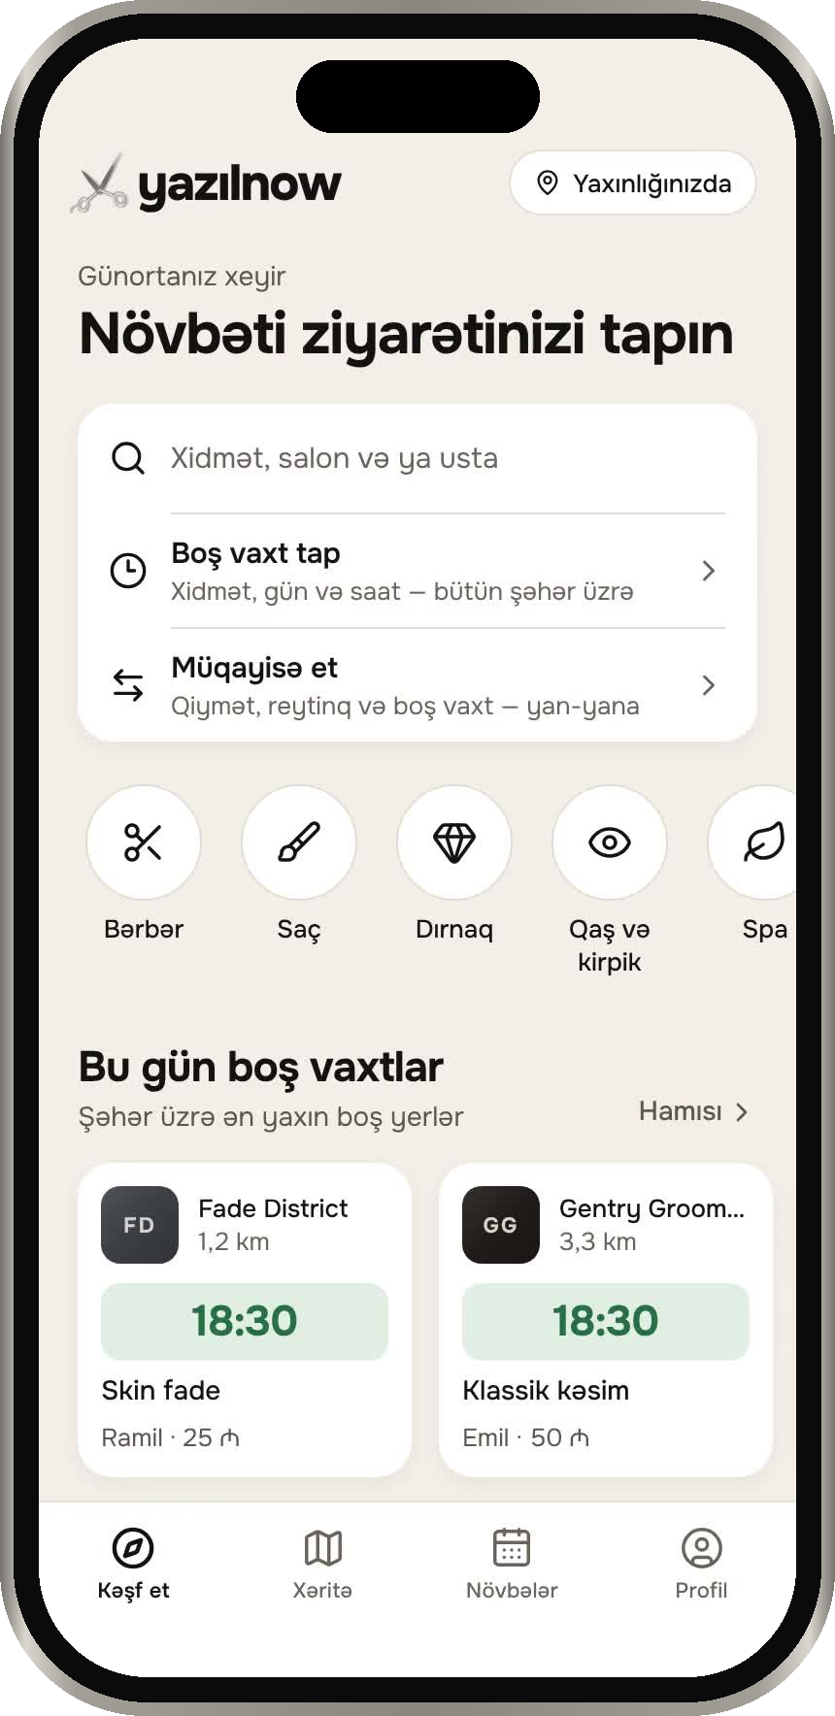
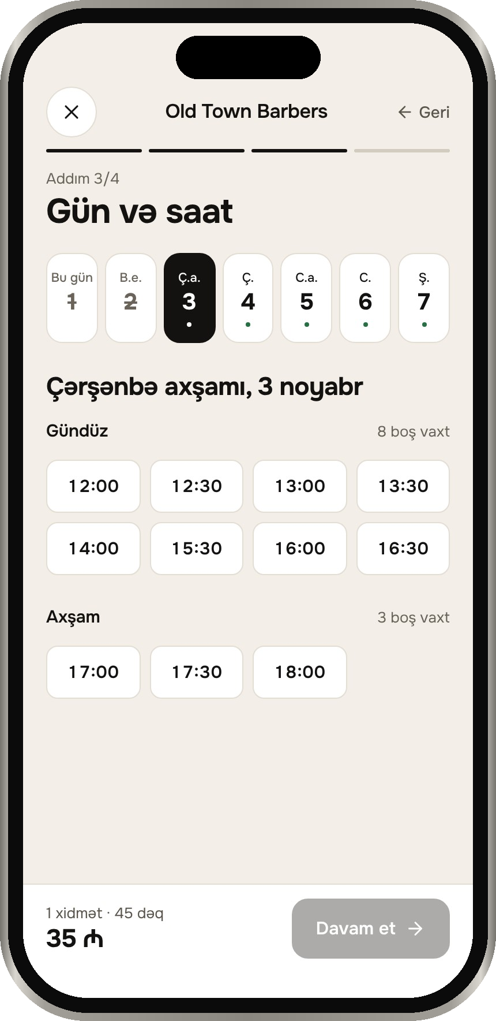
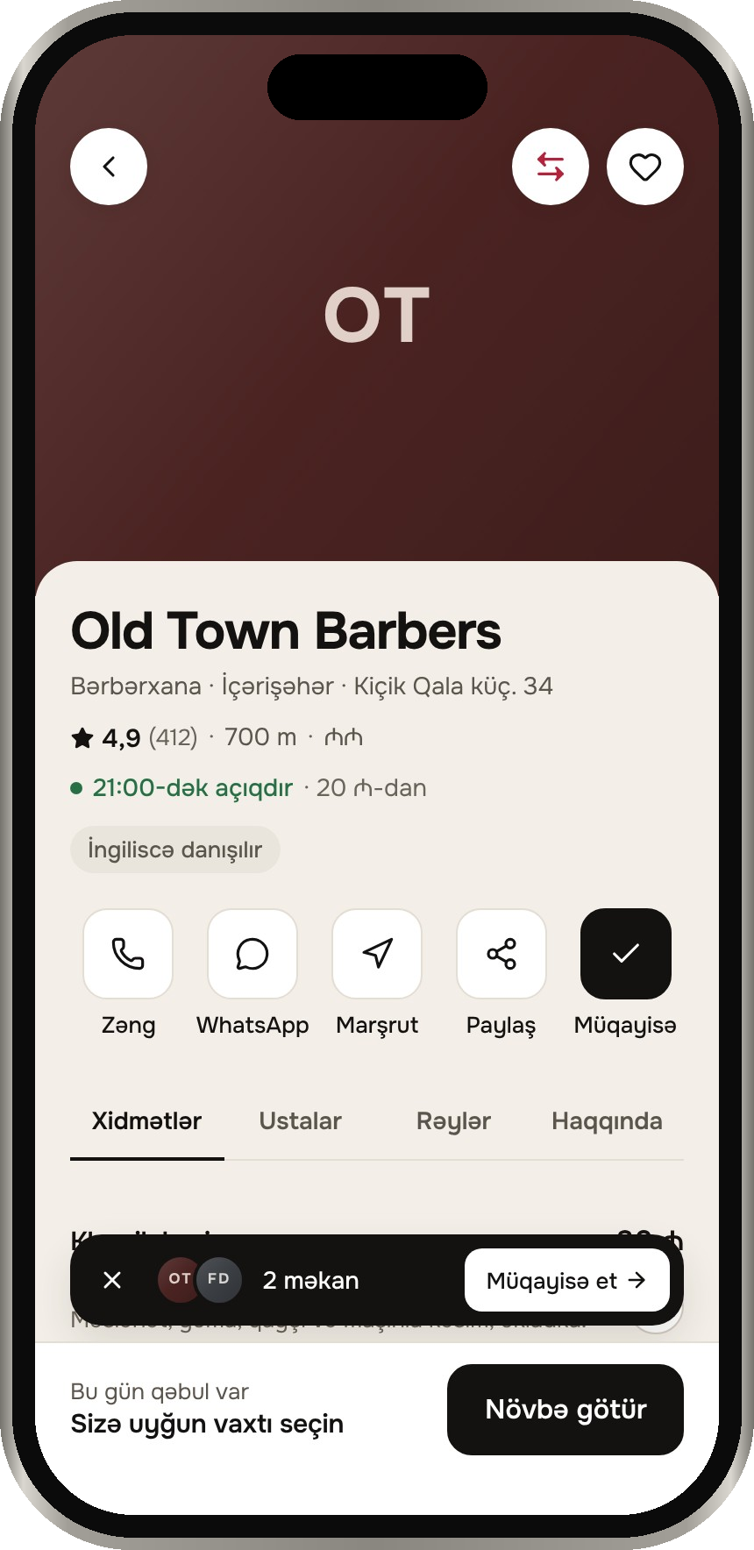
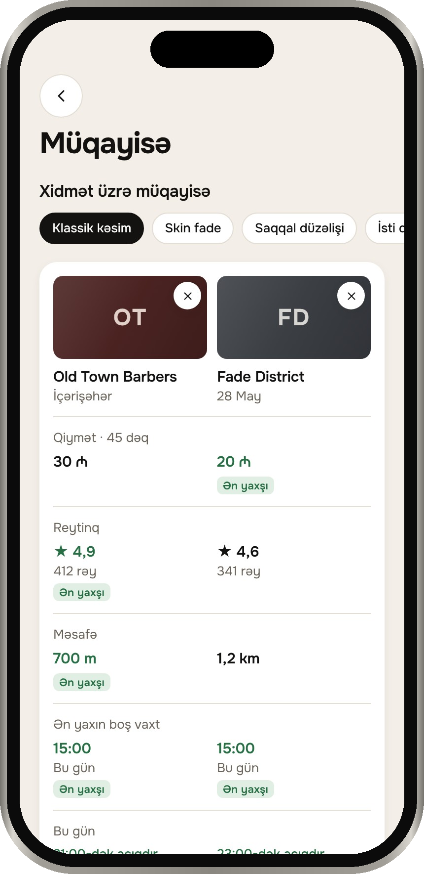
Find, compare, book
PRODUCT · FOR CLIENTS
01
Free times today
The nearest open slots in the city, for the service you want.
02
Map and filters
Price range, rating, distance, women-only salons, English-speaking masters.
03
Compare
Up to three salons: price, rating, distance and next free time.
04
Book
Services, master, day, time. Reminders 24 h and 2 h before.
Home
Booking
Salon
Compare
Notes:
Product for clients: home, a salon, booking a time, comparing salons. The web deck plays the screen recording.

Slide 5
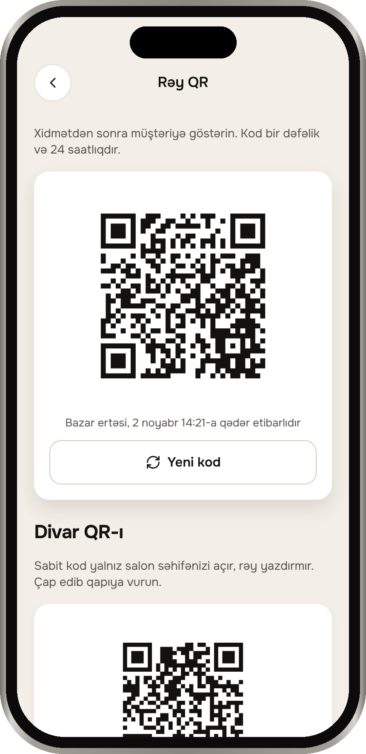
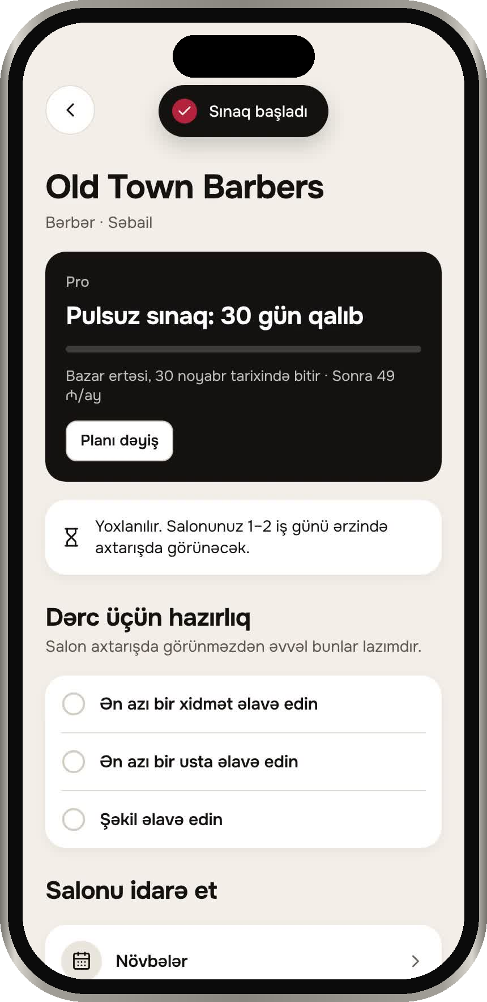
A salon panel, not a CRM to learn
PRODUCT · FOR SALONS
✓
Calendar, walk-ins and time off
✓
Masters and services — no per-seat fees
✓
One-time QR codes for reviews
✓
Statistics and a monthly click report
✓
Branches and manager roles (Pro)
✓
Deposits and a waitlist (Pro)
Runs in the app and in any browser.
Notes:
Product for salons: signing up and starting the Pro trial, then the tools. The web deck plays the recording.

Slide 6
5 people used it on our test server
BETA TEST
Anonymous. Three clients, one salon owner, one barber.
“I saw three free times at once instead of messaging three salons.”
“Comparing prices side by side made the choice quick. I’d like more photos of the work.”
“Adding masters and hours took a few minutes. I want reminders to go out on WhatsApp.”
TESTER 1 · CLIENT
TESTER 2 · CLIENT
TESTER 3 · SALON OWNER
“The QR review is easy — clients did it before leaving the chair.”
“Booking in Azerbaijani felt natural. The reminder before the visit helped.”
TESTER 4 · BARBER
TESTER 5 · CLIENT
Notes:
Beta test: five anonymous testers. Replace these notes with what your testers actually said.

Slide 7
Baku’s salons have tools for themselves. Clients have nothing
MARKET
WHERE
Baku first — about 2.3 million people
State Statistics Committee of Azerbaijan
SALONS
Barbershops, hair and beauty salons, nail and brow studios, spa, makeup
CLIENTS
People who book by DM today, and visitors who need English and clear prices
The market already moved booking online — into messengers. The client side is still empty.
Booksy: $29.99 + $20 per extra master
Fresha: $14.95 per master + 20% of new clients
yazılnow Pro: flat, branches and deposits included
yazılnow Start: flat, unlimited masters
Fresha (CostBench), Booksy (Koalendar); our prices from the app
Notes:
Market: who we serve, and what a salon with five masters pays a month elsewhere.

Slide 8
A flat monthly plan. No commission
BUSINESS MODEL
Sadə
Start
Pro
RECOMMENDED
10 ₼ / month
29 ₼ / month
49 ₼ / month
On the map
QR reviews and replies
“Book” button to the salon’s own page
Monthly click report
Everything in Sadə
Online booking and calendar
Unlimited masters
Reminders for clients
Everything in Start
3 branches included, +15 ₼ each extra
Manager roles, combined reports
Deposits, waitlist, statistics
30 days free, no card · A year costs 10 months · WhatsApp pack: 10 ₼ / 300 messages
Notes:
Business model: the three plans exactly as in the app. No commission on bookings.

Slide 9
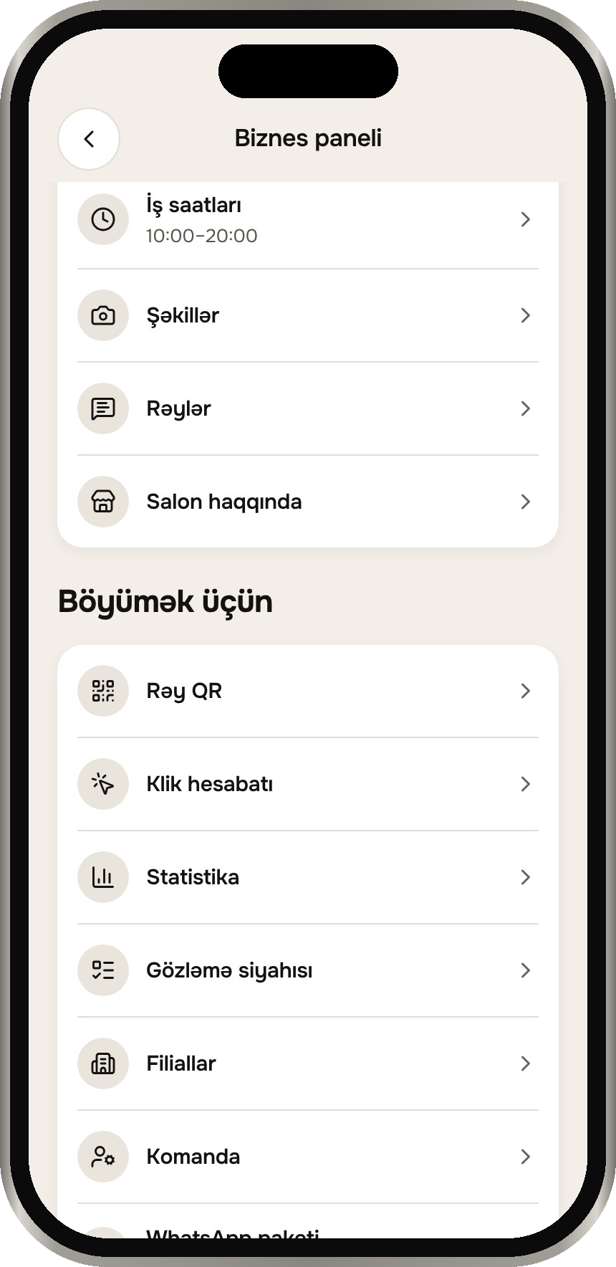
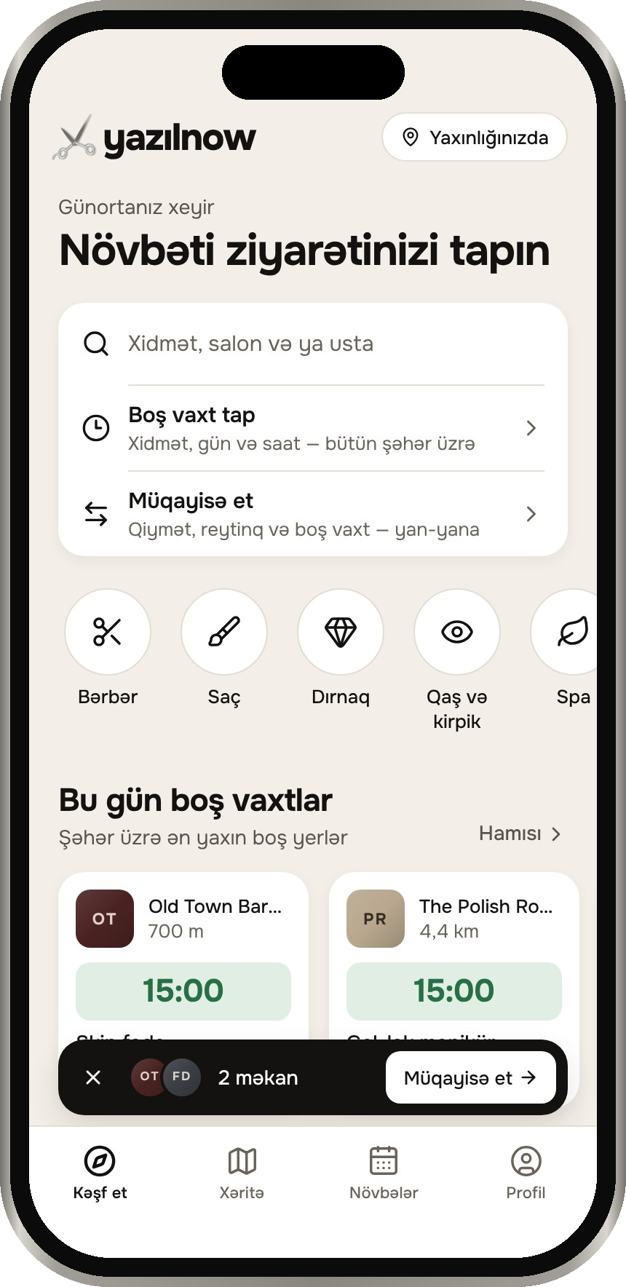
Built and working — before launch
WHERE WE ARE
✓
Mobile app for iOS and Android, plus the web
✓
Salon panel in the browser
✓
Server, admin panel and website
✓
Three languages: Azerbaijani, Russian, English
✓
114 automated server tests passing
NEXT
Connect a payment provider
Host the server on yazilnow.az
Sign the first founding salons
Notes:
Where we are: what exists today, and the next three steps.

Slide 10
The people behind yazılnow
TEAM
NS
NS
NS
Name Surname
Name Surname
Name Surname
PRODUCT & DESIGN
ENGINEERING
SALONS & GROWTH
One line about what you do and why it fits.
One line about what you do and why it fits.
One line about what you do and why it fits.
yazilnow.az · support@yazilnow.az
Notes:
Team: names, roles and one line each. Then the contacts.

Slide 11
yazılnow
Thank you
Ustanı tap, vaxtını tut.
yazilnow.az · support@yazilnow.az
Notes:
Thank you. Contacts on screen.

