Slide 1

Notes:
Introduction: the app opening, then name, one-line pitch and contacts.

Slide 2
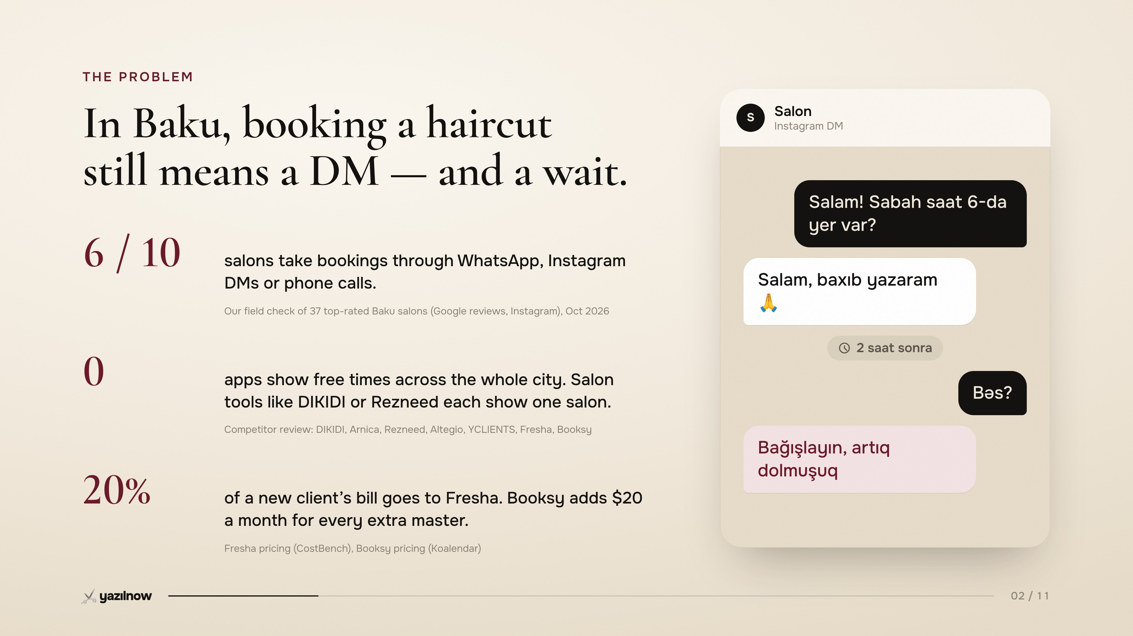
Notes:
Problem: booking happens in DMs; the chat shows the wait.

Slide 3
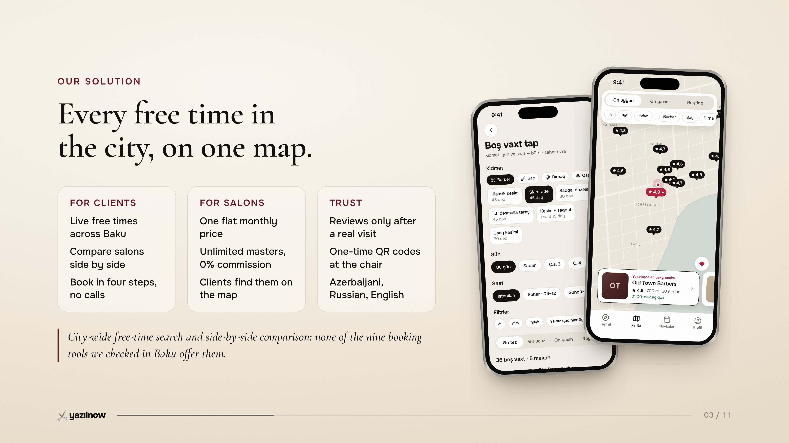
Notes:
Solution: every free time in the city on one map.

Slide 4
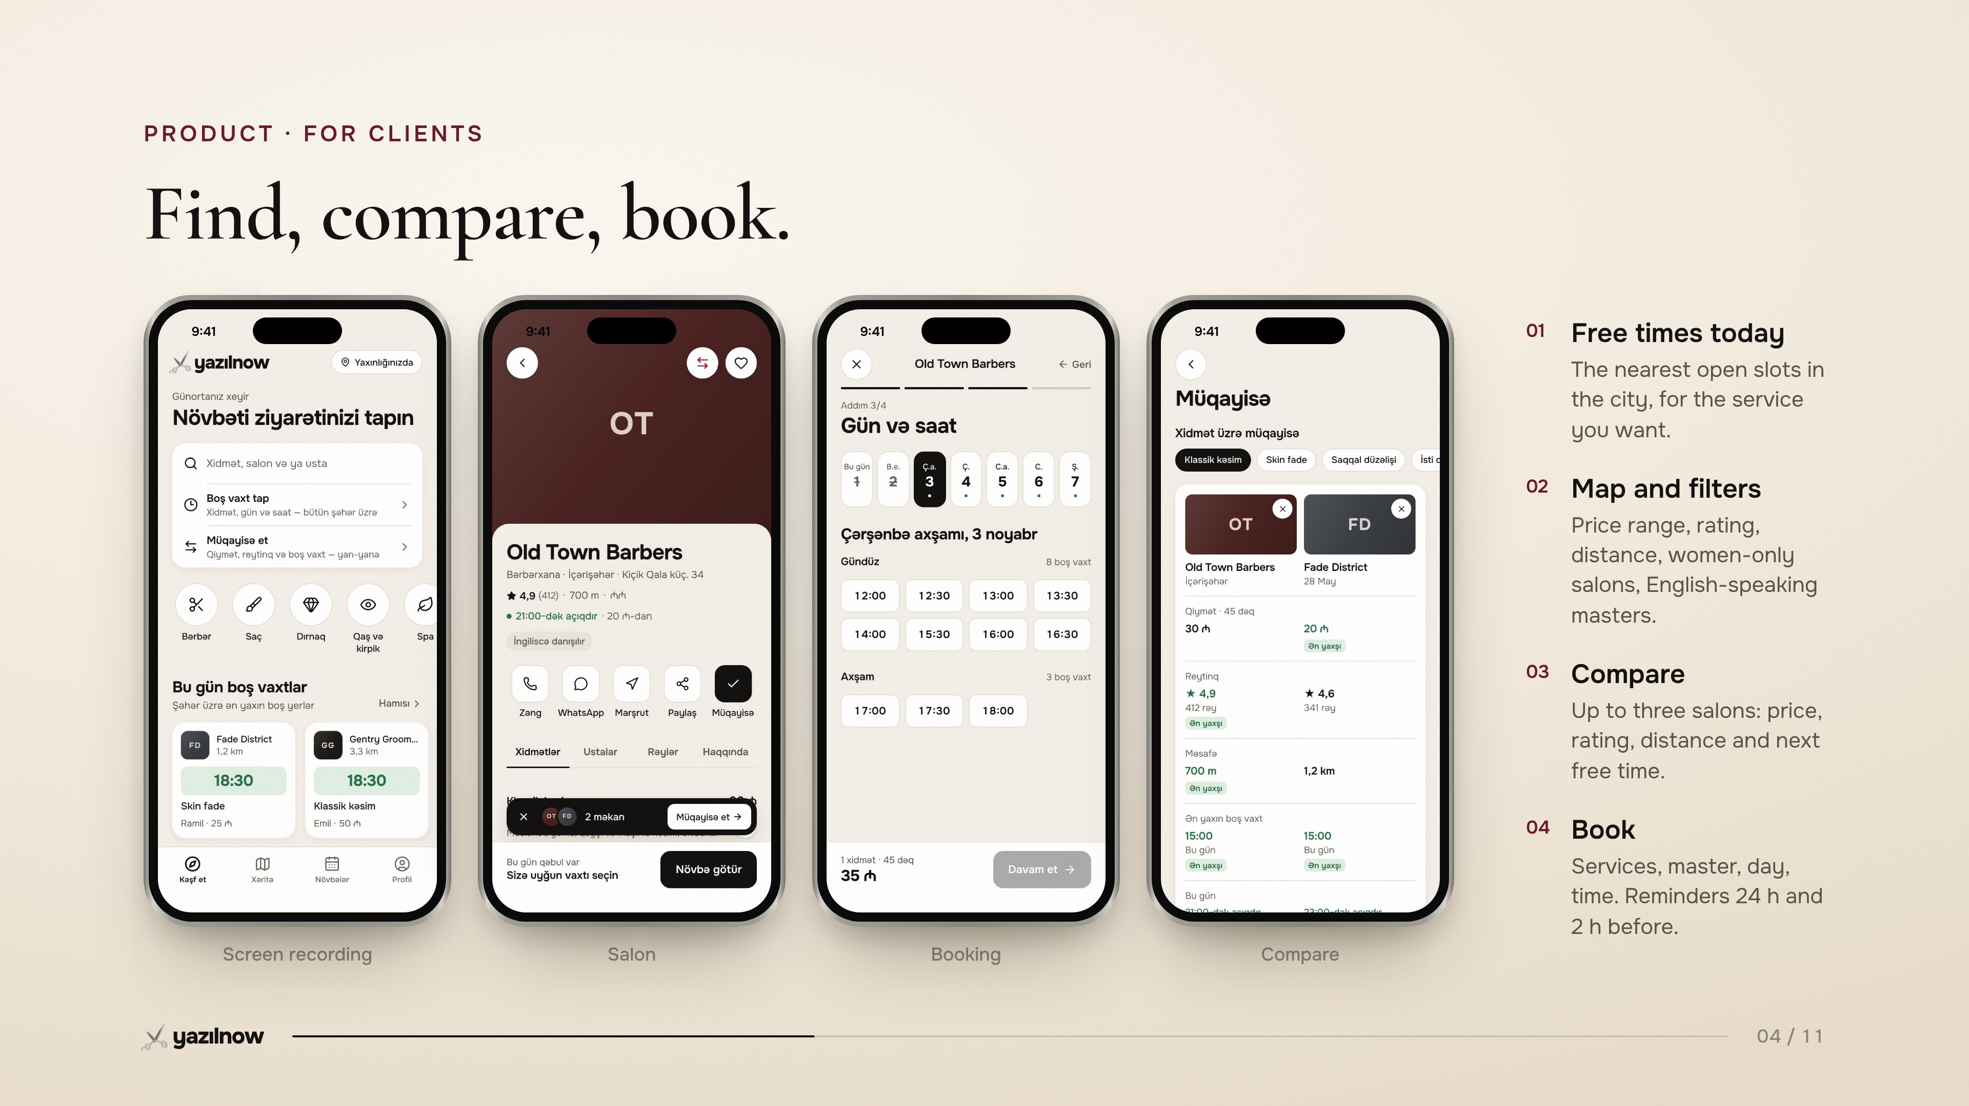
Notes:
Product for clients: recording, salon, booking, compare.

Slide 5
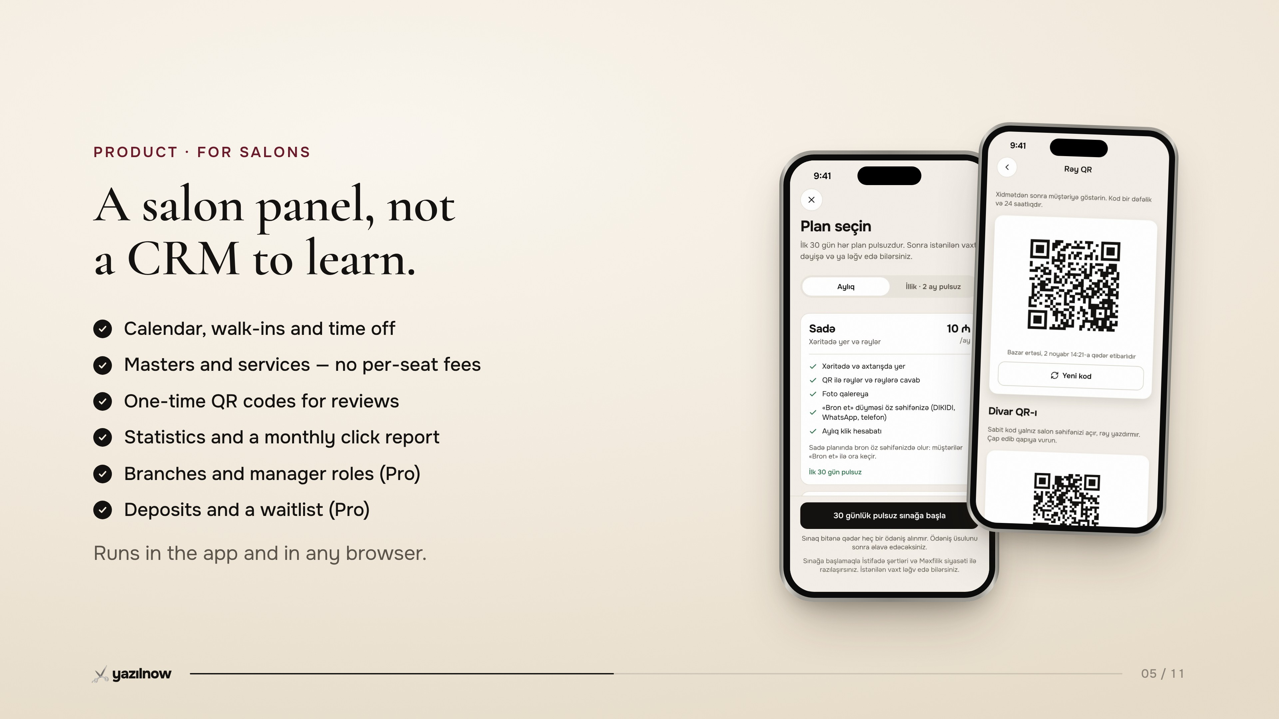
Notes:
Product for salons: sign-up and Pro trial, review QR.

Slide 6
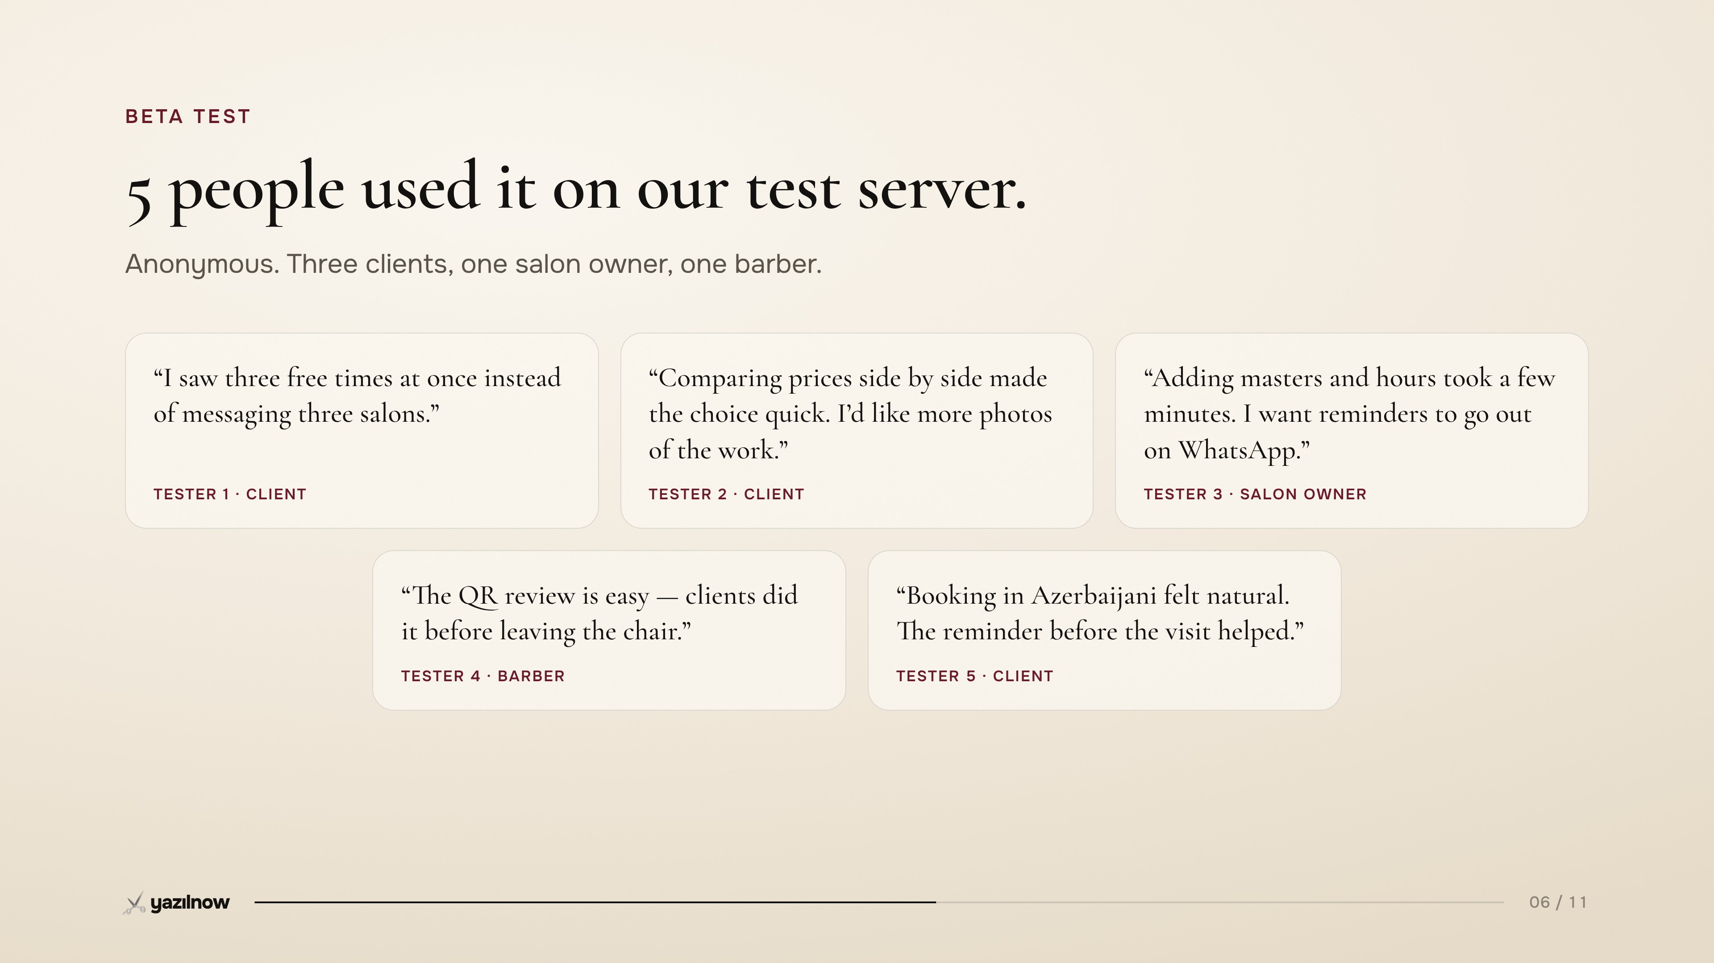
Notes:
Beta test: five anonymous testers (replace notes with real ones).

Slide 7
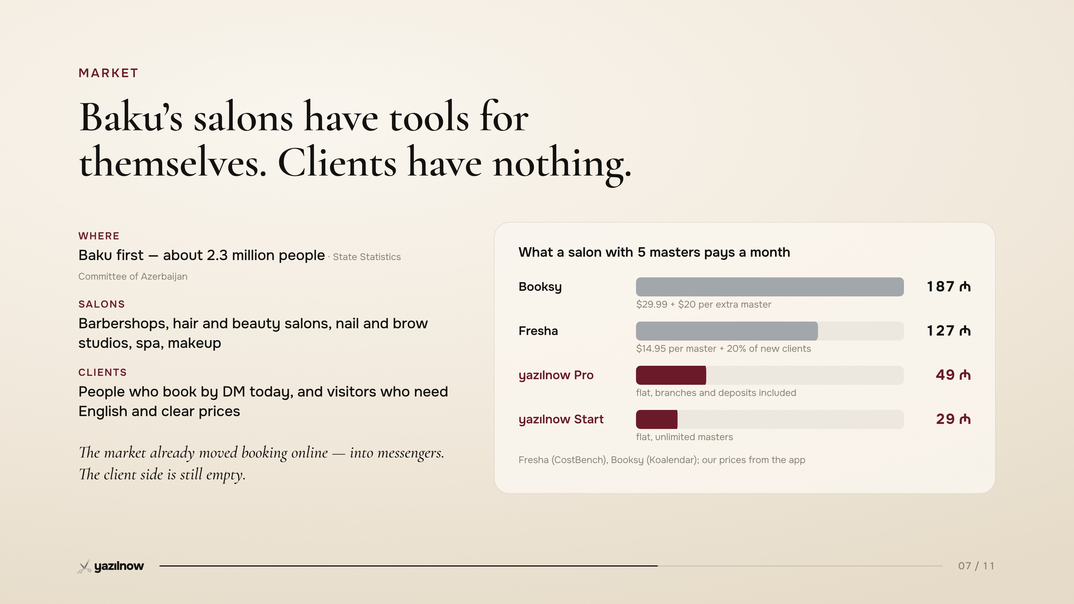
Notes:
Market: who we serve; what a 5-master salon pays a month.

Slide 8
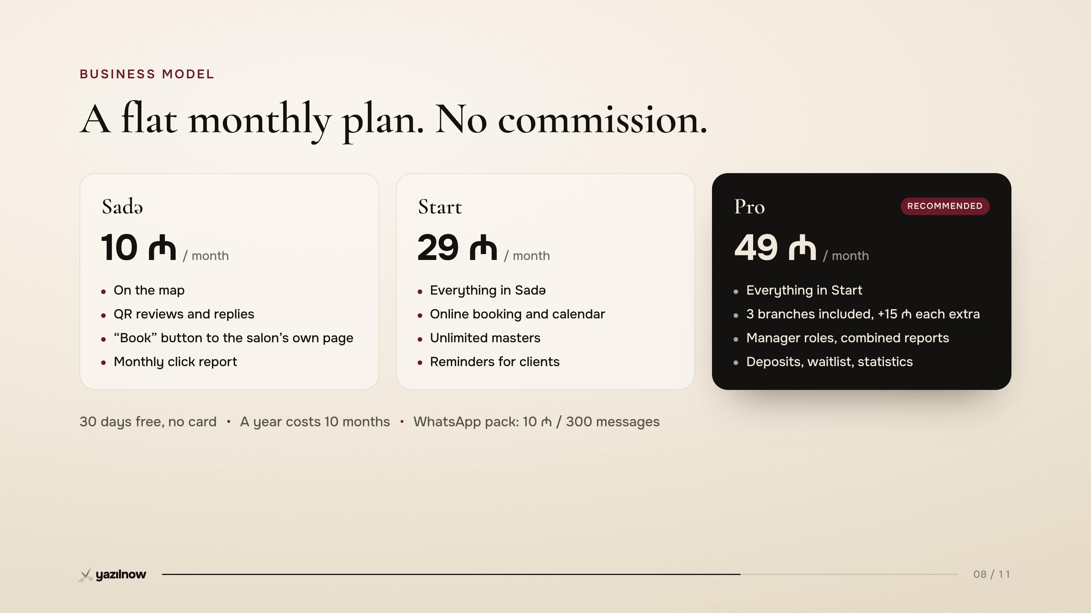
Notes:
Business model: Sadə 10, Start 29, Pro 49.

Slide 9
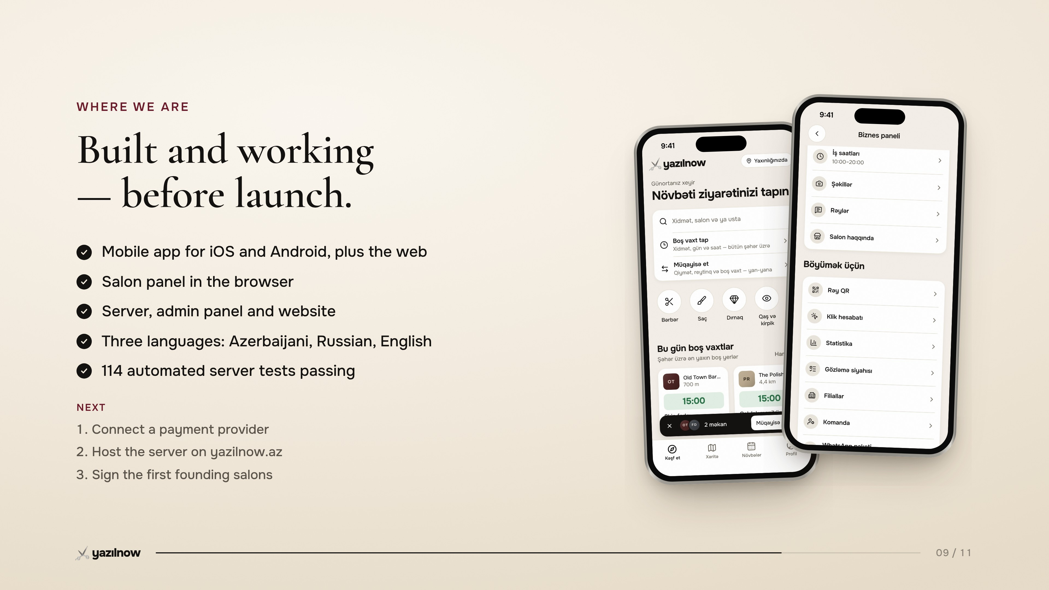
Notes:
Where we are: built, and next steps.

Slide 10
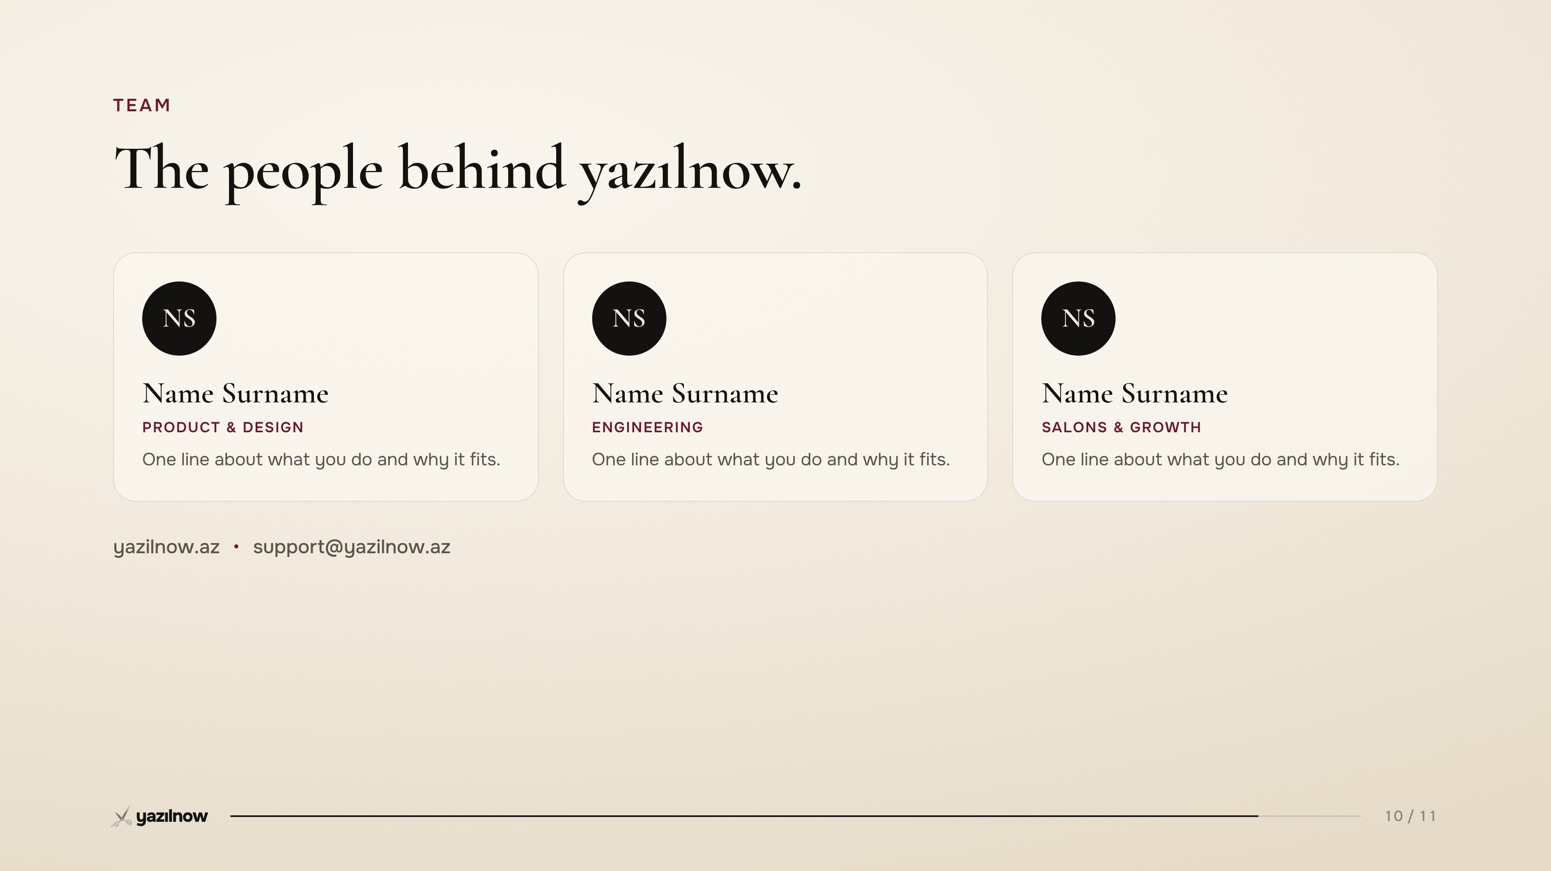
Notes:
Team and contact (fill in names).

Slide 11

Notes:
Thank you.

