Slide 1
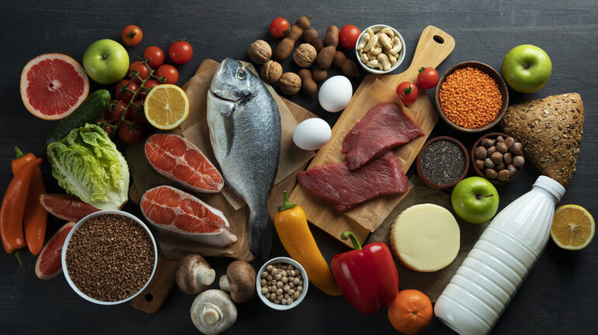
Nutritrack
Noirin, Michael, Mariia & Pia
OS & Infrastructure

Slide 2



Purpose
A portable, real-time, tracking nutrition platform
Tracking daily food intake
Weekly statistics
generation
Calculation of
consumed food

Slide 3

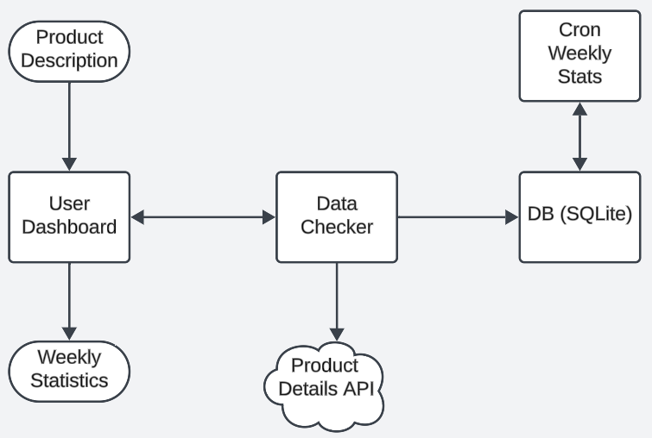

Platform concept
Easy use
Real-time tracking
Data syncing
Dockerized deployment
Lighweight data storage with SQLlite
Notes:
"The data flow in NutriTrack begins with users interacting through the User Dashboard, where they log food details. Nutritional information is fetched from the Product Details API and validated by the Data Checker before being stored in the SQLite database. Automated Cron Jobs run weekly to aggregate user consumption data into the Weekly Stats table and perform daily database backups for secure storage. Finally, the User Dashboard displays the weekly statistics, providing users with a summary of their nutritional intake."

Slide 4

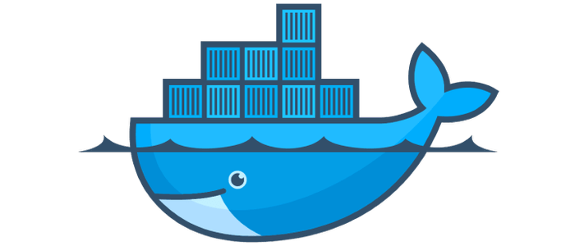



Functionality
User interface for tracking and analytics
Ports specification for multiple devices
Relational data for food consumption and user management
ETL pipeline and export for external analysis
Weekly statistics automatization and database backups

Slide 5
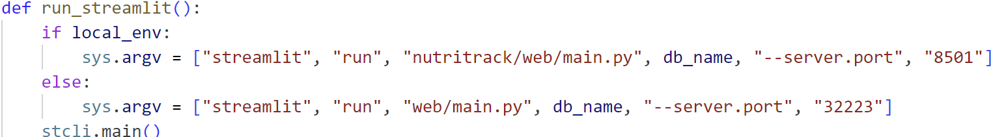
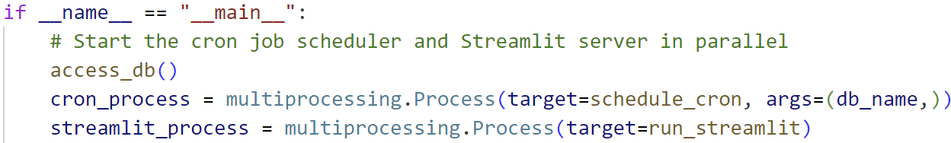
Streamlit
User input
Validation
Database
Display on the UI
Dynamic Port Assesment:
Local mode: port 8501 (debugging & testing)
Production mode: 32223 (final deployment)
Parallel execution with Cron Jobs
Notes:
"In NutriTrack, Streamlit provides the user-friendly interface for logging food consumption and displaying weekly nutrition summaries.“
Streamlit runs alongside scheduled tasks (Cron Jobs), ensuring continuous data updates while providing real-time interaction.

Slide 6
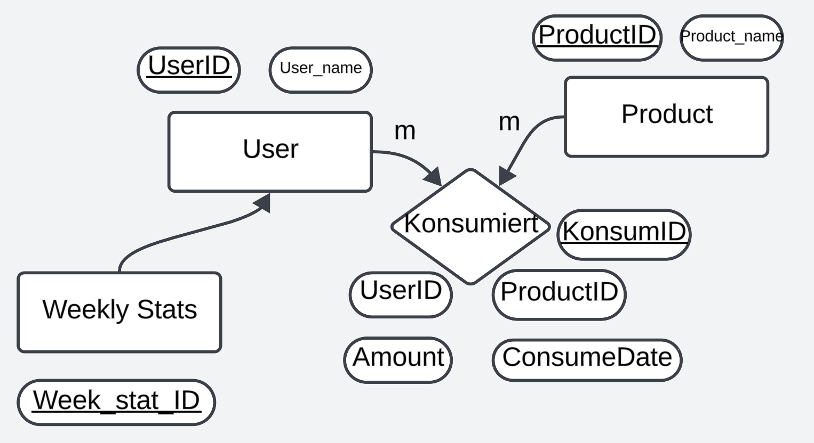
Database architecture
Notes:
Tables:Product: Nutritional data of items.
Users: Tracks user credentials.
Konsumiert (Consumed): Tracks user consumption.
Weekly_Stats: Aggregates weekly totals.
Users ↔ Konsumiert: A user can log multiple consumption records.
Konsumiert ↔ Product: Links consumed items to their nutritional information.
Weekly_Stats ↔ Users: Each user has a unique weekly summary.

Slide 7
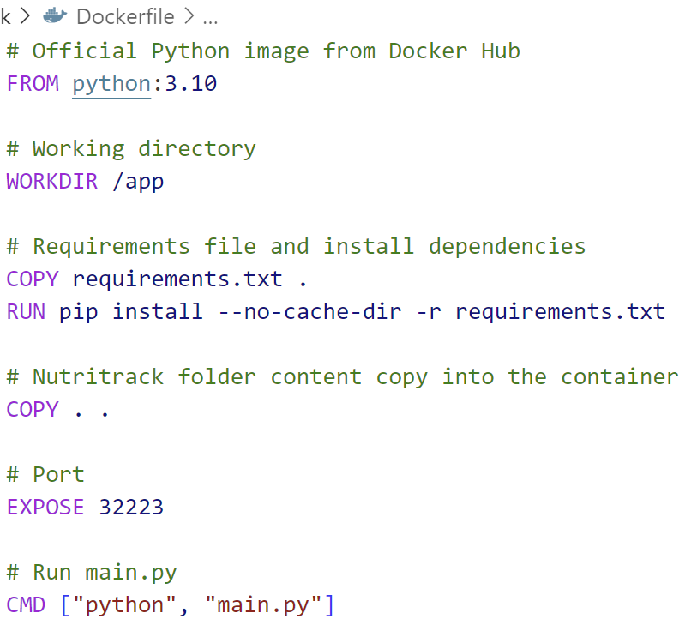
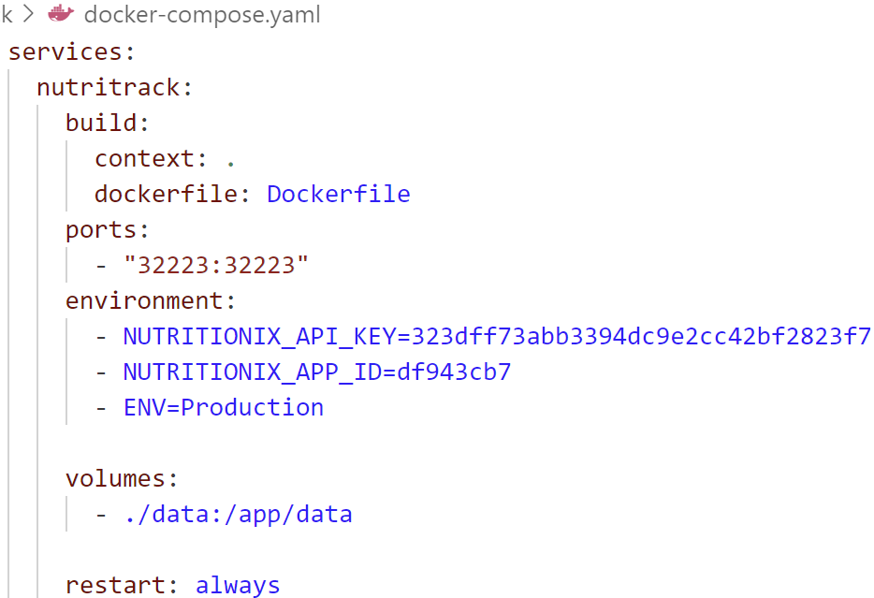
Docker Compose
Ensures Nutritrack runs
across different environments
Notes:
Example for Docker: "We containerized NutriTrack to ensure portability, allowing the platform to run consistently across environments."

Slide 8
Cron Jobs
Secures data backups
Weekly Statistics
Data aggregation (Consumed table) into Weekly Stats table
Every Sunday at 11 pm
Database backups
SQLite table export for secure offline storage
Meltano Job Executiont
Automates data extraction & load processes for extrernal tools
Daily run at 10 pm in production
Notes:
Example for Cron: "Cron schedules automated weekly stats generation at 11 PM every Monay in production mode."

Slide 9
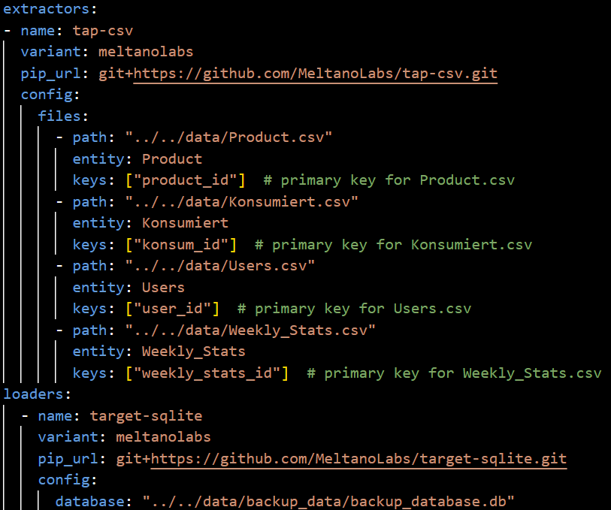
Meltano
Important for data export & integration
Manages EL & ETL pipelines
for further processing
Backup
Notes:
Role in NutriTrack:
Automates daily backups of SQLite database tables to CSV format.
Ensures data portability and integration with external tools.
Triggered as part of the daily cron job schedule.

Slide 10
Challenges
Combining multiple technologies in one system
Correct settling environments variables for paths, ports
Debugging
Cron jobs failures

Slide 11

Demo

