Slide 1



Common R Object Types - Vectors
Objects in R can be various forms and even made to be “custom” types.
Numeric/Integer
Factors (Distinct Classes)
as.factor(c('MALE','FEMALE','FEMALE'))
Cardinality
2
1
10
12
3.47
82
MALE
FEMALE
FEMALE
Unordered
c(1,10,12,3.47)
[1] MALE FEMALE FEMALE
Levels: FEMALE MALE
High
Med
Low
as.factor(c(‘High',‘Med',‘Low'))
Cardinality
3
Ordinal
Boolean
STRING (just text)
TRUE
TRUE
FALSE
TRUE
FALSE
c('MALE','FEMALE','FEMALE')
c(T, T, F, T, F)
c(TRUE,TRUE, FALSE, TRUE,FALSE)
c(T,TRUE, F, TRUE,FALSE)
[1] "MALE" "FEMALE" "FEMALE"
In R, a vector can be numeric, Boolean (T/F), factors, or contain strings.
Notes:
Ordinal – is there an order to the factor, how does that factor level relate to other levels
Cardinality – number of distinct factor levels, the number of elements in a set

Slide 2
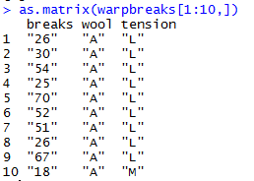
More Complex Common R Object Types - Matrix
Matrices are 2 dimensional data (rows/columns). Each column must be the same type.
RowID | breaks | wool | tension
1 | 26 | A | L
2 | 30 | A | L
3 | 54 | A | L
4 | 25 | A | L
5 | 70 | A | L
6 | 52 | A | L
7 | 51 | A | L
8 | 26 | A | L
9 | 67 | A | L
10 | 18 | A | M
All strings
Matrices are organized into rows and columns. In R, the row names are not actually a vector of the matrix but are an attribute of the matrix. In excel you would need a standalone vector to capture that information.

Slide 3
More Complex Common R Object Types – List
Lists are multi-dimensional objects that can contain different data types of different lengths.
ListA
single value
Single data frame or matrix
single vector
Nested list
Nested data frame
Nested matrix
Lists are useful for data organization but can be complex and difficult to navigate to get specific information.

Slide 4
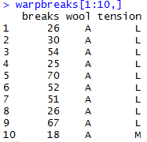
More Complex Common R Object Types – Data Frame
Data Frames are like 2 dimensional data objects but can have mixed data types.
A data frame is actually a named list but with equal length elements. Being a list lets it contain mixed data types.
RowID | breaks | wool | tension
1 | 26 | A | L
2 | 30 | A | L
3 | 54 | A | L
4 | 25 | A | L
5 | 70 | A | L
6 | 52 | A | L
7 | 51 | A | L
8 | 26 | A | L
9 | 67 | A | L
10 | 18 | A | M
Integers
Factor
Factor
Data frames are used often because they can hold different types of vectors, but can be switched back and forth with as.matrix() and as.data.frame(). Remember that the vector classes could change!!

Slide 5
Data Structure for Analysis & Modeling
Often the 1st Column is a unique identifier but the identifier could also be a row attribute (not actually a vector)
name | mfr | type | calories | protein | fat | sodium | fiber | carbo | sugars | potass | vitamins | shelf | weight | cups | rating
100%_Bran | N | C | 70 | 4 | 1 | 130 | 10 | 5 | 6 | 280 | 25 | 3 | 1 | 0.33 | 68.40297
100%_Natural_Bran | Q | C | 120 | 3 | 5 | 15 | 2 | 8 | 8 | 135 | 0 | 3 | 1 | 1 | 33.98368
All-Bran | K | C | 70 | 4 | 1 | 260 | 9 | 7 | 5 | 320 | 25 | 3 | 1 | 0.33 | 59.42551
All-Bran_with_Extra_Fiber | K | C | 50 | 4 | 0 | 140 | 14 | 8 | 0 | 330 | 25 | 3 | 1 | 0.5 | 93.70491
Almond_Delight | R | C | 110 | 2 | 2 | 200 | 1 | 14 | 8 |  | 25 | 3 | 1 | 0.75 | 34.38484
Apple_Cinnamon_Cheerios | G | C | 110 | 2 | 2 | 180 | 1.5 | 10.5 | 10 | 70 | 25 | 1 | 1 | 0.75 | 29.50954
Apple_Jacks | K | C | 110 | 2 | 0 | 125 | 1 | 11 | 14 | 30 | 25 | 2 | 1 | 1 | 33.17409
Basic_4 | G | C | 130 | 3 | 2 | 210 | 2 | 18 | 8 | 100 | 25 | 3 | 1.33 | 0.75 | 37.03856
Bran_Chex | R | C | 90 | 2 | 1 | 200 | 4 | 15 | 6 | 125 | 25 | 1 | 1 | 0.67 | 49.12025
Bran_Flakes | P | C | 90 | 3 | 0 | 210 | 5 | 13 | 5 | 190 | 25 | 3 | 1 | 0.67 | 53.31381
Cap'n'Crunch | Q | C | 120 | 1 | 2 | 220 | 0 | 12 | 12 | 35 | 25 | 2 | 1 | 0.75 | 18.04285
Generally we will use data frames to avoid complexity but you will be exposed to other data types.

Slide 6
Data Structure for Modeling
Informative features are usually independent & do not lend information to other rows (auto-correlation). Can be called informative columns, independent variables, or features.
Remember in a DF, these can be mixed with decimals, integers, factors, strings, T/F.
name | mfr | type | calories | protein | fat | sodium | fiber | carbo | sugars | potass | vitamins | shelf | weight | cups | rating
100%_Bran | N | C | 70 | 4 | 1 | 130 | 10 | 5 | 6 | 280 | 25 | 3 | 1 | 0.33 | 68.40297
100%_Natural_Bran | Q | C | 120 | 3 | 5 | 15 | 2 | 8 | 8 | 135 | 0 | 3 | 1 | 1 | 33.98368
All-Bran | K | C | 70 | 4 | 1 | 260 | 9 | 7 | 5 | 320 | 25 | 3 | 1 | 0.33 | 59.42551
All-Bran_with_Extra_Fiber | K | C | 50 | 4 | 0 | 140 | 14 | 8 | 0 | 330 | 25 | 3 | 1 | 0.5 | 93.70491
Almond_Delight | R | C | 110 | 2 | 2 | 200 | 1 | 14 | 8 |  | 25 | 3 | 1 | 0.75 | 34.38484
Apple_Cinnamon_Cheerios | G | C | 110 | 2 | 2 | 180 | 1.5 | 10.5 | 10 | 70 | 25 | 1 | 1 | 0.75 | 29.50954
Apple_Jacks | K | C | 110 | 2 | 0 | 125 | 1 | 11 | 14 | 30 | 25 | 2 | 1 | 1 | 33.17409
Basic_4 | G | C | 130 | 3 | 2 | 210 | 2 | 18 | 8 | 100 | 25 | 3 | 1.33 | 0.75 | 37.03856
Bran_Chex | R | C | 90 | 2 | 1 | 200 | 4 | 15 | 6 | 125 | 25 | 1 | 1 | 0.67 | 49.12025
Bran_Flakes | P | C | 90 | 3 | 0 | 210 | 5 | 13 | 5 | 190 | 25 | 3 | 1 | 0.67 | 53.31381
Cap'n'Crunch | Q | C | 120 | 1 | 2 | 220 | 0 | 12 | 12 | 35 | 25 | 2 | 1 | 0.75 | 18.04285
Generally we will use data frames to avoid complexity but you will be exposed to other data types.

Slide 7
Data Structure for Modeling
If we are doing supervised learning, there is a dependent variable.
This is the outcome and is “dependent” on the informative columns. An analysis with this vector can be binary, classification, or predictive.
name | mfr | type | calories | protein | fat | sodium | fiber | carbo | sugars | potass | vitamins | shelf | weight | cups | rating
100%_Bran | N | C | 70 | 4 | 1 | 130 | 10 | 5 | 6 | 280 | 25 | 3 | 1 | 0.33 | 68.40297
100%_Natural_Bran | Q | C | 120 | 3 | 5 | 15 | 2 | 8 | 8 | 135 | 0 | 3 | 1 | 1 | 33.98368
All-Bran | K | C | 70 | 4 | 1 | 260 | 9 | 7 | 5 | 320 | 25 | 3 | 1 | 0.33 | 59.42551
All-Bran_with_Extra_Fiber | K | C | 50 | 4 | 0 | 140 | 14 | 8 | 0 | 330 | 25 | 3 | 1 | 0.5 | 93.70491
Almond_Delight | R | C | 110 | 2 | 2 | 200 | 1 | 14 | 8 |  | 25 | 3 | 1 | 0.75 | 34.38484
Apple_Cinnamon_Cheerios | G | C | 110 | 2 | 2 | 180 | 1.5 | 10.5 | 10 | 70 | 25 | 1 | 1 | 0.75 | 29.50954
Apple_Jacks | K | C | 110 | 2 | 0 | 125 | 1 | 11 | 14 | 30 | 25 | 2 | 1 | 1 | 33.17409
Basic_4 | G | C | 130 | 3 | 2 | 210 | 2 | 18 | 8 | 100 | 25 | 3 | 1.33 | 0.75 | 37.03856
Bran_Chex | R | C | 90 | 2 | 1 | 200 | 4 | 15 | 6 | 125 | 25 | 1 | 1 | 0.67 | 49.12025
Bran_Flakes | P | C | 90 | 3 | 0 | 210 | 5 | 13 | 5 | 190 | 25 | 3 | 1 | 0.67 | 53.31381
Cap'n'Crunch | Q | C | 120 | 1 | 2 | 220 | 0 | 12 | 12 | 35 | 25 | 2 | 1 | 0.75 | 18.04285
Generally we will use data frames to avoid complexity but you will be exposed to other data types.

Slide 8
When should you use a specific data type?
Number of Dimensions >1
No
Yes
Use a Vector
Data Types >1
No
Yes
Matrix or Array
Data Frame or List
Most analyses start with a data frame, and change classes as needed.

Slide 9

What about joining tables?

Slide 10
When you have 2+ tables of data with a shared column
Table A
Table B
Come together by a unique yet shared identifier
Like a customer ID
How do you want to bring them together?

Slide 11
Do you want to retain all records in table A & append table B data?
Table A
Records in table B NOT in Table A are dropped.
In this case use a “left” join

Slide 12
Do you want to retain all records in table B & append table A data?
Records in table A NOT in Table B are dropped.
In this case use a “right” join

Slide 13
Do you want to retain records only if they are in A & B?
Records in table A NOT in Table B are dropped.
Records in table B NOT in Table A are dropped.
In this case use an “inner” join

Slide 14
Do you want to keep unique data points not shared in the tables?
Records in table A NOT in Table B are retained.
Records in table B NOT in Table A are retained.
In this case use an “outer” join

Slide 15
Do you want to remove records in Table A that are in table B?
Records in table A & B are dropped.
In this case use an “anti” join

Slide 16
Do you want to just keep all records?
TBH this is what I find myself doing most often!
In this case use a “full” join

Slide 17
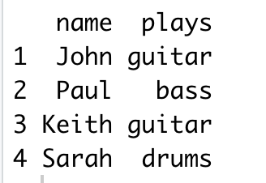
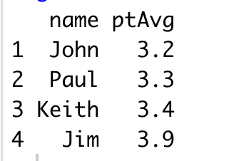
Feature Enrichment Requires a Join
X
Y
Instruments
Grades
Students playing instruments
Student Grades from Honors Science Class
It’s kind of like a vlookup…matching records from one table to another.
Kwartler CSCI 96
Notes:
Very common to append the existing data as the left side
Grades could have millions of more records than instruments table. The only rows that are kept are the instrument table X

Slide 18
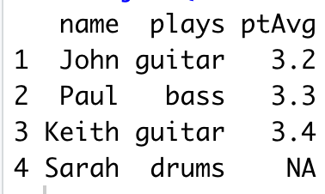
Left Join
Only students in band and honors science class get their grades appended. Band members not in honors science are retained but get “NA”
x
y
instruments
Grades
No Sarah
Return all rows from x where there are matching values in y, and all columns from x and y. If there are multiple matches between x and y, all combination of the matches are returned.
Kwartler CSCI 96
Notes:
Very common to append the existing data as the left side
Grades could have millions of more records than instruments table. The only rows that are kept are the instrument table X

Slide 19
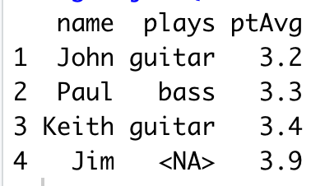
Right Join
Only students in honors science and band class get their instuments appended. Science students not in band science are retained but get “NA”
x
y
instruments
Grades
No Jim
Return all rows from y, and all columns from x and y. Rows in y with no match in x will have NA values in the new columns. If there are multiple matches between x and y, all combinations of the matches are returned.
Kwartler CSCI 96
Notes:
The reverse

Slide 20
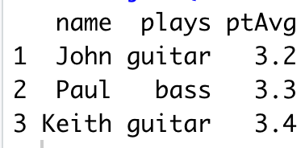
Inner Join
Only students in both band and honors science are retained. All others are dropped and no NAs appear.
x
y
instruments
Grades
No Jim
No Sarah
Return all rows from x where there are matching values in y, and all columns from x and y. If there are multiple matches between x and y, all combination of the matches are returned.
Kwartler CSCI 96
Notes:
What records are in common; say you have a potential mailing list and want to find your existing customers
Will do during text mining

Slide 21
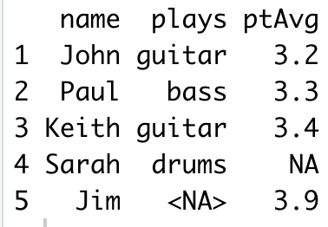
Full Join
All students are retained and NAs filled in as needed.
x
y
instruments
Grades
No Jim
No Sarah
Return all rows and all columns from both x and y. Where there are not matching values, returns NA for the one missing.
Kwartler CSCI 96
Notes:
What records are in common; say you have a potential mailing list and want to find your existing customers
Will do during text mining

Slide 22
Let’s Practice!
Open A_R objects.R:
c() to combine values into a vector
as.matrix() to create a matrix object
data.frame()
as.list()
List elements by index
List elements by name

