Slide 1
CSCI E-96
Data Mining Workflow
Data Types & EDA

Slide 2
Any questions before new material?
EDA is inherently ambiguous
Read C1,C2 and C3

Slide 3
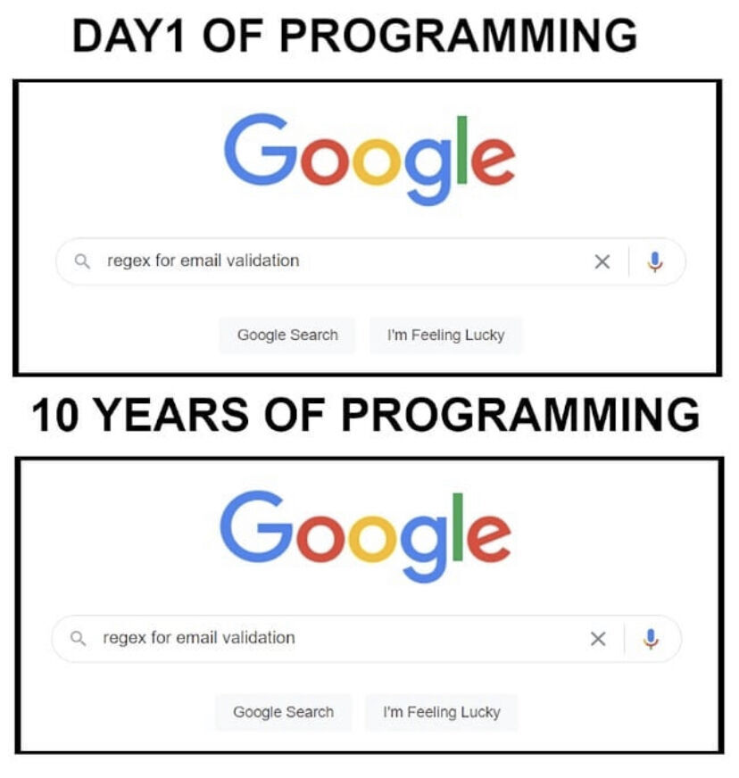

Slide 4
Agenda
Start | End | Item
 |  | Data For Modeling
 |  | Data Mining Workflows
 |  | Data Modification & Preprocessing
 |  | Business Case: Donor Bureau
 |  | Housekeeping, Reading & Homework

Slide 5
Data Structure for Analysis & Modeling
Often the 1st Column is a unique identifier but the identifier could also be a row attribute (not actually a vector)
name | mfr | type | calories | protein | fat | sodium | fiber | carbo | sugars | potass | vitamins | shelf | weight | cups | rating
100%_Bran | N | C | 70 | 4 | 1 | 130 | 10 | 5 | 6 | 280 | 25 | 3 | 1 | 0.33 | 68.40297
100%_Natural_Bran | Q | C | 120 | 3 | 5 | 15 | 2 | 8 | 8 | 135 | 0 | 3 | 1 | 1 | 33.98368
All-Bran | K | C | 70 | 4 | 1 | 260 | 9 | 7 | 5 | 320 | 25 | 3 | 1 | 0.33 | 59.42551
All-Bran_with_Extra_Fiber | K | C | 50 | 4 | 0 | 140 | 14 | 8 | 0 | 330 | 25 | 3 | 1 | 0.5 | 93.70491
Almond_Delight | R | C | 110 | 2 | 2 | 200 | 1 | 14 | 8 |  | 25 | 3 | 1 | 0.75 | 34.38484
Apple_Cinnamon_Cheerios | G | C | 110 | 2 | 2 | 180 | 1.5 | 10.5 | 10 | 70 | 25 | 1 | 1 | 0.75 | 29.50954
Apple_Jacks | K | C | 110 | 2 | 0 | 125 | 1 | 11 | 14 | 30 | 25 | 2 | 1 | 1 | 33.17409
Basic_4 | G | C | 130 | 3 | 2 | 210 | 2 | 18 | 8 | 100 | 25 | 3 | 1.33 | 0.75 | 37.03856
Bran_Chex | R | C | 90 | 2 | 1 | 200 | 4 | 15 | 6 | 125 | 25 | 1 | 1 | 0.67 | 49.12025
Bran_Flakes | P | C | 90 | 3 | 0 | 210 | 5 | 13 | 5 | 190 | 25 | 3 | 1 | 0.67 | 53.31381
Cap'n'Crunch | Q | C | 120 | 1 | 2 | 220 | 0 | 12 | 12 | 35 | 25 | 2 | 1 | 0.75 | 18.04285
Generally we will use data frames to avoid complexity but you will be exposed to other data types.

Slide 6
Data Structure for Analysis & Modeling
Informative features are usually independent & do not lend information to other rows (auto-correlation). Can be called informative columns, independent variables, or features.
Remember in a DF, these can be mixed with decimals, integers, factors, strings, T/F.
name | mfr | type | calories | protein | fat | sodium | fiber | carbo | sugars | potass | vitamins | shelf | weight | cups | rating
100%_Bran | N | C | 70 | 4 | 1 | 130 | 10 | 5 | 6 | 280 | 25 | 3 | 1 | 0.33 | 68.40297
100%_Natural_Bran | Q | C | 120 | 3 | 5 | 15 | 2 | 8 | 8 | 135 | 0 | 3 | 1 | 1 | 33.98368
All-Bran | K | C | 70 | 4 | 1 | 260 | 9 | 7 | 5 | 320 | 25 | 3 | 1 | 0.33 | 59.42551
All-Bran_with_Extra_Fiber | K | C | 50 | 4 | 0 | 140 | 14 | 8 | 0 | 330 | 25 | 3 | 1 | 0.5 | 93.70491
Almond_Delight | R | C | 110 | 2 | 2 | 200 | 1 | 14 | 8 |  | 25 | 3 | 1 | 0.75 | 34.38484
Apple_Cinnamon_Cheerios | G | C | 110 | 2 | 2 | 180 | 1.5 | 10.5 | 10 | 70 | 25 | 1 | 1 | 0.75 | 29.50954
Apple_Jacks | K | C | 110 | 2 | 0 | 125 | 1 | 11 | 14 | 30 | 25 | 2 | 1 | 1 | 33.17409
Basic_4 | G | C | 130 | 3 | 2 | 210 | 2 | 18 | 8 | 100 | 25 | 3 | 1.33 | 0.75 | 37.03856
Bran_Chex | R | C | 90 | 2 | 1 | 200 | 4 | 15 | 6 | 125 | 25 | 1 | 1 | 0.67 | 49.12025
Bran_Flakes | P | C | 90 | 3 | 0 | 210 | 5 | 13 | 5 | 190 | 25 | 3 | 1 | 0.67 | 53.31381
Cap'n'Crunch | Q | C | 120 | 1 | 2 | 220 | 0 | 12 | 12 | 35 | 25 | 2 | 1 | 0.75 | 18.04285
Generally we will use data frames to avoid complexity but you will be exposed to other data types.

Slide 7
Data Structure for Analysis & Modeling
If we are doing supervised learning, there is a dependent variable.
This is the outcome and is “dependent” on the informative columns. An analysis with this vector can be binary, classification, or predictive.
name | mfr | type | calories | protein | fat | sodium | fiber | carbo | sugars | potass | vitamins | shelf | weight | cups | rating
100%_Bran | N | C | 70 | 4 | 1 | 130 | 10 | 5 | 6 | 280 | 25 | 3 | 1 | 0.33 | 68.40297
100%_Natural_Bran | Q | C | 120 | 3 | 5 | 15 | 2 | 8 | 8 | 135 | 0 | 3 | 1 | 1 | 33.98368
All-Bran | K | C | 70 | 4 | 1 | 260 | 9 | 7 | 5 | 320 | 25 | 3 | 1 | 0.33 | 59.42551
All-Bran_with_Extra_Fiber | K | C | 50 | 4 | 0 | 140 | 14 | 8 | 0 | 330 | 25 | 3 | 1 | 0.5 | 93.70491
Almond_Delight | R | C | 110 | 2 | 2 | 200 | 1 | 14 | 8 |  | 25 | 3 | 1 | 0.75 | 34.38484
Apple_Cinnamon_Cheerios | G | C | 110 | 2 | 2 | 180 | 1.5 | 10.5 | 10 | 70 | 25 | 1 | 1 | 0.75 | 29.50954
Apple_Jacks | K | C | 110 | 2 | 0 | 125 | 1 | 11 | 14 | 30 | 25 | 2 | 1 | 1 | 33.17409
Basic_4 | G | C | 130 | 3 | 2 | 210 | 2 | 18 | 8 | 100 | 25 | 3 | 1.33 | 0.75 | 37.03856
Bran_Chex | R | C | 90 | 2 | 1 | 200 | 4 | 15 | 6 | 125 | 25 | 1 | 1 | 0.67 | 49.12025
Bran_Flakes | P | C | 90 | 3 | 0 | 210 | 5 | 13 | 5 | 190 | 25 | 3 | 1 | 0.67 | 53.31381
Cap'n'Crunch | Q | C | 120 | 1 | 2 | 220 | 0 | 12 | 12 | 35 | 25 | 2 | 1 | 0.75 | 18.04285
Generally we will use data frames to avoid complexity but you will be exposed to other data types.

Slide 8
Agenda
Start | End | Item
 |  | Data For Modeling
 |  | Data Mining Workflows
 |  | Data Modification & Preprocessing
 |  | Business Case: Donor Bureau
 |  | Housekeeping, Reading & Homework

Slide 9
Modeling Process
SEMMA (from SAS)
In this course…
1. Sample
In this course, data sets are curated for you. Sampling is done to avoid overfitting.
2. Explore
As part of your case analysis you perform basic exploratory data analysis (EDA)
3. Modify
4. Model
5. Assess
The first day we discussed data mining and structure. Week 2 was devoted to basics of R then how to sample, explore and visualize data. Now we will modify data for modeling!

Slide 10
In addition to SEMMA, Data Mining (from the book)
Define/understand purpose
Obtain data (may involve random sampling)
Explore, clean, pre-process data
Reduce the data; if supervised DM, partition it
Specify task (classification, clustering, etc.)
Choose the techniques (regression, CART, neural networks, etc.)
Iterative implementation and “tuning”
Assess results – compare models
Deploy best model
The book’s process is excellent but is focused largely on the modeling process not how the process is part of a business context or if the effort doesn’t require a model.

Slide 11
Data Mining in a Complete Business Workflow
Iterative Business Data Mining Project Life Cycle
Problem Definition
Identify Available Data Sources
EDA
Perform Analyssis
Assessment
Communicate Results
Document
Problem Formulation.
Define data requirements
Explore the data
Perform Analysis & Create Project Artifacts
Asses/Adjust the Project Artifacts
Communicate Results
Document to make it repeatable
Deploy & Monitor
In this view the steps of a project are not solely for modeling, more iterative and not in isolation because the results are communicated to stakeholders.

Slide 12
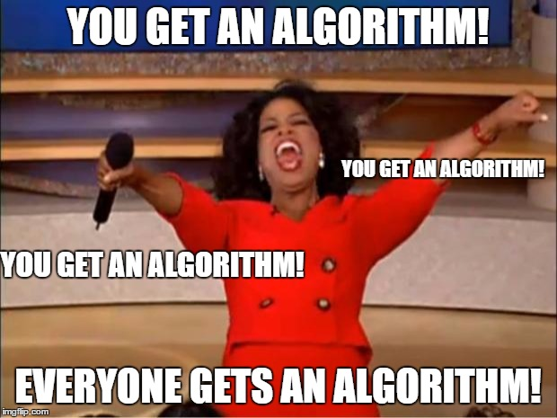
What is a model?
An model is a set of rules governing actions or phenomena.
Empirical Support without math
Your brain:
Algo#1: “fur” =Y, “tail”=Y, “claws”=Y, “meow”=Y therefore high probability that’s a cat
Algo#2: “another meme”=Y, “short & bald professor”=Y therefore “professor trying to hard to be cool”
Algorithms or mental models of reality can be correct or lead you to incorrect assumptions.

Slide 13
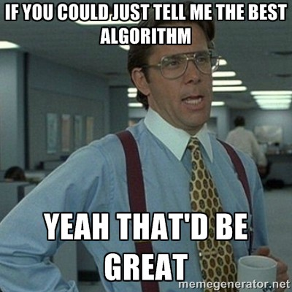
What is a model?
A model is a set of rules governing actions or phenomena.
Empirical Support w/math
The way you instruct the rules to be constructed is the algorithm (KNN, RF, LogReg etc)
Computers can learn complex representations of phenomena
Just like mental algorithms, the observations we give a mathematical algorithm which result in a final model (set of rules) can lead to correct or incorrect assumptions. “Garbage in…Garbage out.”

Slide 14
Vocabulary
What is an algorithm?
What is a model?
The method you choose to construct the model rules.
The way you expect to learn about reality.
A set of learned patterns describing phenomena.
Some representation of reality.
The algorithm produces the model.

Slide 15

Don’t be Dale!
Force stakeholders to agree on a problem, plan and output.
Put together a plan, adjust the plan as needed…but have a plan!!

Slide 16

Common Pitfalls
State the problem in business terms. Avoid open ended questions or just curiosity analysis.
Don’t measure things twice (multi-collinearity) like Celsius & Fahrenheit in the same data set
Understand data integrity & human behavior
Customers filling out surveys are already self selecting & therefore biased compared to all customers
The choice of what to measure will impact the human behavior ie AHT, or FCR
Beware of perfection
Perfectly aligned analyses and SME expectations seldom occur
Model perfection likely means you have an error
Beware of data leak & misunderstanding of the project!
Including flight ”cancel status” when predicting flight delays

Slide 17
Agenda
Start | End | Item
 |  | Data For Modeling
 |  | Data Mining Workflows
 |  | Data Modification & Preprocessing
 |  | Business Case: Donor Bureau
 |  | Housekeeping, Reading & Homework

Slide 18
Modeling Process
SEMMA (from SAS)
In this course…
1. Sample
In this course, most data sets are curated for you.
2. Explore
As part of your course analysis you perform basic exploratory data analysis (EDA)
3. Modify
Data cleanup, Dimension Reduction, Feature Engineering & Feature Enrichment
4. Model
5. Assess
Often data is sampled from a large database so you can more quickly explore, apply methods and prototype before reassessing on full data.

Slide 19
PreProcessing
Many algorithms cannot accept the data directly.
Thus you must preprocess your data before training.
Common Pre-Processing
Categorical Variables
Common Pre-Processing
Numeric Variables
Dummy Variables
Binning Low Frequency Levels
Changing to Numeric for Ordinal
Deal with Missing Levels
Deal with Missing
Outlier Detection
Binning
The book does these steps in a traditional manner but we will use an easier method called variable treatment (vtreat). Review the book if you want to see the manual methods.

Slide 20

Dummy Variables
Always “1 Less than the State of Nature”
2 States of Nature = 1 Light Switch or “dummy variable”
Dog or Cat needs one column where dog =1, cat=0
If the column has a 0 then its a cat.
Represent non-numeric information as light switches.
Kwartler CSCI 96

Slide 21

Dummy Variables
Always “1 Less than the State of Nature”
3 States of Nature = 2 Light Switches or “dummy variables”
If both columns are 0 then by default, this is the same information as the row having a fish.
Dog | Cat
1 | 0
0 | 1
0 | 0
Represent non-numeric information as light switches.
Kwartler CSCI 96

Slide 22

Dummy Variables
Dummy Variables represent category levels as 1/0 within new vectors. For some approaches, this lets the algorithm understand the information.
Consider this data:
CuID | Gender | Profession | Affiliation
CU43E439 | Male | Nurse | Democrat
CU36E506 | Male | Teacher | Independent
CU91E65 | Female | Manager | Republican
CU17E255 | Male | Student | Democrat
CU27E792 | Female | Executive
CU74E430 | Female | Manager | Republican
CU25E466 | Female | Teacher | Democrat
Kwartler CSCI 96

Slide 23
Dummy Variables
Dummy Variables represent category levels as 1/0 within new vectors. For some approaches, this lets the algorithm understand the information.
Consider this data:
Through EDA you realize:
CuID | Gender | Profession | Affiliation
CU43E439 | Male | Nurse | Democrat
CU36E506 | Male | Teacher | Independent
CU91E65 | Female | Manager | Republican
CU17E255 | Male | Student | Democrat
CU27E792 | Female | Executive
CU74E430 | Female | Manager | Republican
CU25E466 | Female | Teacher | Democrat
You wouldn’t use the ID var for training
Gender has 2 levels
Profession has 5 levels
Affiliation has 3 levels & missing
Kwartler CSCI 96

Slide 24
Dummy Variables
Always make dummy variables “1 less than the state of the data nature”
Consider this data:
CuID | Gender | Profession | Affiliation
CU43E439 | Male | Nurse | Democrat
CU36E506 | Male | Teacher | Independent
CU91E65 | Female | Manager | Republican
CU17E255 | Male | Student | Democrat
CU27E792 | Female | Executive
CU74E430 | Female | Manager | Republican
CU25E466 | Female | Teacher | Democrat
CuID | Gender__Male | Profession_Nurse | Profession_Teacher | Profession_Manager | Profession_Student | Affiliation_D | Affiliation_I | Affiliation_Missing
CU43E439 | 1 | 1 | 0 | 0 | 0 | 1 | 0 | 0
CU36E506 | 1 | 0 | 1 | 0 | 0 | 0 | 1 | 0
CU91E65 | 0 | 0 | 0 | 1 | 0 | 0 | 0 | 0
CU17E255 | 1 | 0 | 0 | 0 | 1 | 1 | 0 | 0
CU27E792 | 0 | 0 | 0 | 0 | 0 | 0 | 0 | 1
CU74E430 | 0 | 0 | 0 | 1 | 0 | 0 | 0 | 0
CU25E466 | 0 | 0 | 1 | 0 | 0 | 1 | 0 | 0
A light switch has 2 states, on/off, yet you only need 1 switch. The same is true as more levels are added, you don’t need one for each level.
Kwartler CSCI 96
Notes:
Multicolinearity – counting things twice, algo understands all 0’s represents a piece of information.
Missing “flag” - often has a hidden meaning such as data integrity or data collection. Sometimes these issues are systematic & informative

Slide 25
Dummy Variables
Always make dummy variables “1 less than the state of the data nature”
Dummy Data:
CuID | Gender__Male | Profession_Nurse | Profession_Teacher | Profession_Manager | Profession_Student | Affiliation_D | Affiliation_I | Affiliation_Missing
CU43E439 | 1 | 1 | 0 | 0 | 0 | 1 | 0 | 0
CU36E506 | 1 | 0 | 1 | 0 | 0 | 0 | 1 | 0
CU91E65 | 0 | 0 | 0 | 1 | 0 | 0 | 0 | 0
CU17E255 | 1 | 0 | 0 | 0 | 1 | 1 | 0 | 0
CU27E792 | 0 | 0 | 0 | 0 | 0 | 0 | 0 | 1
CU74E430 | 0 | 0 | 0 | 1 | 0 | 0 | 0 | 0
CU25E466 | 0 | 0 | 1 | 0 | 0 | 1 | 0 | 0
Applying Judgment:
CuID | Gender__Male | Profession_LowCount | Profession_Teacher | Profession_Manager | Affiliation_D | Affiliation_IndependentMissing
CU43E439 | 1 | 1 | 0 | 0 | 1 | 0
CU36E506 | 1 | 0 | 1 | 0 | 0 | 1
CU91E65 | 0 | 0 | 0 | 1 | 0 | 0
CU17E255 | 1 | 1 | 0 | 0 | 1 | 0
CU27E792 | 0 | 0 | 0 | 0 | 0 | 1
CU74E430 | 0 | 0 | 0 | 1 | 0 | 0
CU25E466 | 0 | 0 | 1 | 0 | 1 | 0
Never throw the “kitchen sink” at an algo, exercise your problem knowledge to reduce the number of vectors.
Kwartler CSCI 96
Notes:
Perhaps you can combine independent voters with someone that didn’t register.

Slide 26
Numeric Variables
Numeric variables need to be examined, corrected and missing flags need to be created.
Consider this data:
With domain expertise you realize:
Model | mpg | cyl | disp | hp | drat | wt | qsec
Mazda RX4 | 21 | 6 | 160 | 110 | 3.9 | 2.62
Mazda RX4 Wag | 21 | 6 | 160 | -110 | 3.9 | 2.875 | 17.02
Datsun 710 | 122.8 | NA | 108 | 93 | 3.85 | 2.32 | 18.61
Hornet 4 Drive | 21.4 | 6 | 258 | 110 | 3.08 | 3.215 | 19.44
Hornet Sportabout | 18.7 | 8 | ? | 175 | 3.15 | 3.44 | 17.02
Valiant | 18.1 | 6 | 225 | 105 | 2.76 | NA | 20.22
Duster 360 | 14.3 | 8 | 360 | 245 | 3.21 | 3.57 | 15.84
Merc 240D | 24.4 | 4 | 146.7 | 62 | 3.69 | 3.19
Merc 230 | 22.8 | 4 | 140.8 | 95 | 3.92 | 3.15 | 22.9
Merc 280 | 19.2 | 6 | 167.6 | 123 | 3.92 | 3.44 | 18.3
Its unlikely a car has 122mpg
No way -110 horsepower!
Through EDA you realize:
Missing values are blank, NA, and “?”
Kwartler CSCI 96

Slide 27
Outlier Numeric Variables
Outliers can be removed or the values can be replaced with imputation.
Consider this data:
Drop a row if:
You have many other records for training
The record contains multiple integrity issues
Model | mpg | cyl | disp | hp | drat | wt | qsec
Mazda RX4 | 21 | 6 | 160 | 110 | 3.9 | 2.62
Mazda RX4 Wag | 21 | 6 | 160 | -110 | 3.9 | 2.875 | 17.02
Datsun 710 | 122.8 | NA | 108 | 93 | 3.85 | 2.32 | 18.61
Hornet 4 Drive | 21.4 | 6 | 258 | 110 | 3.08 | 3.215 | 19.44
Hornet Sportabout | 18.7 | 8 | ? | 175 | 3.15 | 3.44 | 17.02
Valiant | 18.1 | 6 | 225 | 105 | 2.76 | NA | 20.22
Duster 360 | 14.3 | 8 | 360 | 245 | 3.21 | 3.57 | 15.84
Merc 240D | 24.4 | 4 | 146.7 | 62 | 3.69 | 3.19
Merc 230 | 22.8 | 4 | 140.8 | 95 | 3.92 | 3.15 | 22.9
Merc 280 | 19.2 | 6 | 167.6 | 123 | 3.92 | 3.44 | 18.3
Impute (use a method to change the value):
Hotdeck – choose a random value in the vector say 19.2
Mean Imputation – mean avg of vector
Median Imputation – median avg
Train an algorithm to fill in the values (KNN)
Kwartler CSCI 96
Notes:
Document document document!!

Slide 28
Detecting Outliers
An outlier is an observation that is “extreme”, being distant from the rest of the data (definition of “distant” is deliberately vague)
Outliers can have disproportionate influence on models
An important step in data pre-processing/EDA is detecting outliers
Once detected, domain knowledge is required to determine if it is an error, or truly extreme.
Correct them to a more normal (avg) value?
Remove the record altogether?
In the OK Cupid data, what to do with income >$1m or age > 90?
Kwartler CSCI 96

Slide 29
Detecting Outliers
In some contexts, finding outliers is the purpose of the DM exercise (airport security screening). This is called “anomaly detection”.
Kwartler CSCI 96

Slide 30
Missing Numeric Variables
Imputation is a best practice over to fill in for missing numeric values. Usually start with an easy method like mean imputation.
Drop a row if:
You have many other records for training
The record contains multiple integrity issues
Model | mpg | FixMPG
Mazda RX4 | 21 | 0
Mazda RX4 Wag | 21 | 0
Datsun 710 | 20.1 | 1
Hornet 4 Drive | 21.4 | 0
Hornet Sportabout | 18.7 | 0
Valiant | 18.1 | 0
Duster 360 | 14.3 | 0
Merc 240D | 24.4 | 0
Merc 230 | 22.8 | 0
Merc 280 | 19.2 | 0
Impute (use a method to change the value):
Hotdeck
Mean
Median
Algorithm (KNN)
Kwartler CSCI 96
Notes:
Changed mpg to mean avg
Document document document
add flag

Slide 31
Original Data
Imputation through domain expertise can be VERY time consuming but is sometimes worth it though not often.
Model | mpg | cyl | disp | hp | drat | wt | qsec
Mazda RX4 | 21 | 6 | 160 | 110 | 3.9 | 2.62
Mazda RX4 Wag | 21 | 6 | 160 | -110 | 3.9 | 2.875 | 17.02
Datsun 710 | 122.8 | NA | 108 | 93 | 3.85 | 2.32 | 18.61
Hornet 4 Drive | 21.4 | 6 | 258 | 110 | 3.08 | 3.215 | 19.44
Hornet Sportabout | 18.7 | 8 | ? | 175 | 3.15 | 3.44 | 17.02
Valiant | 18.1 | 6 | 225 | 105 | 2.76 | NA | 20.22
Duster 360 | 14.3 | 8 | 360 | 245 | 3.21 | 3.57 | 15.84
Merc 240D | 24.4 | 4 | 146.7 | 62 | 3.69 | 3.19
Merc 230 | 22.8 | 4 | 140.8 | 95 | 3.92 | 3.15 | 22.9
Merc 280 | 19.2 | 6 | 167.6 | 123 | 3.92 | 3.44 | 18.3
Drop a row if:
You have many other records for training
The record contains multiple integrity issues
Impute (use a method to change the value):
Hotdeck
Mean
Median
Algorithm (KNN)
Kwartler CSCI 96
Notes:
Document document document!!

Slide 32
Missing Numeric Variables
Imputation through domain expertise can be VERY time consuming but is sometimes worth it though not often.
Consider this data:
Model | mpg | cyl | disp | hp | drat | wt | qsec
Mazda RX4 | 21 | 6 | 160 | 110 | 3.9 | 2.62 | 17.02
Mazda RX4 Wag | 21 | 6 | 160 | 110 | 3.9 | 2.875 | 17.02
Datsun 710 | 20.1 | 8 | 108 | 93 | 3.85 | 2.32 | 18.61
Hornet 4 Drive | 21.4 | 6 | 258 | 110 | 3.08 | 3.215 | 19.44
Hornet Sportabout | 18.7 | 8 | 146.7 | 175 | 3.15 | 3.44 | 17.02
Valiant | 18.1 | 6 | 225 | 105 | 2.76 | 3.15 | 20.22
Duster 360 | 14.3 | 8 | 360 | 245 | 3.21 | 3.57 | 15.84
Merc 240D | 24.4 | 4 | 146.7 | 62 | 3.69 | 3.19 | 22.9
Merc 230 | 22.8 | 4 | 140.8 | 95 | 3.92 | 3.15 | 22.9
Merc 280 | 19.2 | 6 | 167.6 | 123 | 3.92 | 3.44 | 18.3
Impute (use a method to change the value):
-110 looks like a data entry issue & other Mazda has 110.
Mean Imputation
146.7 is the average for the column
…
Kwartler CSCI 96
Notes:
Hotdeck for disp hp and wt
Document document document
add flag

Slide 33
Missing Flags
Add missing indicator dummy variables similar to the categorical exercise.
Consider this data:
Model | mpg | cyl | disp | hp | drat | wt | qsec | missingMPG | missingCyl | missingDisp | Adjust_HP | missingWT | missingQSec
Mazda RX4 | 21 | 6 | 160 | 110 | 3.9 | 2.62 | 17.02 | 0 | 0 | 0 | 0 | 0 | 1
Mazda RX4 Wag | 21 | 6 | 160 | 110 | 3.9 | 2.875 | 17.02 | 0 | 0 | 0 | 1 | 0 | 0
Datsun 710 | 20.1 | 8 | 108 | 93 | 3.85 | 2.32 | 18.61 | 1 | 1 | 0 | 0 | 0 | 0
Hornet 4 Drive | 21.4 | 6 | 258 | 110 | 3.08 | 3.215 | 19.44 | 0 | 0 | 0 | 0 | 0 | 0
Hornet Sportabout | 18.7 | 8 | 146.7 | 175 | 3.15 | 3.44 | 17.02 | 0 | 0 | 1 | 0 | 0 | 0
Valiant | 18.1 | 6 | 225 | 105 | 2.76 | 3.15 | 20.22 | 0 | 0 | 0 | 0 | 1 | 0
Duster 360 | 14.3 | 8 | 360 | 245 | 3.21 | 3.57 | 15.84 | 0 | 0 | 0 | 0 | 0 | 0
Merc 240D | 24.4 | 4 | 146.7 | 62 | 3.69 | 3.19 | 22.9 | 0 | 0 | 0 | 0 | 0 | 1
Merc 230 | 22.8 | 4 | 140.8 | 95 | 3.92 | 3.15 | 22.9 | 0 | 0 | 0 | 0 | 0 | 0
Merc 280 | 19.2 | 6 | 167.6 | 123 | 3.92 | 3.44 | 18.3 | 0 | 0 | 0 | 0 | 0 | 0
Kwartler CSCI 96
Notes:
Hotdeck for disp hp and wt
Document document document
add flag

Slide 34

Feature Engineering- Still Pre-Processing!!
Once you have your data identified, collected and organized, you may want to create new vectors using existing data to aid the analysis.
Feature engineering or “feature crossing” is the act of using existing data to form new data inputs for analysis. For example, dividing one data point by another to derive a new data point.
Kwartler CSCI 96

Slide 35
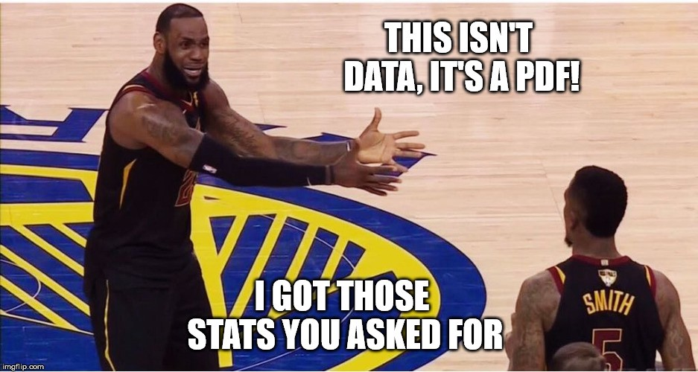
What is Feature Engineering?
Using qualitative or technical expertise to derive new features for machine learning.
Example
Using regular season stats predict the championship outcome:
Raw Data:
Total Rebounds (2017-18): 2749
Total Games: 56
LBJ triple doubles: 10
Engineered
Name | Value | Type | Reasoning
Rebounds per Game | 41 | Technical | Simple ratio of two team level stats
Percent of Games that Lebron James has a “triple double” | 10/56 = 17.8% | Qualitative | Capturing information about the best player’s performance e.g. getting double digit stats in 3 of assists, blocks, points, rebounds, or steals
Kwartler CSCI 96

Slide 36
Why is Feature Engineering Effective?
Using qualitative or technical expertise to derive new features for machine learning.
$$f\left(Modeling Results\right)=the Algo+Parameters+Data provided$$
Better features means flexibility.
less than optimal models can still yield good results
Better features means simpler models.
less than optimal parameters can still yield good results
Better features means better results.
“The algorithms we used are very standard for Kagglers. We spent most of our efforts in feature engineering.” Xavier Conort describing his winning “Flight Quest” submission for $250,000 prize
Way to differentiate & squeeze out more accuracy
Kwartler CSCI 96

Slide 37
Example Feature Engineering Methods
library(vtreat)
Automatic variable treatment functions
library(acepack)
Alternating conditional expectations for feature importance
Hand-Coded Variables
Subject Matter Experts tell you which variables to interact
Dimension Reduction - PCA
Principle component analysis
Grey not covered
Kwartler CSCI 96

Slide 38
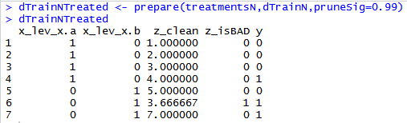

Variable Treatment: library(vtreat)
Vtreat automates some data cleaning, imputation and engineers specific response encoded variables.
Step 3
treatmentsN <- designTreatmentsN(...)
“Prepare” Data into a treated Modeling Matrix
Step 2
“Design Treatment” - Categorical or Numeric outcome
Step 1
Organize Informative Data
Kwartler CSCI 96

Slide 39
Vtreat adjusts data in many ways.
Action | Type | Description
Imputation | Cleaning | Na, Nan, Inf replacement
Imputation Indicator | Cleaning | Append a binary column as imputation flag
Dummy Variables | Cleaning | Create dummy variables for categorical variables
Constant Attribute Suppression | Cleaning | Remove variables with a single value.
Level Deviation –”cat_D” | Engineering | A “deviation fact” about a categorical level. Tells us if ‘y’ is concentrated or diffuse when conditioned on the observed level of the original categorical variable.
Level Prevalence- “cat_P” | Engineering | A “prevalence fact” about a categorical level. Tells us if the original level was rare or common.
Estimated Single Variable Effects – “cat_B” = categorical outcome w/Bayesian “cat_N” = numeric outcome w/Regression | Engineering | A single variable Bayesian model of the change in logit-odds in outcome from mean distribution conditioned on the observed value of the original variable. A single variable regression model of the difference in outcome expectation conditioned on the observed value of the original variable.
Rare Cats* | Engineering | For categorical levels below a frequency threshold, pool different levels into a common “rare-level” variable
Kwartler CSCI 96
Notes:
Does NOT check for co-linear variables
Does not perform outlier suppression

Slide 40

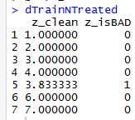
Mean Imputation - PreProcessing
Most of the time we will use vtreat to clean data…its faster and easier.
Vtreat Actions | Common Name
NA, NAN, and Infinity replaced with mean | Mean imputation
When a numeric value is missing
Replace that value with the mean average
Not applicable for categorical variables
Design a treatment plan and apply it.
Kwartler CSCI 96

Slide 41
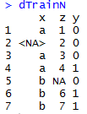
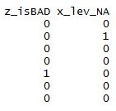
Missing Flags- PreProcessing
Vtreat Actions | Common Name
Indicator | Missing indicator
When a numeric value is missing
Add a missing flag variable
When a factor level is missing
Add a missing flag variable
Design a treatment plan and apply it.
Kwartler CSCI 96

Slide 42

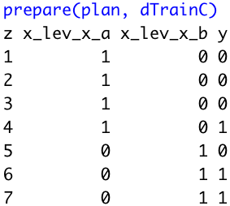
Dummy Variables - PreProcessing
Vtreat Actions | Common Name
Indicator variables | Dummy variable
Not applicable for numeric values
For each factor level, will create dummy variables.
Design a treatment plan and apply it.
Beware! Since some algorithms don’t care, vtreat will return ALL dummy variables and not drop one to represent all 0s.
Kwartler CSCI 96

Slide 43
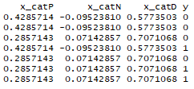

Vtreat Engineered CAT Variables Example
Simple Calculations
The propensity of A to Y=1 is less than average Y’s occurence
CatN (Numeric):
X equals A & Y equals 1: (1/3) minus
Overall Y value equals 1: (3/7)
= -0.0952381
Step 3*
“Prepare” Data into a treated Modeling Matrix
*abridged data shown
Step 2
“Design Treatment” - Categorical or Numeric
treatmentsN <- designTreatmentsN(...)
Step 1
Organize a Modeling Matrix
Kwartler CSCI 96

Slide 44
Vtreat Engineered CAT Variables Example
Simple Calculations
The standard deviation of Y for level B captures the relationship’s distribution
CatD (Deviation):
Level B sd(c(0,1)) = 0.7071068
Step 3*
“Prepare” Data into a treated Modeling Matrix
*abridged data shown
Step 2
“Design Treatment” - Categorical or Numeric
treatmentsN <- designTreatmentsN(...)
Step 1
Organize a Modeling Matrix
Kwartler CSCI 96

Slide 45
Vtreat Engineered CAT Variables Example
Simple Calculations
How prevelant is C among all observations i.e. is it a rare event?
Cat P (Prevalence):
Level C Occurred (2/7) = 0.2857143
Step 3*
“Prepare” Data into a treated Modeling Matrix
*abridged data shown
Step 2
“Design Treatment” - Categorical or Numeric
treatmentsN <- designTreatmentsN(...)
Step 1
Organize a Modeling Matrix
Kwartler CSCI 96

Slide 46

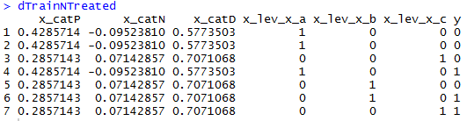
Non-Informative Check
Vtreat Actions | Common Name
Constant/Near Constant | Suppress uninformative variables
Z is automatically dropped.
In this fake example, since z contains a constant value an algorithm can’t learn from it.
Kwartler CSCI 96

Slide 47
Vtreat summary
Original Data
Design a Treatment Plan
Apply the plan to the original and test sets
Get data ready for modeling
When specifying a plan you need to pass in :
The Data
The column names of informative variables.
The name of the Y or Response Variable.
Best Practices:
Almost always drop cat_D variables
When possible design a treatment plan on separate data than the training & test sets
Review the output to ensure coherence, its not a free automated lunch!
Kwartler CSCI 96

Slide 48
REVIEW: Informative Variables
Vtreat does NOT need the IDs or variables that aren’t “informative”
name | mfr | type | calories | protein | fat | sodium | fiber | carbo | sugars | potass | vitamins | shelf | weight | cups | rating
100%_Bran | N | C | 70 | 4 | 1 | 130 | 10 | 5 | 6 | 280 | 25 | 3 | 1 | 0.33 | 68.40297
100%_Natural_Bran | Q | C | 120 | 3 | 5 | 15 | 2 | 8 | 8 | 135 | 0 | 3 | 1 | 1 | 33.98368
All-Bran | K | C | 70 | 4 | 1 | 260 | 9 | 7 | 5 | 320 | 25 | 3 | 1 | 0.33 | 59.42551
All-Bran_with_Extra_Fiber | K | C | 50 | 4 | 0 | 140 | 14 | 8 | 0 | 330 | 25 | 3 | 1 | 0.5 | 93.70491
Almond_Delight | R | C | 110 | 2 | 2 | 200 | 1 | 14 | 8 |  | 25 | 3 | 1 | 0.75 | 34.38484
Apple_Cinnamon_Cheerios | G | C | 110 | 2 | 2 | 180 | 1.5 | 10.5 | 10 | 70 | 25 | 1 | 1 | 0.75 | 29.50954
Apple_Jacks | K | C | 110 | 2 | 0 | 125 | 1 | 11 | 14 | 30 | 25 | 2 | 1 | 1 | 33.17409
Basic_4 | G | C | 130 | 3 | 2 | 210 | 2 | 18 | 8 | 100 | 25 | 3 | 1.33 | 0.75 | 37.03856
Bran_Chex | R | C | 90 | 2 | 1 | 200 | 4 | 15 | 6 | 125 | 25 | 1 | 1 | 0.67 | 49.12025
Bran_Flakes | P | C | 90 | 3 | 0 | 210 | 5 | 13 | 5 | 190 | 25 | 3 | 1 | 0.67 | 53.31381
Cap'n'Crunch | Q | C | 120 | 1 | 2 | 220 | 0 | 12 | 12 | 35 | 25 | 2 | 1 | 0.75 | 18.04285
Kwartler CSCI 96

Slide 49
REVIEW: Informative Variables
Vtreat needs these names
name | mfr | type | calories | protein | fat | sodium | fiber | carbo | sugars | potass | vitamins | shelf | weight | cups | rating
100%_Bran | N | C | 70 | 4 | 1 | 130 | 10 | 5 | 6 | 280 | 25 | 3 | 1 | 0.33 | 68.40297
100%_Natural_Bran | Q | C | 120 | 3 | 5 | 15 | 2 | 8 | 8 | 135 | 0 | 3 | 1 | 1 | 33.98368
All-Bran | K | C | 70 | 4 | 1 | 260 | 9 | 7 | 5 | 320 | 25 | 3 | 1 | 0.33 | 59.42551
All-Bran_with_Extra_Fiber | K | C | 50 | 4 | 0 | 140 | 14 | 8 | 0 | 330 | 25 | 3 | 1 | 0.5 | 93.70491
Almond_Delight | R | C | 110 | 2 | 2 | 200 | 1 | 14 | 8 |  | 25 | 3 | 1 | 0.75 | 34.38484
Apple_Cinnamon_Cheerios | G | C | 110 | 2 | 2 | 180 | 1.5 | 10.5 | 10 | 70 | 25 | 1 | 1 | 0.75 | 29.50954
Apple_Jacks | K | C | 110 | 2 | 0 | 125 | 1 | 11 | 14 | 30 | 25 | 2 | 1 | 1 | 33.17409
Basic_4 | G | C | 130 | 3 | 2 | 210 | 2 | 18 | 8 | 100 | 25 | 3 | 1.33 | 0.75 | 37.03856
Bran_Chex | R | C | 90 | 2 | 1 | 200 | 4 | 15 | 6 | 125 | 25 | 1 | 1 | 0.67 | 49.12025
Bran_Flakes | P | C | 90 | 3 | 0 | 210 | 5 | 13 | 5 | 190 | 25 | 3 | 1 | 0.67 | 53.31381
Cap'n'Crunch | Q | C | 120 | 1 | 2 | 220 | 0 | 12 | 12 | 35 | 25 | 2 | 1 | 0.75 | 18.04285
Kwartler CSCI 96

Slide 50
REVIEW: Outcome/Target Variable
Vtreat needs this name as the outcome.
name | mfr | type | calories | protein | fat | sodium | fiber | carbo | sugars | potass | vitamins | shelf | weight | cups | rating
100%_Bran | N | C | 70 | 4 | 1 | 130 | 10 | 5 | 6 | 280 | 25 | 3 | 1 | 0.33 | 68.40297
100%_Natural_Bran | Q | C | 120 | 3 | 5 | 15 | 2 | 8 | 8 | 135 | 0 | 3 | 1 | 1 | 33.98368
All-Bran | K | C | 70 | 4 | 1 | 260 | 9 | 7 | 5 | 320 | 25 | 3 | 1 | 0.33 | 59.42551
All-Bran_with_Extra_Fiber | K | C | 50 | 4 | 0 | 140 | 14 | 8 | 0 | 330 | 25 | 3 | 1 | 0.5 | 93.70491
Almond_Delight | R | C | 110 | 2 | 2 | 200 | 1 | 14 | 8 |  | 25 | 3 | 1 | 0.75 | 34.38484
Apple_Cinnamon_Cheerios | G | C | 110 | 2 | 2 | 180 | 1.5 | 10.5 | 10 | 70 | 25 | 1 | 1 | 0.75 | 29.50954
Apple_Jacks | K | C | 110 | 2 | 0 | 125 | 1 | 11 | 14 | 30 | 25 | 2 | 1 | 1 | 33.17409
Basic_4 | G | C | 130 | 3 | 2 | 210 | 2 | 18 | 8 | 100 | 25 | 3 | 1.33 | 0.75 | 37.03856
Bran_Chex | R | C | 90 | 2 | 1 | 200 | 4 | 15 | 6 | 125 | 25 | 1 | 1 | 0.67 | 49.12025
Bran_Flakes | P | C | 90 | 3 | 0 | 210 | 5 | 13 | 5 | 190 | 25 | 3 | 1 | 0.67 | 53.31381
Cap'n'Crunch | Q | C | 120 | 1 | 2 | 220 | 0 | 12 | 12 | 35 | 25 | 2 | 1 | 0.75 | 18.04285
Kwartler CSCI 96

Slide 51
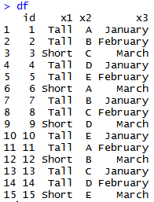
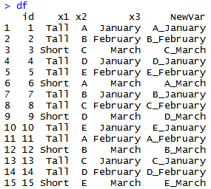
Engineering: SME – Factor Level Interactions
Domain Specific Knowledge can be applied to factors to create new variables.
Example Data w/Factors
If we believe x2 & x3
have a qualitative interaction
Then concatenating the variables
could help the algo learn faster
With factors, you combine by concatenating the levels, capturing the information contained in both variables like “hair” and ”gender” to create a new variable “hair_gender” with a possible level like “bald_male”,or “brown_male”
Kwartler CSCI 96

Slide 52
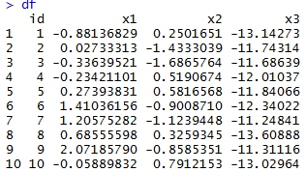
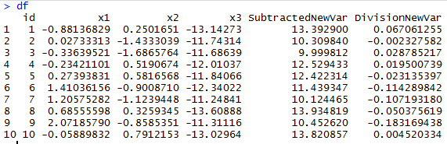
Engineering: SME – Numeric Interactions
Domain Specific Knowledge can be applied to numeric variables to create new variables.
If we believe x2 & x3
have a qualitative interaction
Then interacting them with simple operators
Such as subtraction or division may help the
Algorithm learn faster
Example Data w/Numeric Vectors
X1
X3
Div. New Var
In sports, variables like “turnovers per game” are expert led engineered variables or in airlines “revenue per mile. “per” is interaction through division of two seasonal level statistics.
Kwartler CSCI 96

Slide 53
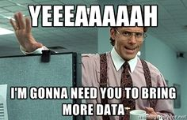
Feature Enrichment
When training a model you can
Add more training records
Find more rows!
OR
Add more information
Find more columns!
Kwartler CSCI 96

Slide 54
Why is Feature Enrichment Effective?
Using qualitative or technical expertise to derive new features for machine learning.
$$f\left(Modeling Results\right)=the Algo+Parameters+Data provided$$
Better features means flexibility.
less than optimal models can still yield good results
Betters features means simpler models.
less than optimal parameters can still yield good results
Better features means better results.
“The algorithms we used are very standard for Kagglers. We spent most of our efforts in feature engineering.” Xavier Conort describing his winning “Flight Quest” submission
Way to differentiate & squeeze out more accuracy
Kwartler CSCI 96

Slide 55
Data Enrichment aids Model Performance
Feature Enrichment is the act of adding new information to your dataset. You are enriching your existing data, often with public or 3rd party data.
Existing Data
New Data
There are limits to what an organization has internally for data.
Companies exist solely to enrich data sources.
Kwartler CSCI 96

Slide 56
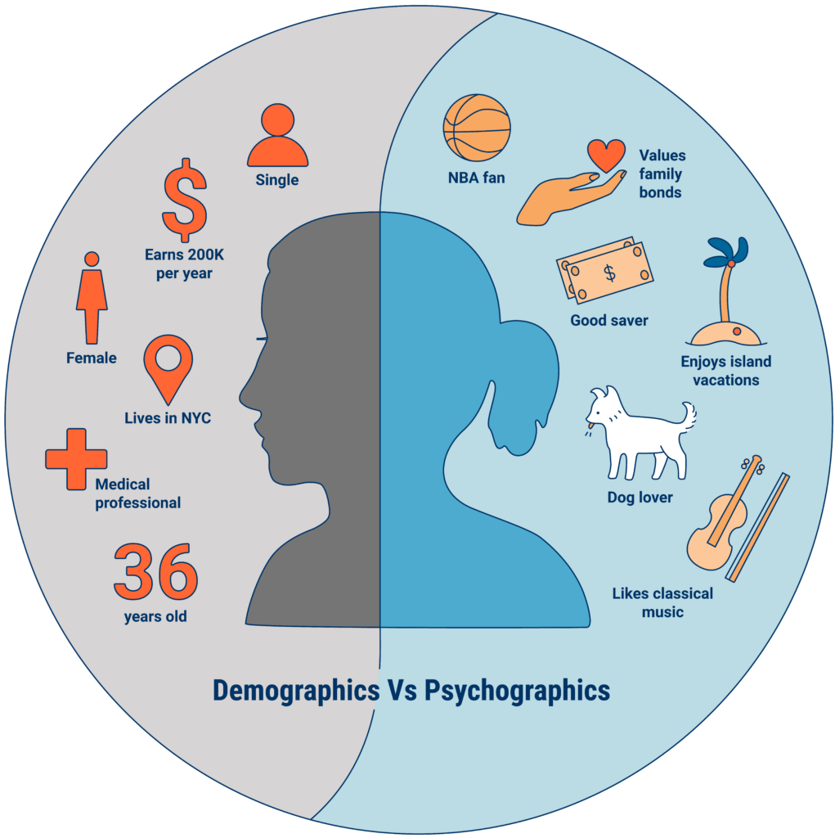
An example of Data Enrichment
They could buy data about employees to have a more complete picture.
An organization may collect some information about employees during interactions.
https://www.cbinsights.com/research/what-is-psychographics/
Kwartler CSCI 96

Slide 57


Modeling with Feature Enrichment is Widespread
Used social media information of individual and friends to model voting tendencies
Uses 3rd party data to predict if a household member has diabetes for marketing.
Most consumers are not aware the type and amount of data that is available about them.
Kwartler CSCI 96

Slide 58

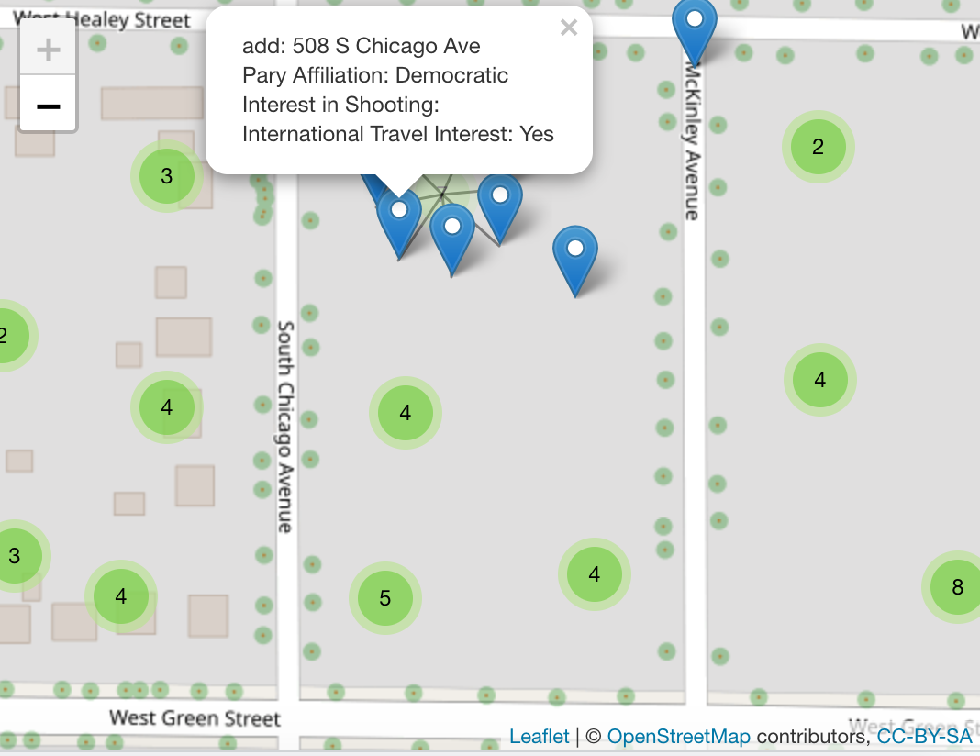
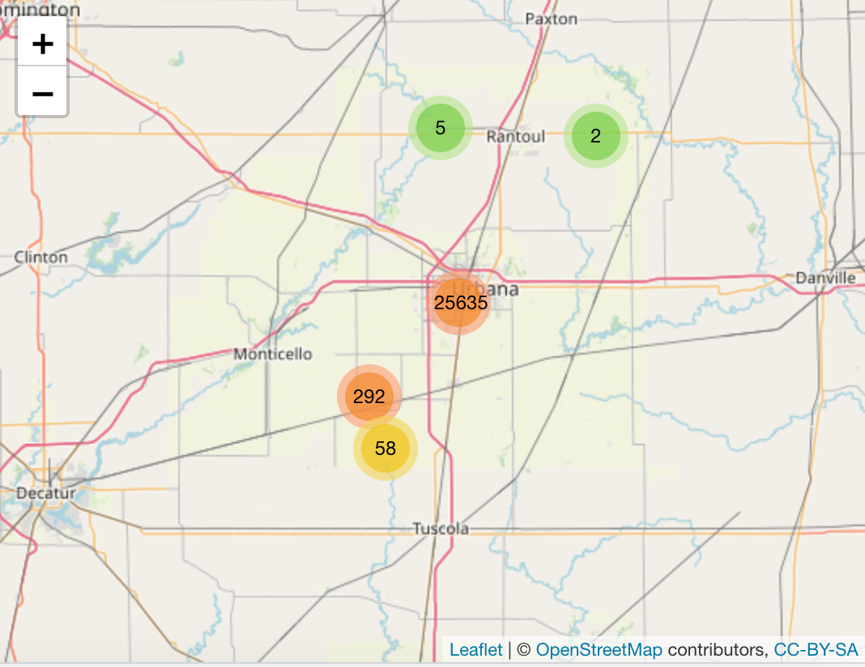
Additional Examples
26000 households in 1 Congressional District
550+ variables
$2500
Dynamic Map with any fields==10 lines of code!

Slide 59
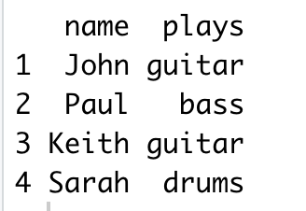
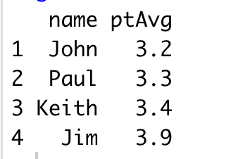
Feature Enrichment Requires a Join
X
Y
Instruments
Grades
Students playing instruments
Student Grades from Honors Science Class
It’s kind of like a vlookup…matching records from one table to another.
Kwartler CSCI 96
Notes:
Very common to append the existing data as the left side
Grades could have millions of more records than instruments table. The only rows that are kept are the instrument table X

Slide 60
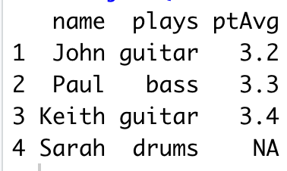
Left Join
Only students in band and honors science class get their grades appended. Band members not in honors science are retained but get “NA”
x
y
instruments
Grades
No Sarah
Return all rows from x where there are matching values in y, and all columns from x and y. If there are multiple matches between x and y, all combination of the matches are returned.
Kwartler CSCI 96
Notes:
Very common to append the existing data as the left side
Grades could have millions of more records than instruments table. The only rows that are kept are the instrument table X

Slide 61
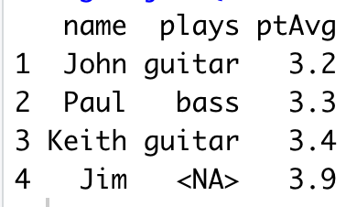
Right Join
Only students in honors science and band class get their instuments appended. Science students not in band science are retained but get “NA”
x
y
instruments
Grades
No Jim
Return all rows from y, and all columns from x and y. Rows in y with no match in x will have NA values in the new columns. If there are multiple matches between x and y, all combinations of the matches are returned.
Kwartler CSCI 96
Notes:
The reverse

Slide 62
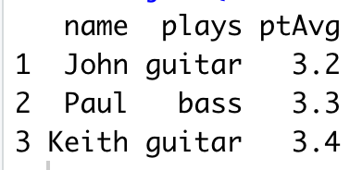
Inner Join
Only students in both band and honors science are retained. All others are dropped and no NAs appear.
x
y
instruments
Grades
No Jim
No Sarah
Return all rows from x where there are matching values in y, and all columns from x and y. If there are multiple matches between x and y, all combination of the matches are returned.
Kwartler CSCI 96
Notes:
What records are in common; say you have a potential mailing list and want to find your existing customers
Will do during text mining

Slide 63
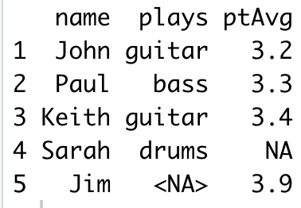
Full Join
All students are retained and NAs filled in as needed.
x
y
instruments
Grades
No Jim
No Sarah
Return all rows and all columns from both x and y. Where there are not matching values, returns NA for the one missing.
Kwartler CSCI 96
Notes:
What records are in common; say you have a potential mailing list and want to find your existing customers
Will do during text mining

Slide 64
Open A_Joins.R
Kwartler CSCI 96

Slide 65
Agenda
Start | End | Item
 |  | Review in Context
 |  | Data Mining Workflows
 |  | Data Modification & Preprocessing
 |  | Business Case: Donor Bureau
 |  | Housekeeping, Reading & Homework

Slide 66

Meet Donor Bureau
Kwartler CSCI 96

Slide 67
Company Overview
Founded in 2011
DonorBureau spun out of a direct mail agency
Works with non-profits to optimize their direct mail fundraising
Data Stats:
900M past mail transactions
140M past donations
40M individuals
Kwartler CSCI 96

Slide 68
Modeling Problem
Two modeling problems
What acquisition targets should NOT get mail?
What donor cultivation targets should get mail?
Acquisition modeling
Drop bottom 20% of list to be mailed
Goal is to have the top 80% gross twice as much as the bottom 20%
Cultivation modeling:
Add names to the monthly 10k piece cultivation mailings
Find 2k additional names per month to mail from a 40k donor file
Kwartler CSCI 96

Slide 69
Let’s Practice
Open B_DataPreProcessingEngineering:
Variable | Description
rowID | Appended Row ID - noninformative
uniqueID | Unique Identifier – noninformative
Zip | Zip code group to anonymize
Homeowner | Y/N if they own a hom
NUMCHLD | Number of children in house
Income | Household Income
Gender | M/F
Wealth | Wealth rating uses median family income and population statistics from each area to index relative wealth within each state. The segments are denoted 0-9, with 9 being the highest wealth group and zero being the lowest. Each rating has a different meaning within each state.
Variable | Description
HV | Avg Home Value in potential donor's neighborhood in hundreds of dollars.
Icmed | Median Income in potential donor's neighborhood in hundreds of dollars.
Icavg | Avg Family Income in potential donor's neighborhood in hundreds of dollars.
IC15 | % earning less than $15K in potential donor's neighborhood.
NUMPROM | Lifetime # of promotions received to date
RAMNTALL | Dollar amount of lifetime gifts to date.
MAXRAMNT | Dollar amount of largest gift to date.
LASTGIFT | Dollar amount of most recent gift.
TOTALMONTHS | Number of months from last donation
TIMELAG | Number of months between first and second gift.
AVGGIFT | Average dollar amount of gifts to date.
Y1_Donation | Y/N did they donate
Y2_DonatedAmt | Dollar Amt of donation
Kwartler CSCI 96
Notes:
2 identifier col
2 y binary and continuous

Slide 70
Agenda
Start | End | Item
 |  | Review in Context
 |  | Data Mining Workflows
 |  | Data Modification & Preprocessing
 |  | Business Case: Donor Bureau
 |  | Housekeeping, Reading & Homework
Kwartler CSCI 96

Slide 71
Housekeeping , Reading & Homework
Keep posting questions – your TAs need something to do!
Bik has posted about Labs.
Labs are not time to ask for unresearched code questions.
Chapter 6
OKCupid Case DUE (see syllabus)
All files including slides, code (if applicable for those using radiant.data & video

