Slide 1
Non-Traditional Market Making & Credit Risk Modeling

Slide 2

Consumer Credit - Lending Club
Consumers apply for loans & instead of bank funding, other consumers fund the loan by purchasing “notes” to receive the interest.
Peer to Peer funding for
Personal Loans
Auto Loans
Small Business Loans
Medical Loans
Everyday investors can accept the loan risk – making it a new banking distribution model
Consumer credit is a traditional market. There are defined inputs (credit score), consumer protections (usury laws), and established distribution (credit applications).

Slide 3
What’s the Risk?
Risk
Mitigation
Over exposure in a single loan
Diversify – Do not fund more than $25 on a single loan
Early payment reduces interest received
Monitor & re-invest monthly
Illiquid – notes are 36-60 months
Buy notes with 36m horizons
Default – debtors that stop paying
Model the probability of default

Slide 4
What’s the Reward?
Reward
Result
Interest is imposed by LC
Investors have no input to the % amount
Usually lower rates for the applicant
Lower capital cost for debtor
LC takes 1% of interest
Reduces reward incentive for investor
Remaining interest is paid monthly to note holders.
Investors act as banks & receive consistent returns

Slide 5
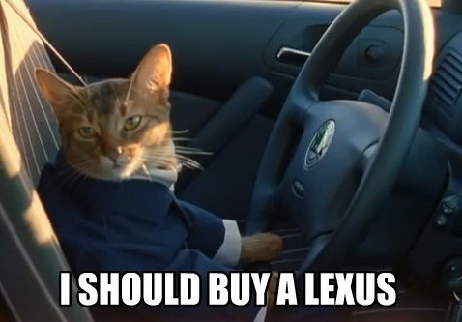
Example
Erin decides to buy a car. Instead of a traditional loan she applies at LC.
Erin applies for a $10k car loan
LC assesses her creditworthiness & posts a $10k loan @ 6% interest on the investor site.
Trish & hundreds of other LC investors fund the loan in $25 increments called “notes”
Each month Erin pays her loan, LC takes 1% and the investors make 5% on their outstanding notes.

Slide 6
Example
12+ yrs of historical performance – Over 1M notes publicly available
Some platform changes in that time
Datasets are updated monthly
Sampled to 20k – either in fully paid of charged off state; when doing it for real use more data
Loan Origination
36 or 60 Monthly Payments
Fully Paid
1 = Success Class
Transitional States of Nature:
Grace Period, late 30-60,60-90 days
Charged Off
0 = Failure Class
https://www.lendingclub.com/info/download-data.action

Slide 7
What is cross – validation?
This is a typical partitioning schema to avoid overfitting.
All Data
Training Data
Test Data
Notes:
No Cross Validation
No Feature Engineering

Slide 8
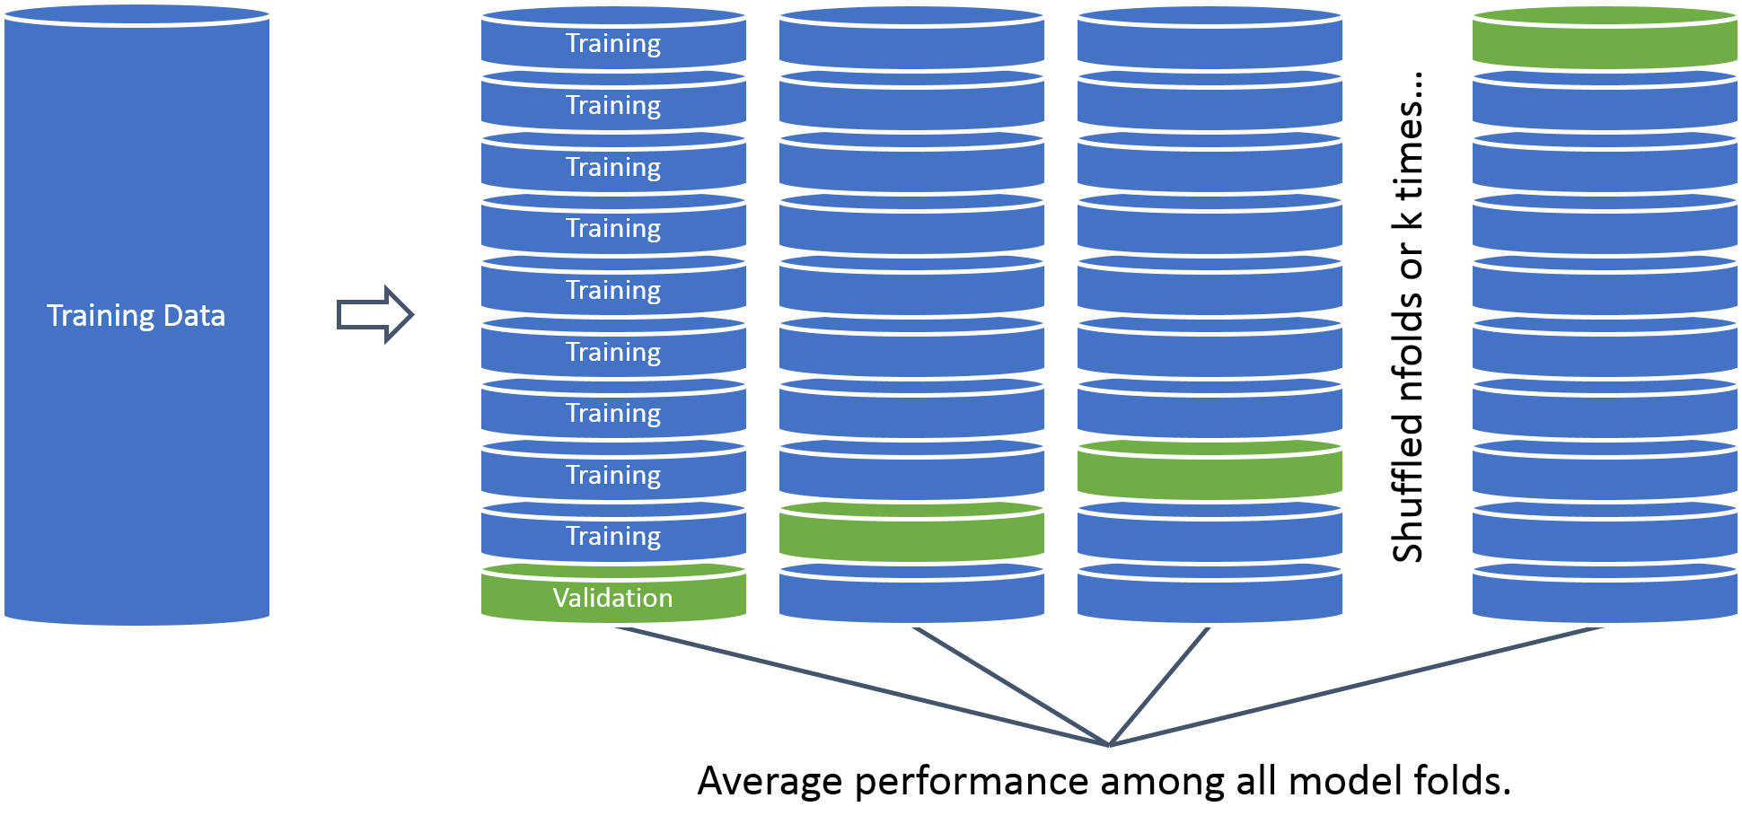
What is cross – validation?
In this example we will perform cross validation because the data set is only 20k records.

Slide 9
Cutoff Threshold
Is 0.50 the optimal cutoff?
Should we be equal weighted?
Do we care equally about picking paying notes and charged off loans?

Slide 10
Open A_ConsumerCreditTraining.R
Learning Objective:
Load in real lending club data
Treat the variables for modeling
Build a cross validated logistic regression with caret
Save model object & variable treatment plan

Slide 11
Agenda
Topic VI
Predicting Loan Defaults Lending Club Information Fit a model to the loan data & save as an example Fit a more validated model with new loans Visualize the loans in a dynamic plot Q & A

Slide 12
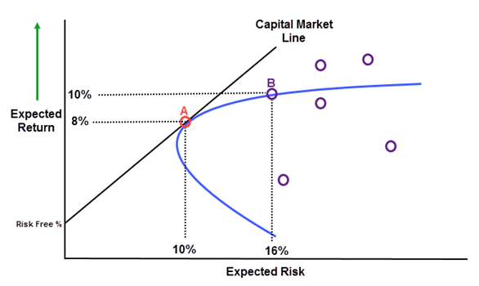
Making a CAPM style plot to understand risk/reward relationship & optimize choice.
T-Bill: usually 3 month

Slide 13
Open B_ConsumerCreditScoring.R
Learning Objective:
Score notes
Make a plot similar to CAPM & identify top loans to fund

Slide 14
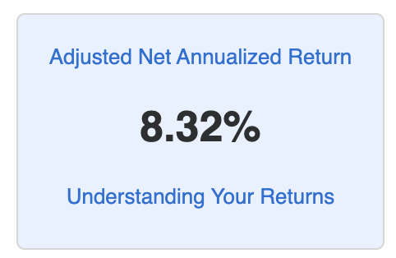
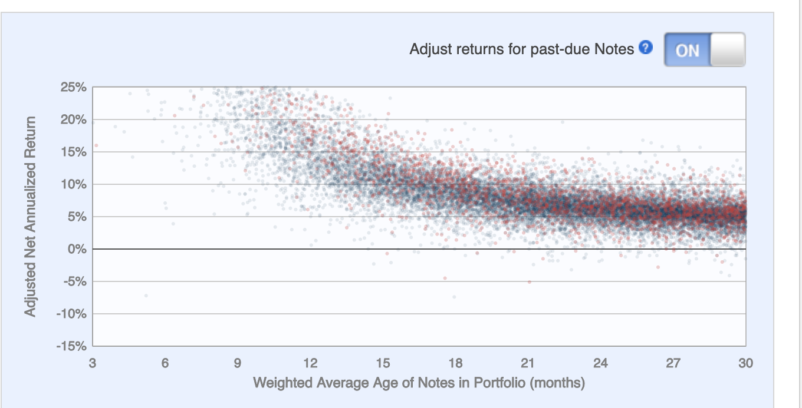
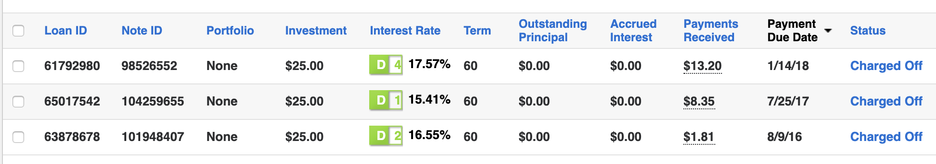
Actual Results using Models.

Slide 15
Agenda
Topic VII
Simulating a Non-Traditional Mkt Opportunity Review the trading card market as an investment vehicle Structure problem for analysis Sample with probability & simulate mkt buying to quantify risk Q & A

Slide 16
Non-Traditional Markets
Traditional
Non-Traditional
Crypto-currencies
Beanie Babies
Derivatives (originally)
Web Domains & Blogs
Shoes https://stockx.com/
…
Stock Markets
Bond Markets
Housing/Mortgages
Commodities – Gold, Silver etc.
Crop Futures
Consumer Credit
In contrast to traditional markets, emerging or non traditional markets lack transparency, regulations and can often be manipulated more easily.

Slide 17
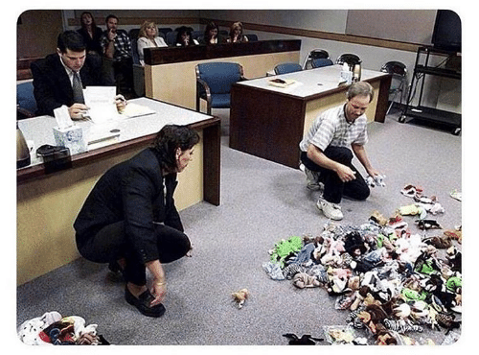
A Non-Traditional Mkt…

Slide 18
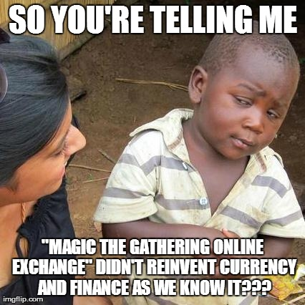

Another non-traditional Market Example
Owned by Hasbro, MTG is a 25 year old collectible trading card game. It is estimated that there are 8-12million players worldwide. Thus is it popular and has demonstrated longevity unlike other non-traditional markets.

Slide 19
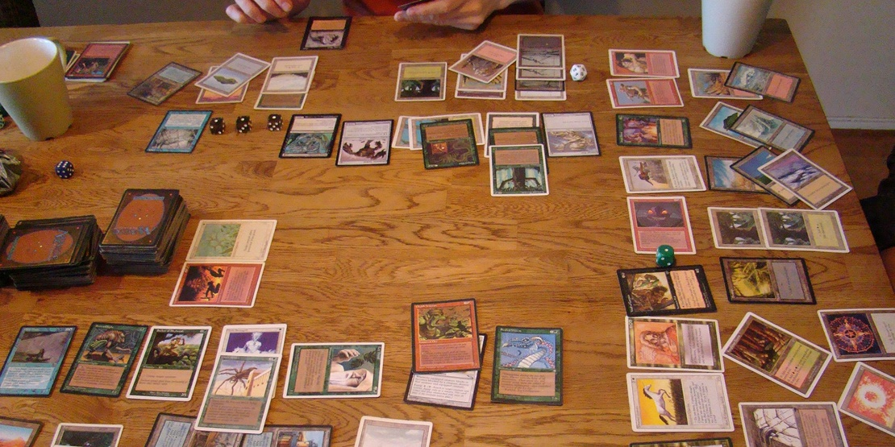
Magic The Gathering
Players create 60 card decks with cards of different abilities for a duel. Cards are fantasy based with creatures, sorceries, and mythical artifacts.

Slide 20
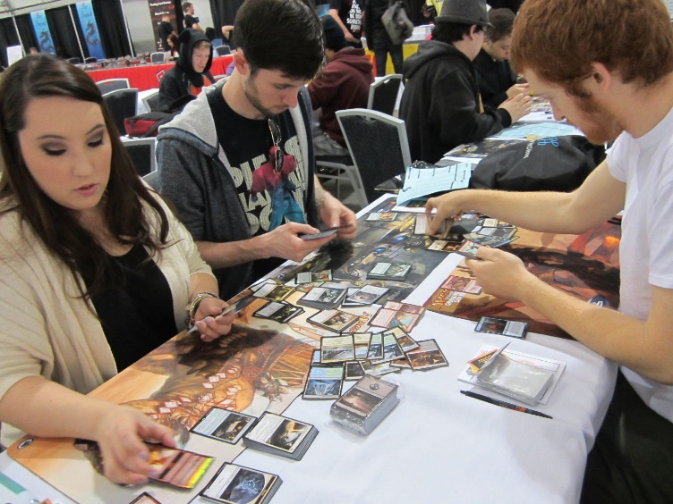
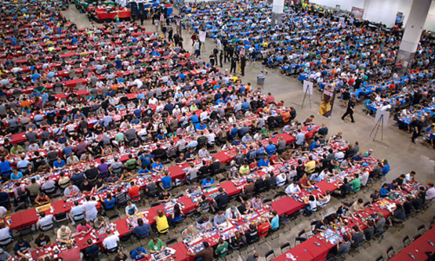
Magic The Gathering
The cards have limited print runs & varying rarities

Slide 21
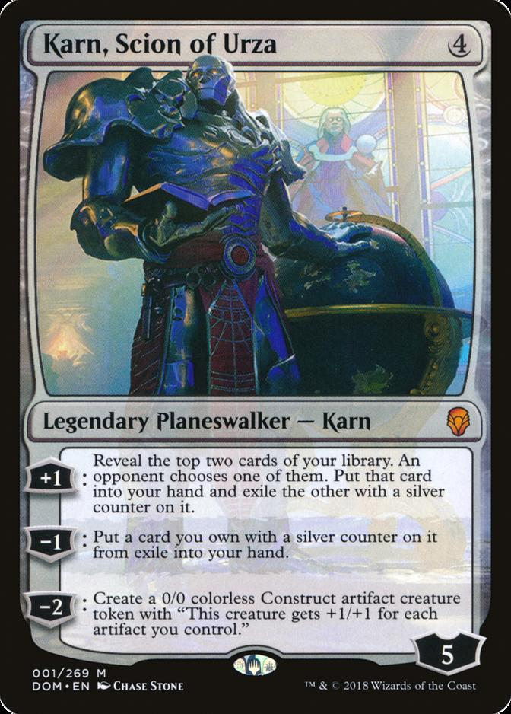
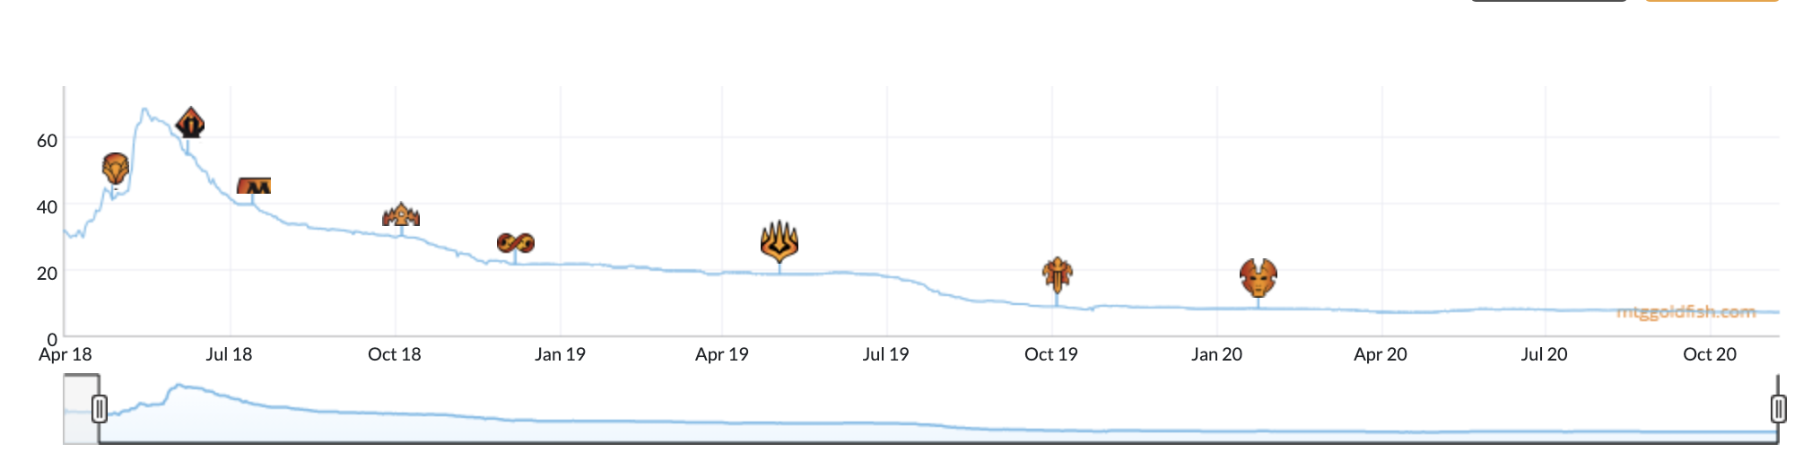
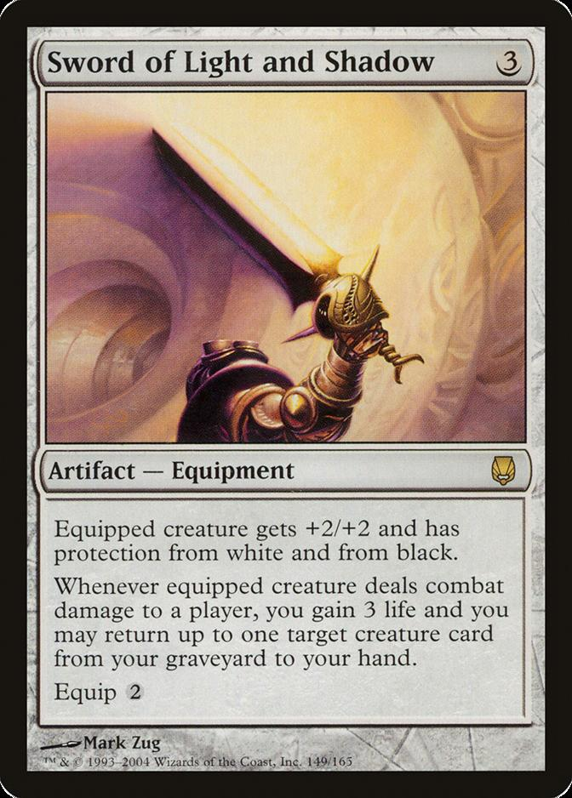
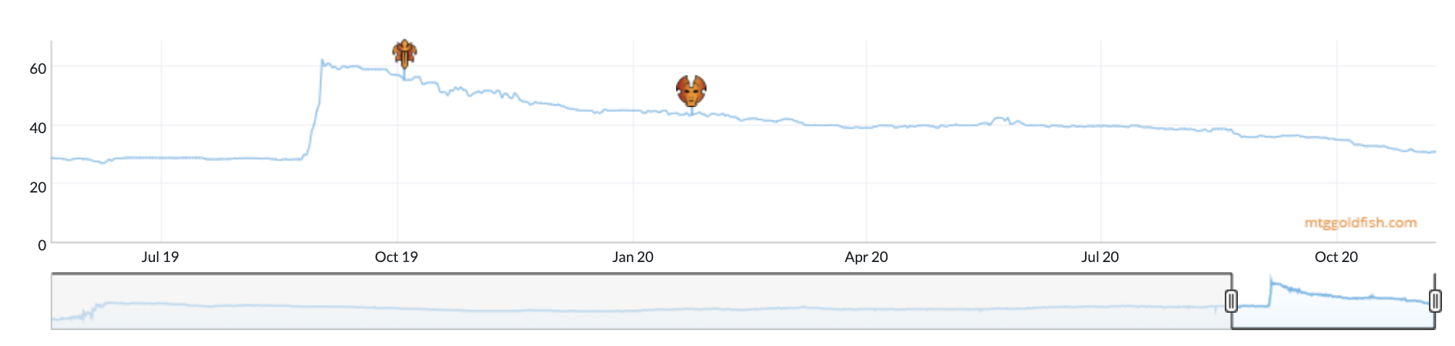
And that’s why it’s a market…
Started out good in the game, but wasn’t!
A new card came out, making this one much more powerful in combination!
Some cards go up and others down at sites like mtggoldfish.com and mtgstocks.com

Slide 22
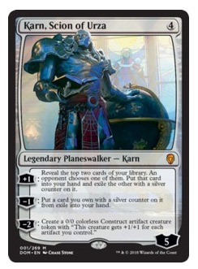
So how do you get cards?
When Karn Scion of Urza came out it was a $40 card. At the time you could get it in a number of ways.
For $19
You could buy Karn from an online marketplace.
For $3
You can open a booster pack from the appropriate expansion set and hope you get it.
For $90
You can buy a booster box of 36 packs from the set and increase your odds of getting it while also getting many other potential valuable cards.
For $540
You can buy 6 of the booster boxes in a case.
Say you are a player that needs to get Karn, Scion of Urza to complete a deck.

Slide 23
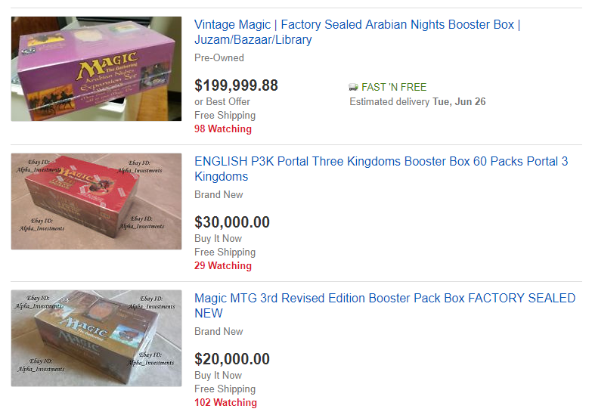
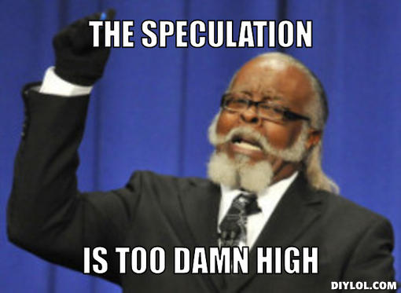
People Speculate as Supply Diminishes

Slide 24
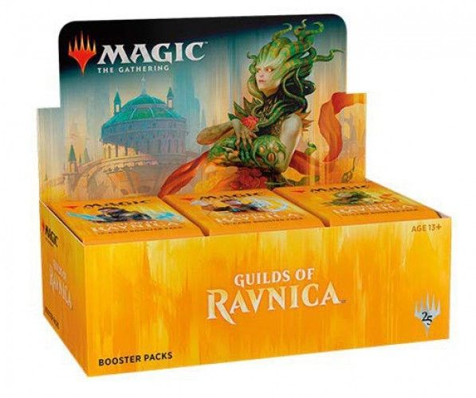
New set characteristics
Usually a pack contains
11 Commons
3 Uncommons
1 Rare
1 in 8 packs will replace the rare with a mythic
1 in 6 packs will have a random premium foil card replacing a common, uncommon, rare or mythic.

Slide 25
Modeling a new set according to risk & reward
When you open a pack:
Risk:
Each expansion set has varying prices. Some cards are worthless while other cards can be expensive.
Reward:
Some packs will contain expensive cards which you can immediately sell for more than the cost of the pack.
Since we know the cards in a set, their prices, and the probabilities of getting specific cards, we can simulate pack openings.
*Keep in mind there are friction costs, shipping a physical good takes time and money.

Slide 26
Agenda
Topic VII
Simulating a Non-Traditional Mkt Opportunity Review the trading card market as an investment vehicle Structure problem for analysis Sample with probability & simulate mkt buying to quantify risk Q & A

Slide 27
Sample with a probability
When you don’t want a random sample, then you can declare probability weights.
idx <- 1:10
# Equal Probs
set.seed(123)
sample(idx,3)
# Example Probs
set.seed(123)
sample(idx, 3, replace = T, prob = c(0,0,1,0,0,0,0,0,0,0))
Open C_sample_w_probs.R

Slide 28
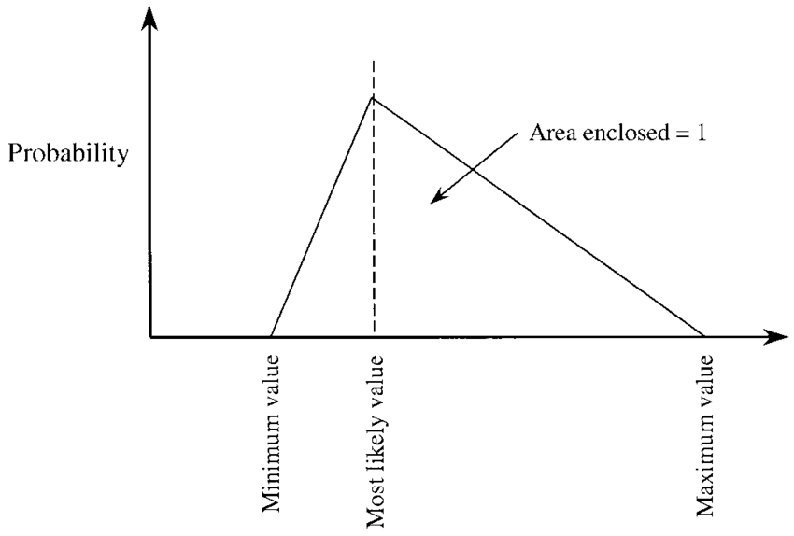
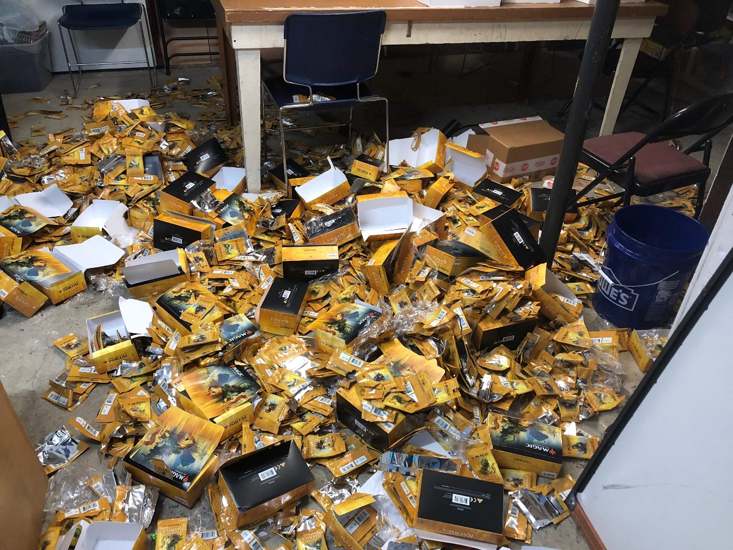
Open 3_D_NonTraditionalMkts.R

