Slide 1
Visuals Best Practices

Slide 2


Choose the right chart
https://r-graphics.org/
https://www.redfin.com/MA/Vineyard-Haven/60-Beach-Rd-02568/unit-237/home/135196757

Slide 3
Avoid pie, donut & 3d!

Slide 4
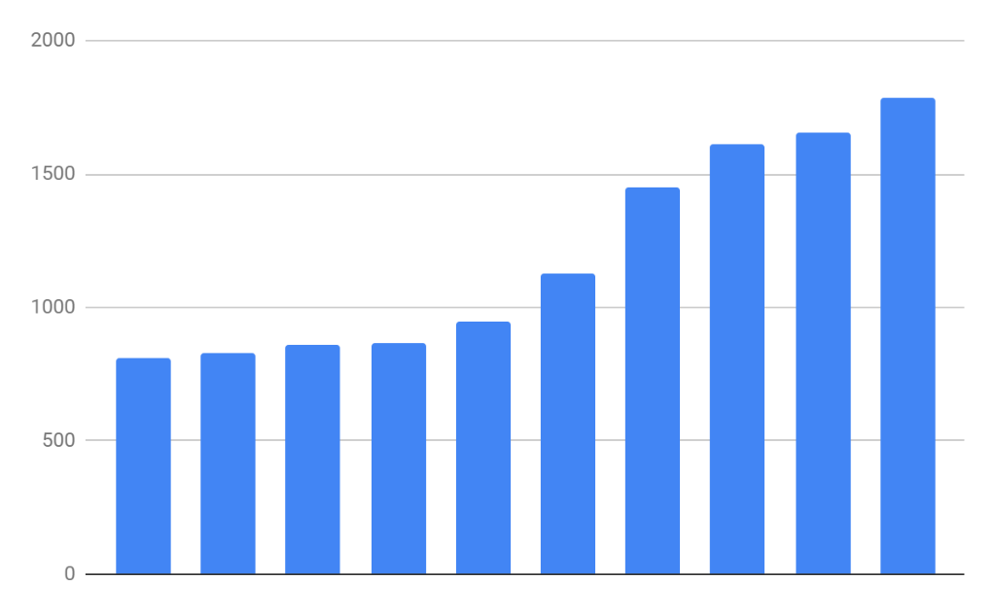
Basic Bar Charts
Rectangles are representative of frequency of term
Frequency Matrix
Variable | freq
Grp1 | 0
Grp2 | 2
Grp3 | 3
… | 5
Grp_n | 2

Slide 5
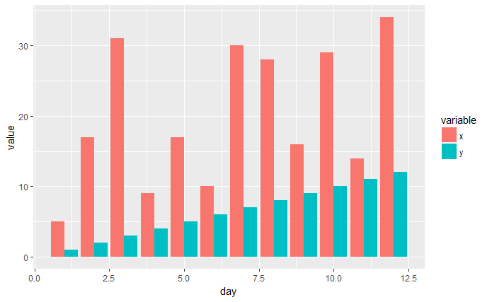
Side by Side Charts
Side by Side bar charts let you compare frequency by category

Slide 6
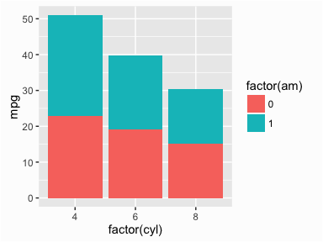
Stacked Bar Charts
Stacked bar charts lets you compare proportion within a category

Slide 7
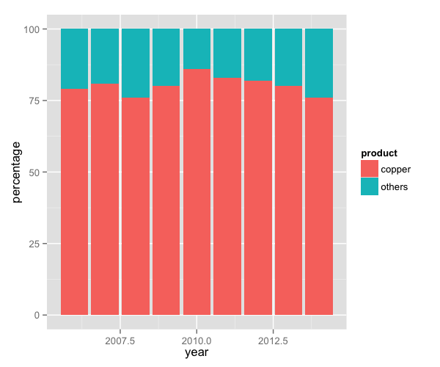
Proportional Stacked Bar Charts
Proportional stacked bar charts let you compare proportion across categories regardless of magnitude

