Slide 1
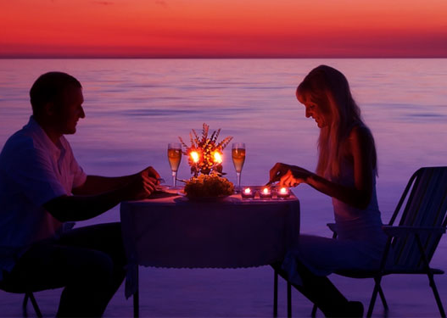
Date Night
An application that plans your night out

Slide 2
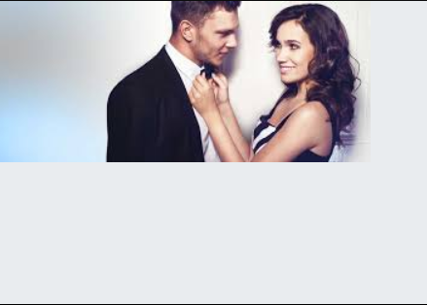
Date Night Franklin Antonio, Charles Gilker, Timothy Mace, Janet Warren
Application Concept
Motivation/Design Process
Technologies
Demonstration
Future Development

Slide 3
Application Concept
The user will select parameters from drop down menus to create a list of appropriate date night selections
The user will be able to specify time of day, price, activity, and zip code.
The chosen parameters (not all need to be selected) will enable the user to personalize the date
Adding a bit of quirkiness, the user can throw caution to the wind and choose to spin a roulette wheel with a random combination of parameters
The User will be able to view the results in table format, set up an escape plan, and have access to several links to facilitate his /her date

Slide 4
Motivation
Initially started an application for local venues and events in the Richmond area.
After searching the available API’s, the ideas shifted to the Date Night App.

Slide 5
Design Process
In class, we began with a concepts meeting to touch base with the progress of the site.
The focus then shifted to what is working, what is incomplete, what needs further development, what isn’t working, and what can we add to make it function better.
Continuously assessing and reassessing functionality and reworking code to accommodate the changes.

Slide 6
Technologies
1. Grid-Template-Areas (CSS Grid)
2. Firebase
3. Ajax
4. GitKraken
5. Utilized Bootstrap for modals and carousel

Slide 7
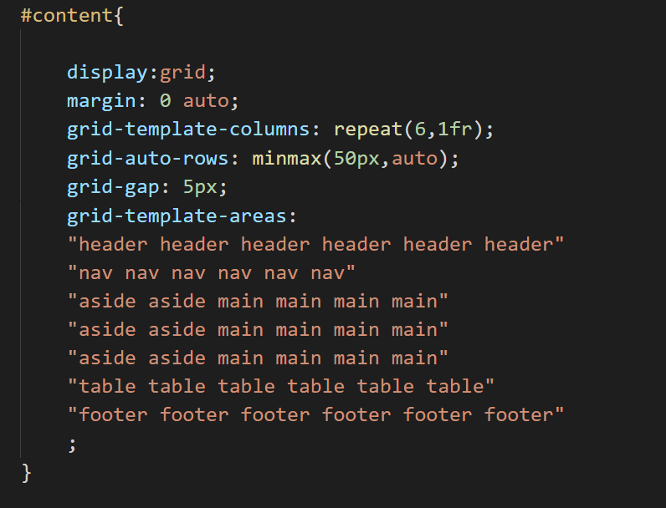
Technologies
Grid-template-areas

Slide 8
Demonstration
Date Night

Slide 9
Future Development
Roulette Wheel
More User interaction with activity choice
Save more of search data on firebase
Add fandango API to further the User search
Add ability to store a date (on calendar) with a more comprehensible user profile

Slide 10
Questions????

