Slide 1
Networks and epidemics
  CDT 14/01/2026
Estelle McCool and Francesco Di Lauro

Slide 2
Network models

Slide 3
Reminder: definition of networks
A network is simply a pair of sets: {nodes}, {links}
It is used to represent “interactions” (links) between actors (nodes)
Edges can represent contacts, infections, relationships…
It can be represented with a matrix $A_{ij}=1$ if node $i$ is in contact with node $j$

Slide 4
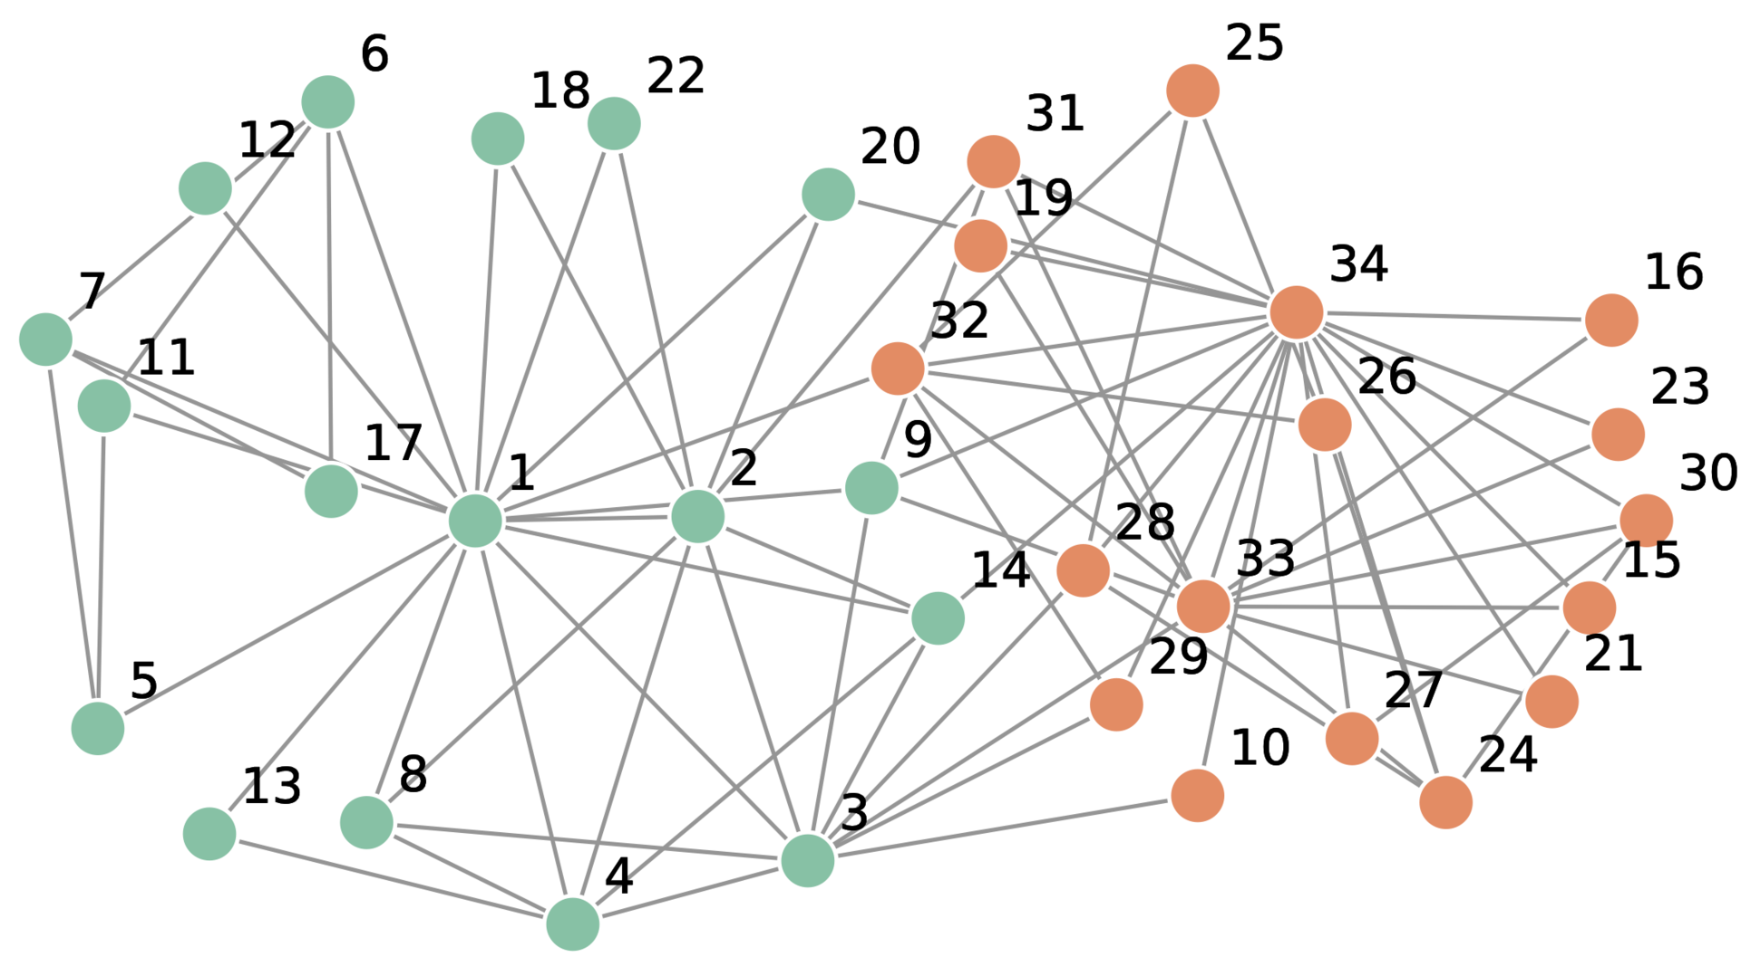
Example networks: Zachary Karate Club
10.1073/pnas.122653799

Slide 5
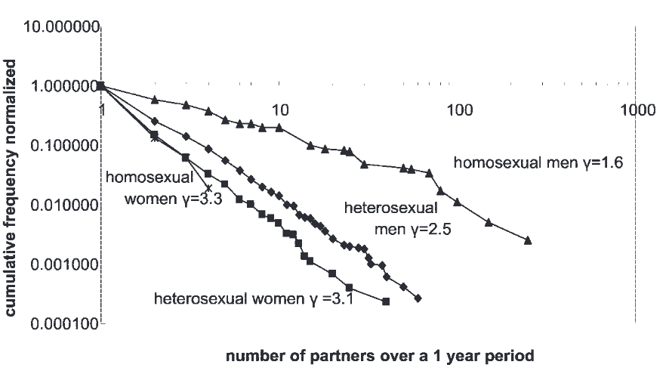
Example: Sexual interactions
https://www.jstor.org/stable/i40210700

Slide 6
Why network models are useful
Real data are often incomplete - sampling errors, censoring
Finiteness: one realisation is not understanding the underlying process
No counterfactuals: data alone does not answer what if scenarios
Need to generalise beyond the observed data
To understand how to link the structure with the outcome of a process on it

Slide 7
Generative (axiomatic) models
E.g. Erdős–Rényi: between any pair of node there is a link with probability p
These models are often analytically tractable and depend on parameters that are directly linked to statistics - such as the average degree
Very useful for understanding the theory and the fundamental processes, e.g. “What structural features matter for transmission?”
Often poor realism

Slide 8
Process-based models
E.g. Barabási–Albert: preferential attachment or “rich gets richer”
Structural properties emerge as an outcome of a process that mimics reality
Often used to explain more fundamental questions: “What behavioural or social mechanisms generate those features?”
Less easy to analyse and parameters may not be directly linked to statistics

Slide 9
Data for networks

Slide 10
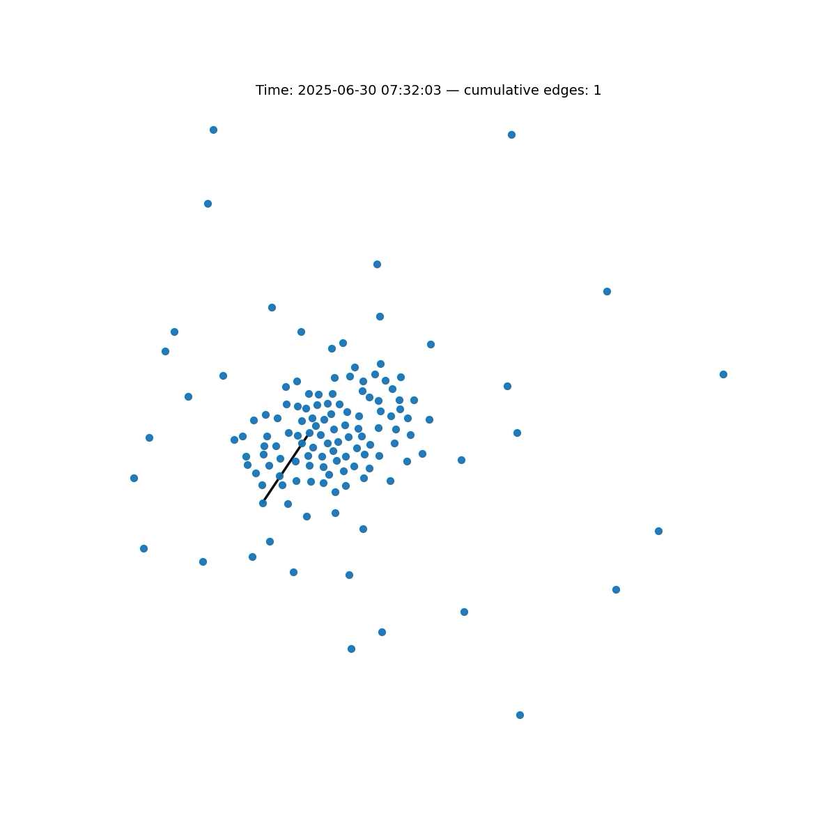
Epi-games
Collect data
  Phones scan nearby devices via Bluetooth (BLE)
  Each detection → (u,v,t)
  Infections propagate along observed contacts
Process events
  Threshold signal strength to infer close contact
  Clean raw detections into contact events
Build temporal network
  Nodes = participants
  Edges = proximity contacts
  Network evolves over time → G(t)
Aggregate & analyze
  Time-bin events (e.g. 5 min)
  Produce static and temporal graphs

Slide 11
Data for network inference
In some cases, data are fully available: e.g. power-grid, spatial networks, controlled settings such as epigames
In real epidemics, we rarely observe the full contact network:
  Missing nodes (people not included in the data/unobserved)
  Missing edges (contacts that were not registered)
  Unknown timing of events
Network models must extrapolate beyond incomplete, noisy, and biased data

Slide 12
Typical data example: sexual surveys
Cross-sectional or longitudinal surveys on sexual behaviour and risk (“how many sexual partners did you have in the past 6 months?”)
Typically “ego-centric data” , individuals report their contacts, not the full network
Many biases: recall bias, social desireability bias…
Not everyone is equally likely to respond to such surveys

Slide 13
Epidemics on Networks

Slide 14
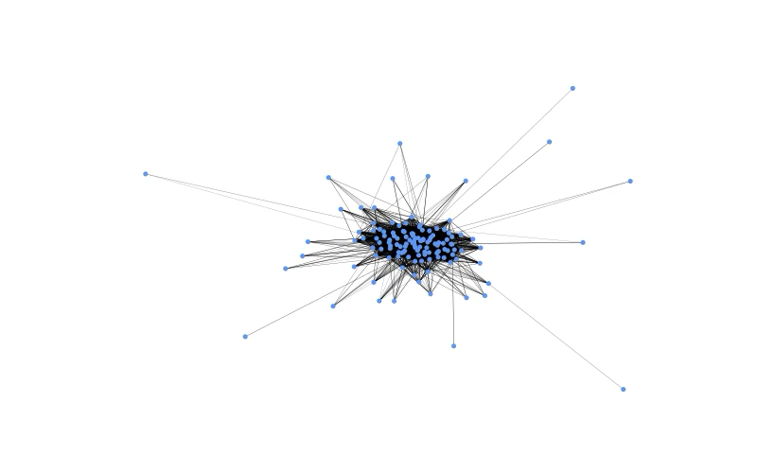
Epi-games
Collect data
  Phones scan nearby devices via Bluetooth (BLE)
  Each detection → (u,v,t)
  Infections propagate along observed contacts
Process events
  Threshold signal strength to infer close contact
  Clean raw detections into contact events
Build temporal network
  Nodes = participants
  Edges = proximity contacts
  Network evolves over time → G(t)
Aggregate & analyze
  Time-bin events (e.g. 5 min)
  Produce static and temporal graphs

Slide 15
Classic SIR model interpretation
Interpretation: the term $\frac{β}{N}SI$ represents infectious contact rates between susceptible and infected
The term $\frac{β}{N}$ is the average per capita contact rate times the average infectivity
This term is somewhat overloaded with meaning: “well-mixed” population hypothesis assumption
$$\frac{dS}{dt}=-\frac{β}{N}SI$$
$$\frac{dI}{dt}=\frac{β}{N}SI-γI$$
$$\frac{dR}{dt}=γI$$

Slide 16
Moving to stochastic models
Infection
$$P(\underset{¯}{S(t+dt)}=S(t)-1,\underset{¯}{I(t+dt)}=I(t)+1,\underset{¯}{R(t+dt)}=R(t))=β\frac{S(t)I(t)}{N}dt,$$
Recovery
$$P(\underset{¯}{S(t+dt)}=S(t),\underset{¯}{I(t+dt)}=I(t)-1,\underset{¯}{R(t+dt)}=R(t)+1)=γI(t)dt,$$
Nothing happens
$$P(\underset{¯}{S(t+dt)}=S(t),\underset{¯}{I(t+dt)}=I(t),\underset{¯}{R(t+dt)}=R(t))=1-\left(β\frac{S(t)I(t)}{N}+γI(t)\right)dt.$$

Slide 17
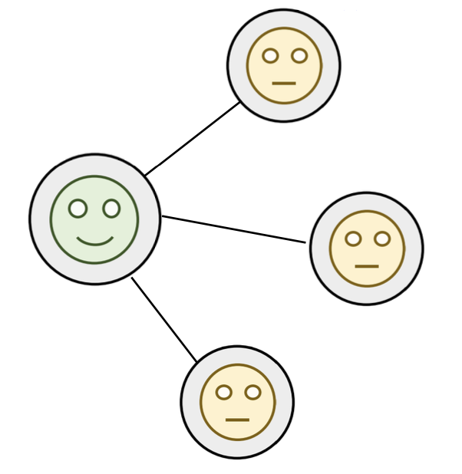
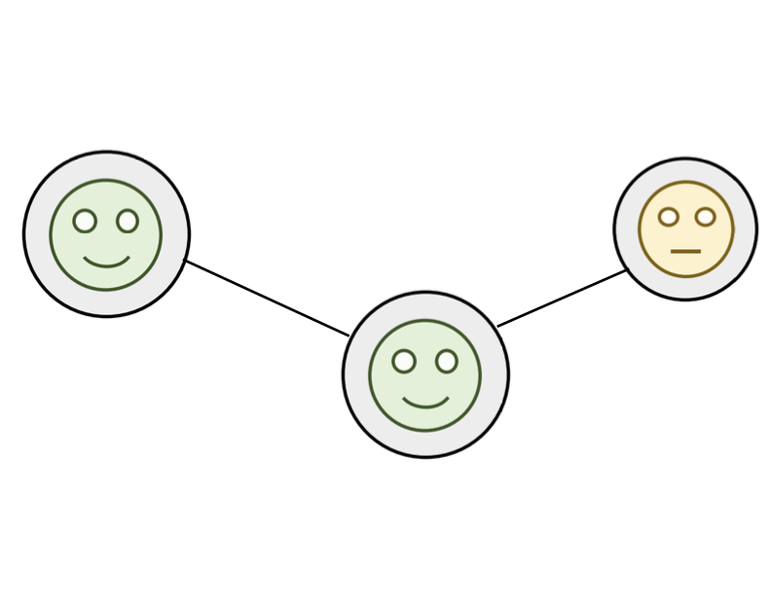
The problem with “reality”
$$P(\underset{¯}{S(t+dt)}=S(t)-1,\underset{¯}{I(t+dt)}=I(t)+1,\underset{¯}{R(t+dt)}=R(t))=β\frac{S(t)I(t)}{N}dt,$$
Infectious contact rate!
What is the “infectious contact rate” here?

Slide 18
Gillespie algorithm to simulate epidemics on networks
Transmission occurs across edges
At each time-step all the infected nodes transmit to their susceptible neighbours with probability $βΔt$ for each neighbour
Each infected node recovers with probability $γΔt$

Slide 19
Pseudo code
t ← 0
Set node states X_i(0)
while there exists i with X_i(t) = I:
for each node i with X_i(t) = S:
k ← number of infected neighbours of i at time t
p_infect ← 1 - (1 - β)^k
with probability p_infect:
mark i to become I
for each node i with X_i(t) = I:
with probability μ:
mark i to become R
update all marked state changes simultaneously
t ← t + 1

