Slide 1
HUMAN FACE RECOGNITION
FRANCESCO ESPOSITO ALESSANDRO ESPOSITO

Slide 2
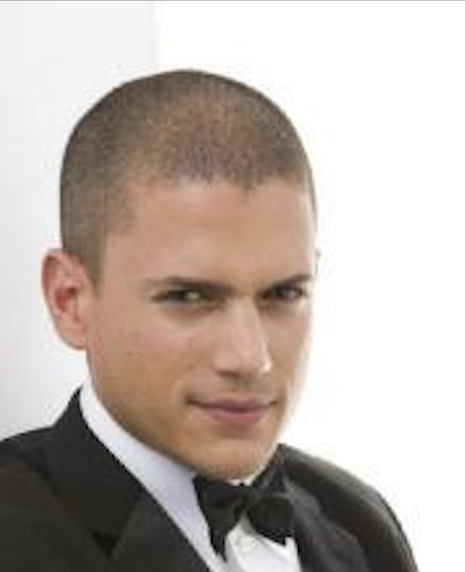
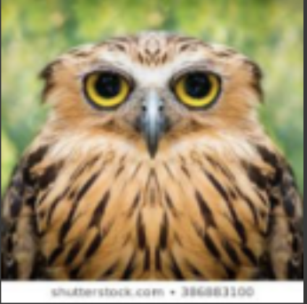
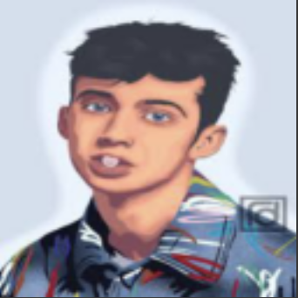
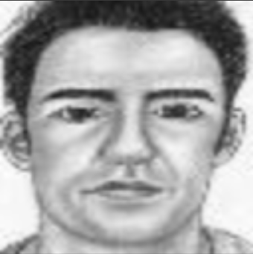
TASK: The project aims at the recognition of images through the use of 2 different CNN architectures
Classes of the dataset:
Celebrities
Animal
Cartoon
Anime
Sketches
Vector Art
Other
Home Object

Slide 3
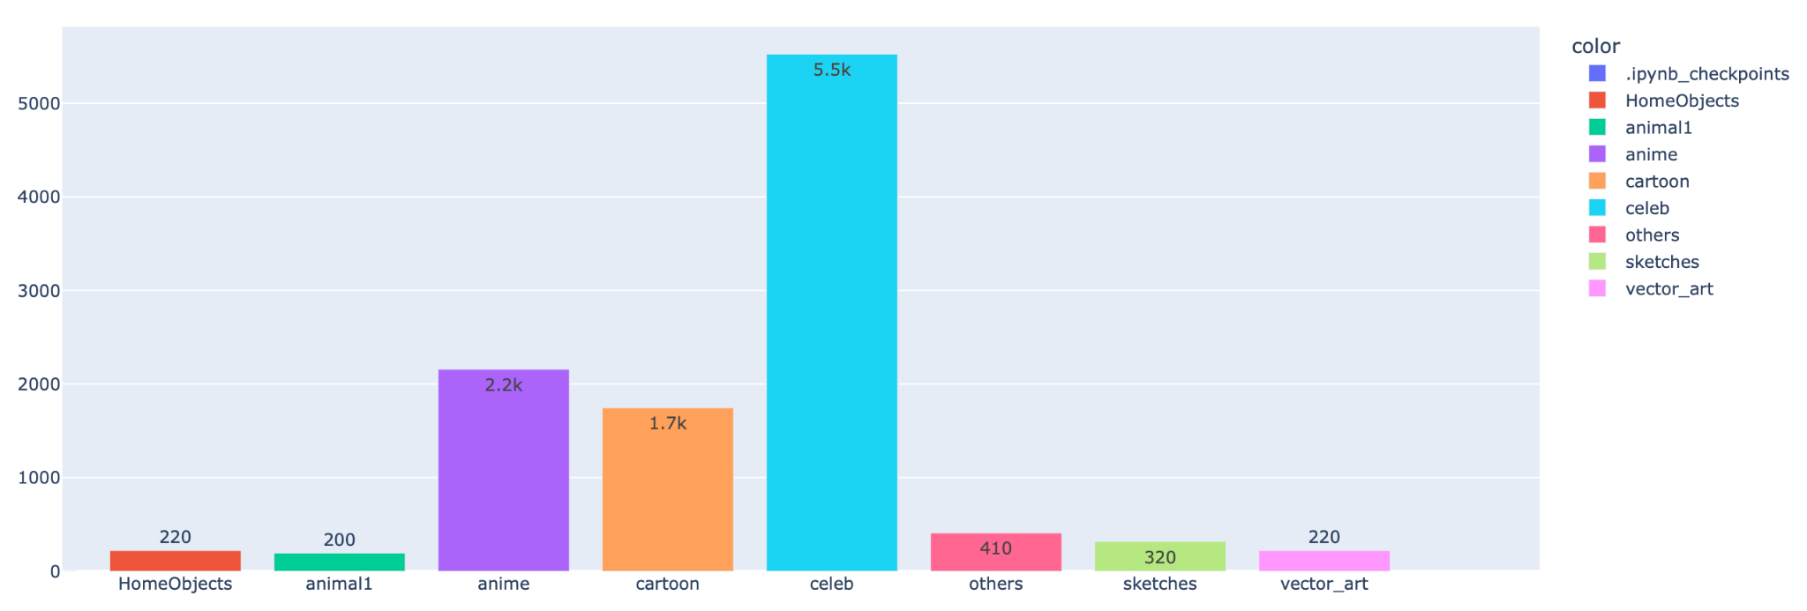
INITIAL DATASET

Slide 4
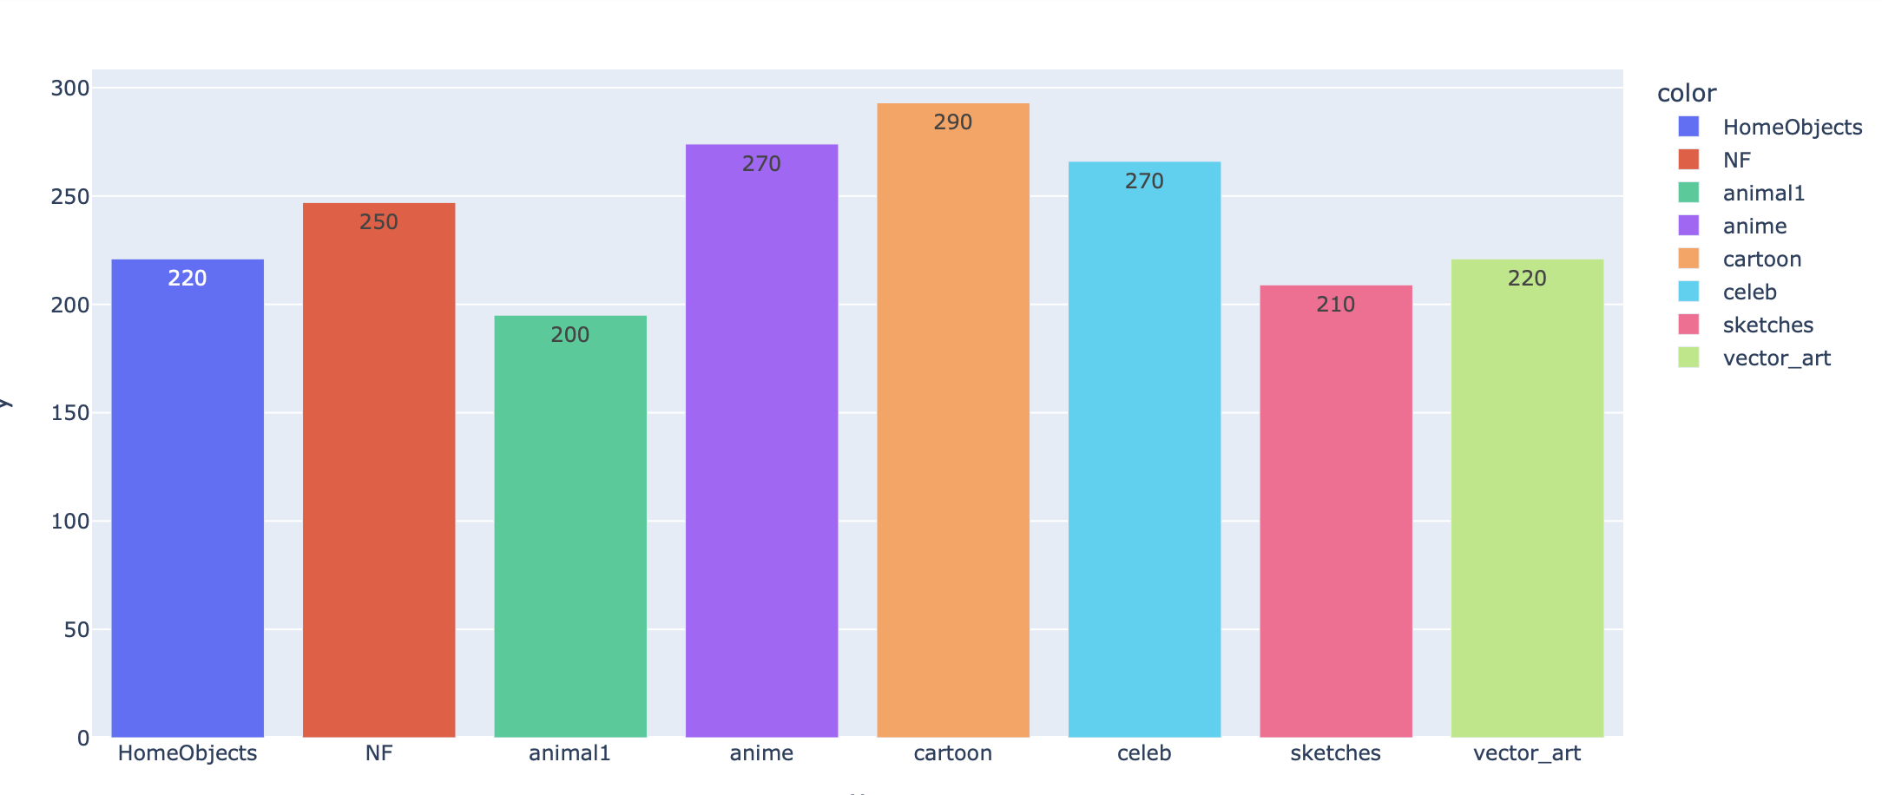
REBALANCED DATASET
Glob library
Os library

Slide 5
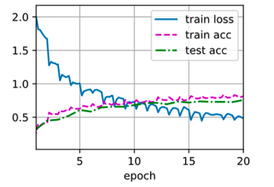
FIRST ARCHITECTURE
Linear 8
Hidden Layer 2400
AlexNet
It is the simplest of those analyzed.
Loss : 0,483
Train accuracy : 0,815
Test accuracy : 0,758
3x3 Max Pool
Conv(96), Kernel 11
Conv(128), Kernel 11
3x3 Max Pool
Conv( 96), Kernel 5
3x3 Max Pool
Conv(30), Kernel 11
Batch Normalization (3)

Slide 6
STEPS FROM THE BASIC TO THE FINAL ARCHITECTURE
Conv(96), kernel 3x3 was added
Change in output: 2400 → 1028
Change in Pooling: MaxPool → AvgPool
Loss
Accuracy Gap
Loss
Accuracy Gap

Slide 7
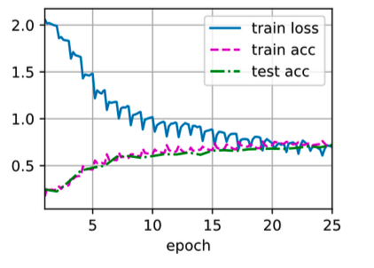
Linear (8)
The finale structure was reached by changing the Pooling and increasing the number of epochs.
It provides us an average value of the loss function between all the trials that we did and the smallest accuracy gap.
Hidden Layer 1028
Hidden Layer 2400
3x3 Avg Pool
Conv(96), Kernel 3
Loss : 0,697
Train accuracy : 0,723
Test accuracy : 0,720
Conv(256), Kernel 3
Conv(128), Kernel 3
3x3 Avg Pool
Conv( 96), Kernel 5
3x3 Max Pool
Conv(30), Kernel 11
Batch Normalization (3)

Slide 8

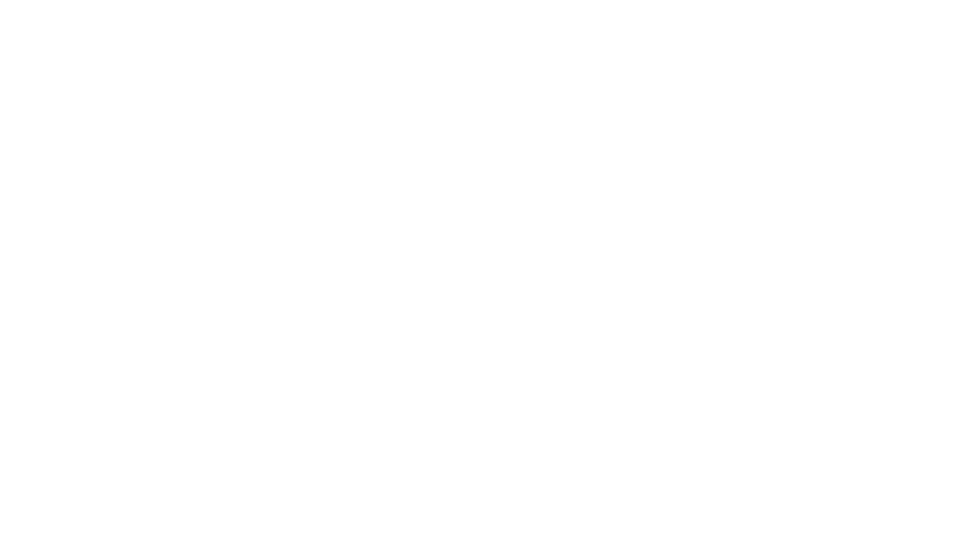
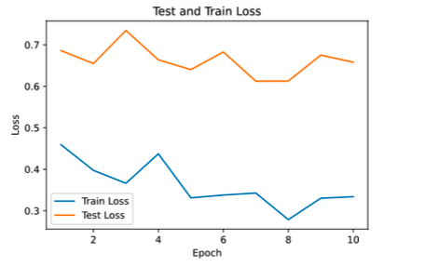
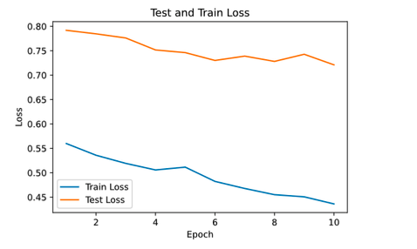
TRAIN AND TEST LOSS COMPARISON
Architecture 1
Architecture 2

Slide 9
Inception Structure
SECOND ARCHITECTURE: GoogLeNet
CONCATENATION
CONV 3X3
CONV 5X5
CONV 1X1
CONV 1X1
CONV 1X1
CONV 1X1
CONV 1X1
CONV 3X3
MAXPOOL 3X3
INPUT

Slide 10
BLOCK STRUCTURE
Block 2
Block 3
Block 4
3 CONVOLUTIONS, BATCH NORMALIZATION, DROPOUT, MAXPOOL
2 INCEPTION, MAXPOOL
3 INCEPTION, MAXPOOL
Block 1
Block 5
3 CONVOLUTIONS, BATCH NORMALIZATION, MAXPOOL
2 INCEPTION AVERAGE POOL

Slide 11
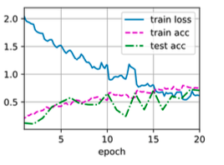
Loss : 0,614 Train acc: 0,757 Test acc: 0,709
Here we get a lower loss function than the first architecture, but a greater accuracy gap. Moreover, the graphically results seems not adequate to chose this as our final structure.
Loss
Accuracy Gap

Slide 12
CONCLUSION
By making a comparison between the first and second architecture the first architecture appears to be more adequate, both in terms of accuracy and graphically. A constraint common to both architectures is the poor sampling of the dataset, as we have seen our dataset contained about 2000 photos, thus forcing a very limited division of train, validation and test. This leads us to infer that the dataset, not having a large number of "features," does not need overly complicated architectures. So, at the end of the day, we consider the first architecture as the most suitable structure for our dataset.

