Slide 1
Model Agnostic solution of CSPs with Deep Learning
Tesi di Laurea Magistrale
in
Intelligent Systems M
CANDIDATO: Francesco Giovanelli
RELATORE: Chiar.ma Prof.ssa Milano Michela
CORRELATORI: Dott. Lombardi Michele, Dott. Galassi Andrea

Slide 2
Background
Learning methods in AI: symbolic and sub-symbolic
Deep Learning: sub-symbolic approach, applied to many problems
CSPs: symbolic approach, difficult to describe
Idea: tackle symbolic problem using sub-symbolic technique, with no pre-existing knowledge
Notes:
Symbolic: FA AFFIDAMENTO SULLA CONOSCENZA DELLE CARATTERISTICHE DEL PROBLEMA + REASONING
Sub-symbolic: APPRENDERE DIRETTAMENTE DAI DATI

Slide 3
Goals
Sub-symbolic approach to CSPs
Extend feasible assignments (Generator NN)
Evaluate assignments (Discriminator NN)
Combine to improve perf. (GAN)

Slide 4
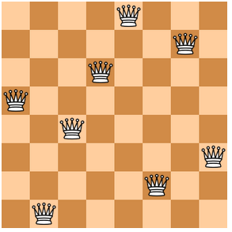
8 Queens problem
8x8 chessboard
8 queens to position on the board
3 constraints (row, column, diagonal)
92 total solutions
Start from empty or partial solutions
NP-Complete problem

Slide 5
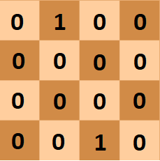
Data representation
Input and output as bit vectors
Models agnostic encoding
No knowledge about constraints
No knowledge about properties

Slide 6
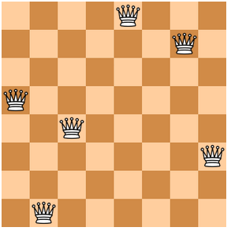
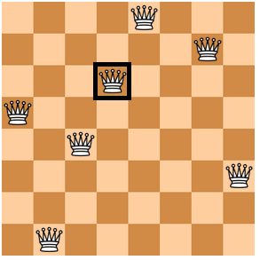
Generator Network (G)
Implemented as Residual Network
Takes partial solutions as input
Needs to produce a single, globally consistent assignment
Probabilistic output
Goal: G learns preferences and hard constraints

Slide 7
Discriminator Network (D)
Implemented as Residual Network
Takes solutions as input
Distinguishes between feasible and infeasible solutions
Goal: D learns the problem’s hard constraints
DISCRIMINATOR
Feasible / Not feasible

Slide 8
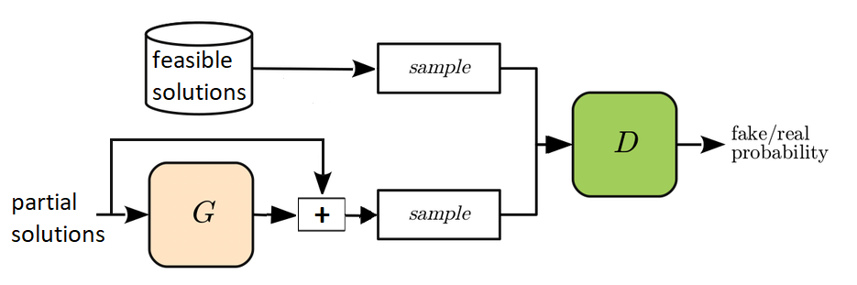
Generative Adversarial Networks (GAN)
D distinguishes between real and “fake” data
G tries to trick D
WGAN: no D, Critic estimates distance between real and generated data distributions

Slide 9
First experiment
Stand-alone training of G and D
Datasets generated through random selection
G needs to produce feasible assignments (feasibility ratio)
D needs to distinguish feasible/infeasible solutions (accuracy)
12 base solutions
Random selection
9 base solutions
3 base solutions

Slide 10
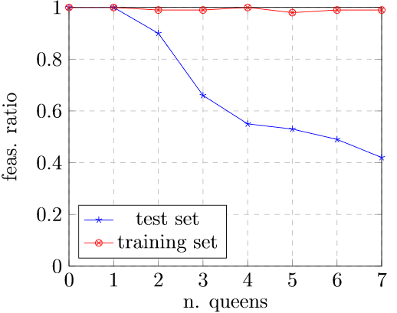
First experiment - results
Generator
Discriminator
Num res. units | Acc. train. set | Acc. test set
50 | 0.99 | 0.82
50 | 0.99 | 0.88
20 | 0.98 | 0.81
20 | 0.99 | 0.86
Notes:
E’ normale che G impari meno di D: G deve imparare soft + hard const., D solo gli hard. Quindi D ci aspettiamo funzioni bene su test set, mentre G ha imparato anche le preferenze dei train set, quindi su dati mai visti è normale non vada altrettanto bene

Slide 11
Second experiment
Mimic real scenario: user preferences
Selection with criterion
Optional pre-training of G & D
GAN training using both pre-trained and untrained G & D
12 base solutions
Selection with criterion
8 base solutions
4 base solutions
Notes:
MOTIVAZIONE: mimare un caso reale, le preferenze utente. Nel mondo reale le soluz. A disposizione è probabile che non siano rappresentative dell’intero spazio dei vincoli.

Slide 12
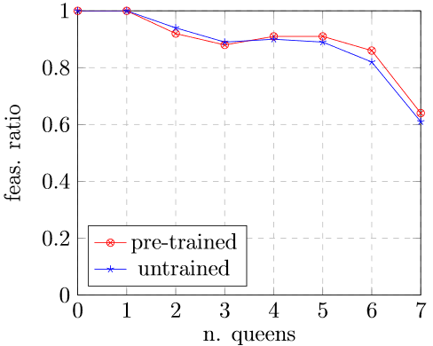
Second experiment - results
GAN-trained G
GAN-trained D
Train. set | Pre-train | Train. set acc. | Other set acc.
DS-1 | yes | 0.70 | 0.35
DS-2 | yes | 0.68 | 0.38
DS-1 | no | 0.68 | 0.41
DS-2 | no | 0.70 | 0.41
Notes:
Scambio di conoscenza, quindi D impara anche le preferenze e questo si riflette sui dati di test set.

Slide 13
Third experiment
Introduce a bias into the datasets
Discard solutions with queens in central position
Evaluate G’s ability to produce valid assignments w.r.t. problem’s constraints and data bias
12 base solutions
Selection with criterion
8 base solutions
4 base solutions

Slide 14
Third experiment - Stochastic generation
Goal: employ trained G to generate complete assignments
One assignment at a time
Probabilistic selection of assignments
Evaluate generated assignments w.r.t. 3 criteria
Problem’s constraints
1
Problem’s constraints
Data bias
2
Data bias
3
CRITERIA

Slide 15
Third experiment – Stochastic Gen. evaluation
N° of attempts = 1000
Train. type | Num. unique assign. | Validity crit. 1 | Validity crit. 2 | Validity crit. 3
standalone | 391 | 61.1% | 61.1% | 98.7%
GAN | 2 | 0.0% | 0.0% | 100.0%
GAN-pretrain | 4 | 0.0% | 0.0% | 100.0%
WGAN | 112 | 49.0% | 49.0% | 100.0%
SVM | 741 | 27.1% | 27.1% | 100.0%
Num. unique valid solutions | 92 | 60 | > 10⁹
Notes:
Num. sol. 3rd crit: circa 2 miliardi (permutazione)

Slide 16
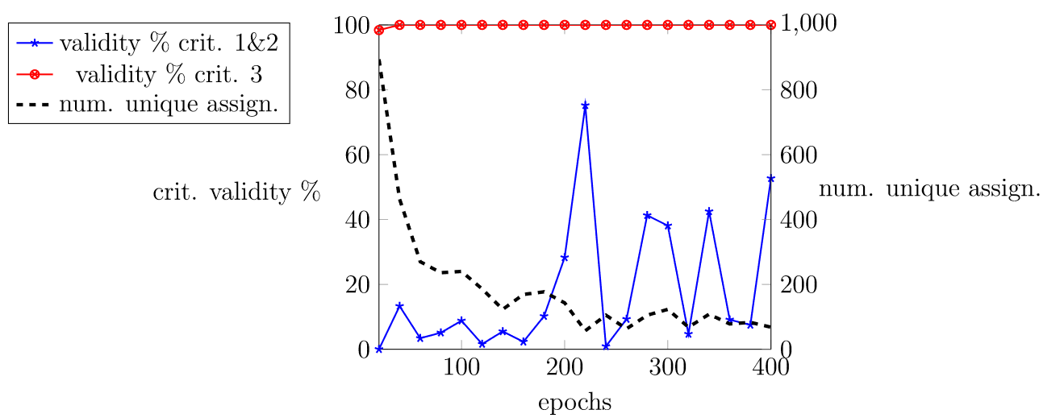
Third experiment – performance of G over time (WGAN)

Slide 17
Conclusions & future developments
Both networks learned something about the problem’s structure
GAN prone to mode collapsing
WGAN very promising, but unstable
SVM displayed low percentage of valid assignments
Future developments:
  improve WGAN training stability
  extend the analysis to more complex problems
Notes:
PRONE TO → SOGGETTO A

Slide 18
Thank you for your attention

