Slide 2
SKILLSENSE: SEMANTIC DRIVEN RESUME SCREENING SYSTEM
ACIDERA, LUCKY FRANCIS
ALBERTO, JOHN BENEDICT
CABUNGAN, MARK ALFRED
DAGUIMOL, RUSSEL
Notes:
Every day, campuses struggle with a problem that should have been solved long ago—proper waste disposal. Even with labeled bins and clear guidelines, students still mix plastics, paper, food waste, and other materials in a single container. This leads to overflowing bins, unpleasant surroundings, and missed opportunities for recycling. But what if waste management didn’t have to depend entirely on manual sorting or consistent student behavior? What if technology could make the process smarter, safer, and more efficient? That’s where our solution comes in—BINOVA, an IoT-powered waste management system designed to transform how campuses handle waste.

Slide 3
INTRODUCTION
Conventional Applicant Tracking Systems (ATS) rely on keyword-based filtering — a rigid approach that overlooks qualified candidates whose resumes lack exact terminology.
Notes:
Every day, campuses struggle with a problem that should have been solved long ago—proper waste disposal. Even with labeled bins and clear guidelines, students still mix plastics, paper, food waste, and other materials in a single container. This leads to overflowing bins, unpleasant surroundings, and missed opportunities for recycling. But what if waste management didn’t have to depend entirely on manual sorting or consistent student behavior? What if technology could make the process smarter, safer, and more efficient? That’s where our solution comes in—BINOVA, an IoT-powered waste management system designed to transform how campuses handle waste.

Slide 4
BACKGROUND OF THE STUDY
Problem/Gap
ATS keyword filters miss context-aware matches
High false-shortlisting from unstructured data
Motivation
To improve the accuracy and efficiency of candidate skill matching in ATS systems
To provide recruiters a more reliable and accurate resume screening system that evaluates based on contextual relevance
Solution
Develop a web-based resume screening system that integrates a pretrained Sentence-BERT (S-BERT) for semantic similarity matching and to capture contextual relationships
Notes:
Improper waste segregation and overflowing bins continue to be major issues in many institutions. Manual sorting at the end of the day is slow, tiring, and prone to errors. When waste gets mixed together, recycling facilities struggle to process it, reducing efficiency and increasing costs. Worse, workers handling mixed waste are exposed to harmful materials, putting their health at risk. These problems create a chain reaction—poor segregation leads to poor disposal, which leads to poor environmental outcomes.
On campuses, the issue is even more visible. Despite having labeled bins, many students still do not dispose of waste properly. Whether due to habit, convenience, or lack of awareness, this leads to campus waste piling up with little order. As a result, the campus loses its cleanliness, and sustainability programs fail to make real progress. We saw this problem firsthand—and realized that something smarter and more systematic had to be done.
BINOVA is our answer—an intelligent, IoT-powered waste management system designed to automate sorting and improve efficiency. With built-in sensors and automated mechanisms, BINOVA classifies waste into the correct categories, reducing the need for manual sorting and keeping users safe from potential hazards.
The system constantly monitors bin status in real time, sending data that helps staff optimize collection schedules and prevent overflow before it happens. This doesn’t just make waste management easier—it makes it more sustainable.
BINOVA supports the campus’s environmental goals by reducing human exposure, improving recycling rates, and raising awareness among students. Through smart technology, we aim to promote cleaner habits today and build a more sustainable campus for the future.

Slide 5
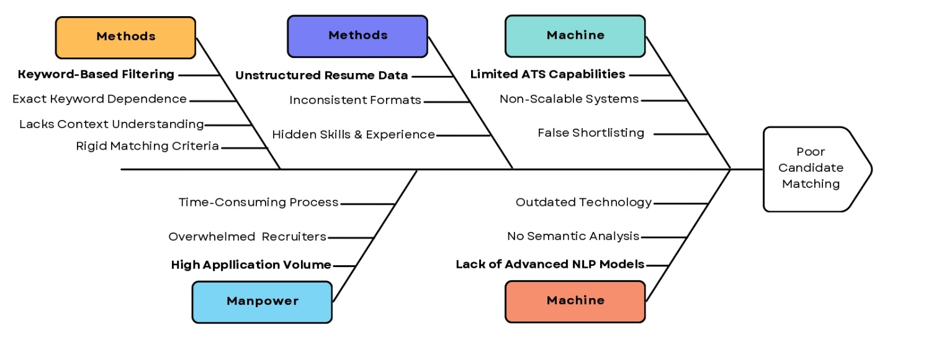
ISHIKAWA DIAGRAM
Notes:
reina

Slide 6
OBJECTIVES OF THE STUDY
Main Objective :
The study aims to design, develop, and evaluate a a web-based resume screening and skill matching system with an integrated Sentence-BERT (S-BERT) model for automation and accurate evaluation
Specific Objectives
Identify system requirements and datasets for mapping skillsets
Implement a preprocessing pipeline that performs text cleaning, entity extraction, and normalization to convert raw inputs into structured, model-ready data.
Utilize a pretrained S-BERT model to generate semantic embedding vectors for resumes and job postings, applying Cosine Similarity to measure candidate-to-job relevance.
Notes:
karl

Slide 7
OBJECTIVES OF THE STUDY
Specific Objectives
Evaluate matching performance using Top-K ranking evaluation and human review, with approximate precision/recall-style analysis, where labeled or inferred relevance is available.
Refine system accuracy by tuning feature weights, improving data quality, and adjusting scoring logic based on evaluation outcomes.
Deploy the refined system as a fully operational web-based resume screening platform accessible to HR personnel and job seekers.
Notes:
karl

Slide 8
SIGNIFICANCE OF THE STUDY
For HR Professionals
Reduces risk of qualified applications being overlooked
Skills evaluated by semantic relevance, not keyword luck
For HR Professionals
Automates initial screening of high-volume applications
Identifies relevant candidates with less manual effort
For Software Developers
Demonstrates S-BERT + rule-based hybrid scoring in a real app
Highlights challenges of integrating embeddings into recruitment systems
Notes:
reina

Slide 9
SCOPE AND DELIMITATION OF THE STUDY
Scope of the Study
Web-based resume screening system for IT and Software Development roles
Covers automated resume parsing, semantic matching, and candidate ranking
Designed for HR personnel and job seekers in a simulated recruitment environment
Validates S-BERT effectiveness as a proof-of-concept, not a commercial deployment
Notes:
Focuses on BINOVA design and development. {Lowell}
Integrates IoT sensors and automation.
Sorts wet, dry, and metallic waste. { Reina}
Implemented in CCIS.
Includes hardware and software components. {Karl}
Tests accuracy, efficiency, and reliability.
Provides real-time monitoring and alerts. {Fiona}
Limited to campus waste management.

Slide 10
SCOPE AND DELIMITATION OF THE STUDY
Delimitations
Domain Coverage : Focused on IT and Software Development roles only, as the skill dictionary was built specifically for technical hiring.
Accepted File Formats: Limited to PDF and DOCX formats, as these are the standard file types in professional recruitment.
Language Input : English-only input, as the pre-trained S-BERT model is trained on English corpora.
Model Approach : Uses pre-trained S-BERT and fine-tuned scoring logic
Notes:
Focuses on BINOVA design and development. {Lowell}
Integrates IoT sensors and automation.
Sorts wet, dry, and metallic waste. { Reina}
Implemented in CCIS.
Includes hardware and software components. {Karl}
Tests accuracy, efficiency, and reliability.
Provides real-time monitoring and alerts. {Fiona}
Limited to campus waste management.

Slide 11
REVIEW OF LITERATURE
Notes:
Every day, campuses struggle with a problem that should have been solved long ago—proper waste disposal. Even with labeled bins and clear guidelines, students still mix plastics, paper, food waste, and other materials in a single container. This leads to overflowing bins, unpleasant surroundings, and missed opportunities for recycling. But what if waste management didn’t have to depend entirely on manual sorting or consistent student behavior? What if technology could make the process smarter, safer, and more efficient? That’s where our solution comes in—BINOVA, an IoT-powered waste management system designed to transform how campuses handle waste.

Slide 12
LITERATURE REVIEWS
Theme [Citations] | Key Insight from Literature | Adopted in this Study | Metric/Benchmark
ATS & Keyword Matching [1][2] | Keyword filters are time-intensive, bias-prone, and miss contextual meaning, causing false rejection of qualified candidates | Motivated the shift to S-BERT over keyword matching as the core screening engine | --
NLP & Semantic Models [6][7][8] | BERT provides bidirectional contextual understanding; semantic models reached 0.74 similarity score in Software Engineering vs. 0.35 for keyword-based | Semantic cosine similarity adopted; 0.74 domain benchmark directly informed similarity threshold calibration | 0.74 vs 0.35 similarity score
Skill Extraction & Normalization [3][4][5] | Inconsistent skill labeling reduces matching accuracy; NLP automates tokenization, normalization, and entity extraction | Skill aliasing mechanism and NLP preprocessing pipeline adopted in the resume parsing module | --
Evaluation & Fairness [16][17][22][25] | Precision, Recall, F1, and nDCG are standard metrics; transformer models achieve up to 92% top-1 accuracy; bias from keyword dependency requires explainable design | P / R / F1 + Top-K (nDCG) adopted as evaluation framework; weighted scoring improves explainability | 92% top-1 accuracy [17]

Slide 13
REVIEW OF RELATED SYSTEMS
Theme [Citations] | Key Feature | Adopted in this Study | Gap/Limitation
IDSS / I-Recruiter [Najjar et al.] | Word2Vec Skip-Gram + Cosine Similarity ranking; three-block NLP pipeline; semantic vector-based matching | Cosine Similarity as core ranking metric; semantic vector matching between resumes and job descriptions | 8% error from noisy bigrams; flat scoring only; no decay factor or skill aliasing
Efficient Resume Screening Tool [Hatt et al.] | TF-IDF vectorization; SVM + Logistic Regression classifiers; PDF intake; Precision, Recall, F1 evaluation | PDF resume support; Precision, Recall, and F1-Score as primary evaluation metrics | No semantic understanding; PDF only and no DOCX; no contextual embeddings
Resume Screening Automation [Paranthaman et al.] | Random Forest + SVM classifiers; NLP contextual interpretation; 88.3% accuracy; continuous learning | NLP-based contextual interpretation of resume and job description content | Inherits historical bias; text-only and no multi-format support; no ranking metric beyond accuracy

Slide 14
CONCEPTUAL FRAMEWORK
DATA GATHERING
DATA PREPROCESSING
MODEL CONSTRUCTION
Model Utilization
Deployment
TESTING
Applicant Resumes
Processes
Text Extraction
Text Cleaning
Tokenization
Stop-word removal
Lematization
Sentence Segmentation
Text Normalization
S-BERT Model
Processes
Accuracy
Precision
Recall
F1-Score
Processes
Fine Tune Scoring Logic
Tuning feature weights
Semantic Driven Resume Screening and Skill Matching System
Job Descriptions
Skills
Qualifications
Experience
Requirements
Semantic Features
Resume embedding vector
Job posting embedding vector
Cosine Similarity Score
Stuctured Features
Years of experience
Education level
Semantic Skill matches
Skill Taxonomies
Feature Extraction
Skill Ontologies

Slide 15
METHODOLOGY

Slide 16
METHODOLOGY
Study (or Research) Design
Research and Development
Population and Sample
4th year students and HR Expert
Data Gathering Instrument
User Acceptance Test

Slide 17
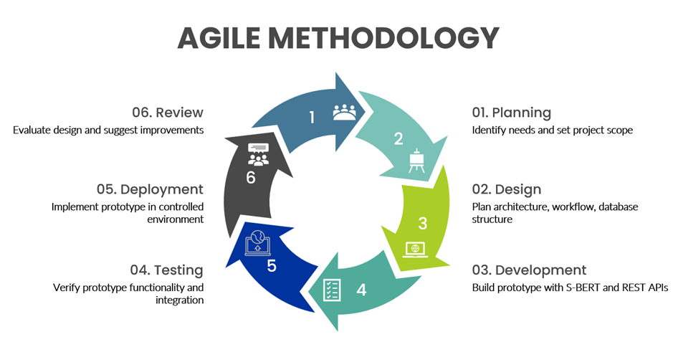
METHODOLOGY

Slide 18
RESULTS

Slide 19
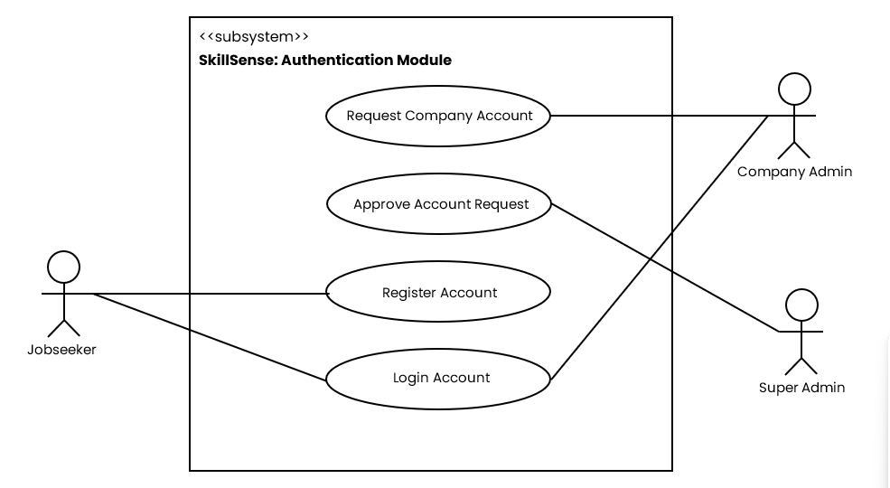
USE CASE DIAGRAM

Slide 20
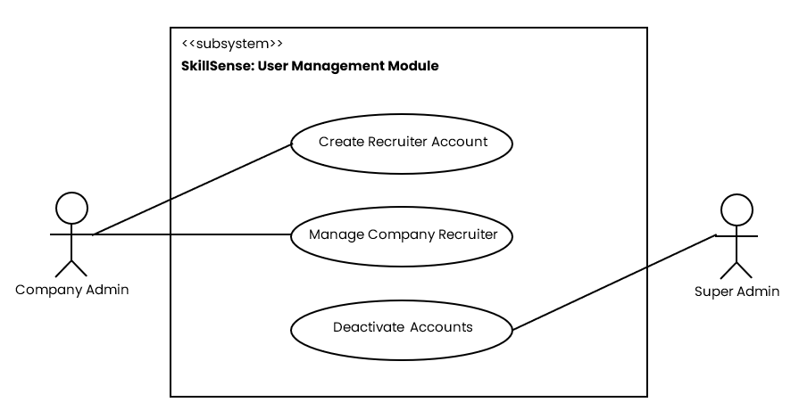
USE CASE DIAGRAM

Slide 21
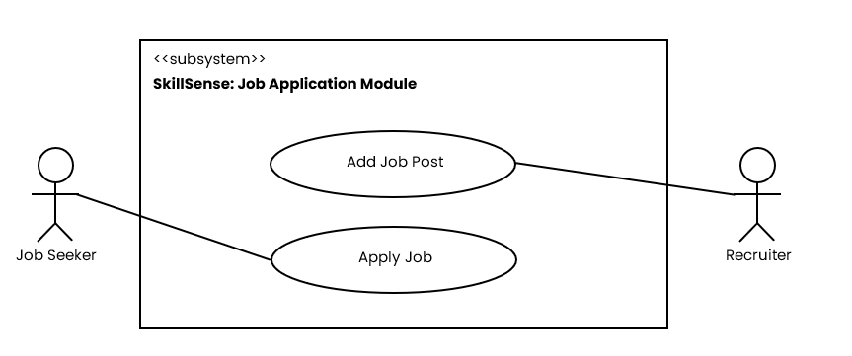
USE CASE DIAGRAM

Slide 22
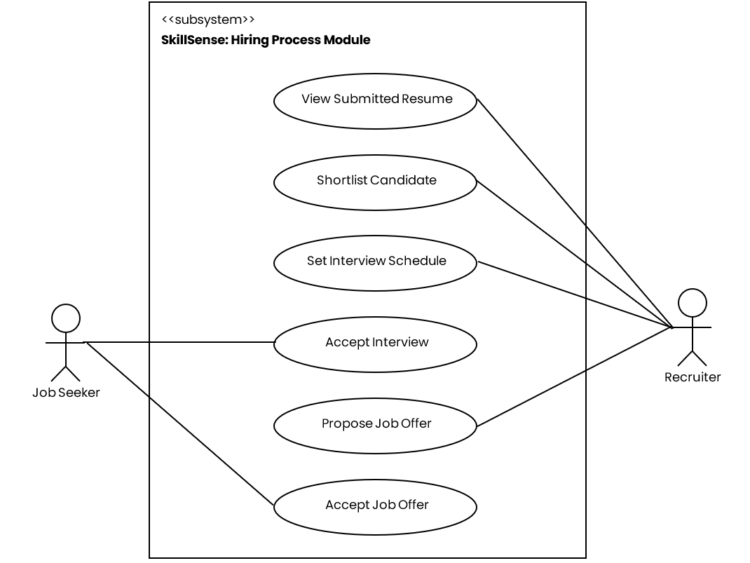
USE CASE DIAGRAM

Slide 23
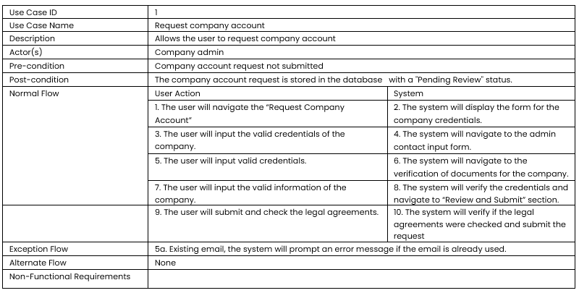
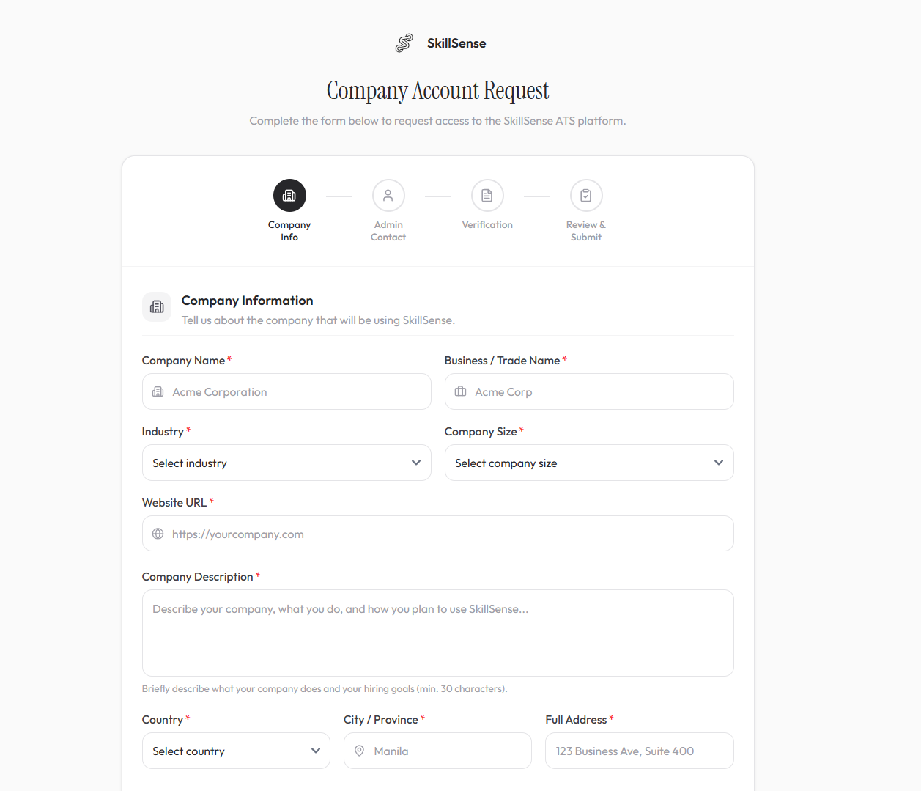
USE CASE DESCRIPTION

Slide 24
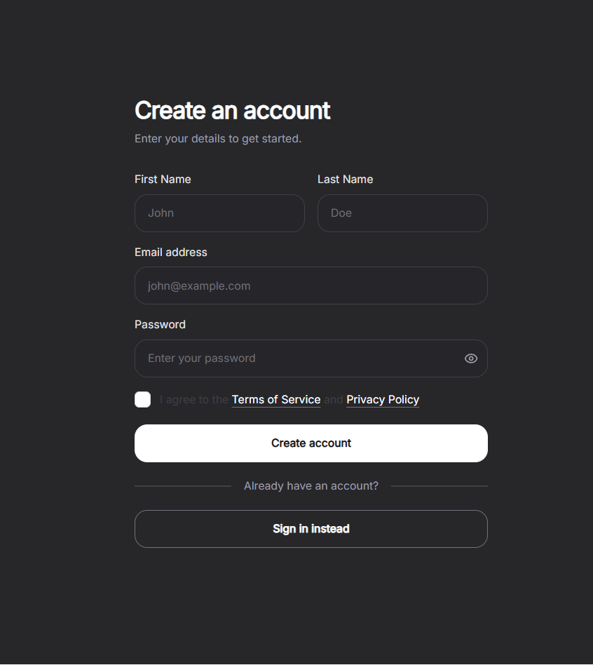
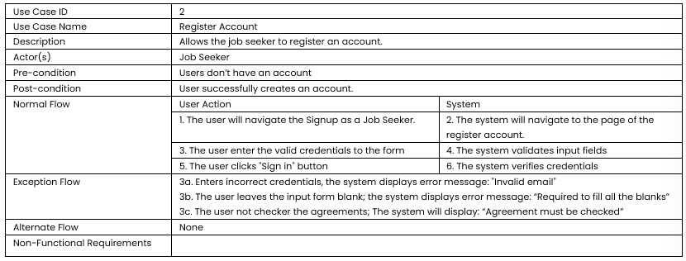
USE CASE DESCRIPTION

Slide 25
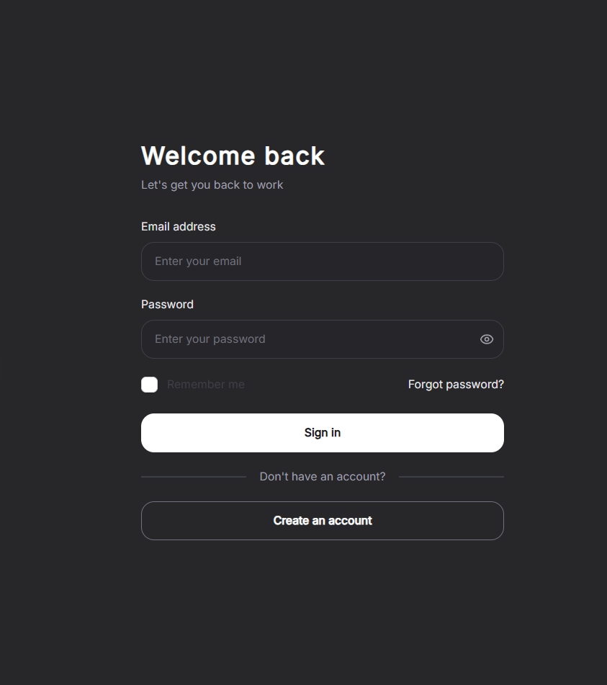
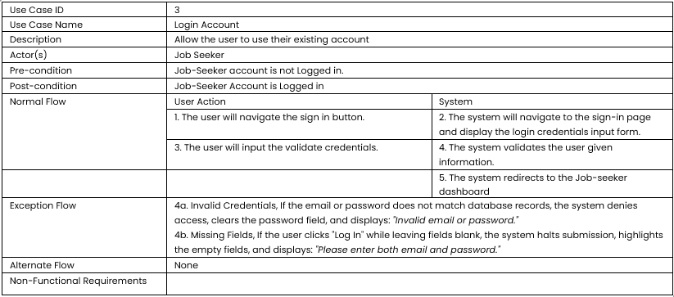
USE CASE DESCRIPTION

Slide 26
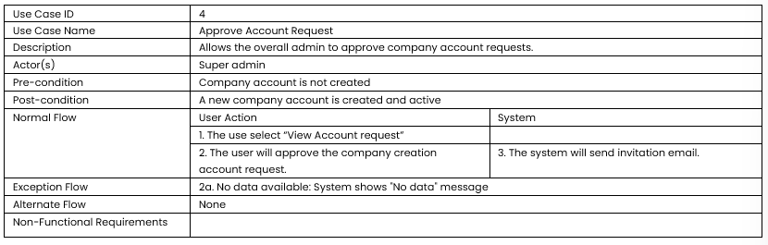
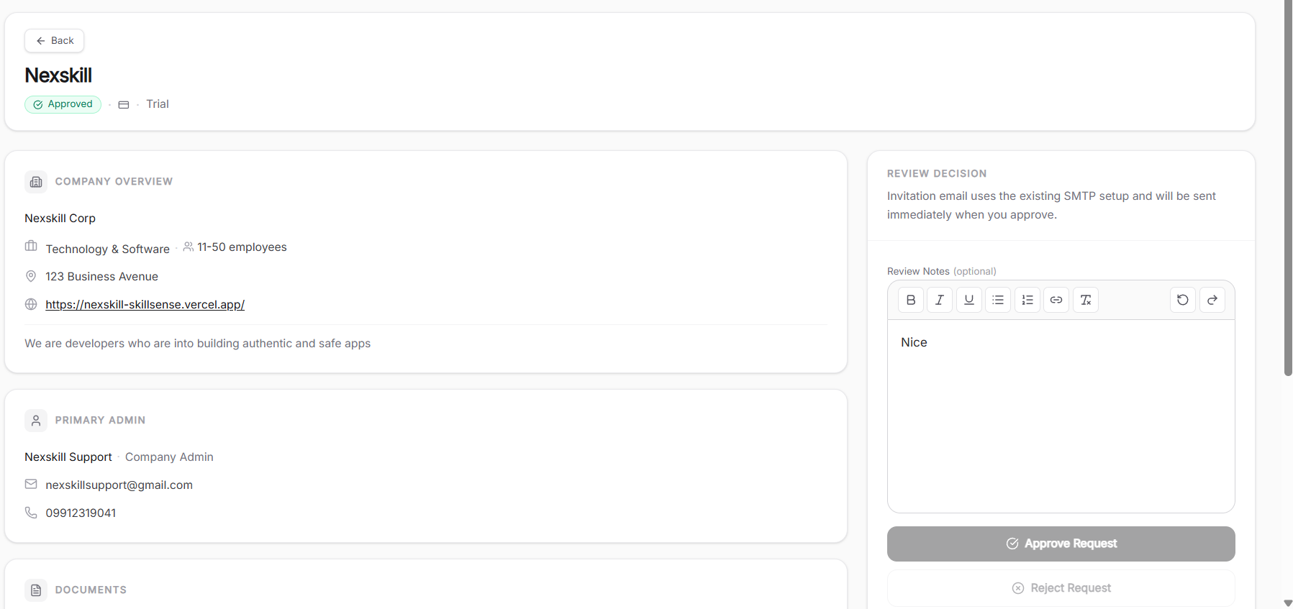
USE CASE DESCRIPTION

Slide 27
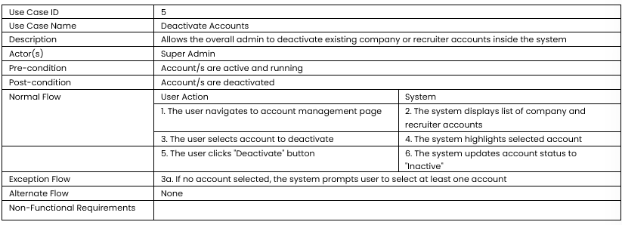
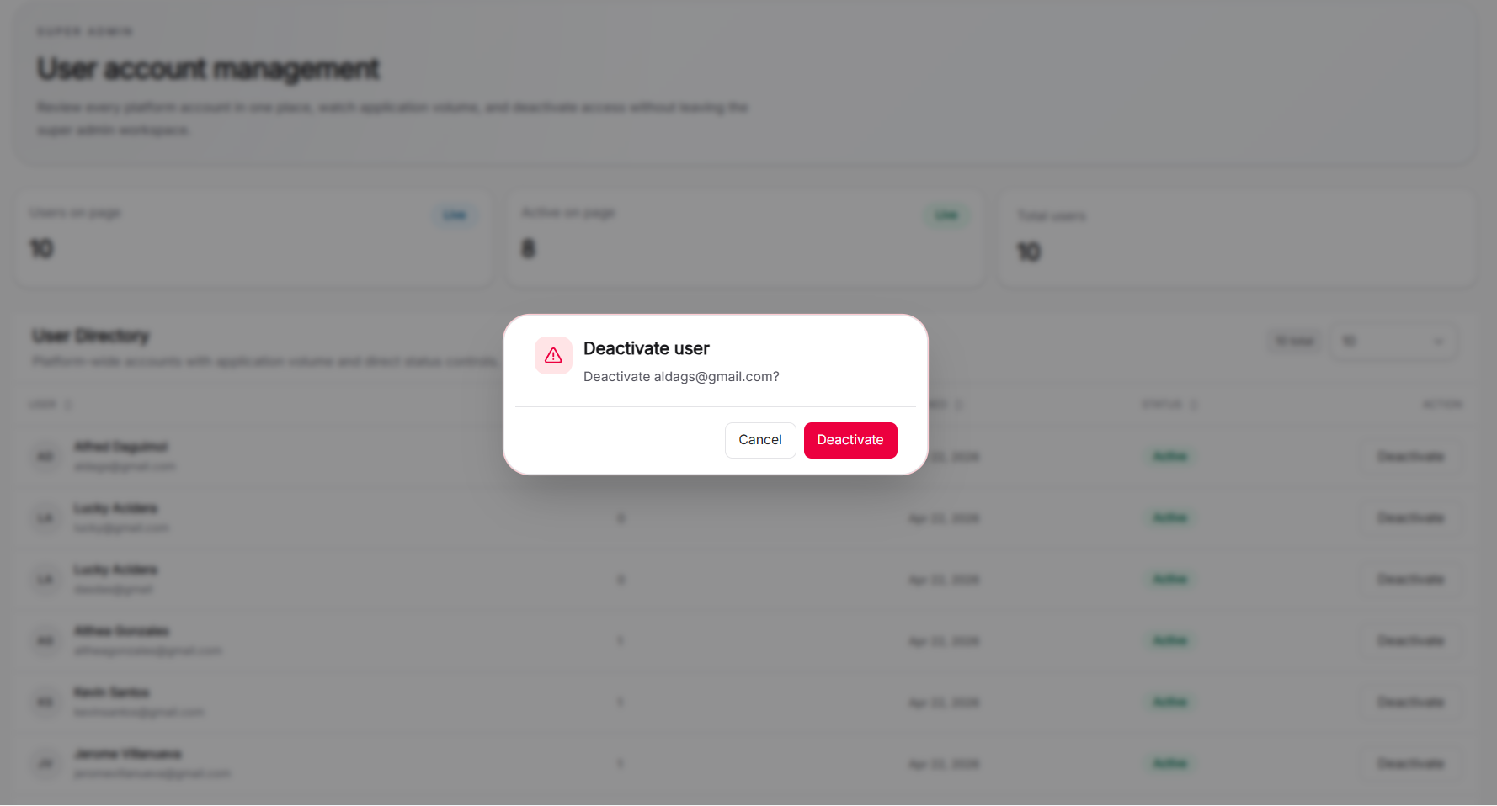
USE CASE DESCRIPTION

Slide 28
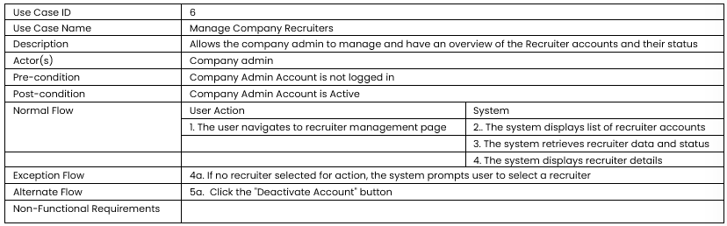
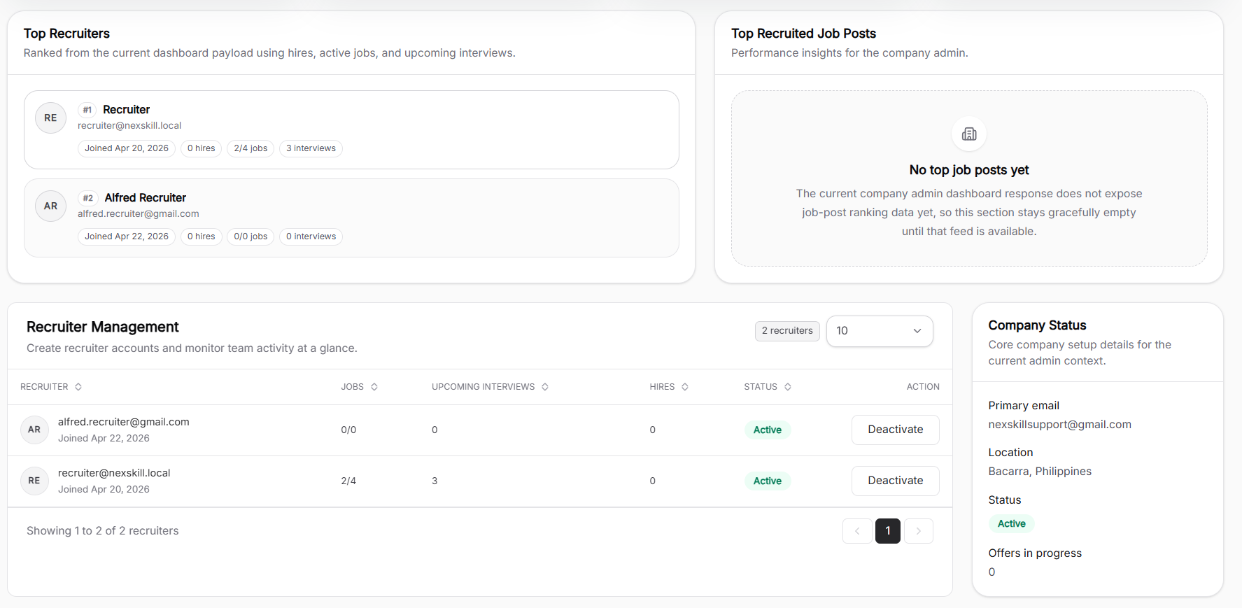
USE CASE DESCRIPTION

Slide 29
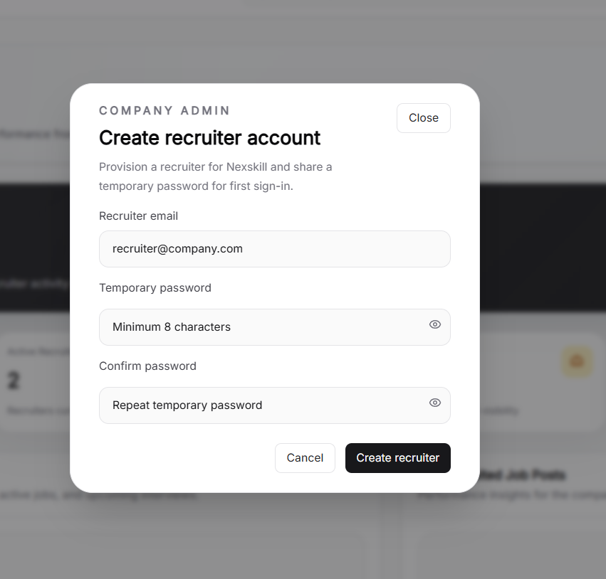
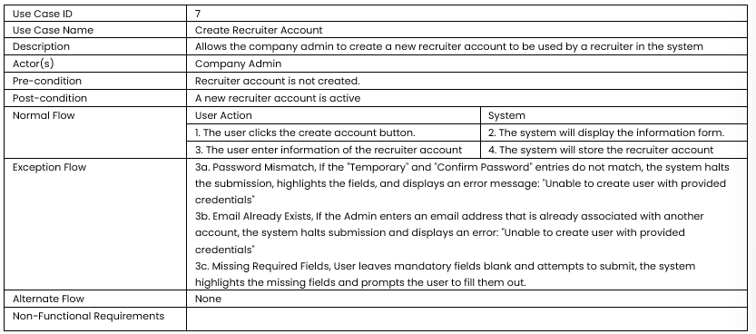
USE CASE DESCRIPTION

Slide 30
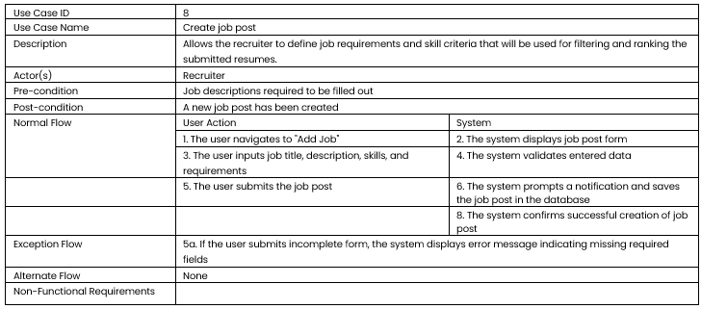
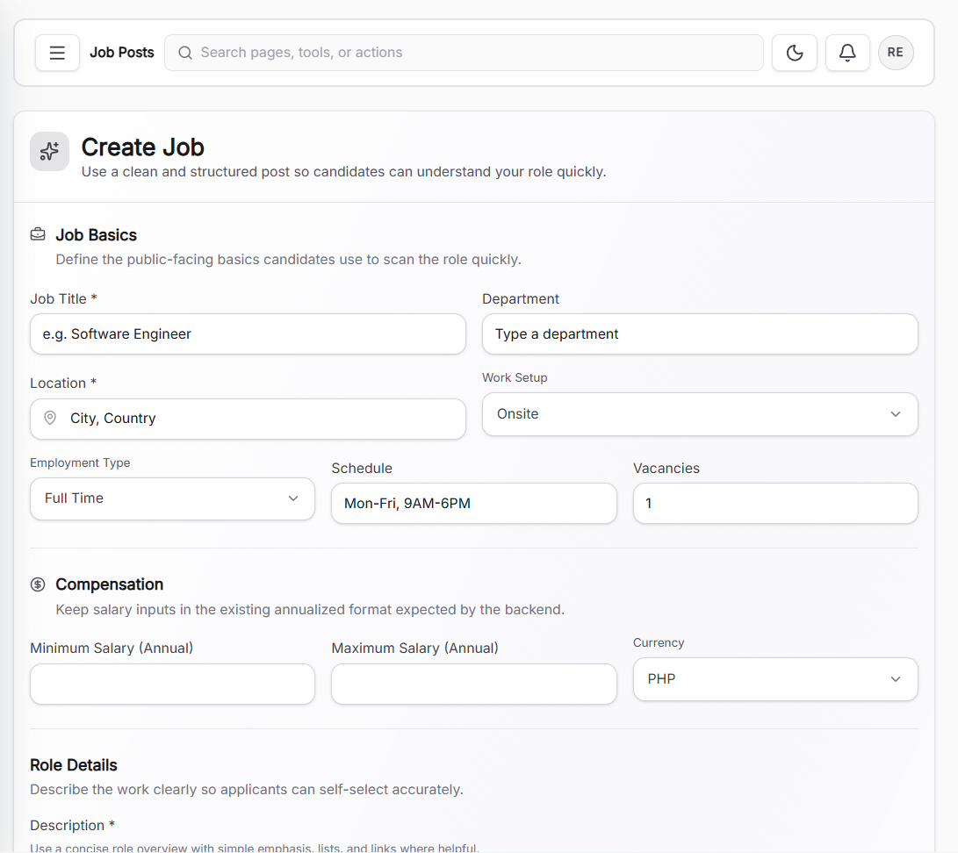
USE CASE DESCRIPTION

Slide 31
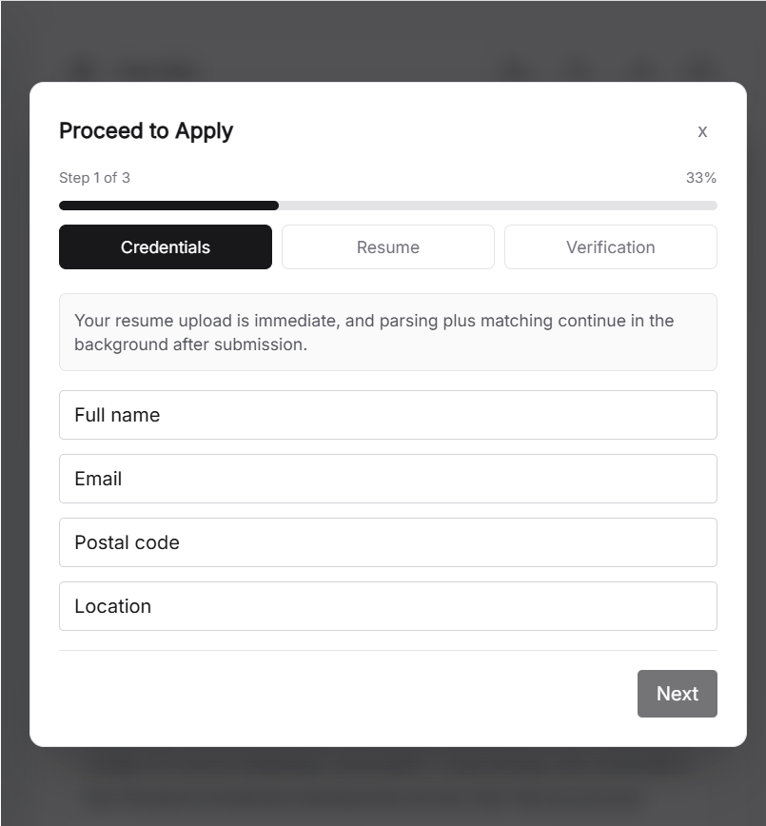
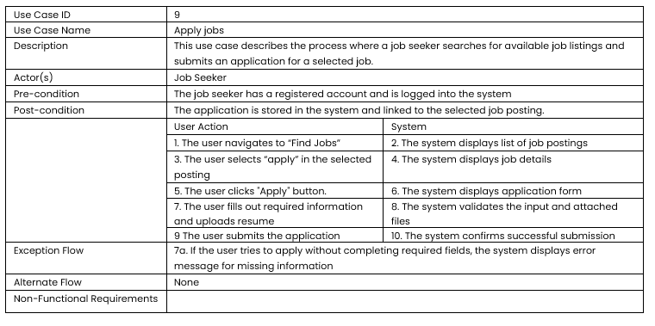
USE CASE DESCRIPTION

Slide 32
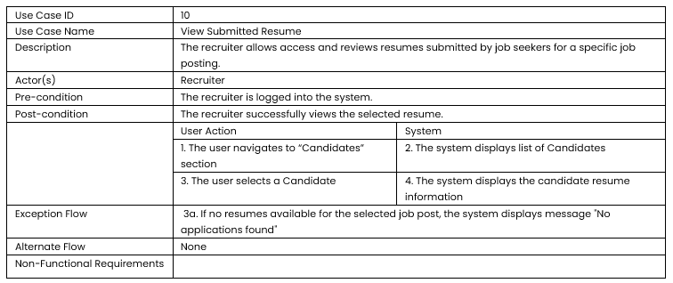
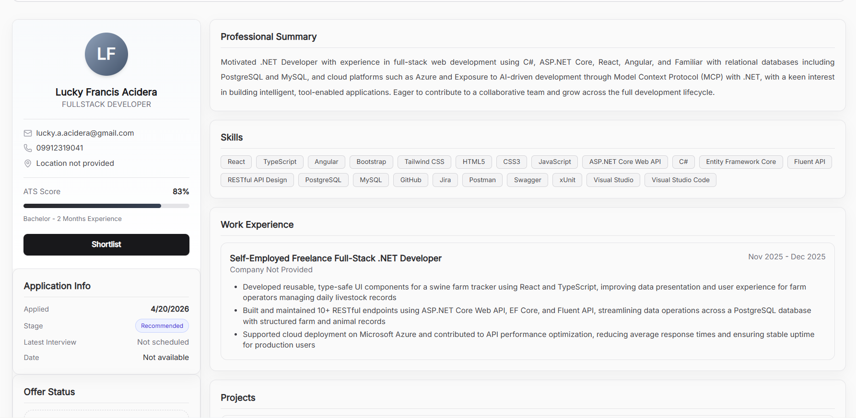
USE CASE DESCRIPTION

Slide 33
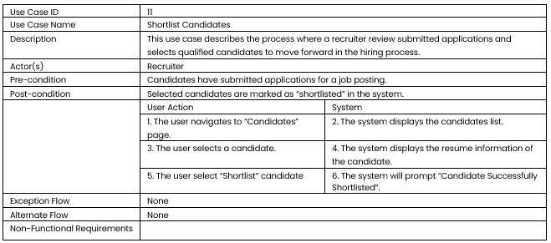
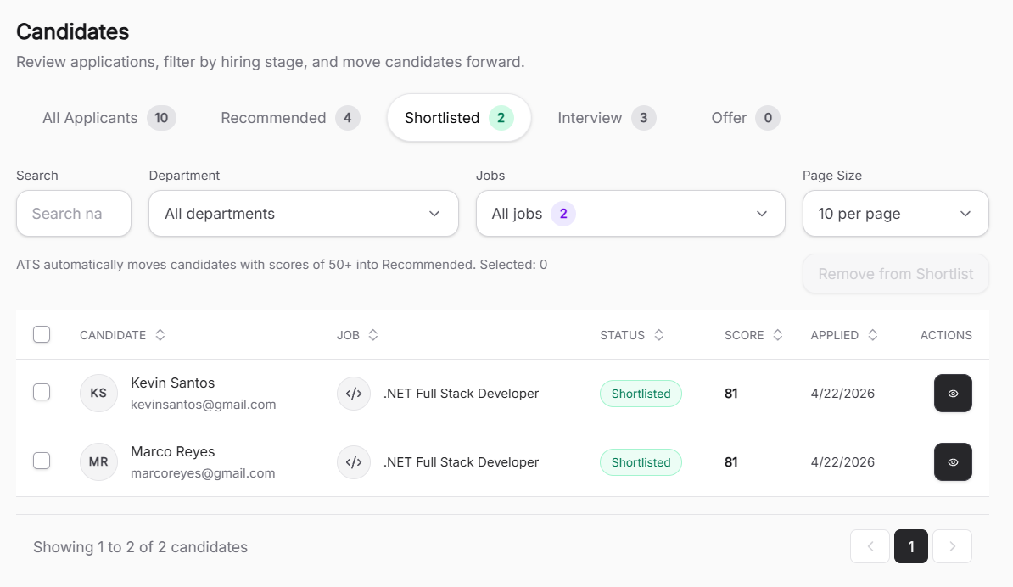
USE CASE DESCRIPTION

Slide 34
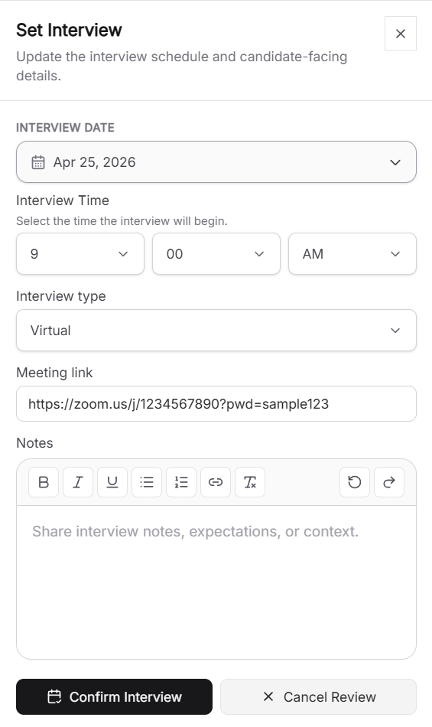
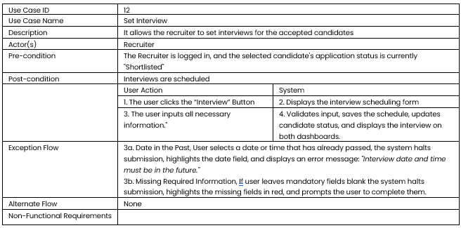
USE CASE DESCRIPTION

Slide 35
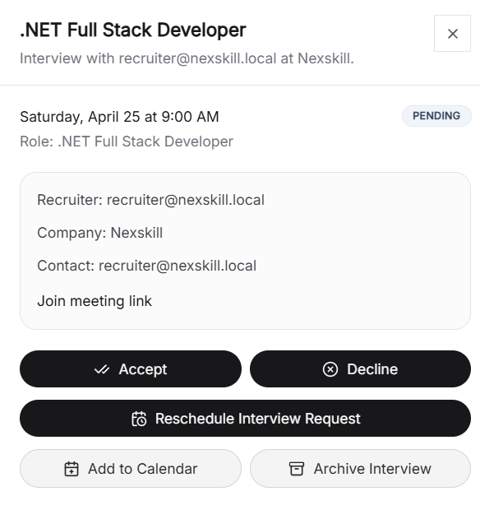
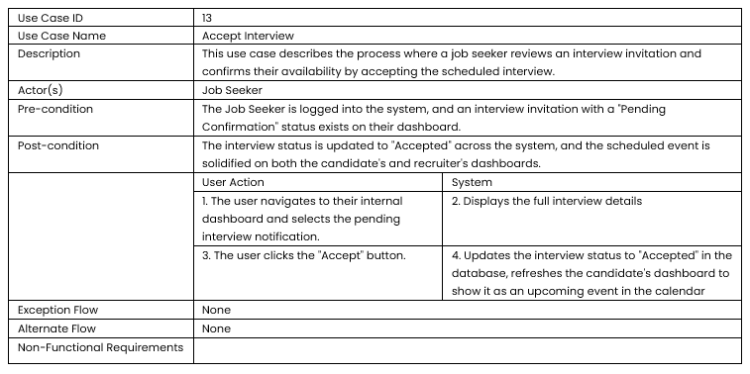
USE CASE DESCRIPTION

Slide 36
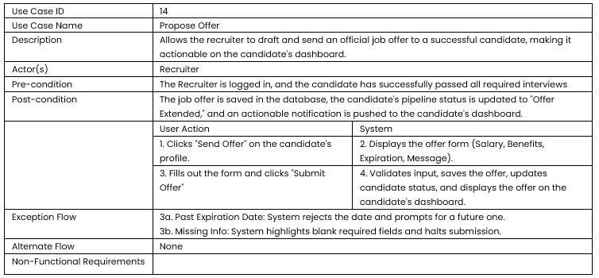
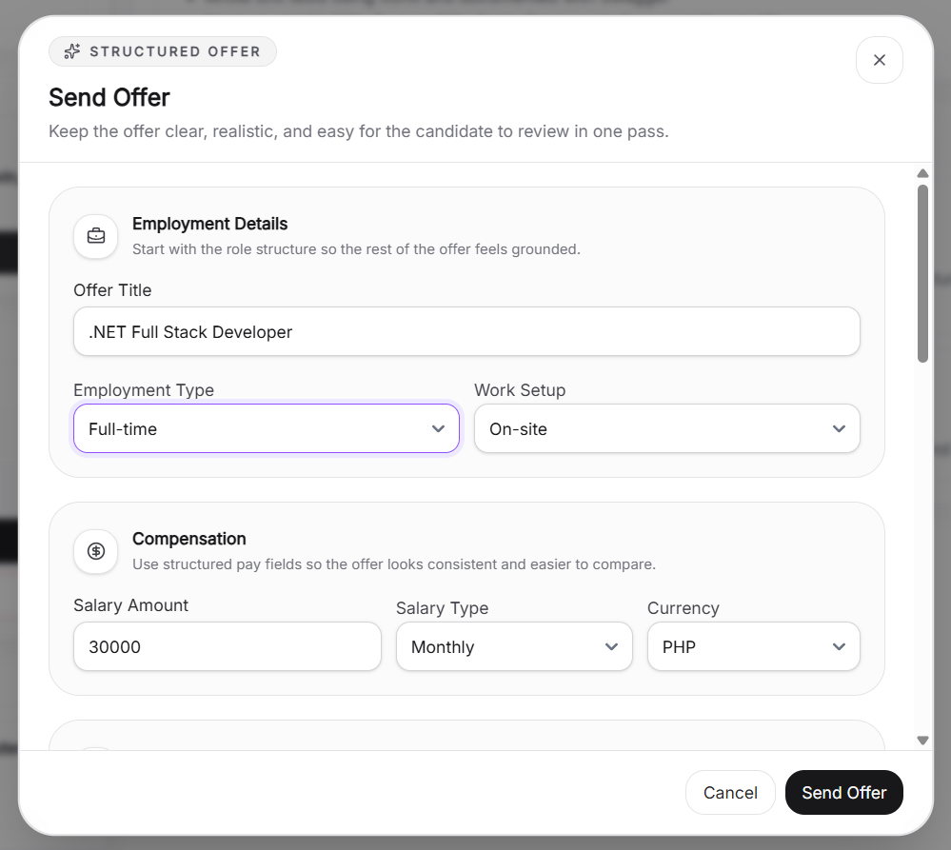
USE CASE DESCRIPTION

Slide 37
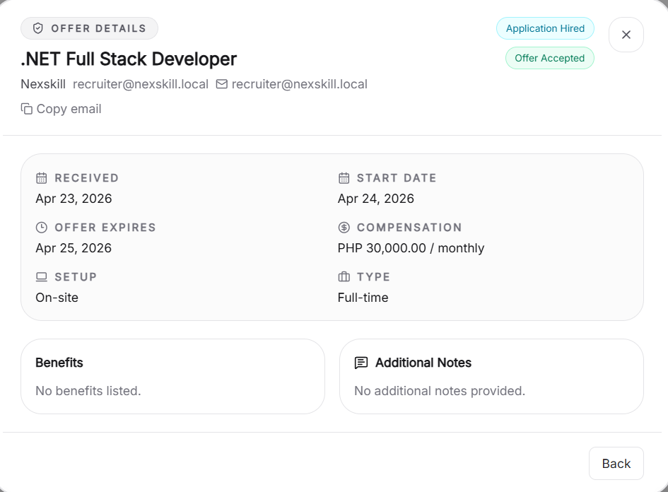
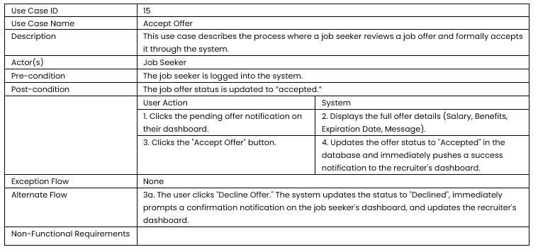
USE CASE DESCRIPTION

Slide 38
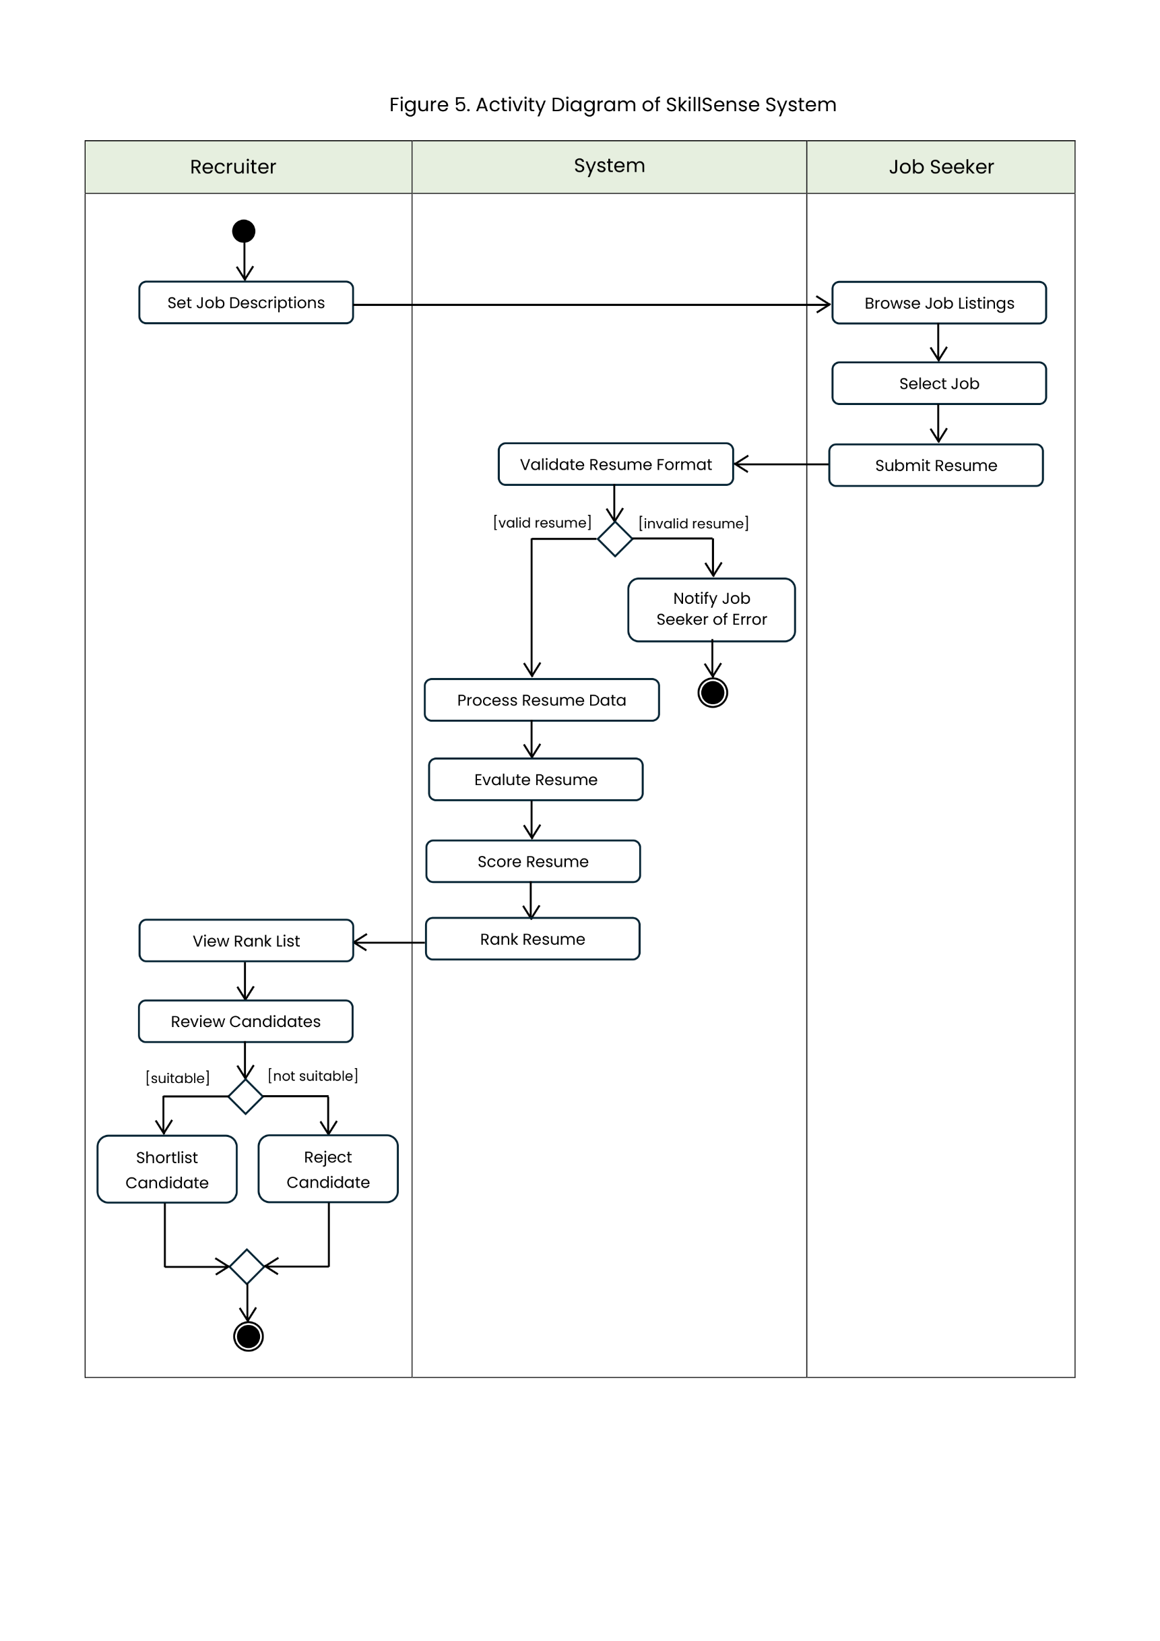
ACTIVITY DIAGRAM

Slide 39
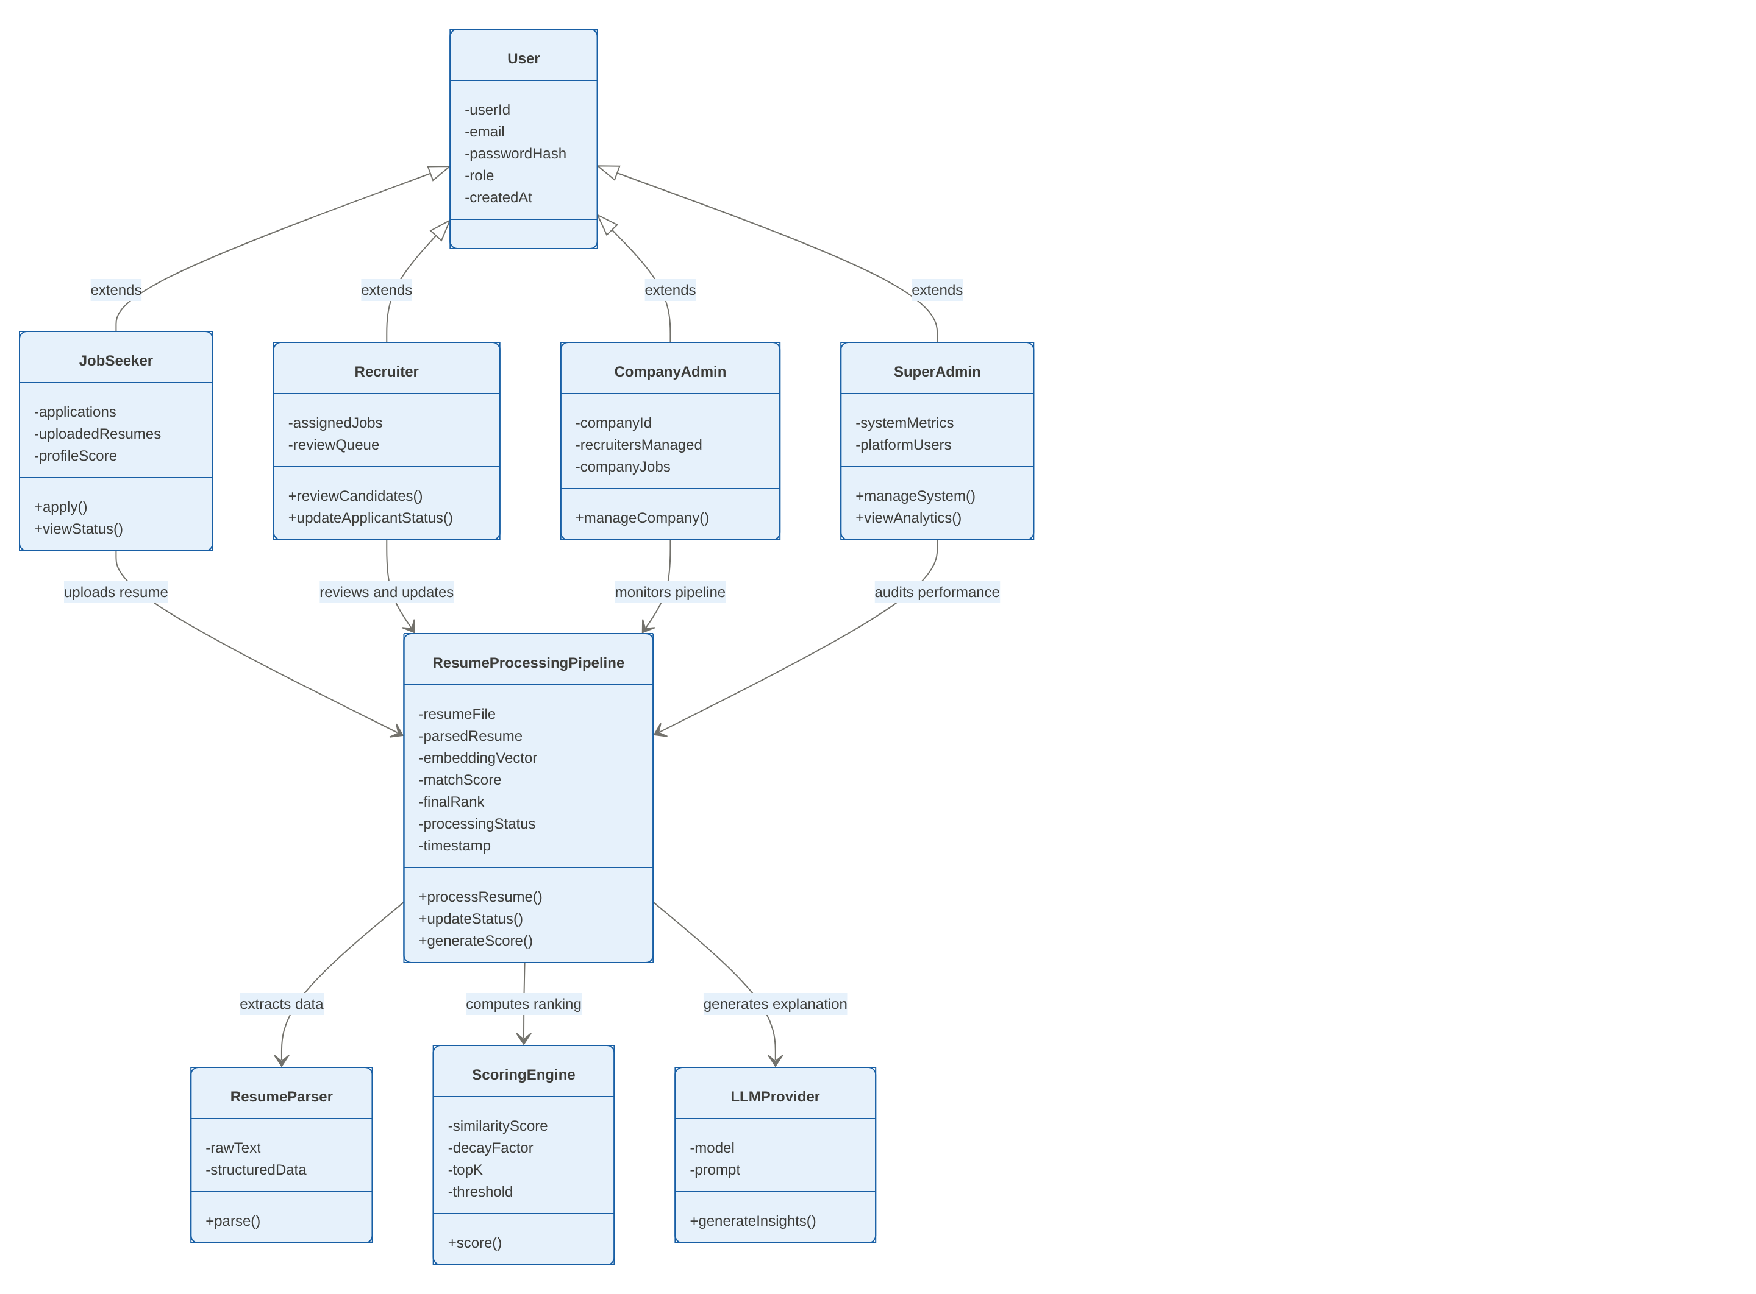
CLASS DIAGRAM

Slide 40
CLASS DIAGRAM

Slide 41
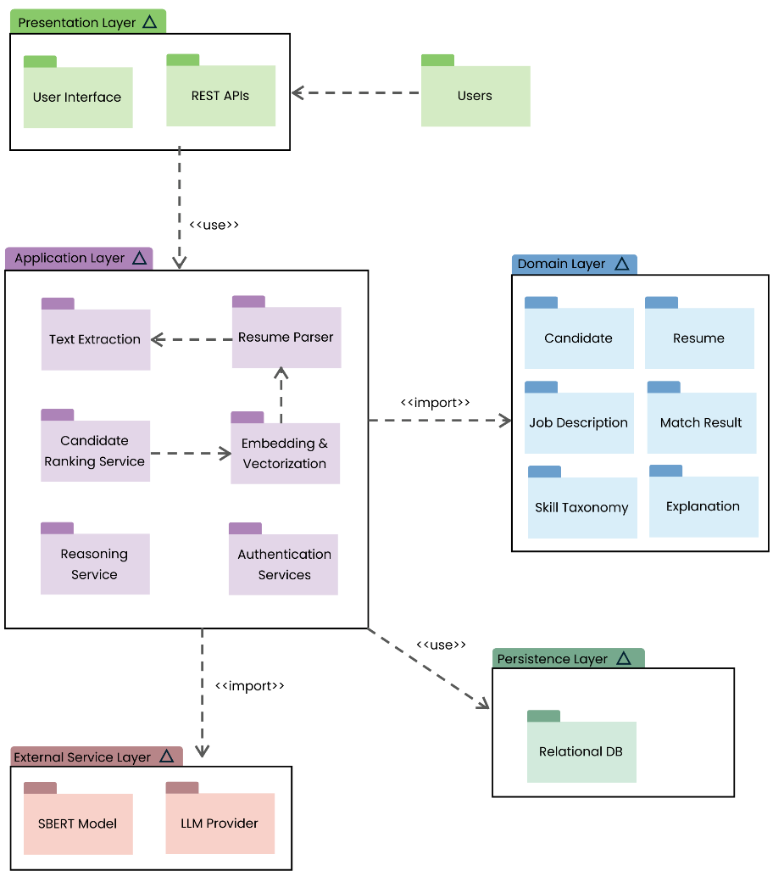
PACKAGE DIAGRAM

Slide 42
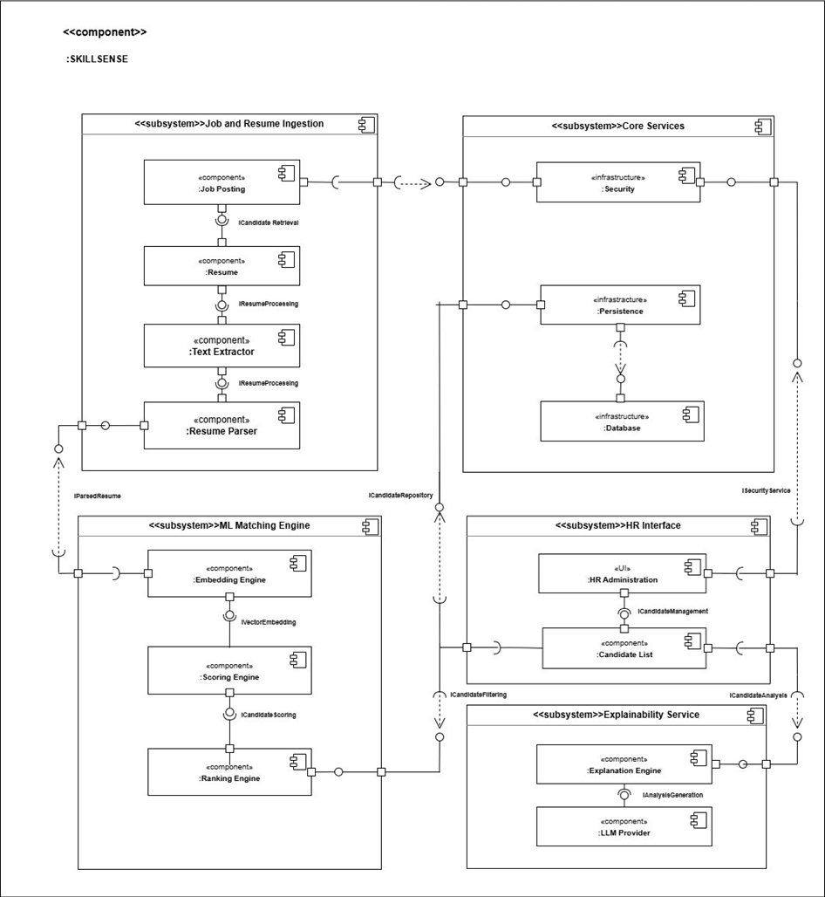
COMPONENT DIAGRAM

Slide 43
COMPONENT DIAGRAM

Slide 44
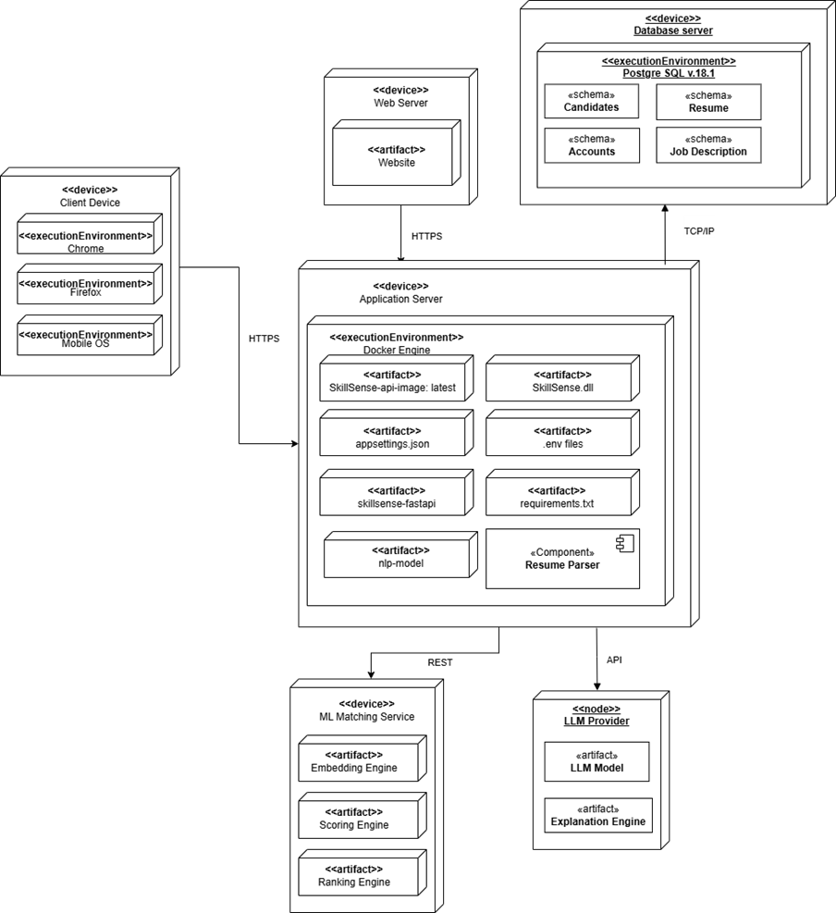
DEPLOYMENT DIAGRAM

Slide 45
User Acceptance Testing Overview
Conducted with 6 respondents
5 fourth year college students and 1 HR expert
Criteria : Functional Suitability, Performance Efficiency, Interaction Capability, Reliability, Security
Evaluated on 5-point Likert Scale
Interval Interpretation:
1.0 - 1.79 = Strongly Disagree
1.80 - 2.59 = Disagree
2.60 - 3.39 = Neutral
3.40 - 4.19 = Agree
4.20 - 5.00 = Strongly Agree

Slide 46
USER ACCEPTANCE TEST RESULTS
Functional Suitability | Weighted Mean
The system allows me to upload and manage my resume efficiently. | 5
The system successfully submits my application after the resume upload process. | 4.6
The system allows me to browse and save job listings for future reference. | 4.2
The system accurately tracks and displays the status of my submitted applications. | 4.6
Functional Suitability: 4.6 – Strongly Agree

Slide 47
USER ACCEPTANCE TEST RESULTS
Performance Efficiency | Weighted Mean
The system processes my uploaded resume within an acceptable amount of time. | 4.8
The system loads job listings quickly and without delay. | 4.6
The system updates and displays my application status efficiently. | 4.4
The system loads my saved jobs without significant delays. | 4.8
The system maintains good performance when browsing and submitting applications simultaneously. | 4.6
Performance Efficiency: 4.64– Strongly Agree

Slide 48
USER ACCEPTANCE TEST RESULTS
Interaction Capability | Weighted Mean
The system interface is clear and easy to understand. | 4.4
The application process can be completed without difficulty. | 4.2
Browsing and saving jobs is intuitive and straightforward. | 4.8
Tracking my application status is easy to access and understand. | 4.6
The layout and design of the system are organized and user-friendly. | 4.4
Interaction Capability: 4.48– Strongly Agree

Slide 49
USER ACCEPTANCE TEST RESULTS
Reliability | Weighted Mean
The system performs the resume upload and application process without errors under normal operation | 5
The system is accessible and available whenever I need to browse jobs or track my application | 4.8
The system operates without unexpected crashes or failures during browsing and application. | 4.6
My saved jobs remain accessible and are not lost between sessions. | 4.8
Reliability Mean: 4.80 – Strongly Agree

Slide 50
USER ACCEPTANCE TEST RESULTS
Security | Weighted Mean
The system requires proper login authentication before accessing my account. | 4.8
My uploaded resume appears to be securely stored in the system. | 4.6
The system ensures that my submitted data cannot be modified without proper authorization. | 4.6
Reliability Mean: 4.67 – Strongly Agree

Slide 51
USER ACCEPTANCE TEST RESULTS (RECRUITER)
Functional Suitability | Score
The system accurately extracts relevant information such as skills, education, and experience from applicant resumes. | 5
The system provides accurate ranking or scoring of applicants based on their qualifications. | 5
The system allows me to view and manage submitted applicant resumes efficiently. | 4
The system enables me to shortlist and evaluate candidates based on the generated scores. | 5
Functional Suitability Mean: 4.75 – Strongly Agree

Slide 52
USER ACCEPTANCE TEST RESULTS (RECRUITER)
Performance Efficiency | Score
The system processes uploaded resumes within an acceptable amount of time. | 5
The system generates ranking results quickly after resume analysis. | 4
The system provides AI-generated explanations without significant delays. | 4
The system loads candidate evaluations and ranking results efficiently. | 5
Performance Efficiency Mean: 4.50 – Strongly Agree

Slide 53
USER ACCEPTANCE TEST RESULTS (RECRUITER)
Interaction Capability | Score
The system interface is clear and easy to navigate for candidate evaluation. | 3
The system provides intuitive navigation for accessing screening results and candidate explanations. | 4
The AI-generated insights displayed after shortlisting a candidate are clear and helpful for evaluation decisions. | 4
The layout and design of the system are organized and user-friendly. | 3
Interaction Capability Mean: 3.50 – Agree

Slide 54
USER ACCEPTANCE TEST RESULTS (RECRUITER)
Reliability | Score
The system processes uploaded resumes within an acceptable amount of time. | 5
The system generates ranking results quickly after resume analysis. | 5
The system provides AI-generated explanations without significant delays. | 5
The system loads candidate evaluations and ranking results efficiently. | 5
Reliability Mean: 5.0 – Strongly Agree

Slide 55
USER ACCEPTANCE TEST RESULTS (RECRUITER)
Security | Score
The system requires proper login authentication before accessing recruiter functions. | 4
The system prevents unauthorized access to applicant resumes and personal data. | 4
The system ensures that candidate data cannot be modified without proper authorization. | 4
Security Mean: 4.0 – Agree

Slide 56
USER ACCEPTANCE TEST RESULTS (RECRUITER)
Security | Score
The system requires proper login authentication before accessing recruiter functions. | 4
The system prevents unauthorized access to applicant resumes and personal data. | 4
The system ensures that candidate data cannot be modified without proper authorization. | 4
Security Mean: 4.0 – Agree

Slide 57
TEST CASES : SKILLSENSE VS KEYWORD ATS
Resume | Test Case Category | Expected ATS Score | Expected SkillSense Score
1 | Perfect Match | High | High
2 | Different Terminology | Low–Medium | High
3 | Career Changer | Low | Medium–High
4 | Keyword-Stuffed | High | Low–High
5 | Clearly Unqualified | Low | Low

Slide 58
TEST CASES : SKILLSENSE VS KEYWORD ATS
Resume Scores Across Test Cases: Keyword-Based Apps and SkillSense
Resume # | SkillSense | ResyMatch.io | SkillSyncer | ResumeWorded
1 | 81 | 63 | 81 | 95
2 | 79 | 52 | 44 | 53
3 | 78 | 38 | 50 | 72
4 | 81 | 50 | 73 | 95
5 | 25 | 41 | 30 | 8

Slide 59
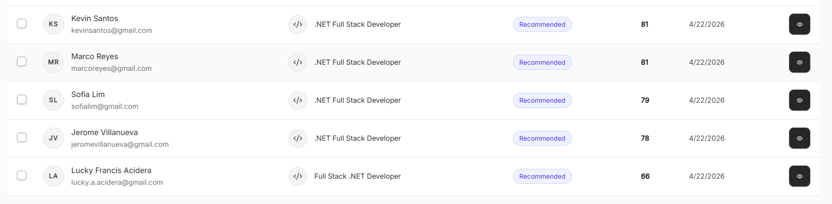
TEST CASES : SKILLSENSE VS KEYWORD ATS
APP : SKILLSENSE
T4
T1
T2
T3
T5

Slide 60
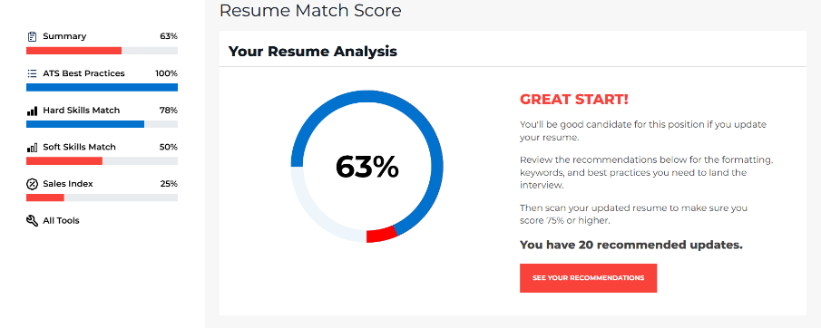
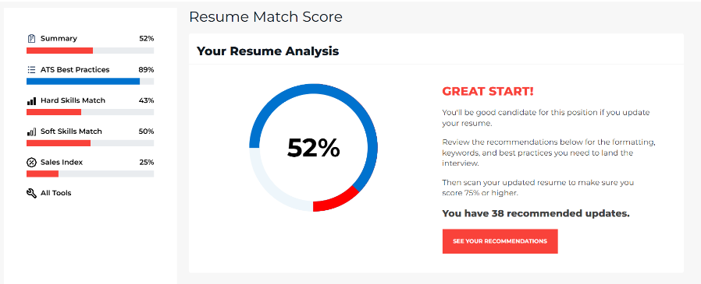
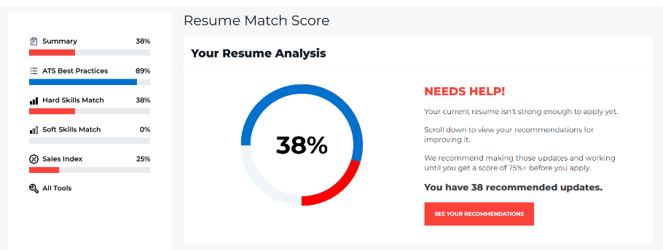
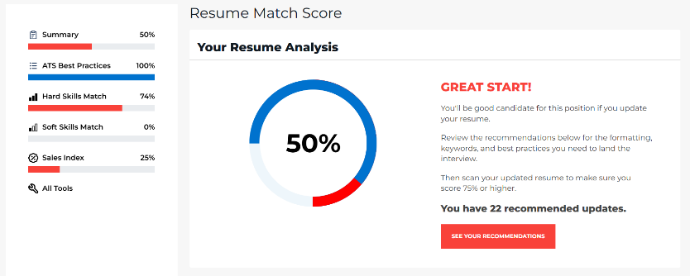
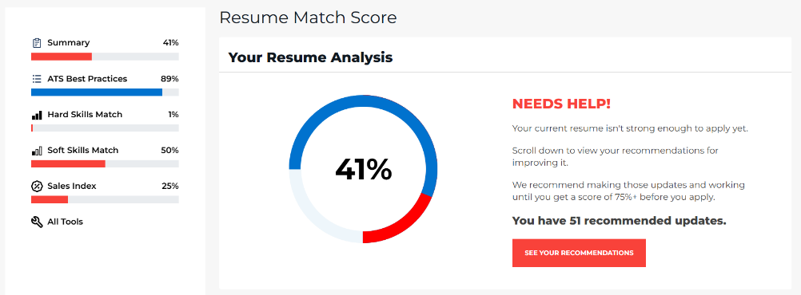
TEST CASES : SKILLSENSE VS KEYWORD ATS
APP : ResyMatch.io

Slide 61
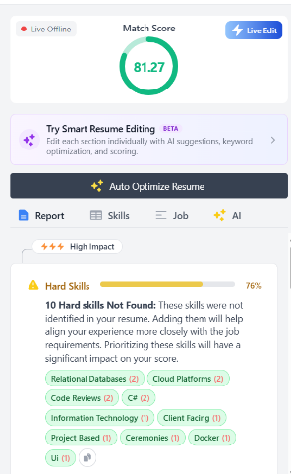
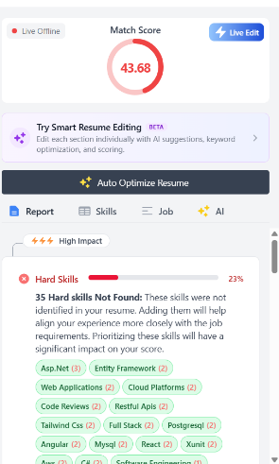
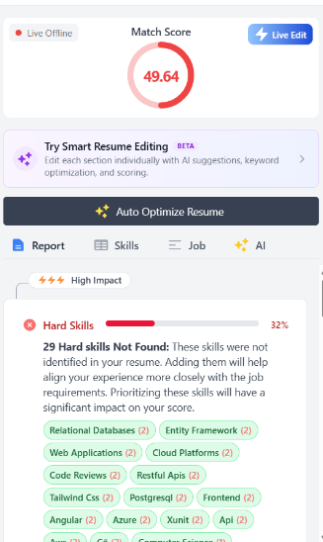


TEST CASES : SKILLSENSE VS KEYWORD ATS
APP : SkillSyncer.io

Slide 62





TEST CASES : SKILLSENSE VS KEYWORD ATS
APP : ResumeWorded

Slide 63
CONCLUSIONS AND RECOMMENDATIONS

Slide 64
CONCLUSION
Keyword-based screening systems misrank candidates who use different but equivalent terminology
Context-aware evaluation improves identification of relevant skills and reduces false rejections
Higher scores compared to existing tools (e.g., 79 vs 52 vs 44; 78 vs 38) demonstrate better recognition of equivalent and transferable skills
Combining semantic matching with structured scoring produces more accurate and nuanced candidate rankings
Performance is limited by lack of domain adaptation, static skill mapping, and restricted evidence aggregation

Slide 65
RECOMMENDATION
Fine-tune S-BERT on domain-specific data
Use ontology-based skills (ESCO / O*NET)
Replace Top-K with dynamic or attention-based scoring
Support multilingual models (LaBSE / mSBERT)
Expand beyond IT to other industries
Validate via real-world deployment

Slide 66
LITERATURE CITED

Slide 67


Slide 68


Slide 69


Slide 70


Slide 71


Slide 72
APPENDICES

