Slide 1

TCCI : Title Contention Composite index
Leonardo Agate 1945534
Francesco Natali 1945581

Slide 2
Index
Purpose of TCCI
Data
Methodologies
Historic Performance
Offensive index
Difensive index
Market index
Results
Results
Leonardo Agate e Francesco Natali
TCCI : Title Contention Composite index

Slide 3
To assess a football teams likelihood of winning the league title by considering their historical performance, difensive, attacking skill during the season and the financial power of the teams.
This index can help to identify the favourites track changes in title contention through the seasons and potentially spot under performance teams.
Purpose of TCCI
Leonardo Agate e Francesco Natali
TCCI : Title Contention Composite index

Slide 4


The index was build using the data available from Optascore and TransferMarkt.
The first one was useful to collect information for the analysis for the game stats.
The second one was used to analyze the financial status and the investment made by the football societies.
We have considered the data from the season 2015/2016 to the session 2022/2023
Data
Leonardo Agate e Francesco Natali
TCCI : Title Contention Composite index

Slide 5
The analysis was conducted in time series in order to compare the actual rank with the index one.
For this reason we have used the AMPI method since the individual indicators are normalized by a re-scaling according to two «goalposts»,i.e a minimum and a maximum value which represent the possible range of each variable of all time variable and for all units.
Such type of normalization allow to performe absolute comparisons over time
Then the TCCI is composed by 4 weighted sub index :
TCCI=0.3*Off index + 0.3*Dif index + 0.2*Hist performance +0.2*Mark index
Methodologies
Leonardo Agate e Francesco Natali
TCCI : Title Contention Composite index

Slide 6
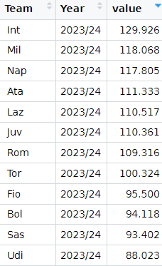
Historic performance index
Position in the league
Average points
Points in big match
Titles won
Number of european matches
Goal difference
Domestic cup won during the season
Historic title league won
Leonardo Agate e Francesco Natali
TCCI : Title Contention Composite index

Slide 7
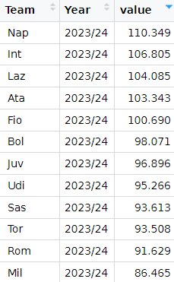
Offensive index
Difference between expected goal scored and actual goal scored
Average Shoot per game
Expected goal
Average passes completed
Perc of dribbling
Ball possession per game
Leonardo Agate e Francesco Natali
TCCI : Title Contention Composite index

Slide 8
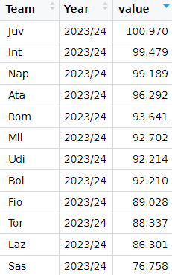
Difensive index
Difference between expected goal conceded and actual goal conceded
Average Shoot in target
Expected goal conceded
Tackles won per game
Interceptions
Perc of football saves per game
Number of cleansheet
Sum of yellow and red cards
Fouls per game
Ball recover per game
Leonardo Agate e Francesco Natali
TCCI : Title Contention Composite index

Slide 9
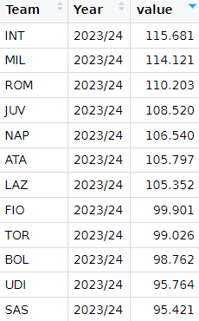
Market index
Financial stable of the club
Money spent in the session
Average value of the team
Financial debt of team
Number of players with market value>40 millions
Average stadium spectators
Wage of coach
Cost of the team(sum of annual value of players+ average wages for year)
Leonardo Agate e Francesco Natali
TCCI : Title Contention Composite index

Slide 10
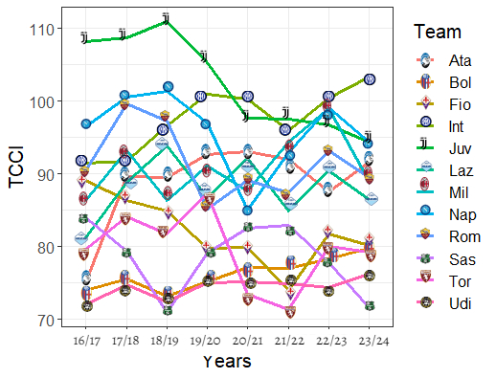
Results
Leonardo Agate e Francesco Natali
TCCI : Title Contention Composite index

Slide 11
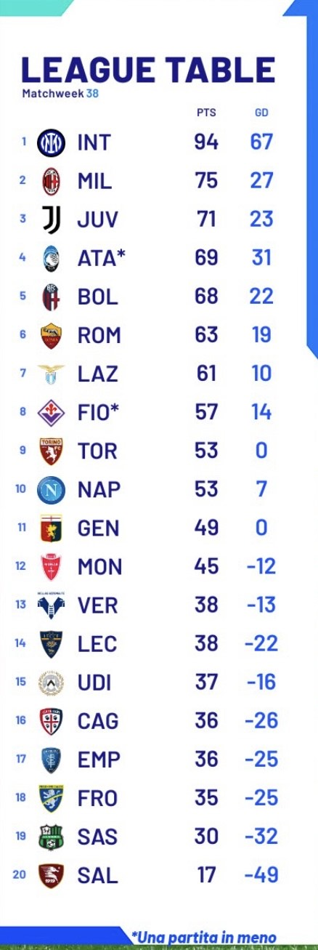
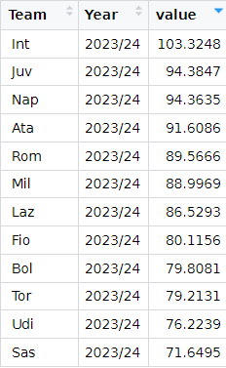
Results
Leonardo Agate e Francesco Natali
TCCI : Title Contention Composite index

