Slide 1
Delivery market analysis: Flanders and Brussels
10/01/2025
Frank, Alek and Miro(?)

Slide 2
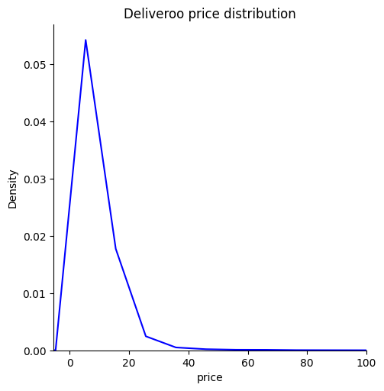
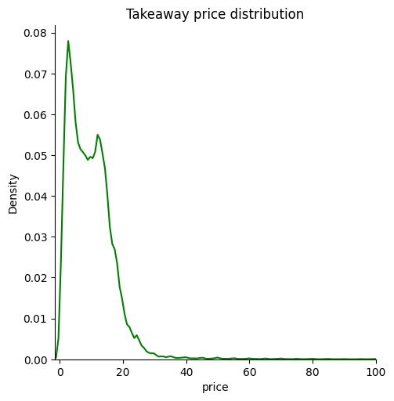
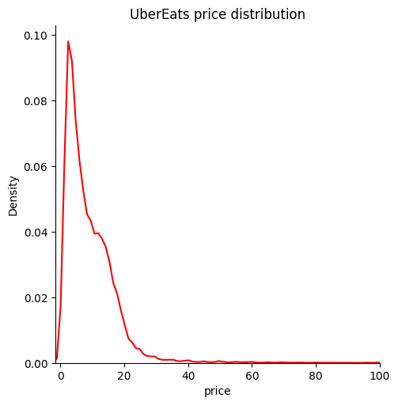
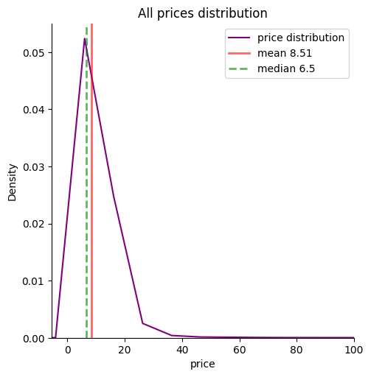
Menu items and delivery pricing
Mean price: 8.51 € Median price: 6.50 €
Average delivery Deliveroo 4.96 €
Average delivery Takeaway 2.70 €
Uber Eats delivery fee depends on order

Slide 3
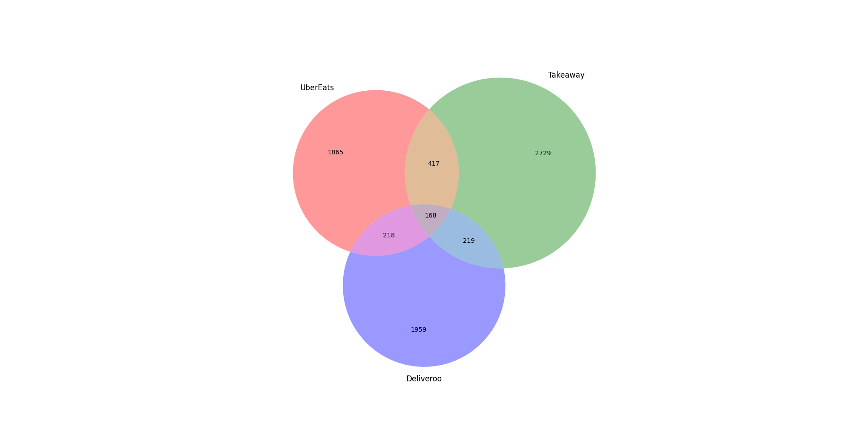
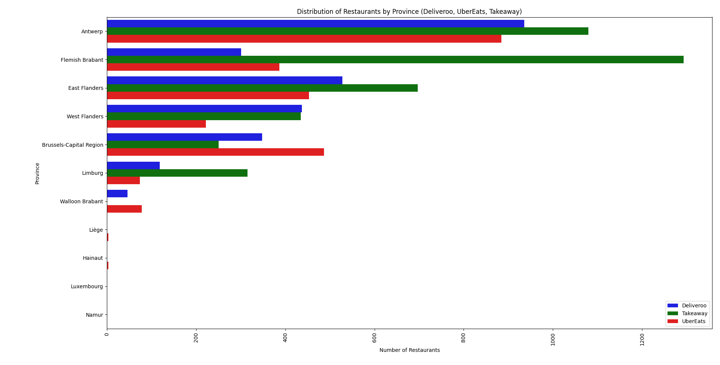
Distribution of restaurants across space and platforms

Slide 4
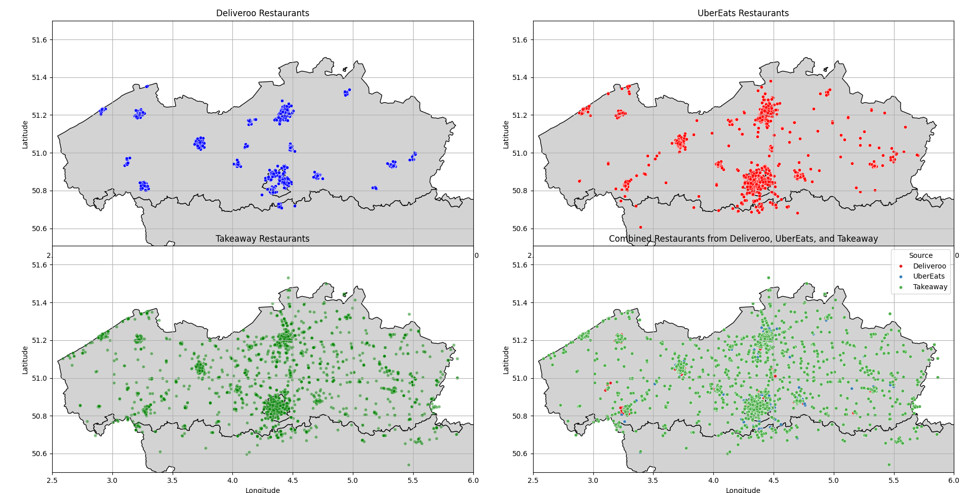

Slide 5
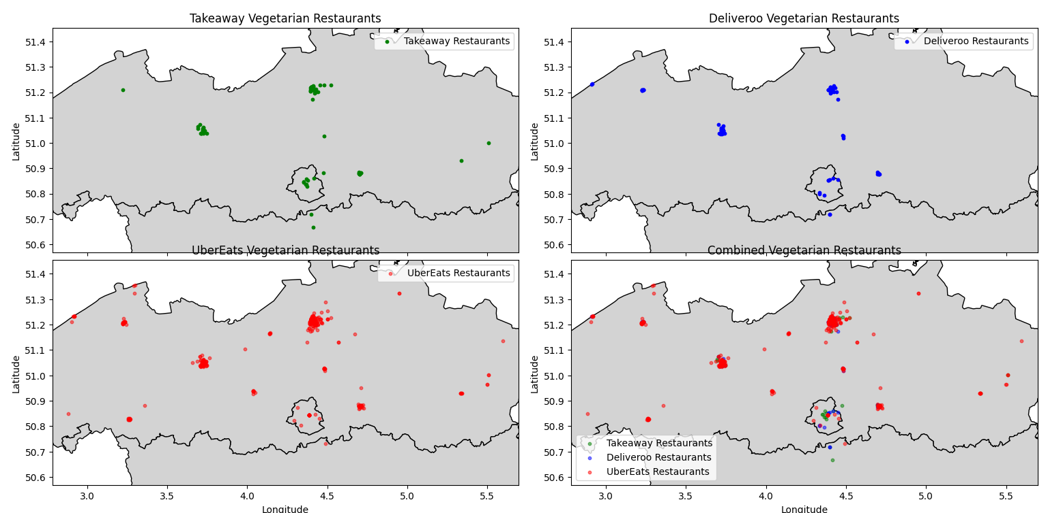

Slide 6
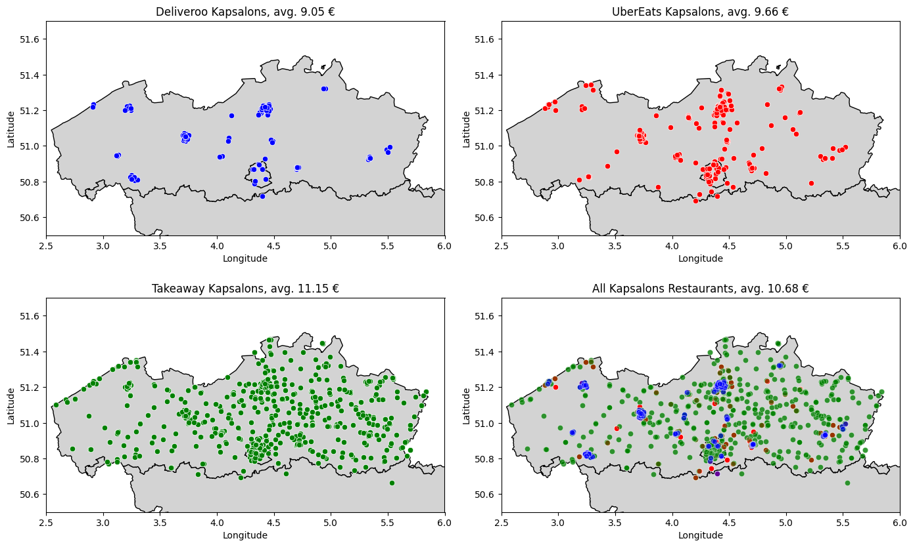

Slide 7
Top pizzas and hummus
Deliveroo
Place 2 Eat, Roeselare, 4.6 ⭐
Les Deux Petits Diables, Auderghem, 4.6 ⭐
Pizza Hut Strombeek-Bever, 4.6 ⭐
La Barchetta, Wolouwe, 4.6 ⭐
Pretzel King, Roeselare, 4.6 ⭐
Sforno, Bruges, 4.6 ⭐
Keurslager Michielsen, Antwerp, 4.6 ⭐
Da Toni, Kraainem, 4.5 ⭐
Plant a Pizza, Ghent, 4.5 ⭐
Tutti Atelier, Wolouwe, 4.5 ⭐
Takeaway
De Echte Eethuis Carlos, Aarschot, 5 ⭐
Veziroglu, Vilvorde, 5 ⭐
Kebap - Pizza De Brug, Hasselt, 5 ⭐
Trend Kebab & Pizzeria, Maaseik, 5 ⭐
Pizza Minute, Schaerbeek, 4.9 ⭐
Pizza Heat, Wetteren, 4.9 ⭐
Pitza Service, Sint-Niklaas, 4.9 ⭐
Pizza Time Evergem, 4.9 ⭐
Baskent Meerhout, 4.9 ⭐
Pitta Seker, Aalst, 4.9 ⭐

Slide 8
Top pizzas and hummus
Uber Eats
Pizza Autentica, Wemmel, 4.9 ⭐
Pizarro, Antwerp, 4.8 ⭐
Kalura, Antwerp, 4.8 ⭐
Pizzeria Gloria, Alsemberg, 4.7 ⭐
Great Market – Traiteur, Schaerbeek, 4.7 ⭐
MiTo Orban / Milano Torino, Woluwe, 4.7 ⭐
Pita Amon, Antwerp, 4.7 ⭐
Pizzeria Saporito, Aalst, 4.6 ⭐
Pizza Pasta Nr 1 – City, Antwerp, 4.6 ⭐
Boo-Bo Pizza & Pasta, Evere, 4.6 ⭐
WHO
Uber Eats
Mosaic Leuven, Oude Markt 25, 4.8 ⭐
Deliveroo
Plus+, Ajuinlei 14, Ghent, 4.7 ⭐
Takeaway
Restaurant le Royal, Chaussée de Louvain 188, Brussels, 5 ⭐

Slide 9
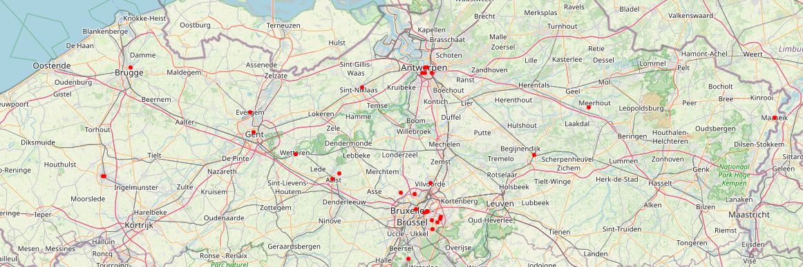
Where’s the best pizza?

