Slide 1
NiFi and Solr

Slide 2
The current version of Chrome has some xcorss issues html tags for which we need to install
The Chrome plug-in to avoid a BLANK page

Slide 3
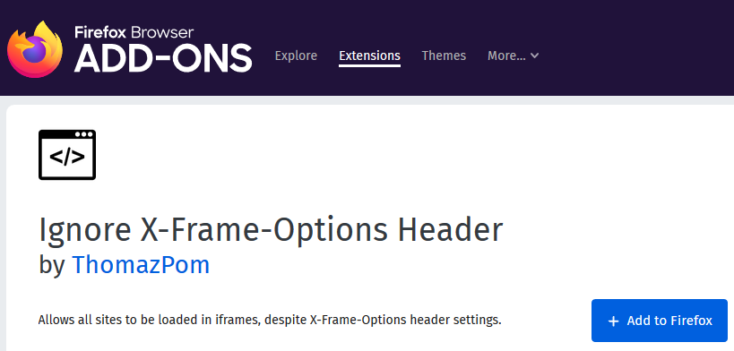
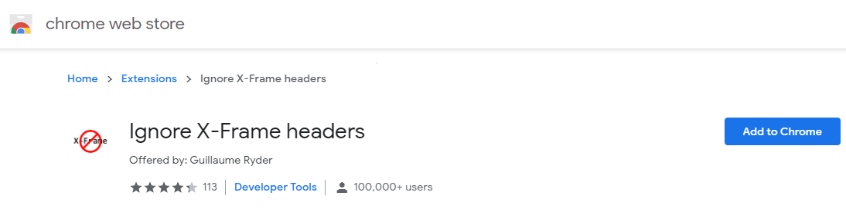
Enterprise Data Management Environment Setup
Client Machine Browser
Help, the card is not rendering EDM.
Browser add-on “Ignore X-Frame-Options Header” (FF)/”Ignore X-Frame Header” (Chrome) is required.
Install browser add-on “Ignore X-Frame-Options Header” (FF)/”Ignore X-Frame Header” (Chrome)
Fire Fox:
Click the Open menu icon and select Add-ons.
In the Search box, enter “Ignore X-frame”.
In search results, click on “Ignore X-Frame-Options Header”.
Click on Add to Firefox.
In the popup, click Add extension.
Chrome
https://chrome.google.com/webstore/detail/ignore-x-frame-headers/gleekbfjekiniecknbkamfmkohkpodhe?hl=en-US
Click Add to Chrome.
In the popup, click Add extension.

