Slide 2

Connecting people who need a hand
with people willing to help.

Slide 3
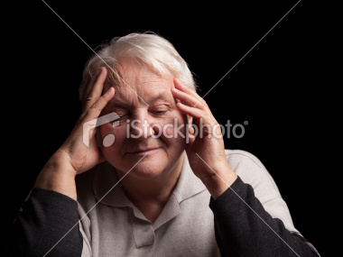
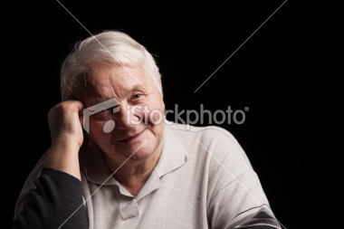
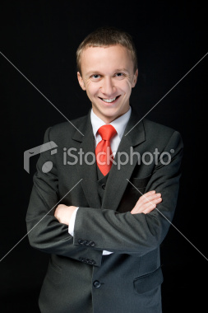
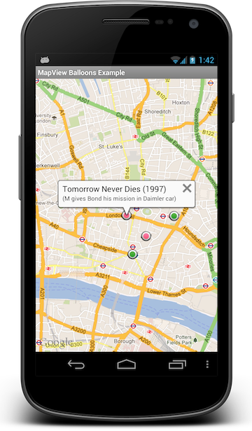
The CONCEPT…
Doris needs help…
So she posts a request on casual-heroes.org
Jerry has some time and is happy to help…
His phone tells him someone close needs help…
So he accepts Doris’ request…
And Doris gets the help she needs.

Slide 4
It’s That Simple
Demo time!

Slide 5
The Casual heroes…
Tor Harrington
Patrick Mooney
William Wedin
Robert McCartney
Joel Hammond-Turner
James C

