Slide 2

Connecting people who need a hand
with people willing to help.

Slide 3


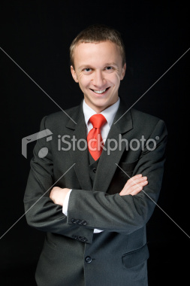
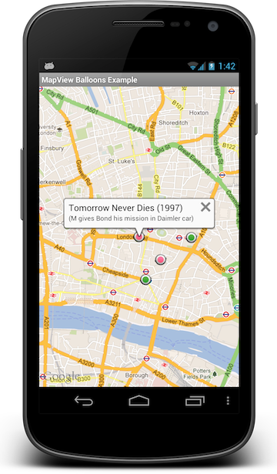
The CONCEPT…
Doris needs help…
So she posts a request on casual-heroes.org
Jerry has some time and is happy to help…
His phone tells him someone close needs help…
So he accepts Doris’ request…
And Doris gets the help she needs.

Slide 4
It’s That Simple
Demo time!

Slide 5
The Technology…
HTML5 / jQuery
REST WebAPI Services
Azure Mobile Services
SQL Azure Database
Github source control
Azure Websites
Google Maps
Native Android client / Java

Slide 6
The Casual heroes…
William Wedin
Tor Harrington
Robert McCartney
Patrick Mooney
Joel Hammond-Turner
James Counihan

