Slide 1

Data Parallelism
and
Intel's Threading Building Blocks
Message Passing
and
Boost.MPI

Slide 2

Data Parallel
The data-parallel paradigm (DP) expresses work-sharing by doing exactly the same thing to (potentially) large collections of data
Worker sub-processes cannot communicate
Motivation: low-level thread coding can shorten your life span
Define the data domain (where), the operation to do with that data (what), and you're done!
Key Insight: someone else decides the how (splitting up the range onto different workers)‏

Slide 3
Iteration and Reduction
Iteration says, do something (identical) for each piece of data.
Reduction says, compute some value based on all of the inputs.
Notice that iteration is the special case of reduction where the output value is simply thrown away. No need for Object::join(&other).
Examples: raytracer vs. minimum value.
Note that divide-and-conquer algorithms are not necessarily a good fit for DP. These are good candidates for task-based parallelism.

Slide 4
What's Happening
Question: can every parallelisable problem be expressed with the DP paradigm?
Answer: if all of the ”Cowichan” problems can be expressed with it, there is a good possibility that DP has real-world applicability
We'll use Intel's Threading Building Blocks (TBB), which has the STL-like methods parallel_for, parallel_reduce, and parallel_sort
    TBB also defines some concurrent types, objects that can be accessed by different threads simultaneously while maintaining correctness
    We generally do not need to use these for DP

Slide 5
Game of Life (TBB)‏
parallel_for(
blocked_range2d<size_t,size_t>
(0, BOARD_SIZE, 0, BOARD_SIZE),
myGame, auto_partitioner());
...
void Game::operator()(const blocked_range2d<size_t,size_t>& range) const {
for (y in range.rows())‏
for (x in range.cols()) {
int peers =
sumNeighbours(x, y);
if (peers<2 || peers>3)‏
(*second)[y][x] = 0;
elif (peers == 3)‏
(*second)[y][x] = 1;
else
(*second)[y][x] =
(*first)[y][x];
}
}
For each cell, want to compute whether or not it is alive in the next iteration.
Note that while this uses multiple inputs per output, our sub-processes still do not need communication.
Ping-pong technique.
task_scheduler_init init(n);

Slide 6
Game of Life (TBB) Results

Slide 7
DP/TBB Conclusions
TBB is handy because its iteration spaces (range, range2d, ...) are specifically designed to optimise processor cache locality
  New processors (i7) moving toward combined cache for all cores which will make many (and especially naive) parallel programs run faster
DP is natural to the mind and gives very good parallel speed-up compared to theoretical limits
Pitfall: must compare DP against good serial implementation; translation to the DP paradigm might be destroying your throughput

Slide 8
Message Passing Interface
Message Passing Interface (MPI) is a specification for an API that allows computers to communicate with each other.
User specifies:
1. Number of processes
2. List of computers
3. Communication between processes (explicit!)
Implementations: MPICH1, MPICH2, OpenMPI
Boost.MPI works with any MPI implementation trying to make programmer’s life easier.

Slide 9
Communication (Boost.MPI)
Point-to-point communication (send, recv, isend, irecv)
Collective operations (broadcast, gather, reduce).
Communicators - groups of processes.
Example: Computing Matrix Vector Product
- assign a number of rows to each process
- broadcast parts of the resulting vector

Slide 10
Matrix Vector Product C++
Split Work:
int lo, hi; /* work controls */
int r, c; /* loop indices */
int rank;
// work
if (get_block_rows_mpi (world, 0, nr, &lo, &hi)) {
printf ("lo is %d, hi is %d\n", lo, hi);
for (r = lo; r < hi; r ++) {
result[r] = matrix[r * nc] * vector[0];
for (c = 1; c < nc; c++) {
result[r] += matrix[r * nc + c] * vector[c];
}
}
}
else {
printf ("no work\n");
}
Broadcast Result Vector:
// broadcast result
for (rank = 0; rank < world.size (); rank++) {
if (get_block_rows_mpi (world, 0, nr, &lo, &hi,
rank)) {
broadcast (world, &result[lo], hi - lo, rank);
}
}

Slide 11
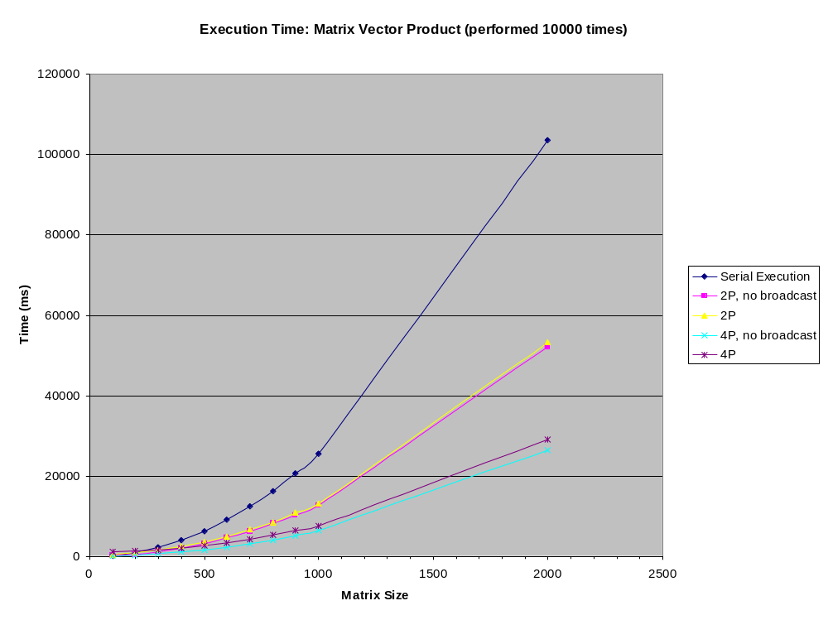
MPICH2 Results

Slide 12
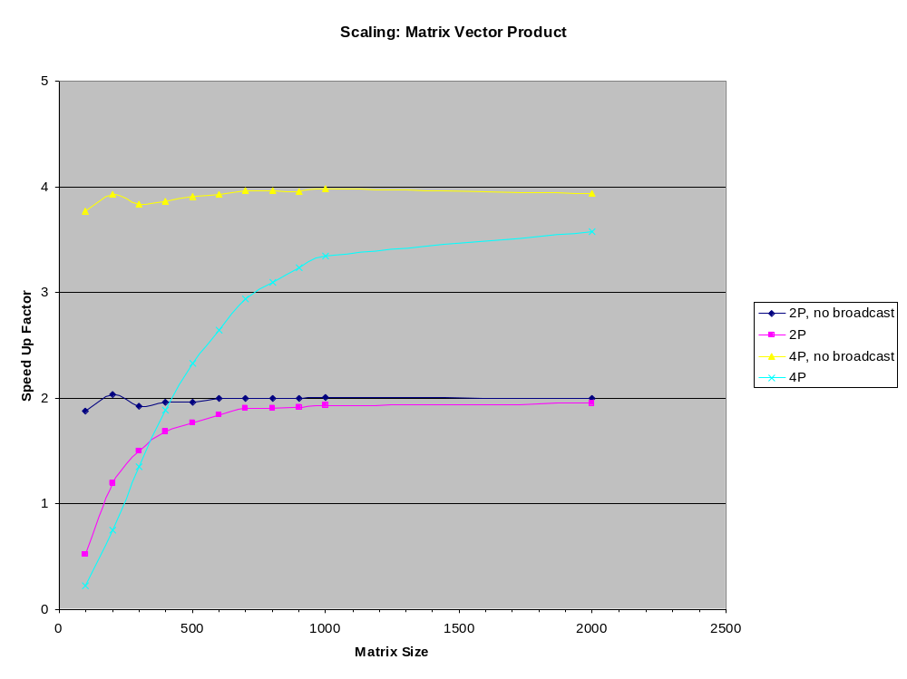
MPICH2 Results

Slide 13
Boost.MPI and MPICH2 Usability
Advantages:
  Platform independent
  Well Maintained
  Boost.MPI is a subset of MPI
  Decent performance
Disadvantages:
  Communication controlled by programmer
  Debugging (good debuggers are not free)
  Degree of parallelism is not automatic

