Slide 1
Pyano Piano simulation in Python
Luka Bavdaz, Fabian Fool,
Mathijs Garming, Stefan van der Sar

Slide 2
The Goal
To simulate movement of piano strings, and play the generated sound in real time.

Slide 3
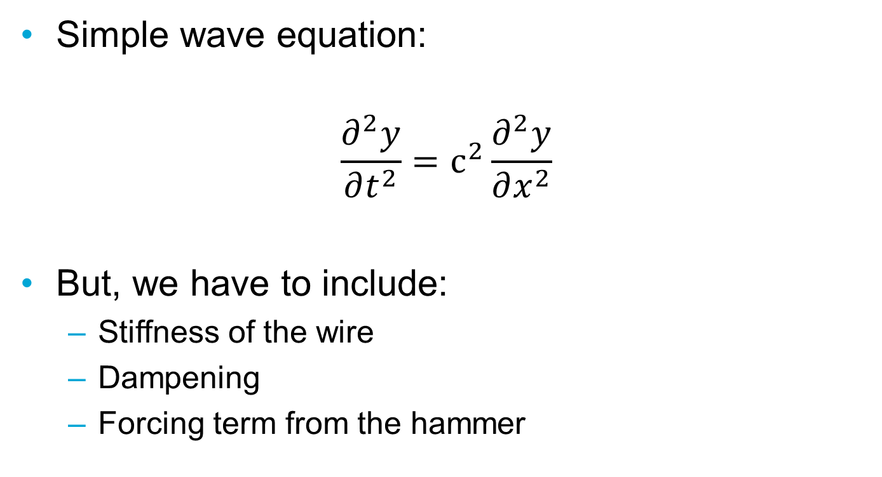
Physics in a piano wire
Simple wave equation:
$$\frac{∂^{2}y}{∂t^{2}}=c^{2}\frac{∂^{2}y}{∂x^{2}}$$
But, we have to include:
Stiffness of the wire
Dampening
Forcing term from the hammer

Slide 4
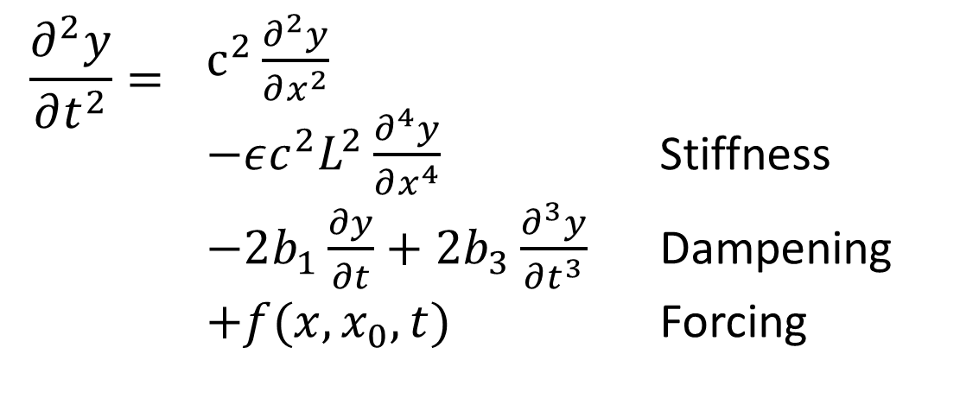
Physics in a piano wire
Wave equation to solve:
$$\frac{∂^{2}y}{∂t^{2}}=$$ | $c^{2}\frac{∂^{2}y}{∂x^{2}}$ $−εc^{2}L^{2}\frac{∂^{4}y}{∂x^{4}}$ Stiffness $−2b_{1}\frac{∂y}{∂t}+2b_{3}\frac{∂^{3}y}{∂t^{3}}$ Dampening $+f(x,x_{0},t)$ Forcing

Slide 5
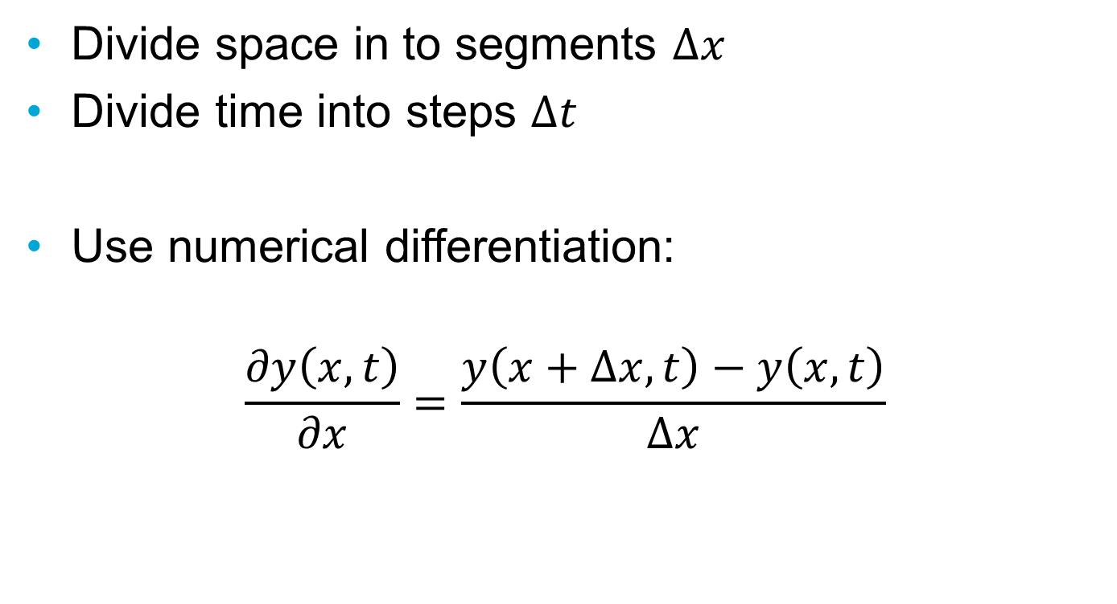
Discretise
Divide space in to segments $Δx$
Divide time into steps $Δt$
Use numerical differentiation:
$$\frac{∂y\left(x,t\right)}{∂x}=\frac{y\left(x+Δx,t\right)−y\left(x,t\right)}{Δx}$$

Slide 6
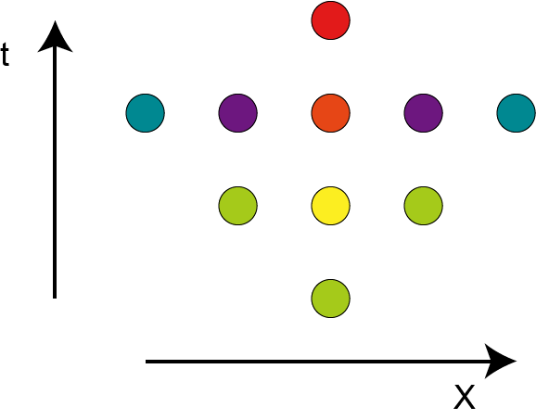
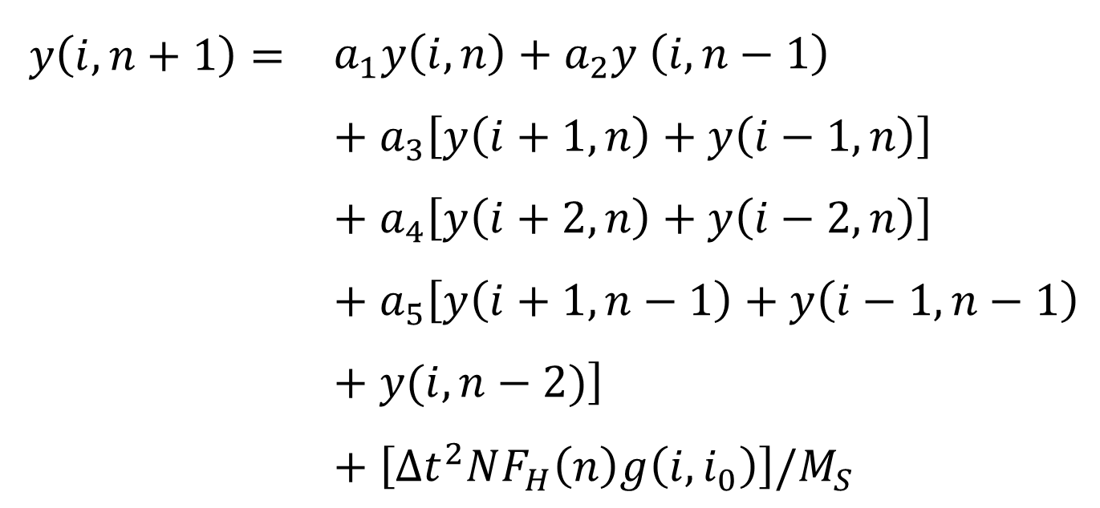
Discretise
$$y\left(i,n+1\right)=$$ | $$a_{1}y\left(i,n\right)+a_{2}y \left(i,n−1\right)+a_{3}\left[y\left(i+1,n\right)+y\left(i−1,n\right)\right]+a_{4}\left[y\left(i+2,n\right)+y\left(i−2,n\right)\right]+a_{5}\left[y\left(i+1,n−1\right)+y\left(i−1,n−1\right)+y(i,n−2)\right]+\left[Δt^{2}NF_{H}\left(n\right)g\left(i, i_{0}\right)\right]/M_{S}$$

Slide 7

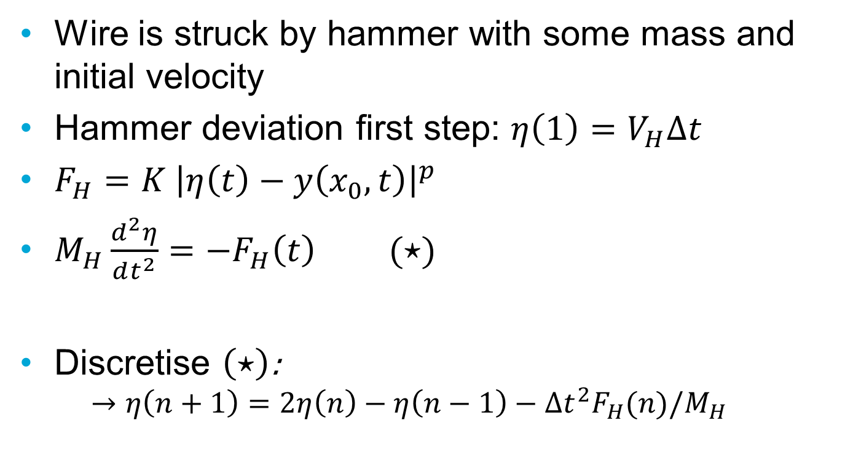
Initial condition
Wire is struck by hammer with some mass and initial velocity
Hammer deviation first step: $η\left(1\right)=V_{H}Δt$
$F_{H}=K {\left|η\left(t\right)−y\left(x_{0},t\right)\right|}^{p}$
$M_{H}\frac{d^{2}η}{dt^{2}}=−F_{H}\left(t\right)$ $(⋆)$
Discretise $\left(⋆\right)$:
$$→η\left(n+1\right)=2η\left(n\right)−η\left(n−1\right)−Δt^{2}F_{H}(n)/M_{H}$$

Slide 8
Generating different tones
Parameters to vary:
Length of string
Tension of string
Diameter of string
Hammer properties
Bridge position
Introduce distortion (synthesiser mode)

Slide 9
Code structure
Main process to handle buttons
On press, processes to generate sound are called
Optionally plot spectrum to verify proper tuning

Slide 10
Optimisations
Speed: JIT
Delay reduction: Audio streaming
Simultaneous notes: Multiprocessing

