Slide 1
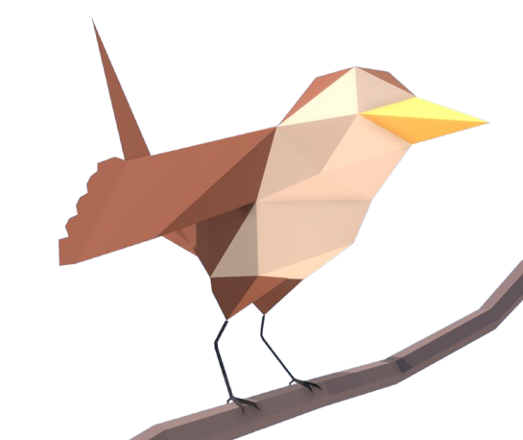
Stenoqwit: Mouseless Circuit Editor
Attribute to: Christian Galvez
01 - OVERVIEW
Goal: Mouseless Visual Circuit Design
The Problem It Solves
EDA tools are mouse reliant, and is tedious navigating through complicated UI menus; schematics should be creatable at the designer’s own pace.
GOAL: Enable complete schematic capture using only a Stenoqwit
Select → Action → Adjust → Commit… all without a mouse or user coding. Place symbols, route wires, label nets, export.
Grid System
User Dictionary
No Mouse
Grid system with key-accessible coordinates for each component
Common components, wiring junctions, etc., can be defined in a dictionary and recalled easily through chording
Every operation works through keypresses/chording only.
SUCCESS: User can launch → place symbols with chords → connect → label → export → open in EDA
Theme: Plover Blog (Awesome Inc. by Tina Chen)

Slide 2
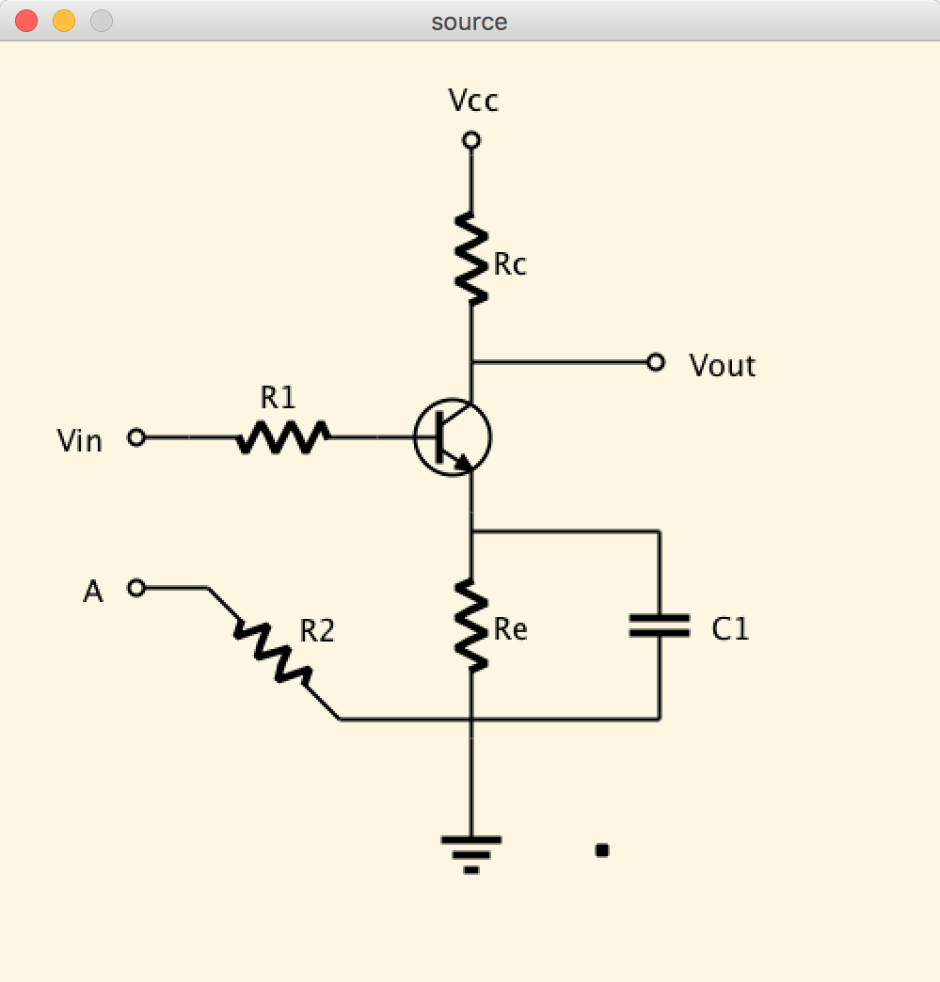
Stenoqwit: Mouseless Circuit Editor
Attribute to: Christian Galvez
02 - OVERVIEW
Interaction Loop
SELECT COORDINATE
GRID VIEWPORT EX
1
▼
2
CHOOSE ACTION
▼
3
ADJUST WITH KEYS
▼
4
COMMIT
KEY BINDING EXAMPLES (configurable)
W-R
wire
SR-R
rotate
F-P
flip
#
cycle / select
-T
text
https://github.com/puqeko/circuits.git
-U
undo
-S
save / export

Slide 3
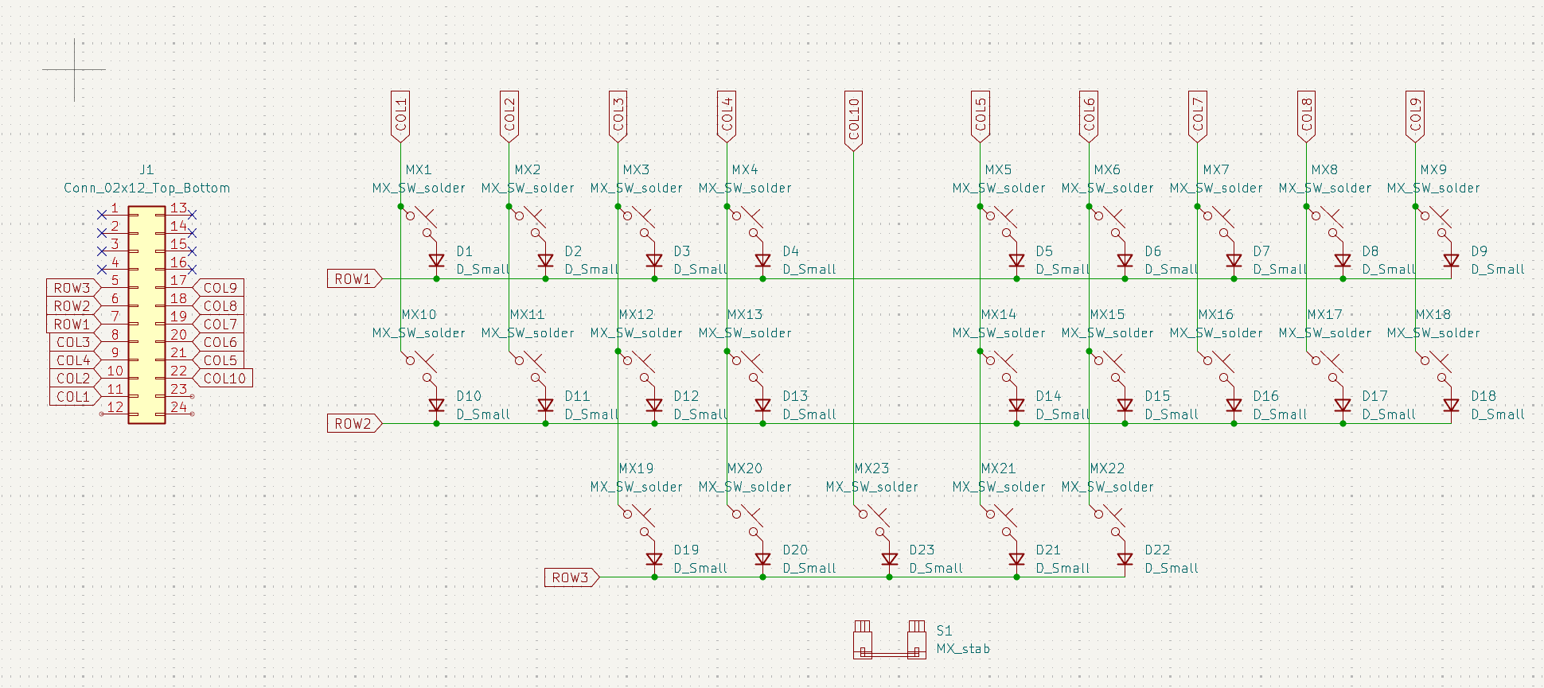
Stenoqwit: Mouseless Circuit Editor
Attribute to: Christian Galvez
03 - HARDWARE
Schematic
KICAD SCHEMATIC
SPECIFICATION
Keys
23 Cherry MX2A
+ 2u stabilizer
Diodes
23 1N4148W SOD-123
protection
MCU
SparkFun Qwiic
Pro Micro USB-C (ATmega32U4)
Matrix
3 rows × 10 cols
MATRIX_ROW_PINS PD4/0/1

Slide 4

Stenoqwit: Mouseless Circuit Editor
Attribute to: Christian Galvez
04 - VALUE
Why This Matters
A keyboard-first EDA workflow builds rare, transferable skills — and makes schematic capture accessible.
ACCESSIBILITY & ERGONOMICS
TECHNICAL SKILLS
Full schematic capture without a mouse. Good for users with arthritis/wrist mobility issues
Hardware, firmware, EDA, and software architecture in one project.
No mouse dependency
KiCad schematic & PCB design
Minimal hand travel & strain
QMK firmware & matrix scanning
Rust architecture
Data modeling & export
EDUCATIONAL IMPACT
OPEN & REUSABLE
A teaching platform for chorded key-inputs, human-computer interaction, and open-hardware product design.
Everything is open: spec, firmware, PCB, and editor. User dictionaries & macros compound community value.
Steno theory & dictionary design
State-machine
Test frameworks

Slide 5
Stenoqwit: Mouseless Circuit Editor
Attribute to: Christian Galvez
05 - COMPONENT COST
Bill of Materials (BOM)
Component | Qty | Per Unit | Total
Cherry MX2A Brown (1644-MX2A-G1NB) | 23 | $1.75 | $40.25
1N4148W SOD-123 diodes (1655-1N4148W) | 23 | $0.06 | $1.36
SparkFun Qwiic Pro Micro USB-C | 1 | $23.95 | $23.95
MX 2u Stabilizer (S1) | 1 | $1.50 | $1.50
Pin headers TS-112-T-A-1 | 2 | $2.35 | $4.70
PCB (JLCPCB HASL-LF) | 3 | $4.00 | $12.00
Case / Plate (3D-printed or FR4) | 1 | - | -
USB-C cable | 1 | - | -
Screws, misc components | As needed | - | -
TOTAL COST |  |  | $86.26
*Refer to .xlsx for more details. Shipping & tariffs not included

Slide 6
Stenoqwit: Mouseless Circuit Editor
Attribute to: Christian Galvez
06 - TIMELINE
Timeline
GANTT CHART
W1
W3
W5
W7
W8
W10
W12
W14
PHASE 1
Terminal output to verify hardware key presses
Terminal
PHASE 2
Command palette, fuzzy
search, labels, selection
cycling, copy/paste
Usability
PHASE 3
Simultaneous / sequential / held chording, preview, user dictionary…
Stenographic keying
PHASE 4
Connectivity graph,
junction validation,
reference numbering
Schematic design
PHASE 5
Export to .kicad_sch, footprints, other additional fixtures,…
Export to EDA (stretch goal)
HARDWARE
Order → Build → Test → Order
PCB fab
Ergonomics

