Slide 1








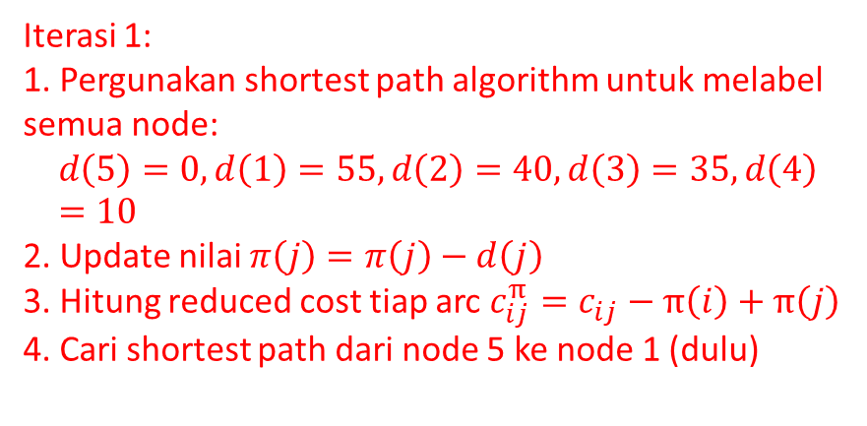





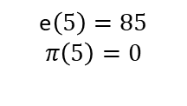
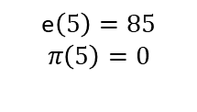


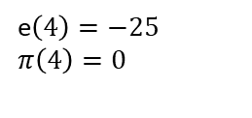

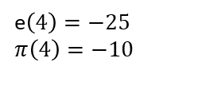


e$\left(4\right)=−25$
$$π\left(4\right)=0$$
4
$$10$$
$$25$$
$$\text{e}\left(5\right)=85$$
$$π\left(5\right)=0$$
$$30$$
e$\left(3\right)=−30$
$$π\left(3\right)=0$$
5
2
$$15$$
3
e$\left(2\right)=−15$
$$π\left(2\right)=0$$
Iterasi 1:
1. Pergunakan shortest path algorithm untuk melabel semua node:
$$d\left(5\right)=0, d\left(1\right)=55,d\left(2\right)=40,d\left(3\right)=35,d\left(4\right)=10$$
2. Update nilai $π\left(j\right)=π\left(j\right)−d\left(j\right)$
3. Hitung reduced cost tiap arc $c_{ij}^{π}=c_{ij}−π\left(i\right)+π\left(j\right)$
4. Cari shortest path dari node 5 ke node 1 (dulu)
$$55$$
$$20$$
1
e$\left(1\right)=−20$
$$π\left(1\right)=0$$
e$\left(4\right)=−25$
$$π\left(4\right)=−10$$
4
$$0$$
$$0$$
$$\text{e}\left(5\right)=85$$
$$π\left(5\right)=0$$
$$0$$
e$\left(3\right)=−30$
$$π\left(3\right)=−35$$
$$10$$
5
2
3
e$\left(2\right)=−15$
$$π\left(2\right)=−40$$
$$0$$
$$5$$
1
e$\left(1\right)=−20$
$$π\left(1\right)=−55$$

Slide 2





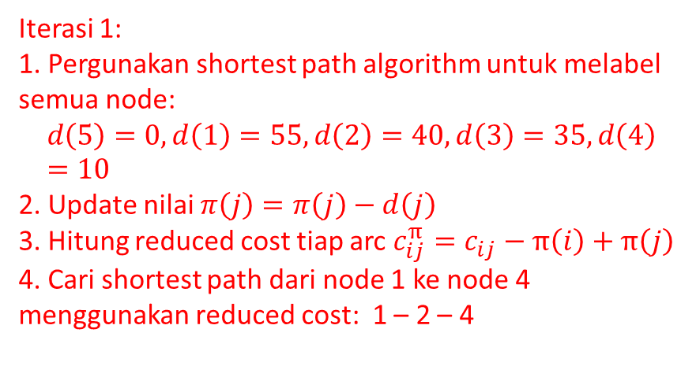


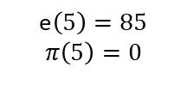


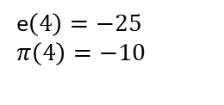
e$\left(4\right)=−25$
$$π\left(4\right)=−10$$
4
$$0$$
$$0$$
$$\text{e}\left(5\right)=85$$
$$π\left(5\right)=0$$
$$0$$
e$\left(3\right)=−30$
$$π\left(3\right)=−35$$
5
2
$$10$$
3
e$\left(2\right)=−15$
$$π\left(2\right)=−40$$
Iterasi 1:
1. Pergunakan shortest path algorithm untuk melabel semua node:
$$d\left(5\right)=0, d\left(1\right)=55,d\left(2\right)=40,d\left(3\right)=35,d\left(4\right)=10$$
2. Update nilai $π\left(j\right)=π\left(j\right)−d\left(j\right)$
3. Hitung reduced cost tiap arc $c_{ij}^{π}=c_{ij}−π\left(i\right)+π\left(j\right)$
4. Cari shortest path dari node 1 ke node 4 menggunakan reduced cost: 1 – 2 – 4
$$0$$
$$5$$
1
e$\left(1\right)=−20$
$$π\left(1\right)=−55$$

