Slide 1
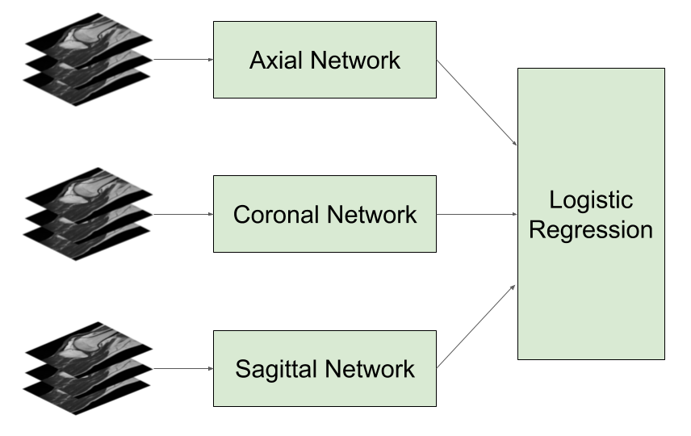
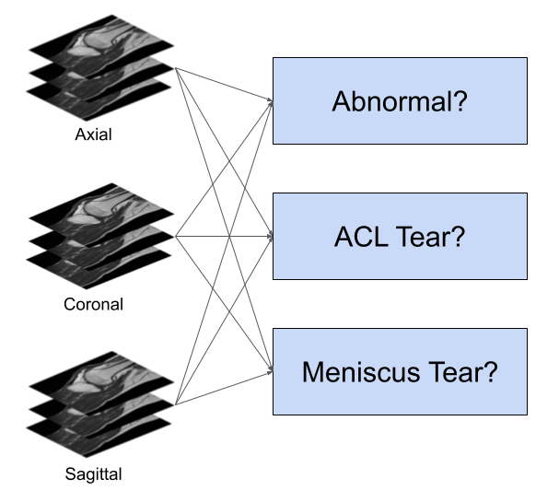
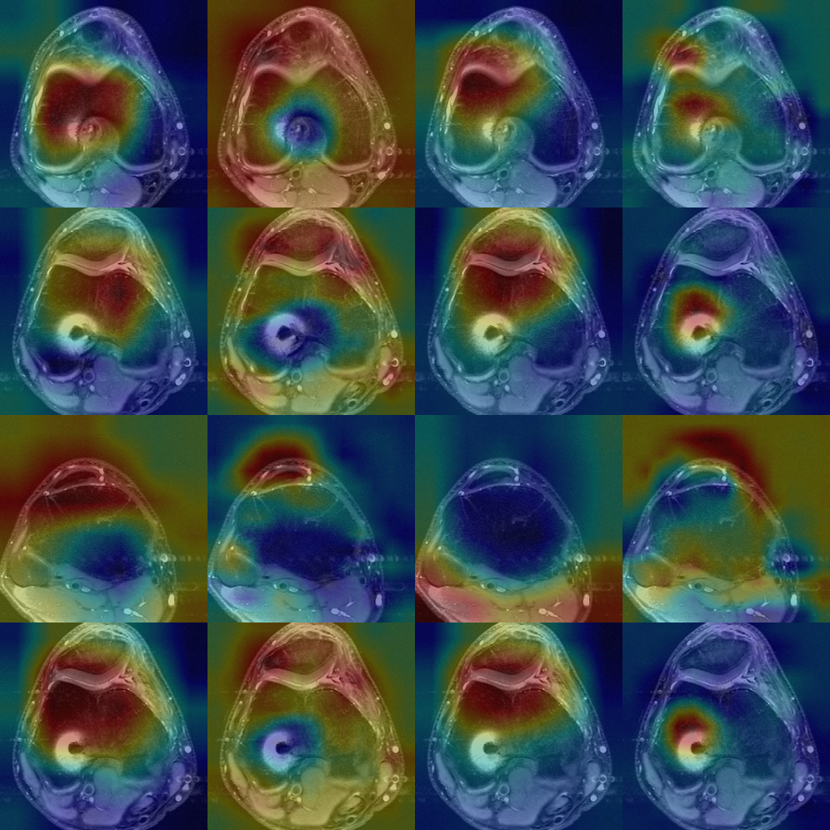
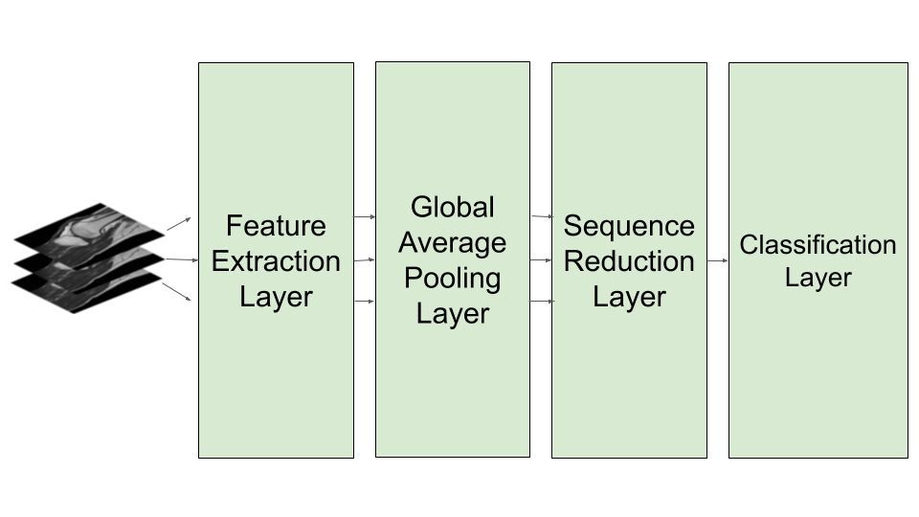
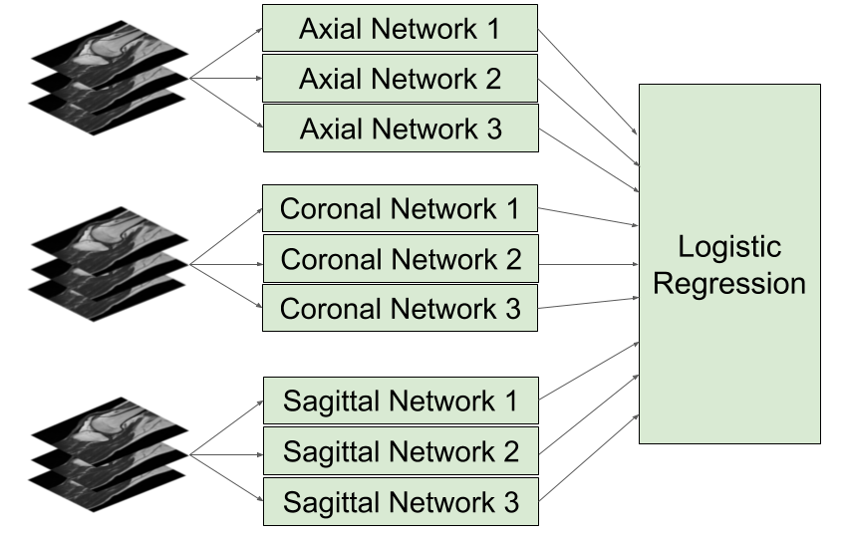
Ensembled Transfer Learning for MRI-based Knee Injury Diagnosis
Shayne Miel smiel@stanford.edu
Problem formulation
Three MRI sequences per instance:
Axial (from above), Coronal (from front), Sagittal (from side)
Three independent binary labels per instance:
Is abnormal? Has ACL tear? Has meniscal tear?
Model | Average | Abnormal | ACL | Meniscus
MRNet (reported) | 0.916 | 0.937 | 0.965 | 0.847
MRNet | 0.913 | 0.940 | 0.960 | 0.839
MRNet-Squeeze | 0.910 | 0.925 | 0.974 | 0.829
MRNet-Attend | 0.891 | 0.925 | 0.910 | 0.838
MRNet-SqueezeAttend | 0.915 | 0.936 | 0.925 | 0.885
Ensemble | 0.931 | 0.939 | 0.976 | 0.876
AUC on validation set
Models
3 sequence-specific networks (independently trained)
Sequence-specific predictions are features for logistic regression
Case 1218 – Axial, ACL
Model | Feature Extraction Layer | Sequence Reduction Layer
MRNet [1] | AlexNet | Max pooling
MRNet-Squeeze | SqueezeNet | Max pooling
MRNet-Attend | AlexNet | Attention
MRNet-SqueezeAttend | SqueezeNet | Attention
Frame 11
Data Set
MRNet Challenge:
https://stanfordmlgroup.github.io/competitions/mrnet/
1,250 instances:
training (1,010), tuning (120), and validation (120)
Frame 7
Frame 20
Frame 6
MRNet
MRNet-Squeeze
MRNet-Atend
MRNet-SqueezeAttend
Sequence-specific networks
- Pretrained CNN feature extractor
- Global average pooling to reduce image dimensions
- Sequence reduction layer to reduce sequence of images
- Classification layer to predict binary label
Ensemble
12 sequence-specific CNNs (4 model types x 3 sequences)
Sequence-specific predictions are features for logistic regression
[1] Bien, Nicholas, et al. "Deep-learning-assisted diagnosis for knee magnetic resonance imaging: Development and retrospective validation of MRNet." PLoS medicine 15.11 (2018): e1002699.

