Slide 1

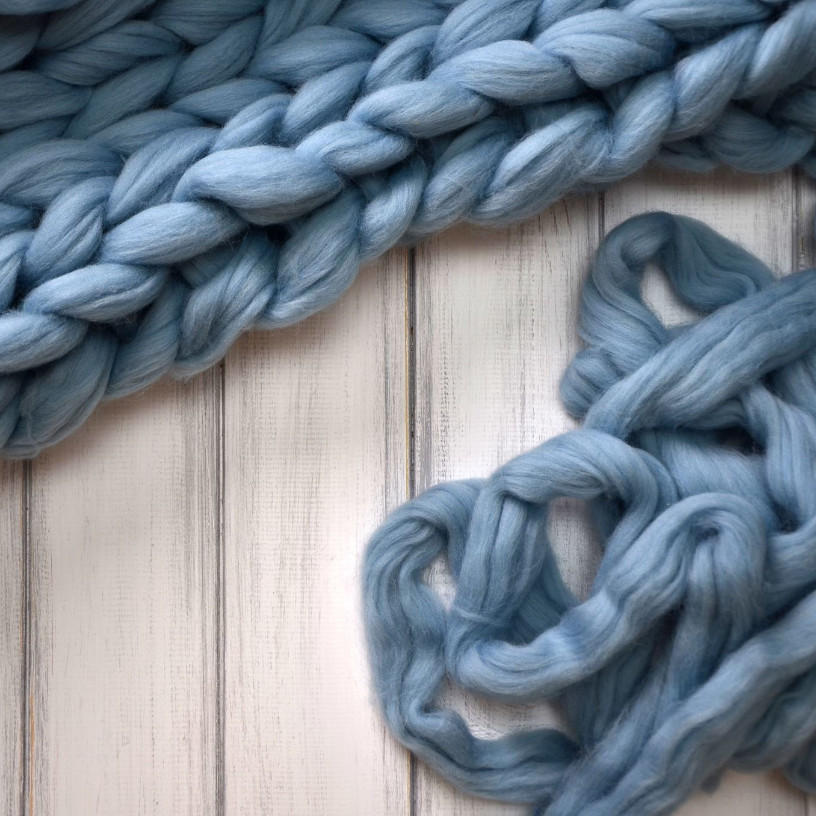
Ravelry Knitting Pattern Recommender Engine
Kristina Halbig

Slide 2
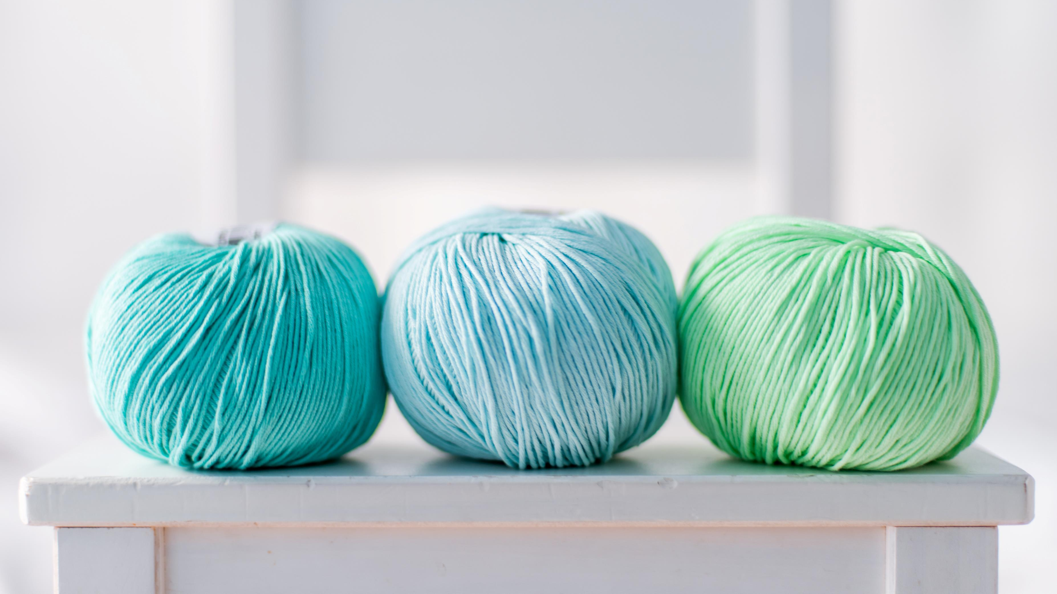
Ravelry – A Website For Fiber Artists
World’s most extensive database of patterns and yarns
As of 2023:
1.2 million patterns
11 million registered users

Slide 3

Which Pattern to Knit Next?
Thousands of patterns to choose from can lead to decision fatigue.
A recommender engine can help fiber artists narrow down choices and lead to a greater likelihood of purchasing a pattern.

Slide 4
Ravelry API Script
First API call to get the pattern ID. Patterns limited to most popular knitting patterns by American designers and not yet discontinued.
Second API call to use the pattern ID to get more detailed data such as pattern author, price, average, difficulty, and gauge.
Transformed collected features into a CSV file

Slide 5
Recipe For a 15,000 Pattern Recommendation Engine
Features include pattern author, price, and average difficulty
Eleven features in all
Numeric null values typically filled with averages
SpaCy natural language processing and FuzzyWuzzy used to handle author notes and user input
Implemented Recommendation system on Streamlit
Cosine distances calculated between each pattern

Slide 6
Recommendation Pattern Example
Pattern Name | Average Overall Rating | Average Difficulty Rating | Yarn Weight | Project Count | Project Queue | Author
Musselburgh | 4.9 | 2 | Fingering | 23,805 | 3,114 | Ysolda Teague
Hermione’s Everyday Socks | 4.7 | 2 | Fingering | 40,897 | 13,612 | Erica Leudar
Turn A Square Hat | 4.5 | 1 | Worsted | 20,280 | 7239 | Jared Flood
Monkey Socks | 4.6 | 3 | Fingering | 23,277 | 6,087 | Cookie A
Jaywalker Socks | 4.3 | 3 | Light Fingering | 12,389 | 3,919 | Grumperina
Simple Skyp Socks | 4.7 | 2 | Sport | 11,863 | 5,596 | Adrienne Ku

Slide 7
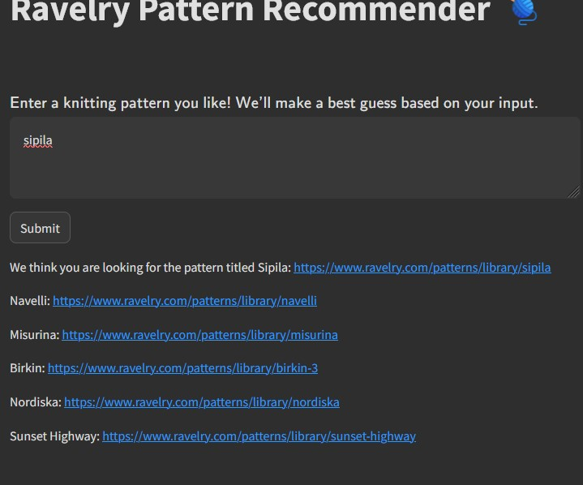
Streamlit App
Type in a pattern you like and get five recommendations based on its pattern features.

Slide 8
Room For Improvement
SQL Queries – Allow users to search for patterns by author or yarn weight
Increase potential guesses based on user input
Take advantage of their photo database…

Slide 9
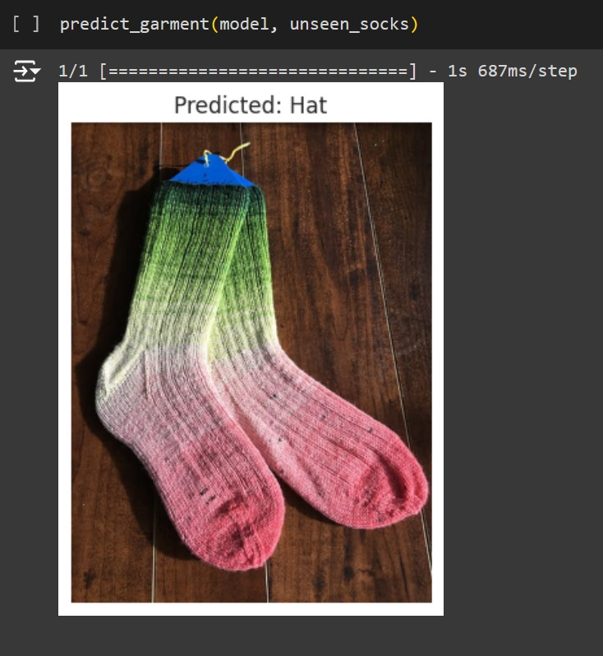
Photo VGG16 CNN
Implemented VGG16 convolutional neural network as a transfer learning model
Classes are pullover, hat, or socks
VGG16 is older, but simple to use
Initial model training scored 86% accuracy, but 30% on test data.

Slide 10
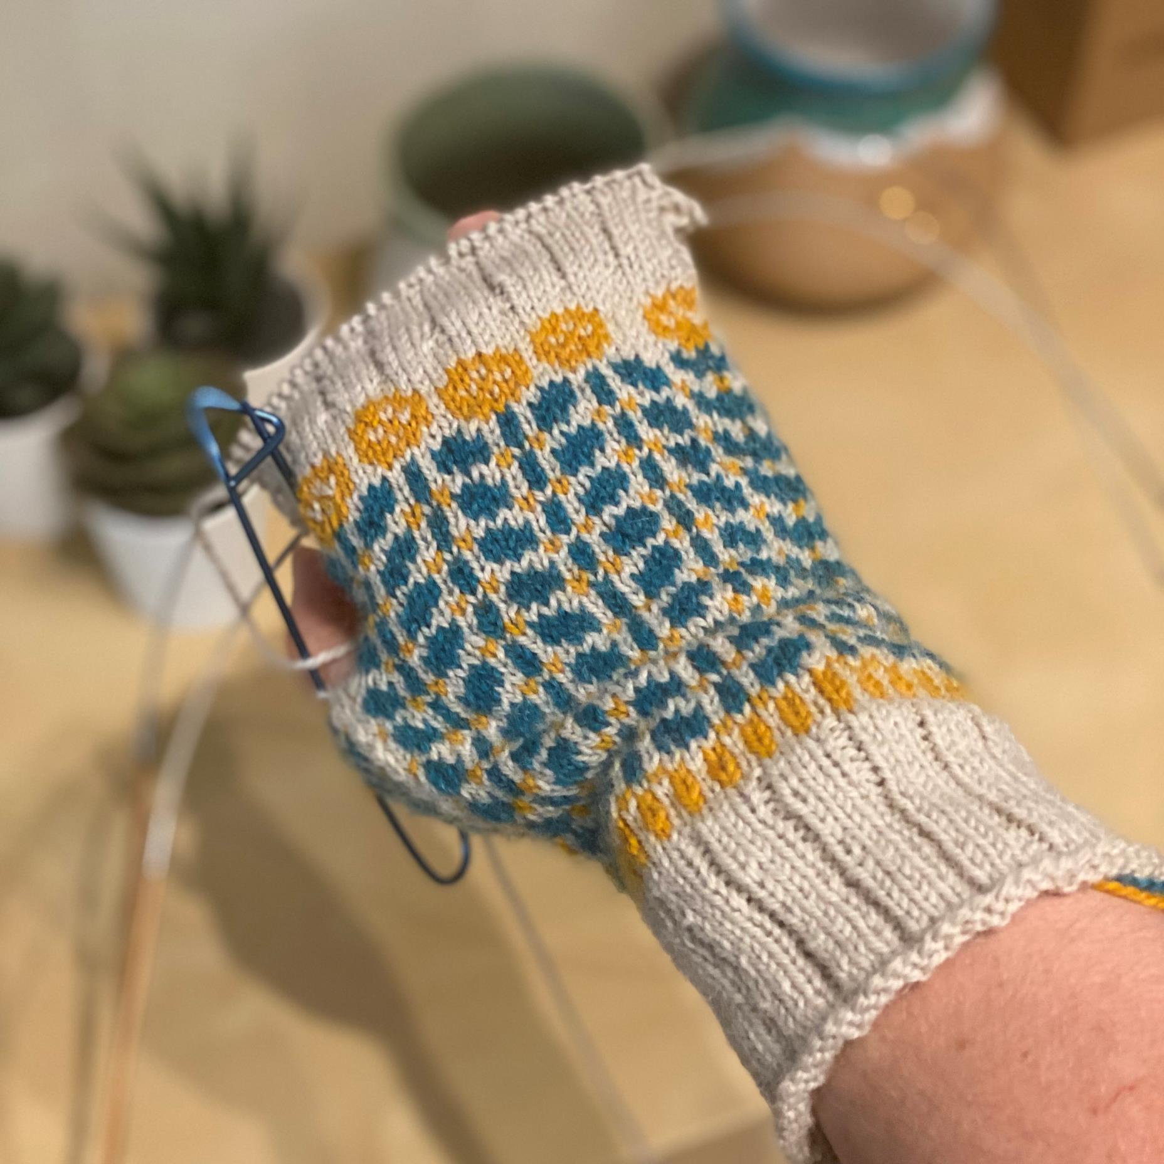
Questions?
Congratulations Everyone!

