Slide 1
Symmetry Guided Gradient Descent

Slide 2


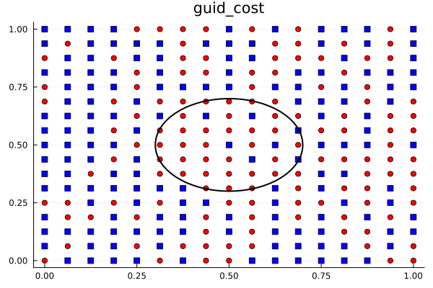
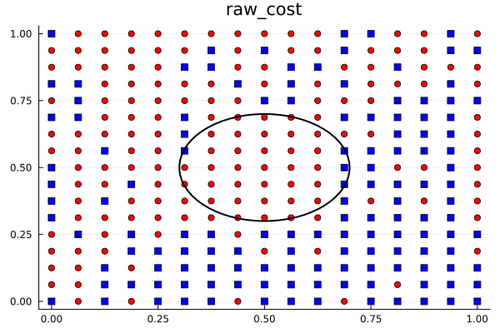
What I’ve done this week:
Change program language from python to julia
Roation encoding → binary encoding
9.5h
33s
Primary result looks…
Acceptable..

Slide 3
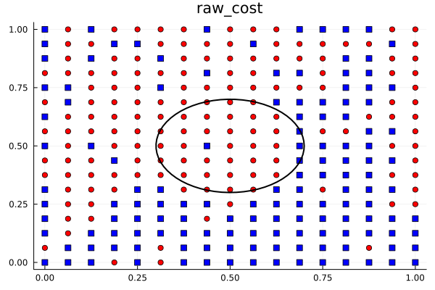
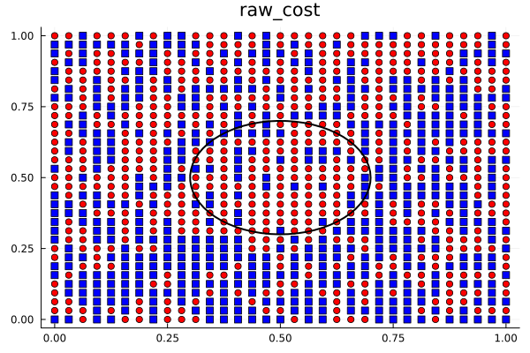
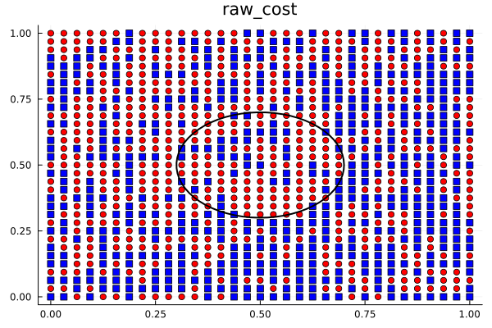
The improvement enable me to do larger simulation
So I try different configuration of training
8 bits
16 layers
5 min
8 bits
20 layers
11 min
Seems 8 bits work better than 10 bits…
But I don’t know why
10 bits
20 layers
300 min
10 bits
32 layers
420 min

Slide 4
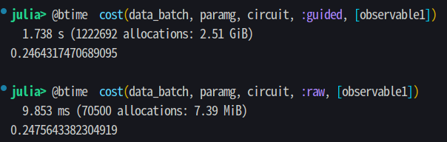
When I twirling gates, I found one important fact that affects performance:
The calculation of mixed state (the density matrix) cost much much more
Resource than pure state

Slide 5
