Slide 1

Early-Warning System for Risk-Off Regimes
with Domain-Specific Allocation Routing
Unsupervised Anomaly Detection for Regime-Aware Portfolio Allocation
Edoardo Ercelli · Luca Galli · Francesco Impenati · Francesco Mazzini
POLIMI Graduate School of Management — Politecnico di Milano
New Technologies for Finance — May 2025

Slide 2

PRESENTATION
Problem Statement & Motivation
The gap in traditional risk management
• Most early-warning systems treat risk-off as a binary decision: equity vs. cash
• But crises are heterogeneous: in 2008 the USD was the safe haven (dollar funding squeeze); in 2020 it initially strengthened then weakened; in an inflationary stress regime, gold outperforms
• No existing framework combines regime detection with allocation routing based on the nature of the stress
Our contribution
An EWS that answers two questions simultaneously:
1. WHEN to go risk-off (ensemble anomaly detection)
2. WHERE to allocate (domain-specific macro routing)
Investment Thesis
Deploy 1.5× equity leverage during calm regimes to exploit the equity risk premium, and rely on the EWS to detect stress early enough to avoid drawdowns — maximizing the Sharpe ratio.
The leverage is justified only if the detection system has sufficient recall: missing a crisis at 1.5× is costlier than at 1.0×.
This creates a built-in accountability constraint on model performance.
Key references
Maggiori (2020) — dollar as global safe asset
Baur & Lucey (2010) — gold: hedge vs. safe haven
Avdjiev et al. (2019) — dollar-leverage-flows triangle
Ercelli, Galli, Impenati, Mazzini — PoliMi GSoM
2 / 15

Slide 3
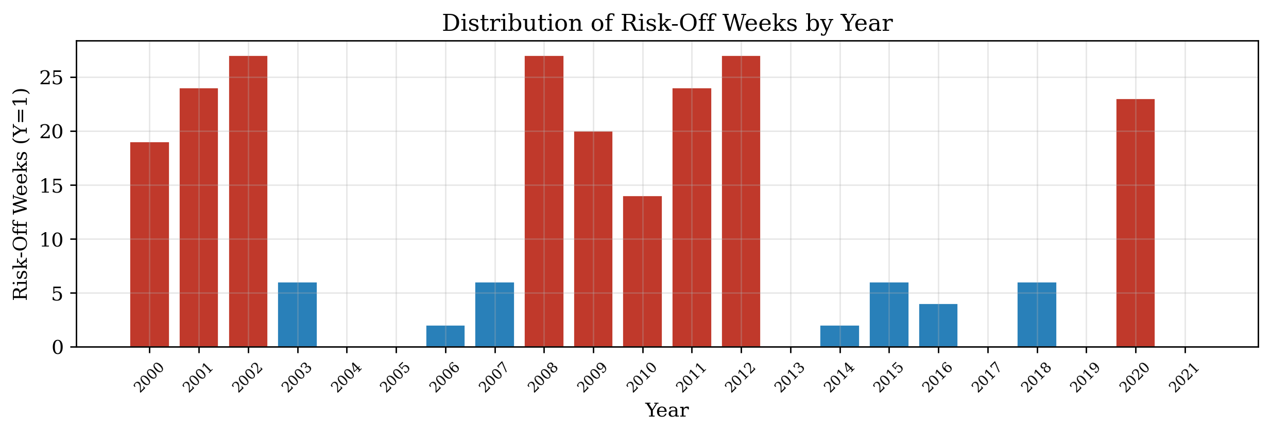
PRESENTATION
Dataset Overview
Bloomberg weekly data — 2000 to 2021 — 1,111 observations
43 features: 7 MSCI equity, 3 FX, 4 commodities, 8 bond TR indices, 18 yields/rates, VIX, US Economic Surprise
Target Y=1: risk-off week (21.3% prevalence, 237/1111 weeks)
No missing values across entire dataset
Proxy decisions (maintained throughout):
• MSCI World (absent) → MXUS as single-name proxy
• Global Aggregate (absent) → LUACTRUU (US IG Corporate TR)
• Credit spreads = log price-index ratios (not OAS yields)
Risk-off clusters in 2000–02, 2008–09, 2011–12, 2020. Mid-decade years have near-zero positives — this data property critically shapes cross-validation design.
Ercelli, Galli, Impenati, Mazzini — PoliMi GSoM
3 / 15

Slide 4
BUSINESS LOGIC
Three Macroeconomic Domains for Routing
USD Domain
Dollar is safe haven when stress is global but external to the US, or during dollar funding squeeze (Avdjiev et al. 2019).
Triggers (signed z-scores):
[+] LIBOR-3M spread Δ4w (funding stress)
[+] DXY momentum Δ4w
[+] VRP (implied > realized vol)
[−] US 10Y Δ change (Treasury flight)
[+] USA relative vs DM composite
Gold Domain
Gold when stress has monetary/inflationary component or the dollar itself is the problem (Baur & Lucey 2010; Erb & Harvey 2013).
Triggers (signed z-scores):
[−] Real yield proxy Δ4w
[−] DXY Δ4w (opposite sign!)
[+] JPY strength (safe haven)
[+] Equity-bond ρ 13w (diversif. failure)
[+] Gold-oil ratio Δ4w
MBS Domain
MBS is NOT a crisis refuge — it is defensive carry for moderate stress only (Diep et al. 2021).
Rule-based activation:
• VIX ∈ [20, 28] (nervous, not panic)
• Term spread > 0 (normal curve)
• Drawdown ∈ [−12%, −5%]
Blocked if:
• VIX > 30 (acute stress)
• Funding spread > p90
• HY-IG widening > 50bps
Note: DXY appears in both USD (+) and Gold (−) domains with opposite sign — same indicator, opposite economic reading. By design.
Ercelli, Galli, Impenati, Mazzini — PoliMi GSoM
4 / 15

Slide 5
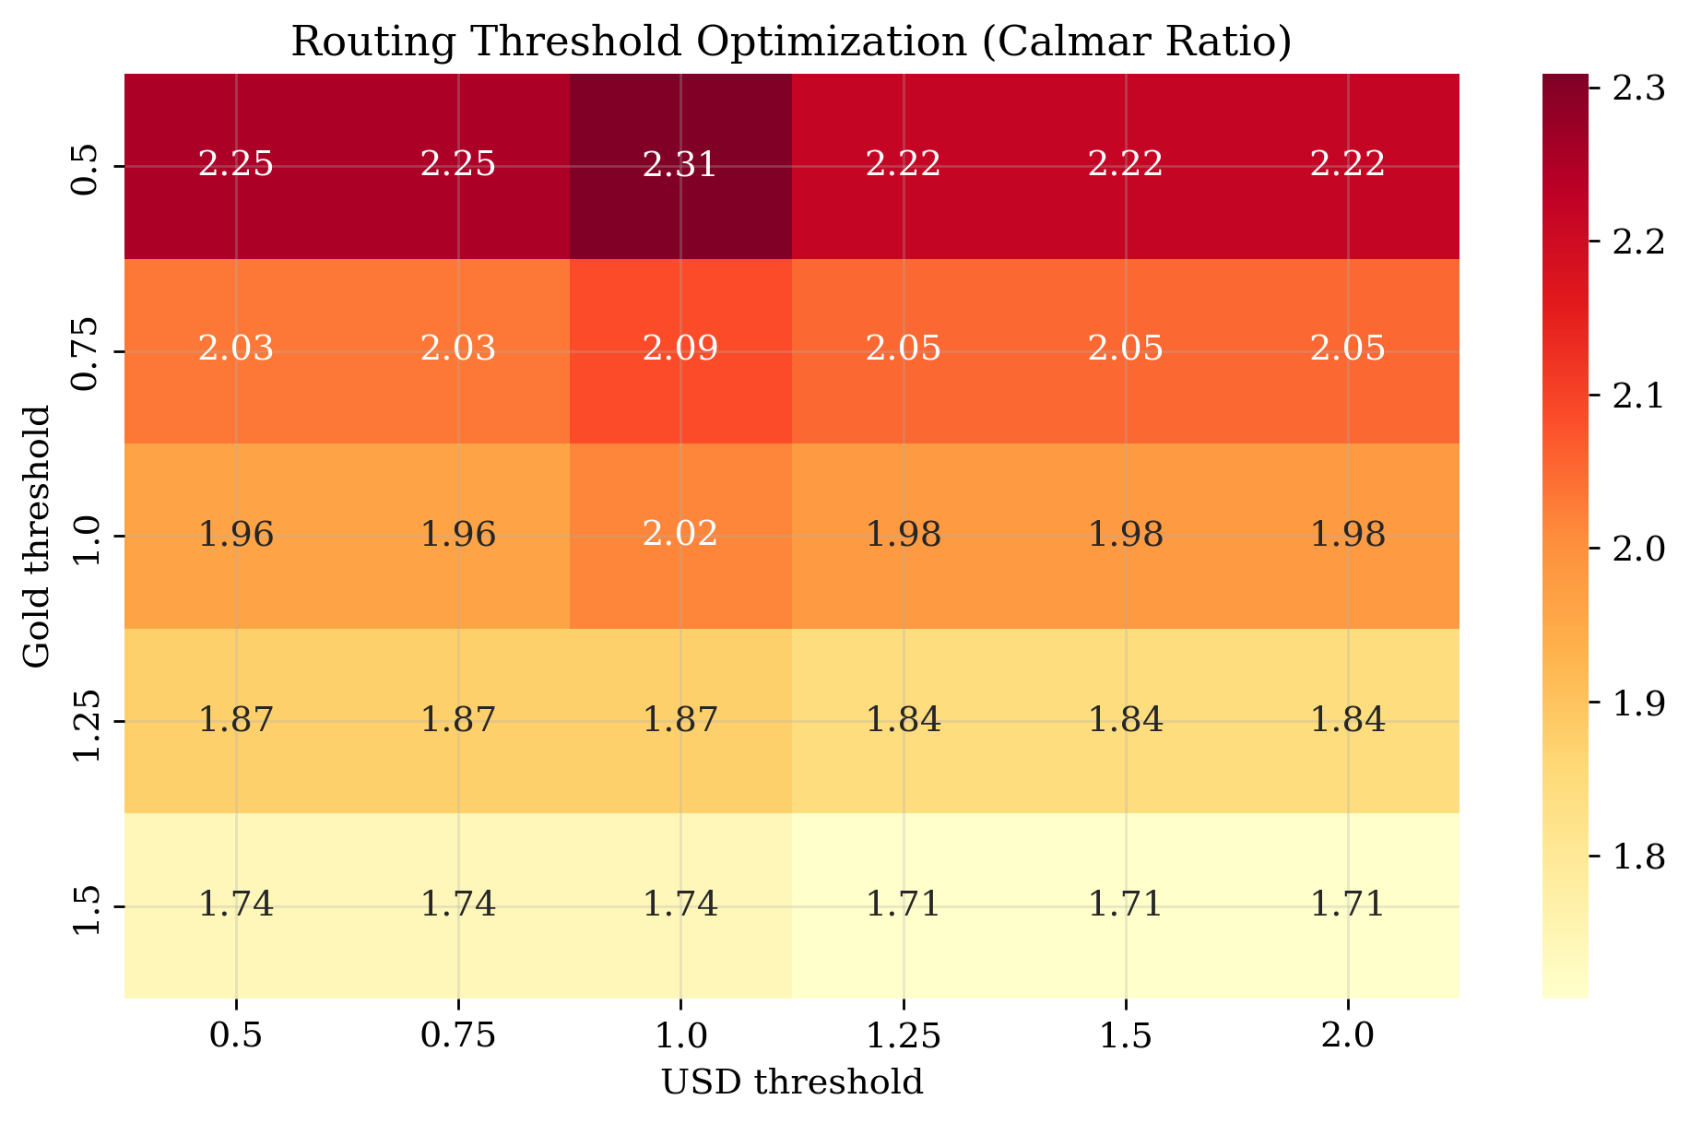
BUSINESS LOGIC
Routing Architecture & Decision Matrix
Allocation Decision Matrix
Risk-on (signal=0) → EQUITY (1.5× equity, −0.5× cash)
Risk-off + USD > τ + DXY↑ → CASH USD
Risk-off + Gold > τ → GOLD
Risk-off + MBS active → MBS
Risk-off + default → CASH USD
Design principles:
• Priority: USD → Gold → MBS (funding stress is most urgent)
• Default = Cash: zero-cost, doesn't compound errors
• TC differentiated: equity 5bps, cash 2bps, gold 8bps, MBS 20bps
• Only 2 scalar thresholds optimized — rest is rule-based from macro rationale
Sub-Score Construction
S = (1/|D|) × Σ sign × (x − μ_dev) / σ_dev
μ and σ estimated ONLY on development set (no leakage)
Threshold optimization: grid search τ_usd × τ_gold,
selecting by Calmar ratio weighted by fold duration
Ercelli, Galli, Impenati, Mazzini — PoliMi GSoM
5 / 15

Slide 6
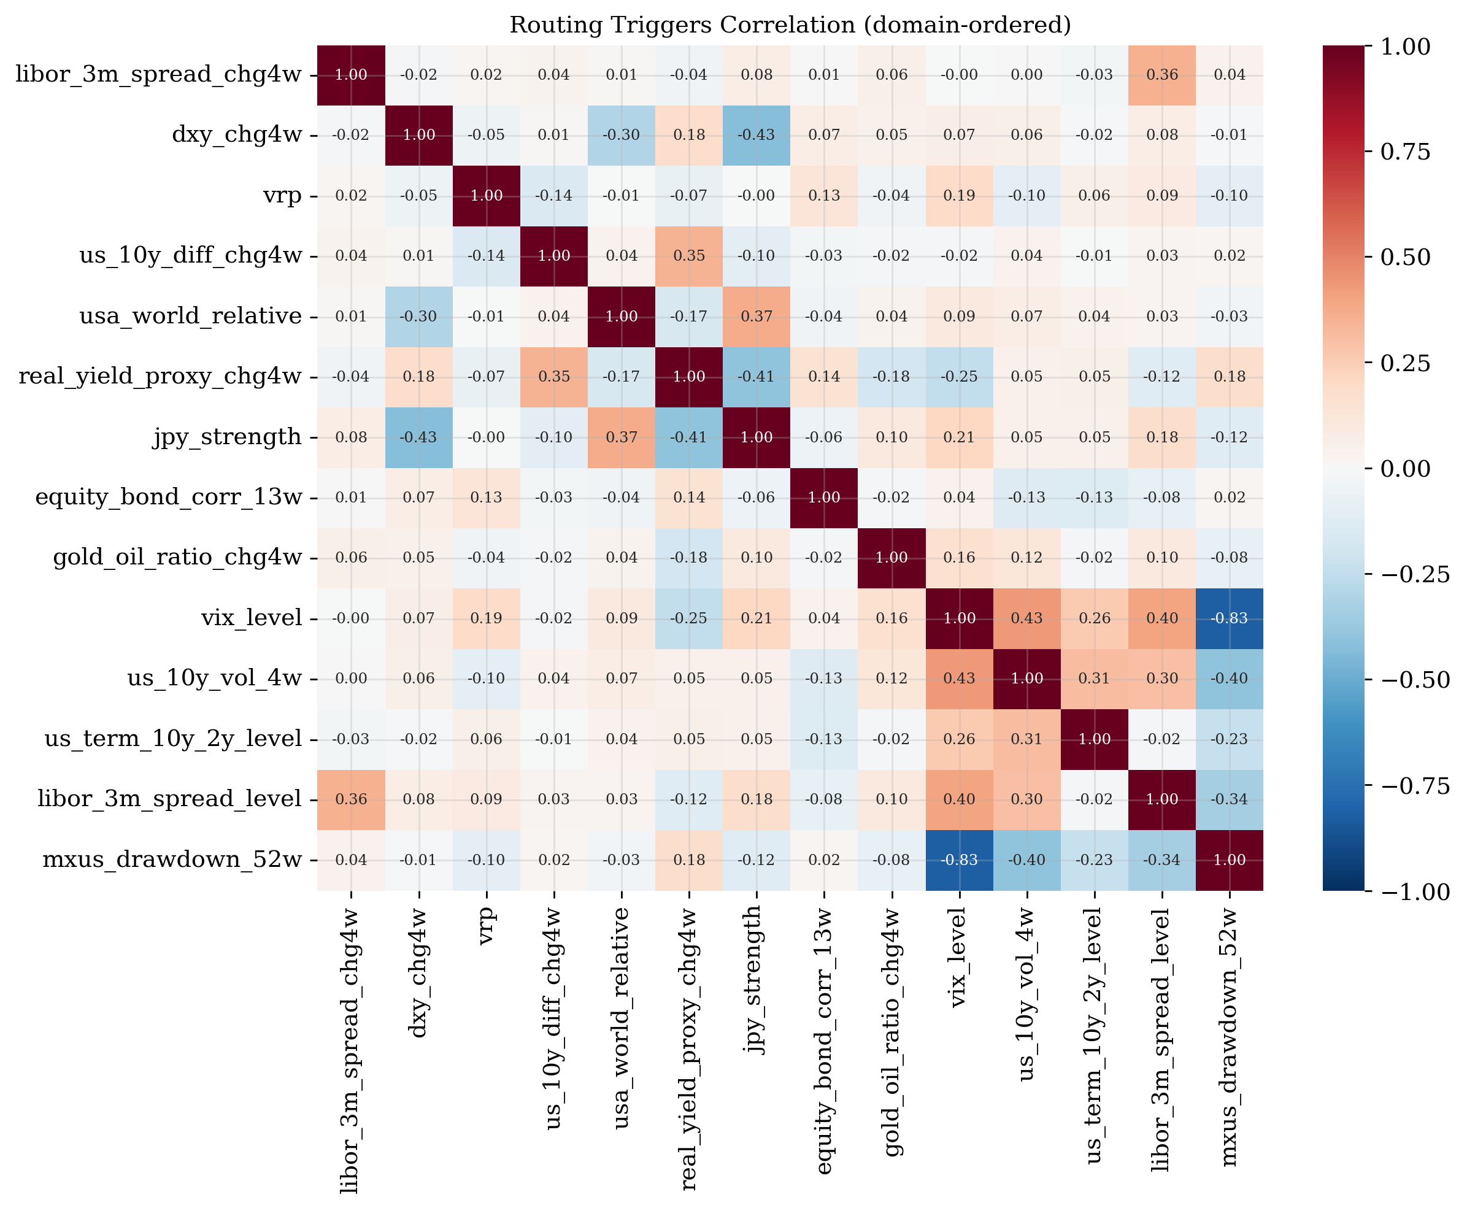
PROCESS & EXECUTION
Feature Engineering: Stationarity & Cross-Asset Spreads
Stationarity transforms
Anomaly detection assumes stable distribution — non-stationary features violate this fundamentally.
• Log-returns: prices (equity, FX, commodities, bond TR)
• First differences: yields and rates
• Level: VIX, ECSURPUS (already stationary)
Result: 42/42 features pass ADF at 5%
20 cross-asset spreads constructed:
• Term: US 10Y−2Y, DE 10Y−2Y, BTP−Bund, US−DE
• Credit: HY-IG, EM (log price ratios, safe − risky)
• VRP: VIX − realized vol (4w, annualized)
• Equity-bond rotation, gold-oil ratio, JPY strength
7 collinear features removed (|ρ| > 0.9) → 56 clean features
Ercelli, Galli, Impenati, Mazzini — PoliMi GSoM
6 / 15

Slide 7
PROCESS & EXECUTION
Walk-Forward Cross-Validation with Purged Embargo
Design rationale
• Expanding window: train always starts at t₀ — mimics real deployment
• 4-week embargo: we drop the first 4 observations between train end and val start. This eliminates data leakage from all 4-week lookback features (Δ4w, rolling windows, EWMA warm-up). No temporal overlap is possible.
• Test holdout (2019–2021): SEALED. Never touched during selection or tuning.
Why weighted-by-n_pos aggregation?
Folds 1–2 have 53/64 positives (GFC, Euro Debt) — statistically reliable. Folds 3–5 have only 2/10/6 positives because 2013–2018 is a structurally low-volatility regime. This is a data property, not a design error.
Weighting by n_pos ensures folds 1–2 dominate the CV metric while folds 3–5 contribute at the margin without introducing noise.
Fold Val Period Y=1% n_pos Crisis
1 2007–2009 34.9% 53 GFC 2008
2 2010–2012 41.7% 64 Euro Debt
3 2013–2014 2.0% 2 Taper 2013
4 2015–2016 10.1% 10 China-Oil
5 2017–2018 6.1% 6 Q4 Selloff
Folds 3–5 are thin → n_pos weighting essential
Scaler discipline (critical)
• StandardScaler fit ONLY on each fold's train
• Test holdout: scaler fit on full development set
• AE early stopping: temporal sub-split of train
This is the #1 source of silent leakage in ML finance
Ercelli, Galli, Impenati, Mazzini — PoliMi GSoM
7 / 15

Slide 8
PROCESS & EXECUTION
Four Anomaly Detection Models
Novelty detection: trained on normal weeks (Y=0) only
1. Multivariate Gaussian (MVG)
Score = squared Mahalanobis distance: d²(x) = (x−μ)ᵀ Σ⁻¹ (x−μ)
Ledoit-Wolf shrinkage is mandatory: with 56 features and ~360 normals in Fold 1, the sample covariance is near-singular. LW computes the optimal shrinkage Σ* = (1−α)Σ + α·(tr(Σ)/p)·I minimizing expected Frobenius loss — producing a well-conditioned estimator.
3. Autoencoder (symmetric bottleneck)
56 → 24 → 12 → 6 → 12 → 24 → 56
ReLU, dropout 0.15, Adam lr=1e-3, MSE loss
Early stopping on temporal 85/15 sub-split of train normals — NEVER on the CV validation fold (leakage)
2. One-Class SVM (RBF kernel)
Maps normals to high-dim feature space, finds smallest hypersphere.
Grid: ν ∈ {0.05, 0.10, 0.15, 0.22} × γ ∈ {scale, auto, 0.01, 0.001}
Best: ν=0.05, γ=0.001 — selected by weighted F1
4. Isolation Forest
200 trees, random partitioning. Anomalies isolated in fewer splits.
Grid: contamination ∈ {0.05, 0.10, 0.15, 0.22}. Best: 0.10
Threshold fine-tuned via walk-forward weighted by n_pos
Ercelli, Galli, Impenati, Mazzini — PoliMi GSoM
8 / 15

Slide 9
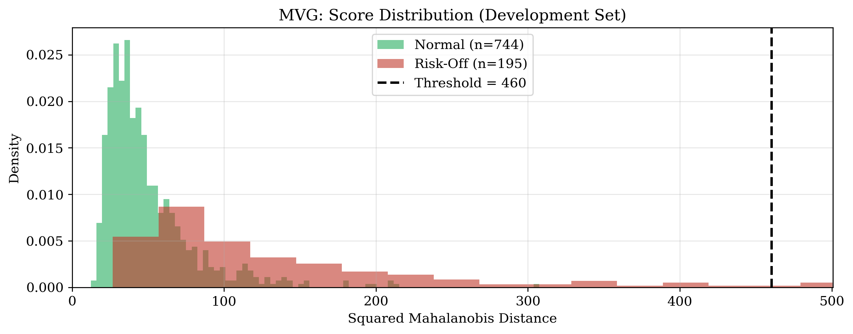
PROCESS & EXECUTION
Model Results — Test Holdout (2019–2021)
F1 AUC-ROC AUC-PR Prec Recall F2
MVG 0.516 0.886 0.770 1.000 0.348 0.400
SVM 0.615 0.851 0.732 0.750 0.522 0.556
IF 0.583 0.810 0.680 0.560 0.609 0.598
AE 0.516 0.873 0.764 1.000 0.348 0.400
Key observations:
• MVG & AE: perfect precision but low recall — conservative thresholds
• SVM: best single model on F1 (balanced precision/recall)
• IF: highest recall (catches 61% of risk-off weeks)
• MVG highest AUC-ROC (0.886): ranking is good, threshold conservative
• F2 (β=2) weights recall double: missing a crisis at 1.5× is costly
Ercelli, Galli, Impenati, Mazzini — PoliMi GSoM
9 / 15

Slide 10
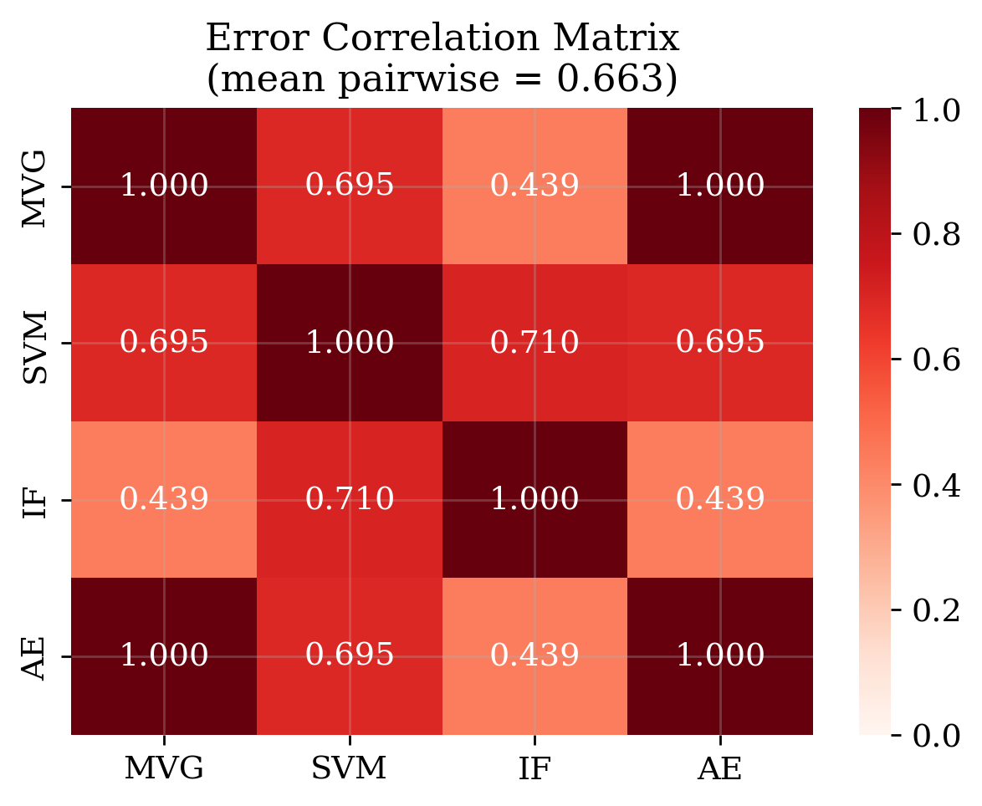
PROCESS & EXECUTION
Ensemble: Combining Four Diverse Detectors
Why ensemble?
Each model captures different anomaly aspects: distributional shift (MVG), boundary violations (SVM), reconstruction difficulty (AE), structural isolation (IF). If errors are uncorrelated, combining reduces both FP and FN.
Percentile mapping:
Raw scores are on incomparable scales. We convert each to its empirical percentile against the train-normals distribution: p = F_train(s). All scores become ∈ [0,1].
Three variants:
1. Hard voting: majority (≥3/4) wins
2. Soft mean: average of percentiles, threshold τ tuned on CV
3. Soft median: robust to one rogue model
Winner: Soft Mean (F1=0.650, beats best single 0.615)
F1 AUC-ROC AUC-PR
Hard Vote 0.516 0.859 0.742
Soft Mean 0.650 0.859 0.742
Soft Median 0.619 0.869 0.759
Mean pairwise error correlation = 0.66 < 0.85 → ensemble adds genuine value
Ercelli, Galli, Impenati, Mazzini — PoliMi GSoM
10 / 15

Slide 11
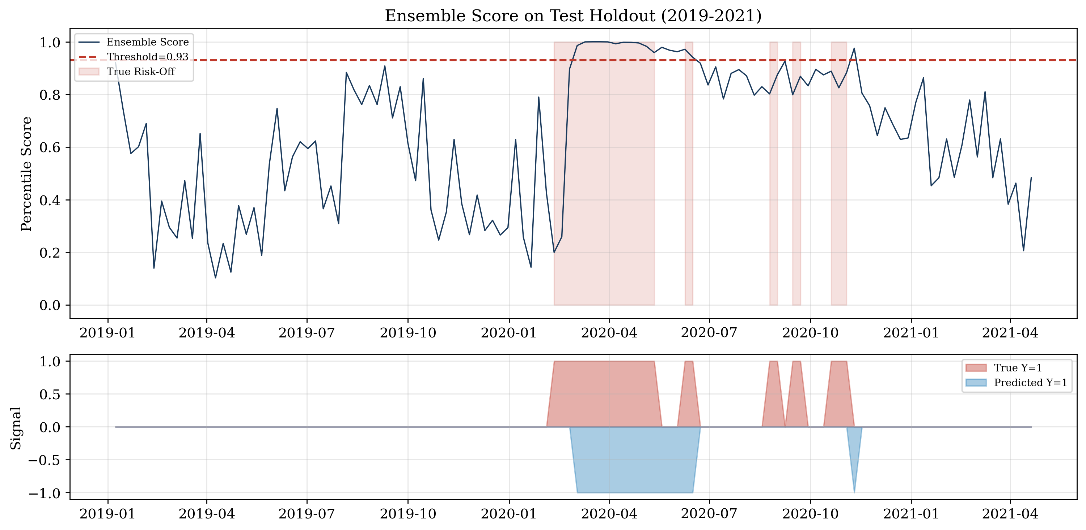
PROCESS & EXECUTION
Ensemble Predictions on Test Holdout
Top: Soft mean percentile score vs. threshold. Red = true risk-off. Bottom: predicted vs. actual signals. The ensemble captures the COVID cluster and correctly filters calm periods.
Ercelli, Galli, Impenati, Mazzini — PoliMi GSoM
11 / 15

Slide 12
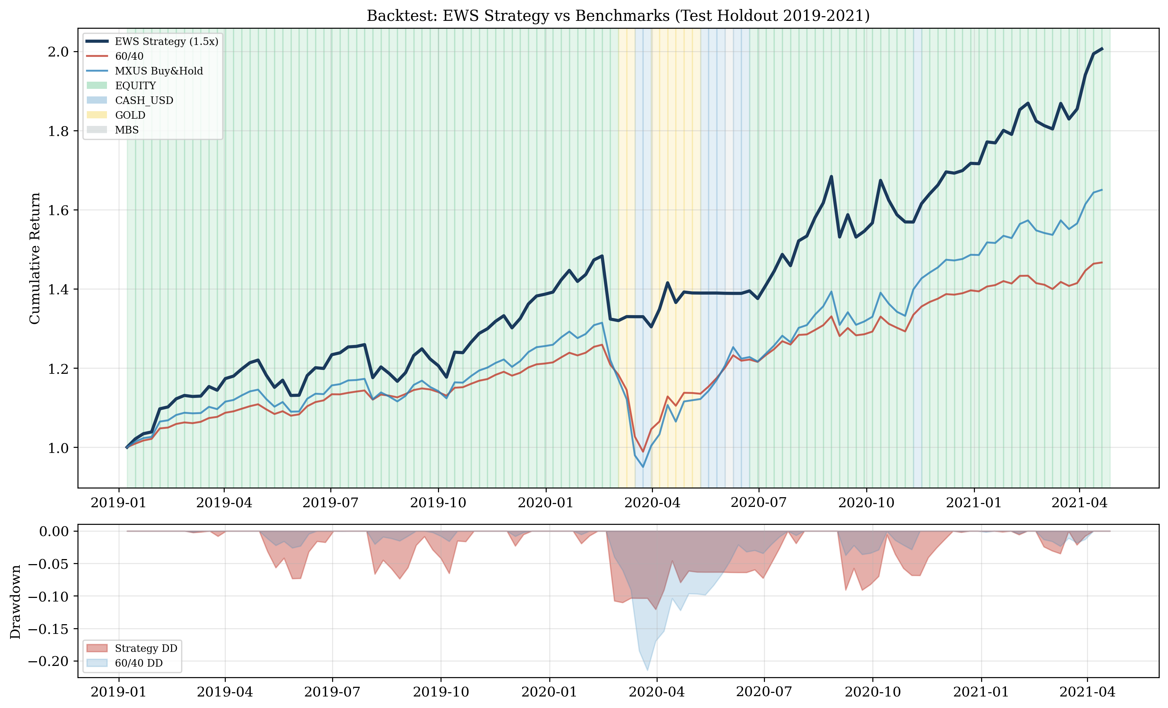
PROCESS & EXECUTION
Backtest Results: Strategy vs. Benchmarks (2019–2021)
Strategy 60/40 B&H
CAGR 35.2% 18.1% 24.2%
Sharpe 1.93 1.44 1.38
Max DD −12.1% −21.5% −27.7%
Calmar 2.92 0.84 0.87
Turnover 3.9/yr
Allocation breakdown:
Levered Equity: 103 weeks (85.8%)
Gold: 8 weeks (6.7%)
Cash USD: 8 weeks (6.7%)
MBS: 1 week (0.8%)
Leverage generates alpha in calm periods (103w at 1.5×),
while EWS limits drawdowns: −12% vs −28% buy&hold.
Leverage + early warning = superior Sharpe ratio.
Ercelli, Galli, Impenati, Mazzini — PoliMi GSoM
12 / 15

Slide 13
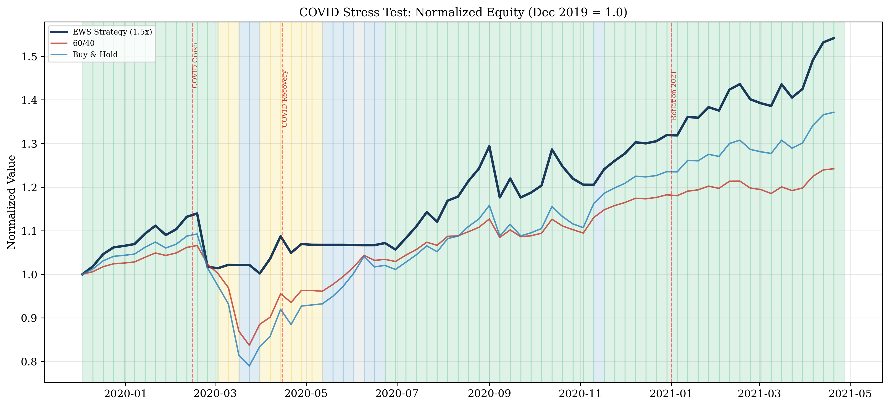
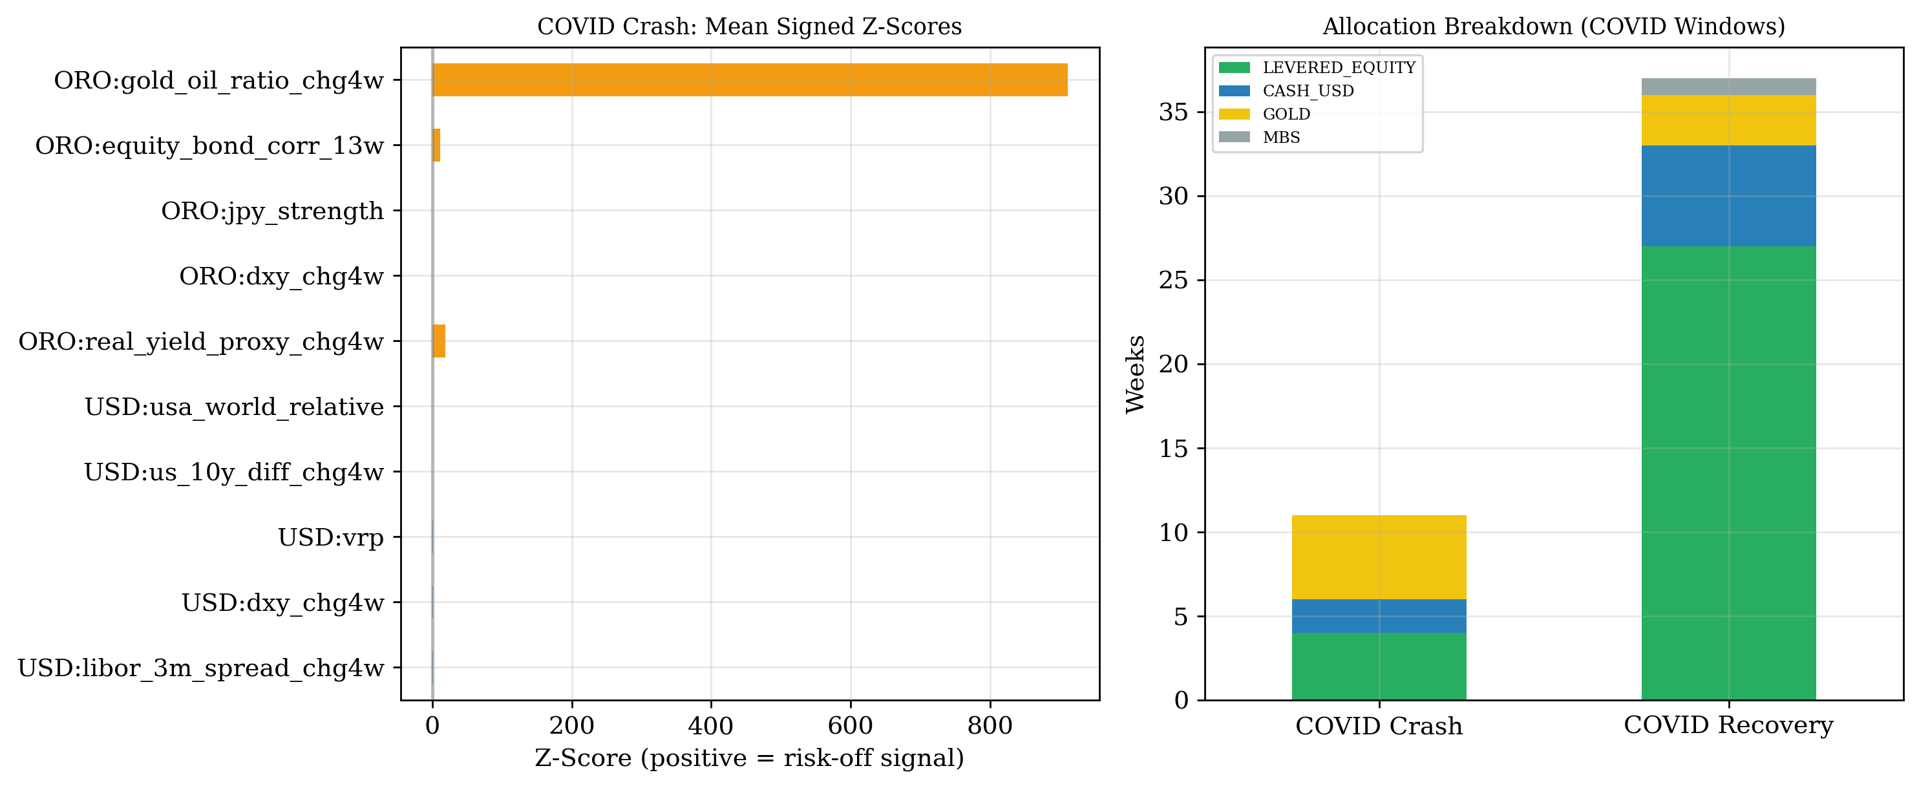
PROCESS & EXECUTION
COVID Stress Test: Trigger Analysis & Allocation Routing
COVID Crash (Feb–Apr 2020)
• Ensemble signals risk-off as VIX spikes
• USD triggers fire first: funding stress (LIBOR-3M widens), DXY rallies, VRP explodes
• Routing → Cash USD and Gold
• MBS correctly blocked (VIX > 30)
COVID Recovery (Apr–Dec 2020)
• Risk-off signals fade as markets stabilize
• Returns to 1.5× equity, captures V-shaped rebound
• Gold score stays elevated (fiscal stimulus → inflation expectations)
Reflation 2021
• Full equity exposure maintained
• No false alarms during re-opening rally
Ercelli, Galli, Impenati, Mazzini — PoliMi GSoM
13 / 15

Slide 14
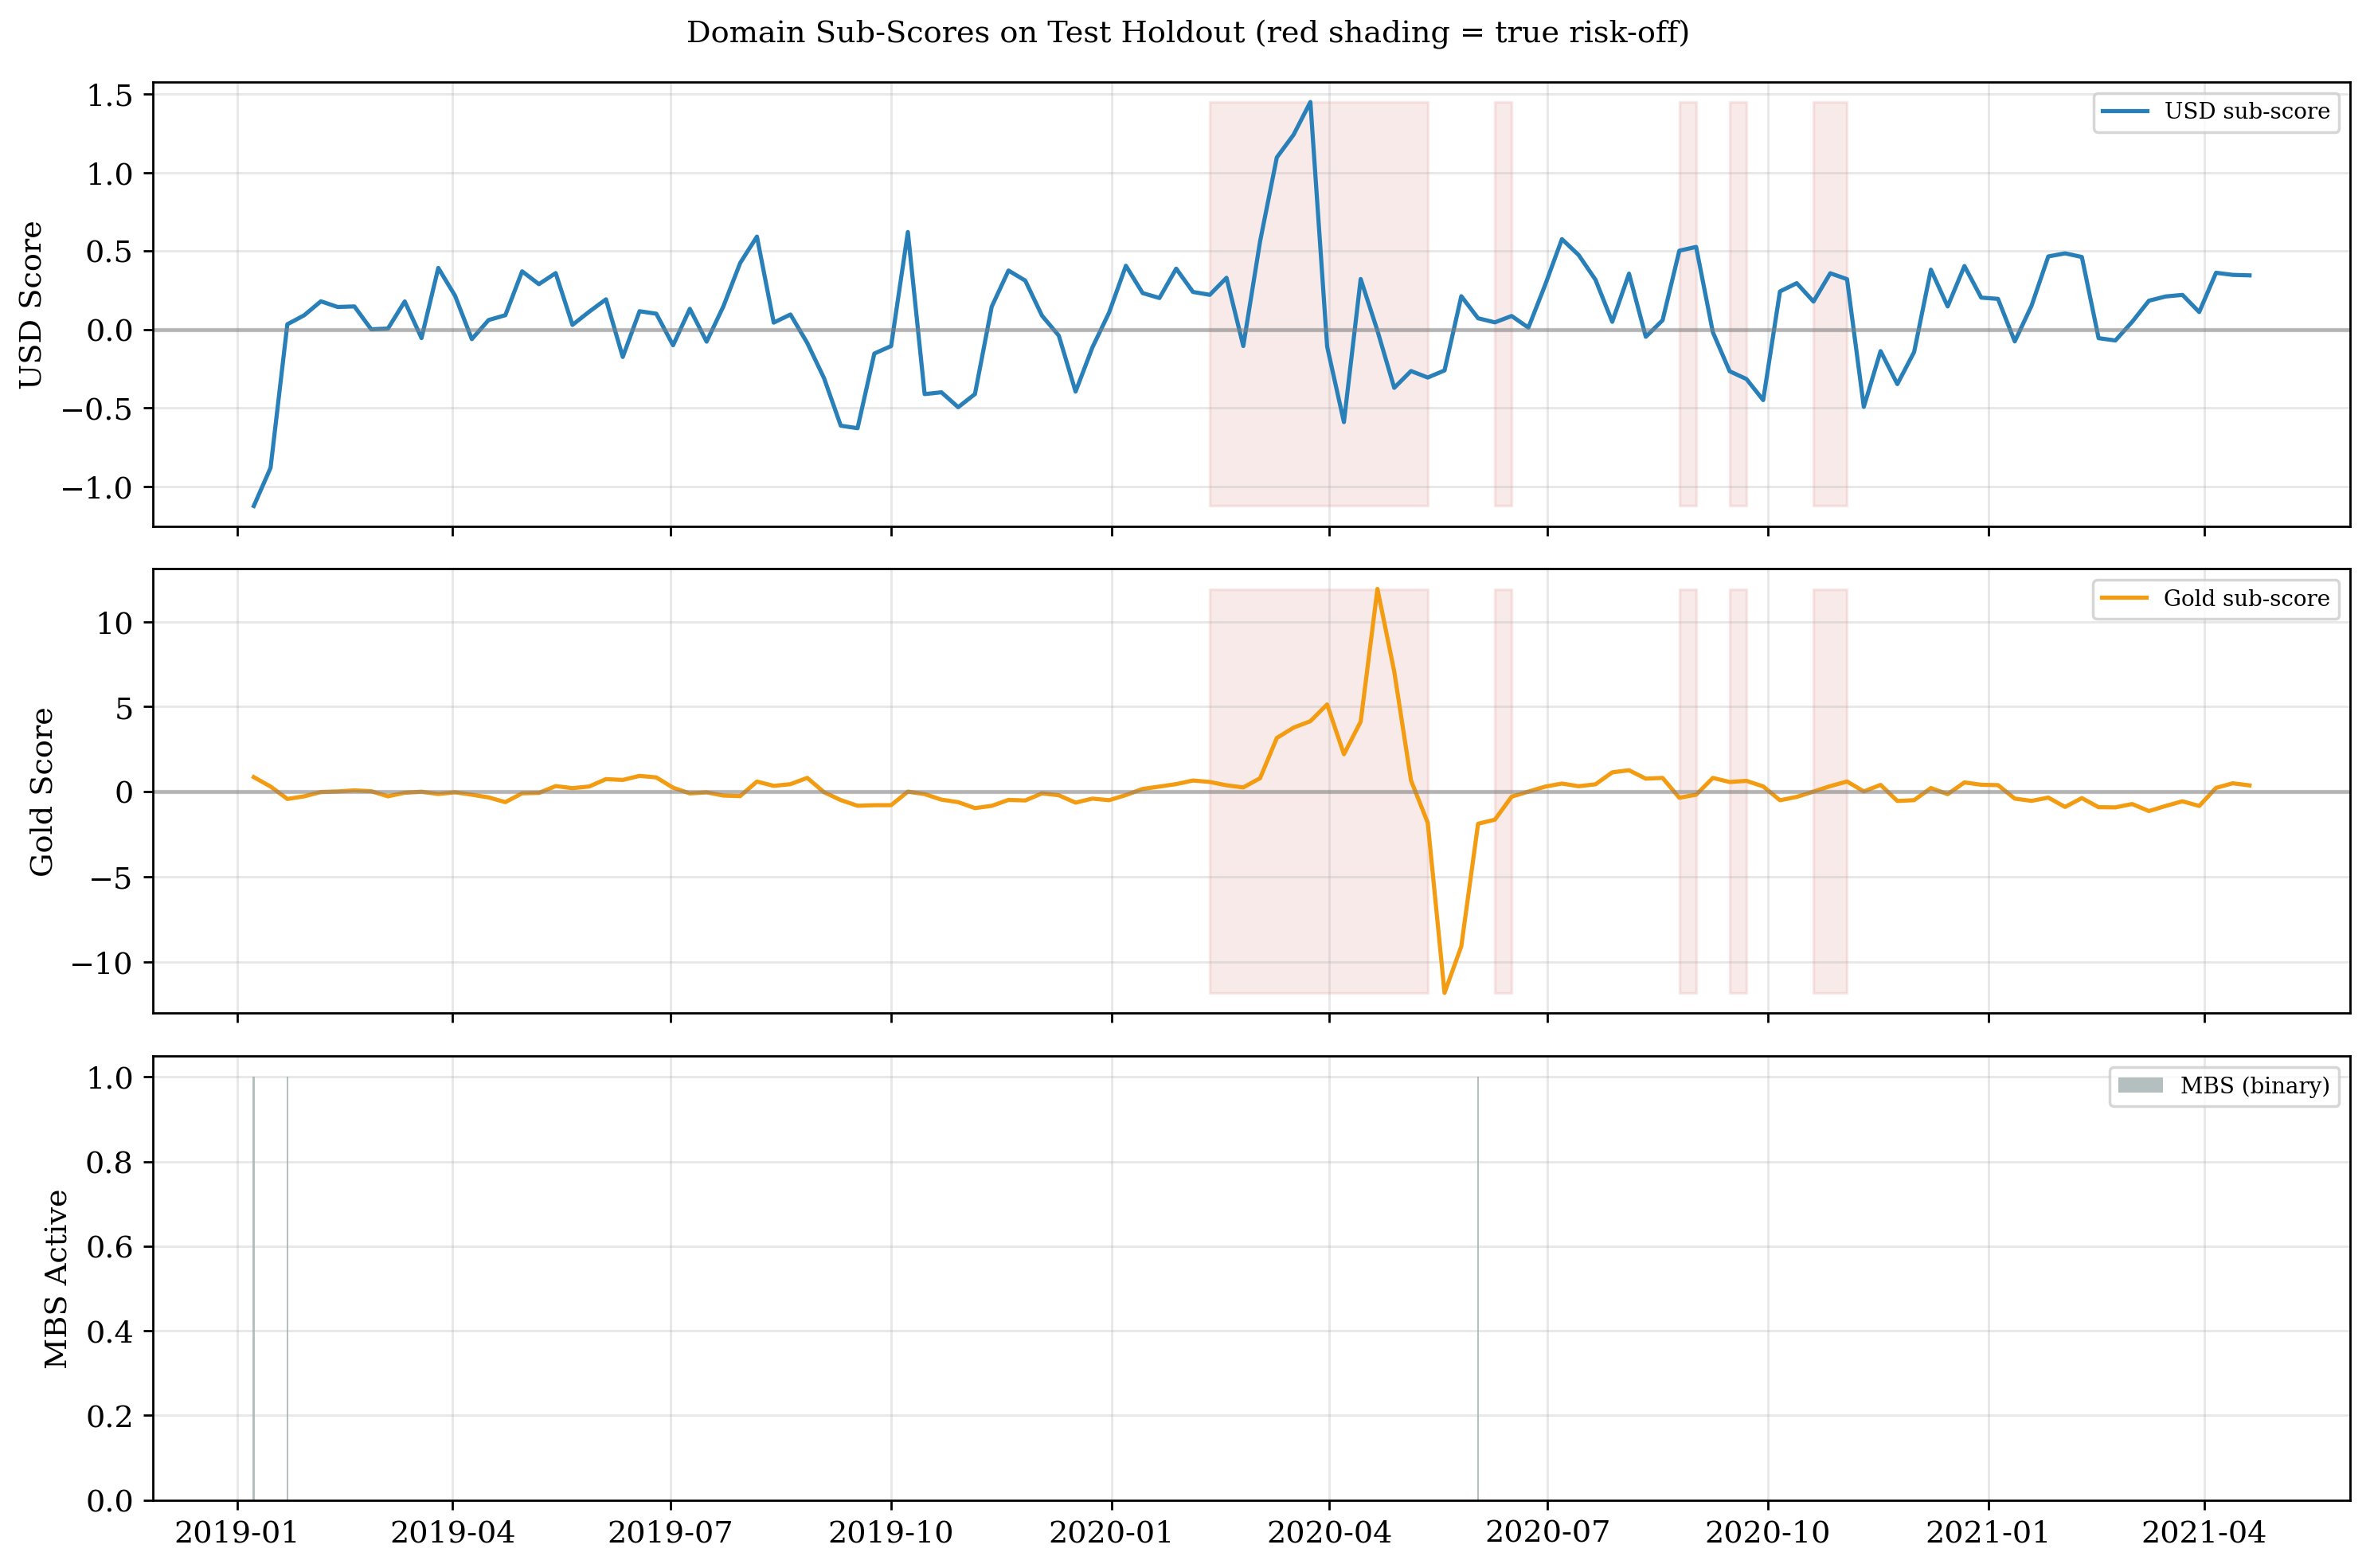
PROCESS & EXECUTION
Domain Sub-Score Dynamics on Test Holdout
Interpretation:
USD sub-score (top): spikes during COVID crash — funding stress, DXY rally, VRP explosion
Gold sub-score (mid): elevated during COVID and recovery — stimulus drives low real yields, DXY weakens
MBS (bottom): activates only once — strict conditions correctly filter out acute stress
Red shading = true risk-off weeks. Sub-scores provide interpretable routing: you can trace which macro regime drove each allocation decision.
Ercelli, Galli, Impenati, Mazzini — PoliMi GSoM
14 / 15

Slide 15
PROCESS & EXECUTION
Limitations, Conclusions & Future Work
Limitations (candidly)
• Short test: 120 weeks, 9 switches — results depend on few trades
• Thin CV folds 3–5: 2–10 positives, n_pos weighting mitigates but doesn't eliminate noise
• Proxy constraints: MXUS ≠ MSCI World; log-ratios ≠ OAS
• Weekly frequency misses intra-week volatility events
• No 2022 data: inflation/rate shock regime not tested
• At 1.5×, recall gap (35%) is a genuine concern
Conclusions
• Ensemble (F1=0.65) outperforms all single models
• Domain-specific routing adds genuine intelligence vs. binary risk-on/off
• Walk-forward + embargo = methodologically sound OOS evaluation
• Strategy: Sharpe 1.93, Max DD −12% vs −28% buy&hold
• Leverage + early warning = superior risk-adjusted returns
Future Work
• Daily frequency for finer granularity • SHAP / Mahalanobis decomposition for signal attribution • Include 2022–2025 data (inflation regime validation)
• Regime-switching models (HMM) as benchmark • Bootstrap CV for confidence intervals • Dynamic threshold adaptation
Ercelli, Galli, Impenati, Mazzini — PoliMi GSoM
15 / 15

