Slide 1
RETAIL SYNERGY SERVICES LTD
MERCHANDISING TRAINING

Slide 2
Course Agenda
Introduction
Definition of a Merchandising
Objectives of a Merchandiser
What and Who is involved
Roles And Responsibilities
Communication
Reporting

Slide 3
OUR Story
Retail Synergy Ltd a member of PMS Group continues to strive to become the region’s most successful and retained agency, by the sheer virtue of quality and service excellence we provide to our clients.
With over 22 years of experience in the retail space – we are experts in understanding what is best for brands to stand out. Our credibility rests on quality, competent management and dedicated professionals that have made us a force to reckon with in the industry.
Our foundations are built on understanding the shopper and the evolving retail environment both on & offline. We make it our business to uncover insights for our clients that influence brand choice on the journey to purchase.
The result – positive brand connections.

Slide 4


















































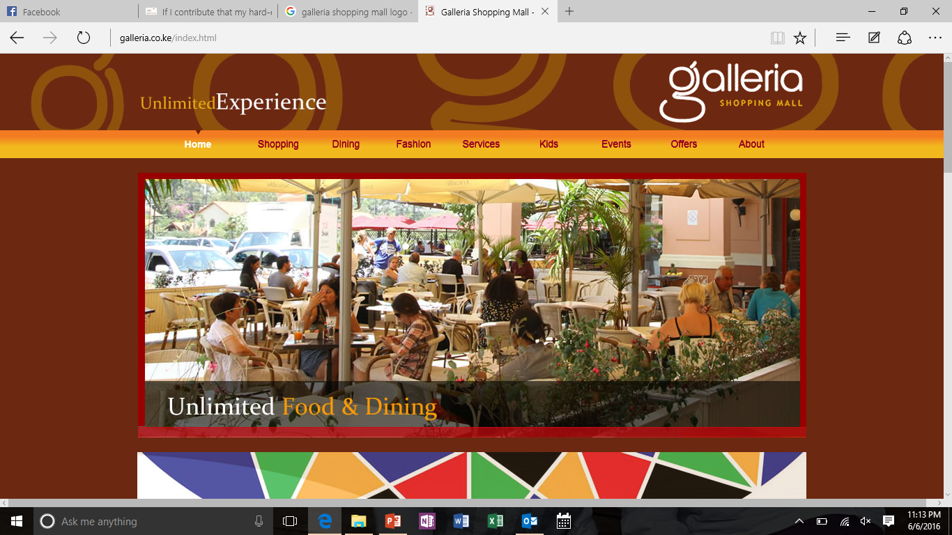

OUR CLIENTS Old & New
.

Slide 5


WHO WE ARE
PMS Group is an integrated one-stop shop agency incorporating the following companies in the stable;

Slide 6
What is Merchandising?
Merchandising is everything you do to promote and sell your products once the potential customer is in your store
Merchandising activities may include display techniques, free samples, on-the-spot demonstration, pricing, shelf strips, special offers, and other point-of-sale methods.

Slide 7
Merchandising Roles
Ensuring stock availability and managing a replenishment system that will ensure proper stocks levels are maintained.
Conducting market research, monitoring competitive activity and offering recommendations on how effectively to compete on shelf
Improving rapport with the customers and making use of existing relationships to make the specific brands a winner at point of purchase.
Effectively utilizing point of sale material and replenishment.
Implementing the 5Ps and ensuring growth and sustainability within the branches covered. Acts as our contact between the outlet management, consumers and client.
Order generation and practicing FIFO/FEFO in all outlets covered.
Maintaining excellent product presentation on and off shelf

Slide 8
MERCHANDISING OBJECTIVES
Visibility – Maximize use of POSM and set out the perfect store experience
Space Management – Ensure that the clients shelf space is guarded and the products achieve an equivalent or more share than the market share
Asset Management - Keep track of fridges, and any other ISF and maximize use of POSM and set out the perfect store experience
Data Audit – Ensure monitoring and data audit for all secondary placements and keep asset records
Data Collection- – Manage price audits, capture competitor activations and ensure adherence to merchandising guideline call card
Price – Ensure price compliance in all merchandised outlets and ensure all products have neat price labels

Slide 9
MERCHANDISING OBJECTIVES
Promotion – Through Identifying, advising, proposing and executing promotions
Stock uplift– through 100% brand availability on shelf at all times and order generate to eliminate stock outs and increase 20% increase during promotions
Listing and Placements for all new products- Ensure that all merchandised outlets have listed and are achieving the set sales targets
Relationship Building – Shop ownership by the merchandising personnel, creation of good rapport and motivation of the shelf talkers to recommend influence order generation for Spice World brands
Reports – Ensure all reports are send using our online reporting tool which captures real time submission of the 5P’s
Space Management – Ensure that the clients shelf space is guarded and the products achieve an equivalent or more than the market share
Planogram Implementation- By identifying gaps, analyzing the share of shelf and advising the client on the PICOS for each merchandised store

Slide 10

OUR EXECUTION STRATEGY THROUGH THE 5P’S
Presence- availability
Placement/Planogram
Price
Promotion
Point of sale materials
Merchandising is best defined in 5 KPIs.
We shall however define it in relation to the client’s specific objectives by adopting our PMS merchandising guide

Slide 11
OUR APPROACH
INSIGHT
Market trends
Competitor Analysis
EXECUTION
Merchandising KPIs
POS Placement & Planogram
MONITORING & EVALUATION
Analytics and refinement
Understanding Our Consumers

Slide 12
1) 100% PRESENCE/AVAILABILITY
Establish Stock Norms by category for order replenishment in all merchandised outlets
Ensure order generation and follow up are shared with the client
Raise alarm in case of under or delayed stock supplies

Slide 13
2) PLACEMENT(PLAN-O-GRAM/SHARE OF SHELF)
Ensure that Spice World products on shelf have acquired more shelf space than the market share
Influence order generation process to ensure good stock pressure for the brands
Practice FIFO & FEFO to eliminate expiries
Attain block displays
Negotiate for extra displays
Adherence to set planograms as per client’s guidelines
Ensure that category placement is done in consideration to traffic
Maintain clean products

Slide 14
PLACEMENT & VISIBILITY
Ensure that the planogram compliance in all the merchandised outlets
Recognize best in class ( perfect store) and reward the merchandisers as a motivation and make it competitive to the rest of the team members.
Share the share of shelf report with client and review action plans for the following month, this will keep the team on toes and ensure we achieve the set projected target
Through our rapport, negotiate for extra visibility placements during the end of the month period or during promotional activities, this will also include new product that Spice World may introduce during this period.
We shall make sure that any new entry products acquire new share of shelf instead of cannibalizing on our existing share
We also propose to have regular trainings for any new products launched into the market so that the team become Spice World brand advocates while in trade and understand in depth the expectations

Slide 15
3) PRICING
Ensure price adherence- Recommended Retail Price
Correct placement of price labels in all categories for all the products
Communication of price offers
Monitor competitor price

Slide 16
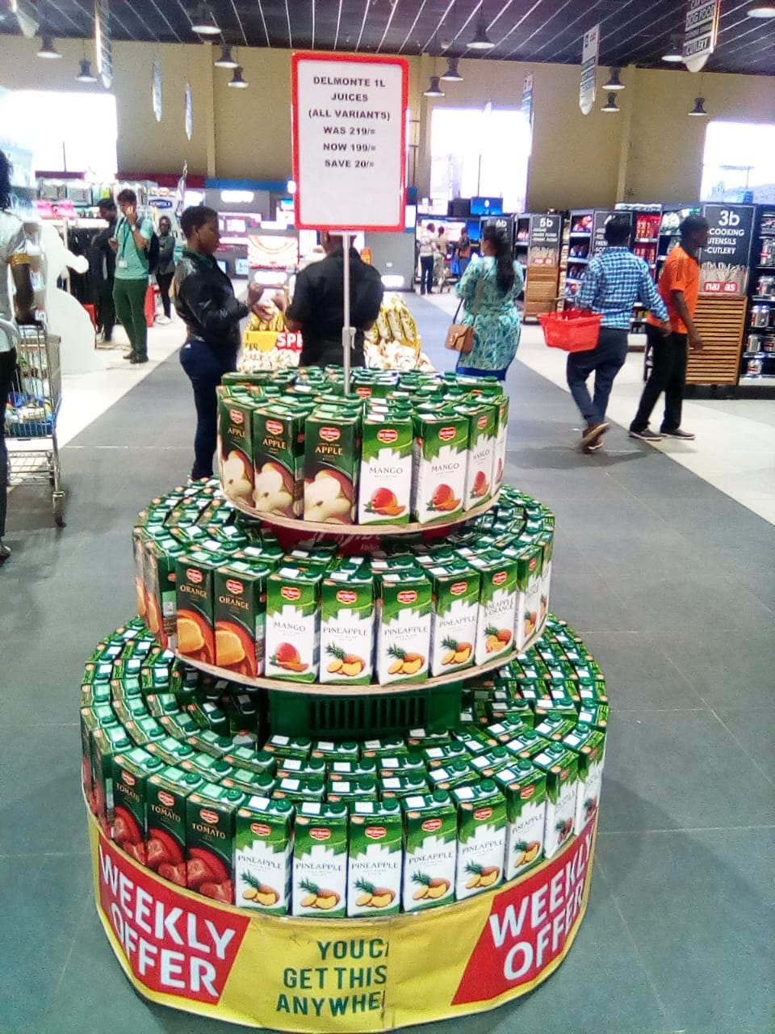
4) PROMOTIONS
Tailored chain activations
National consumer promotions
Back-to-school campaign
Seasonal promotions – Easter, Christmas etc.
Short expiry offers to clear stocks
Bundling offers & gifting
Any other activation for Spice World brand

Slide 17
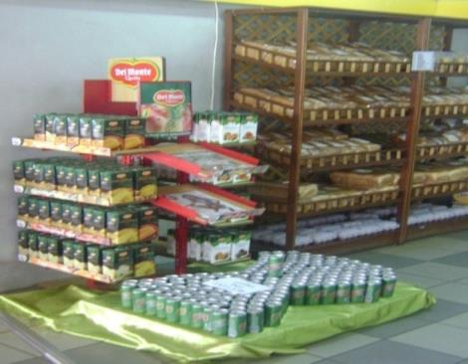
5) POINT OF SALE MATERIALS
Negotiate and do placement communication through ;
Channel staff – mechanics, terms and conditions
POS materials, posters, wobblers, shelf strips and dividers
Share quarterly POS replenishment and use our good rapport to negotiate for the placements
Regular instore furniture audit to be shared on monthly basis

Slide 18
RECAP OF THE 5 KPI’S
In a nut shell, the following KPIs will be addressed;
Presence- We will esnure100% product availability in all stores merchandised
Placement – We need to set parameters for our products; next to our main competitor in a block display with good visibility
Promotion- We will share a promotional activities per region with a full year calendar. This promotions will be target based to help us meet companies' goal
Expiries and damages control- Our trained
Pricing- we will ensure that all product range have price labels which is very key in execution as one of merchandising KPIs
Point of Sale materials- we will manage and place FSU’s, wobblers, shelf dividers and shelf strips
Extra Displays- These will be negotiated by our team at the branch level where most of the decisions are made

Slide 19

NENEGOTIATION Skills
Negotiation is a formal discussion between people who are trying to reach an agreement.
Effective verbal communication.
Listening.
Reducing misunderstandings is a key part of effective negotiation.
Rapport Building.
Problem Solving.
Decision Making.
Assertiveness.
Dealing with Difficult Situations.

Slide 20
Reporting
During merchandising, the Merchandiser will give a report on:
Share of Shelf management
Pricing
Sales performance and stock availability
Market Intelligence
Any other relevant information

Slide 21


CUSTOMER Service
We value you!
We value your time!
We value your Input!

