Slide 1
PMS BTL TRAINING MANUAL

Slide 2
Course Agenda
Introduction
Definition of a Promotion
Objectives of a Promotion
What and Who is involved
Roles And Responsibilities
Communication
Reporting

Slide 3
OUR Story
Retail Synergy Ltd a member of PMS Group continues to strive to become the region’s most successful and retained agency, by the sheer virtue of quality and service excellence we provide to our clients.
With over 22 years of experience in the retail space – we are experts in understanding what is best for brands to stand out. Our credibility rests on quality, competent management and dedicated professionals that have made us a force to reckon with in the industry.
Our foundations are built on understanding the shopper and the evolving retail environment both on & offline. We make it our business to uncover insights for our clients that influence brand choice on the journey to purchase.
The result – positive brand connections.

Slide 4


















































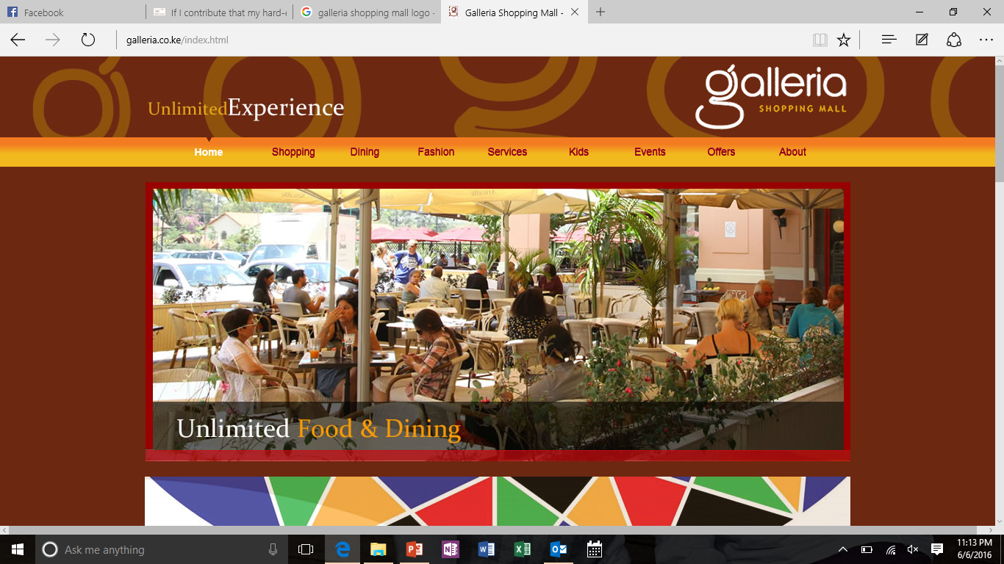

OUR CLIENTS Old & New
.

Slide 5


WHO WE ARE
PMS Group is an integrated one-stop shop agency incorporating the following companies in the stable;

Slide 6
What is Promotion
An activity designed to boost the sales or awareness of a product or service. It may include
An advertising campaign
Increased PR activity
Free-sample campaign
Arranging demonstrations or exhibitions
Setting up competitions with attractive prizes
Temporary price reductions
Door-to-door calling

Slide 7
Objectives Of A Promotion
To Act as a feeder brand to the premium segment
To ensure sustained growth
To be the universal brand of choice
Generate awareness, subsequent trial and conversion.

Slide 8
BRAND AMBASSADOR
Who is a Brand Ambassador?
A Brand Ambassador is a company Representative deployed in an outlet to carry out promotion for a particular product.
BRAND AMBASSADOR

Slide 9
Key Responsibilities
Ensure that company products are available in the outlet and well placed
Communication – Talk to consumer to lead them to the activation and make them participate
Reward consumers on incentive chosen (if any)
POS placement – Posters are in place and maintained at all times
Gather and compile timely reports and Market Intelligence

Slide 10


COMMUNICATION Style
The methods used to communicate can take 3 forms:
Verbal
Non Verbal
Written

Slide 11

COMMUNICATION Style
Aggressive
It is all about winning – often at someone else's expense.
Their needs are the most important – Selfish
They feel they have more rights, and have more to contribute than other people.
It is an ineffective communication style. The content of the message may get lost as people are too busy reacting to the way it's delivered.
"You are crazy!"
"Do it my way!"
"You make me sick!"
"That is just about enough out of you!"
Sarcasm, name-calling, threatening, blaming, insulting.

Slide 12

COMMUNICATION Style
Passive Aggressive
Persons appear passive on the surface, but are actually acting out their anger in indirect or behind-the-scenes ways.
People who behave in this manner usually feel powerless and resentful, and express their feelings by subtly undermining the object (real or imagined) of their resentments – even if this ends up sabotaging themselves.
Prisoners of War often act in passive-aggressive ways in order to deal with an overwhelming lack of power.
Passive-aggressive language is when you say something like "Why don't you go ahead and do it; my ideas aren't very good anyway" but maybe with a little sting of irony or even worse, sarcasm, such as "You always know better in any case."
"Oh don't you worry about me, I can sort myself out – like I usually have to."

Slide 13

COMMUNICATION Style
Submissive
This style is about pleasing other people and avoiding conflict. A submissive person behaves as if other peoples' needs are more important, and other people have more rights and more to contribute.
"Oh, it's nothing, really."
"Oh, that's all right; I didn't want it anymore."
"You choose; anything is fine.

Slide 14

COMMUNICATION Style
Manipulative
This style is scheming and calculating.
Manipulative communicators are skilled at influencing or controlling others to their own advantage.
Their spoken words hide an underlying message, of which the other person may be totally unaware.
"You are so lucky to have those chocolates, I wish I had some. I can't afford such expensive chocolates."
"I didn't have time to buy anything, so I had to wear this dress. I just hope I don't look too awful in it." ('Fishing' for a compliment).

Slide 15

COMMUNICATION Style
Assertive
High self esteem
Most effective style of communication
The in between of being too aggressive and too passive
No manipulation or games straight to the point
Limits are known and boundaries are set
"Please would you turn the volume down? I am really struggling to concentrate on my studies."
"I am so sorry, but I won't be able to help you with your project this afternoon, as I have a dentist appointment."

Slide 16
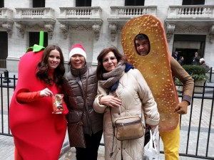
COMMUNICATION Style
Engaging
Attracting attention is one thing, but keeping it is just as important. A brand ambassador needs to know how to keep people interested in your brand’s message. He or she should generate brand excitement that leads to brand loyalty and engagement, even after the event has concluded.

Slide 17
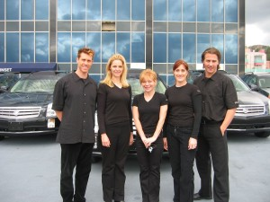
COMMUNICATION Style
Approachable
People should feel comfortable being around you. You should be someone who is friendly yet professional and makes others feel at ease. Others should be comfortable coming to you with any questions, or just to chat!
You should be passionate and enthusiastic, and your attitude should be infectious

Slide 18
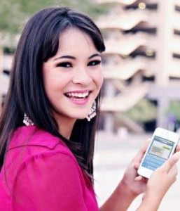
COMMUNICATION Style
Positive Online Presence
Social media has become an integral part of Brand Ambassadorship. You represent your brand both during and after campaigns. This means you should have a good online presence and a positive reputation.

Slide 19
BEING Respectful
Golden Rule: Do to others as you would have them do to you (Luke 6:31)
You can demonstrate respect with simple, yet powerful actions;
Treat people with courtesy, politeness, and kindness.
Encourage coworkers to express opinions and ideas.
Listen to what others have to say before expressing your viewpoint. Never speak over, interrupt, or cut off another person.
Use people’s ideas to change or improve work. Let employees know you used their idea, or, better yet, encourage the person with the idea to implement the idea.
Never insult people, name call, disparage or put down people or their ideas.
Do not nit-pick, constantly criticize over little things, belittle, judge, demean or patronize. A series of seemingly trivial actions, added up over time, constitutes bullying.

Slide 20

PROFESSIONALISM Defined
The term describes the standards of education and training that prepare members of the profession with the particular knowledge and skills necessary to perform the role of that profession. In addition, most professionals are subject to strict codes of conduct enshrining rigorous ethical and moral obligations.

Slide 21

PROFESSIONAL Image
Interpersonal relationships can be won or lost in the
first 4 minutes. 1st Impressions!
7 things your appearance tell:
Income
Education Level
Social Position
Sophistication
Success
Moral Character
Trustworthiness
SELF
Presentation
Hair- Neat and professional
Face – Minimal make up
Clothing – Branded
Shoes - Comfortable
Nails – Short and neat
Body Odors – Fresh and mild perfume

Slide 22
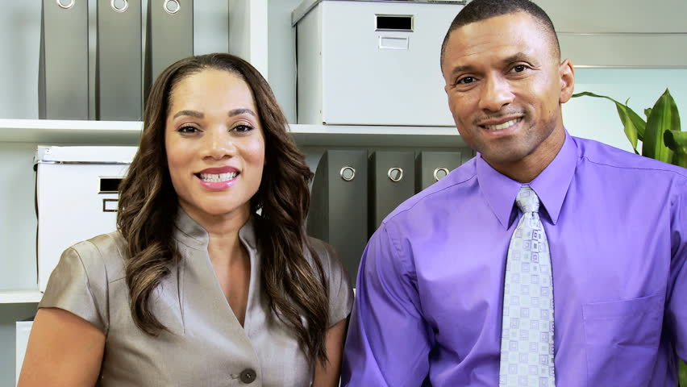
PROFESSIONAL Image
Points to note:
The world is a catwalk
Everyday is a photo-shoot
Everyone you meet interviews you.
If you look good; you feel good.
If you feel good you perform better
ALWAYS look your BEST

Slide 23
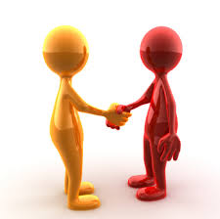
NEGOTIATION Skills
Negotiation is a formal discussion between people who are trying to reach an agreement.
Effective verbal communication.
Listening.
Reducing misunderstandings is a key part of effective negotiation.
Rapport Building.
Problem Solving.
Decision Making.
Assertiveness.
Dealing with Difficult Situations.

Slide 24
NEGOTIATION Skills
Active LISTENING
3-stage process:
STAGE 1
STAGE 2
STAGE 3
Eye contact, head nods, or other non-verbal affirmations
Verbal cues, or phrases, such as uh-huh, go on, really!
Questions for clarification or summarizing statements, such as,

Slide 25
CUSTOMER Service
Be observant
Physical environment
Emotional environment

Slide 26
CUSTOMER Service
Smile!! Smile! Smile!
Use direct eye contact.
Be aware of your body language and tone of voice.
Make sure the environment is ALWAYS clean and professional.
Be GENUINE!
6. The customer is ALWAYS right even if they are wrong

Slide 27
CUSTOMER Service
Dealing Client Complaints
Do not personalize the problem.
Stay focused on the situation, not on the individual.
If you can’t fix it.
Find someone who can
Composure is a team effort.
Involve and support other team members after a service setback.

Slide 28
Reporting
During the Activation, the BA will give a report on:
Customers contacts, names
Consumers feedback on the brand
Positive/ Negative
Sales performance and stock availability
Market Intelligence
Any other relevant information

Slide 29


CUSTOMER Service
We value you!
We value your time!
We value your Input!

