Slide 1
Performance and Scalability in Azure using CQRS Patterns
Jon Banta – Oct 2018

Slide 2
Define CQRS and System Design
Handling Multiple Data Sources
Comparisons to Event Sourcing and Traditional patterns
Effective Strategies for a CQRS System
Performance and Scalability in Azure
Code Demos!
Sample Architectures
Service Bus + Microservices Patterns
Agenda

Slide 3
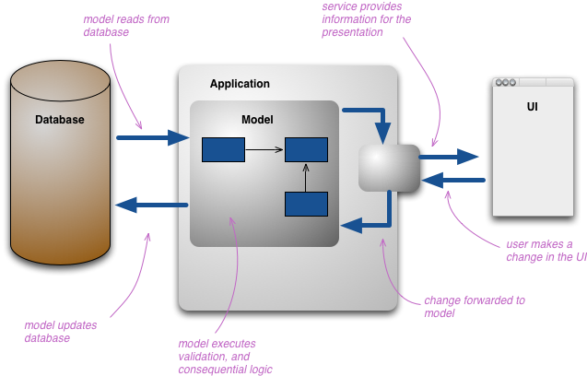
Basic System Design
Typical Database + Application + UI Design
Application contains models
Models update persistent storage
https://martinfowler.com/bliki/CQRS.html

Slide 4
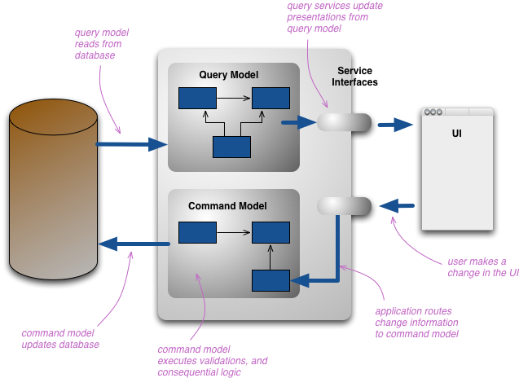
CQRS Definitions
Command Query Responsibility Segregation (CQRS)
Allows you to separate the load from reads and writes allowing you to scale each independently
Apply different optimization strategies to the two sides
https://martinfowler.com/bliki/CQRS.html
https://docs.microsoft.com/en-us/azure/architecture/patterns/cqrs
https://microservices.io/patterns/data/cqrs.html
https://docs.microsoft.com/en-us/previous-versions/msp-n-p/jj591573(v=pandp.10)

Slide 5
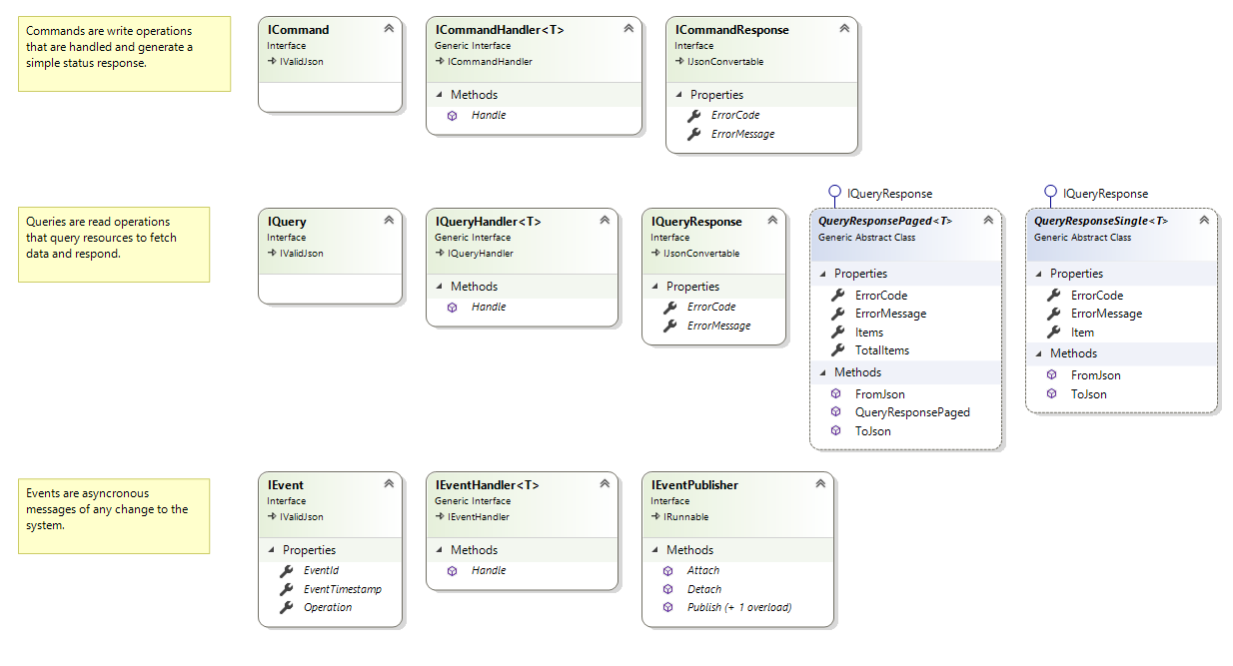
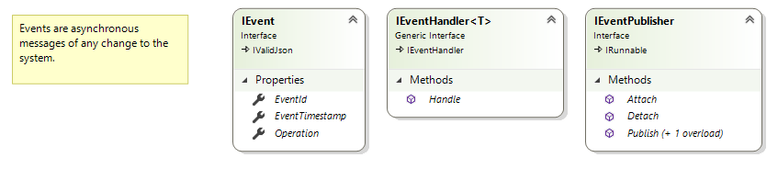
CQRS Code Diagram

Slide 6
Demo #1 – Pattern Code Definitions

Slide 7
Demo #2 – Game Logic

Slide 8
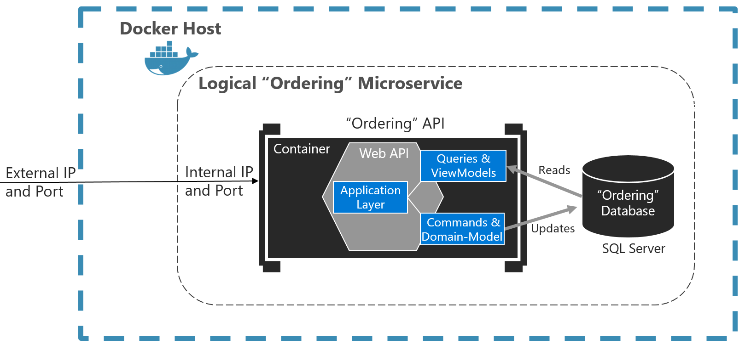
CQRS Microservices
Microservices with CQRS patterns
Single container can contain both Commands + Queries
https://docs.microsoft.com/en-us/dotnet/standard/microservices-architecture/microservice-ddd-cqrs-patterns/apply-simplified-microservice-cqrs-ddd-patterns

Slide 9
Demo #3 – CQRS Services

Slide 10
CQRS - Comparisons
CQRS Example
“RESTful” Example
Vue JS + Vuex
ASP.NET Core MVC
Micoservice + WebSockets
ASP.NET Core API
Game Engine
Game Engine
In Memory Data
In Memory Data

Slide 11
Demo #4 – REST

Slide 12
Demo #5 – Add Front End Applications

Slide 13
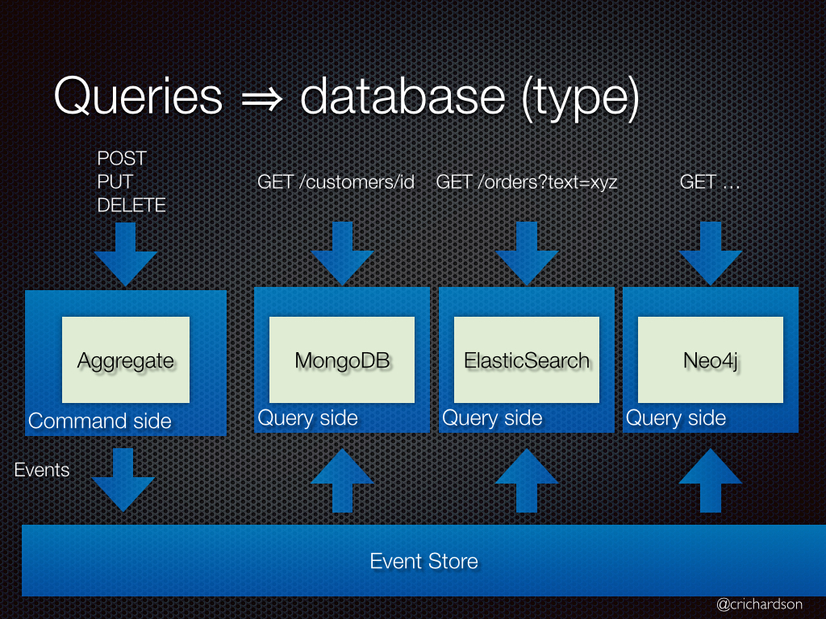
CQRS – Multiple Data Stores
Dedicated queries abstract the calls away from primary storage
Command (“Write”) operations only effect primary storage
Query (“Read”) operations can read from other data stores/caches
https://microservices.io/patterns/data/cqrs.html

Slide 14
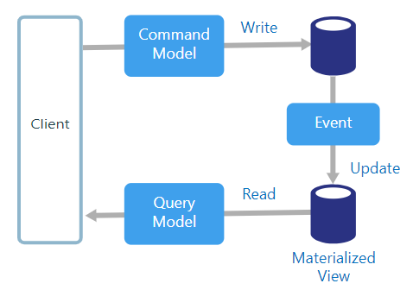
CQRS – Event-Driven Architecture
Events are used to synchronously or asynchronously update associated data stores/caches
Eventual consistency
Data is written strategically for effective reads
Materialized views and calculations are updated with each write
https://docs.microsoft.com/en-us/azure/architecture/guide/architecture-styles/cqrs

Slide 15
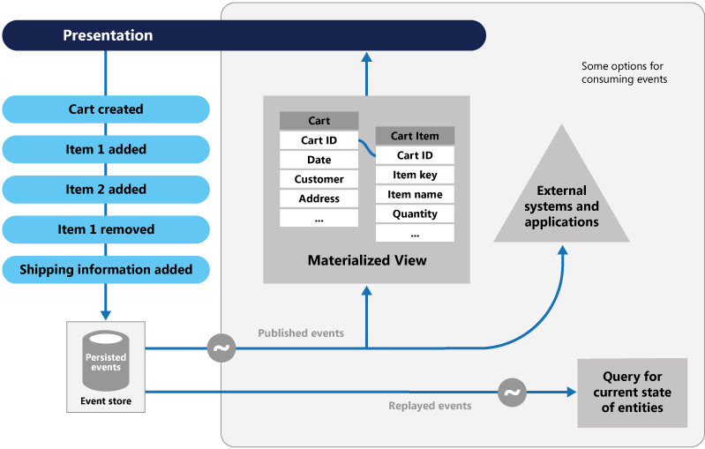
CQRS – A Step towards to Event Sourcing
Event Sourcing is enforcing all changes to application state is a sequence of event data
Reads are from materialized views of the event sequence
Great for replay – streaming options
Not required for the CQRS pattern
https://docs.microsoft.com/en-us/azure/architecture/guide/architecture-styles/cqrs

Slide 16
CQRS in the Cloud

Slide 17
Azure Auto Scaling

Slide 18
Azure Auto Scaling – Best Practices

Slide 19
ARM Templates

Slide 20
New Requirement – Fantasy Points

Slide 21
Demo #6 – Fantasy Points

Slide 22
Pros / Cons of CQRS

Slide 23
Strategies – Serialization
High performance systems are heavily dependent upon serializing commands/queries across many endpoints
JsonConvert.SerializeObject() is not enough in most cases
Highly recommend abstracting serialization implementation
https://www.newtonsoft.com/json
https://blog.codinghorror.com/performance-is-a-feature/
Common Formats
JSON
BSON
Binary
Serialization Providers
Newtonsoft.Json
https://www.newtonsoft.com/json
Jil
https://github.com/kevin-montrose/Jil
ProtoBuf
https://developers.google.com/protocol-buffers/

Slide 24
Strategies – Serialization
Recommendations:
Small # of Messages
Small Bounded System
ProtoBuf
Large # of Messages
Multiple Consumers / Third Parties
Jil
Service Bus
BSON
https://codeclimate.com/blog/choose-protocol-buffers/
https://www.sitepoint.com/data-serialization-comparison-json-yaml-bson-messagepack/
This:
{
“property”: “”
}
Is Different:
{
“property”: null
}
Than This:
{
}

Slide 25
Strategies - Versioning
While encouraging distributed commands and queries, it is possible to have out-of-date requestors / consumers
Different versions could implement different business logic / validation
Highly recommend requiring version information on every command, query, event, and message.
https://www.infoq.com/news/2017/07/versioning-event-sourcing
In order to identify the version of any message, it is common to require header information on every message:
{
“name”: “”,
“version”: “1.0.0”,
“payload”: {
…
}
}
Or require version in the url:
http://tempuri.org/v1/resource

Slide 26
Strategies – Event Subscriptions
Highly recommend requiring subscriptions for events, rather than broadcast every event to every system
Could implement a layered approach to events.
Events are broadcasted to parent / inherited systems
Events are NOT broadcasted to sub-systems
.
https://www.infoq.com/articles/microservices-aggregates-events-cqrs-part-2-richardson

Slide 27
Strategies – Hash-Based Read Caching
Perform hash lookup of query objects in cache stores
Does not require explicit knowledge / logic of each query – just the hash lookup value
https://www.infoq.com/articles/microservices-aggregates-events-cqrs-part-2-richardson

Slide 28
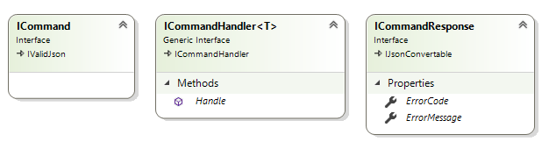
Strategies – Command Responses?
Highly debated issue
Commands can return values
Confirm validation message
Acknowledgement of completion
Version increment
maybe
Commands should not respond with any stateful data
In our example, we reply with ErrorCode and ErrorMessage only
https://martinfowler.com/bliki/CQRS.html

Slide 29
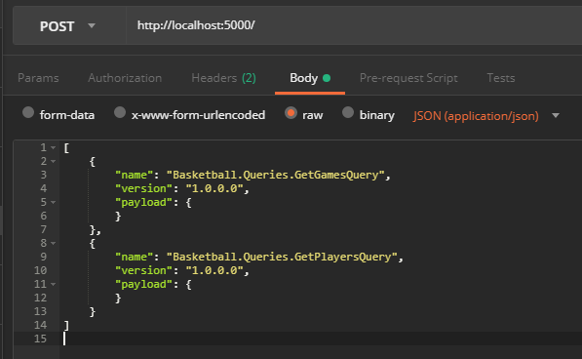
Strategies - Batching
Never limit a round trip between two endpoints to a single message
A single HTP request can define a series of messages and how they should be handled
Can be asynchronously or synchronously handled
Can define workflow parameters
Continue if…
If response then …
https://martinfowler.com/bliki/CQRS.html

Slide 30
The Ilities

Slide 31
Sample Architectures

Slide 32
Demo #6 – Service Bus

Slide 33
Final Thoughts

Slide 34
Final Thoughts

Slide 35
Further Presentations
.NET Core Containers
<75 MB
TensorFlow
Securing Distributed Systems

Slide 36
Further Reading

