Slide 1
Performance and Scalability in Azure using CQRS Patterns
Jon Banta – Oct 2018

Slide 2
Define CQRS and System Design
Code Demos
CQRS Architectures
Comparisons to Other Patterns
Multiple Data Sources
Comparisons to Event Sourcing
Performance and Scalability in Azure
More Code Demos!
Effective Design Strategies
Sample Architectures
Final Thoughts
Agenda

Slide 3
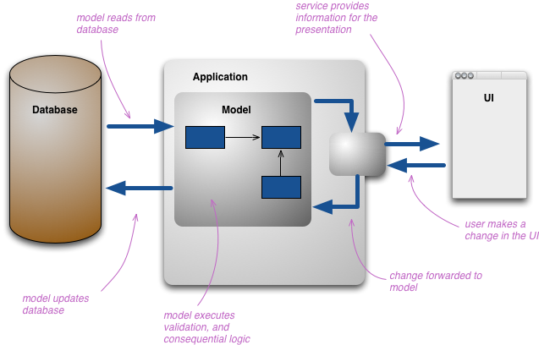
Basic System Design
Typical Database + Application + UI Design
Application contains models
Models update persistent storage
https://martinfowler.com/bliki/CQRS.html

Slide 4
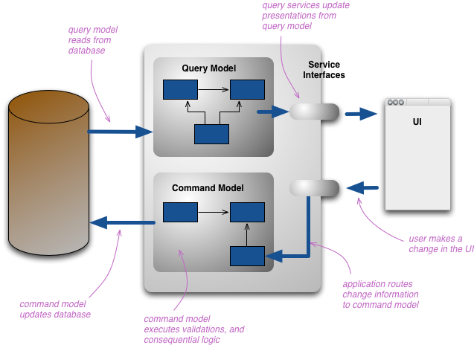
CQRS Definitions
Command Query Responsibility Segregation (CQRS)
Allows you to separate the load from reads and writes allowing you to scale each independently
Apply different optimization strategies to the two sides
https://martinfowler.com/bliki/CQRS.html
https://docs.microsoft.com/en-us/azure/architecture/patterns/cqrs
https://microservices.io/patterns/data/cqrs.html
https://docs.microsoft.com/en-us/previous-versions/msp-n-p/jj591573(v=pandp.10)

Slide 5
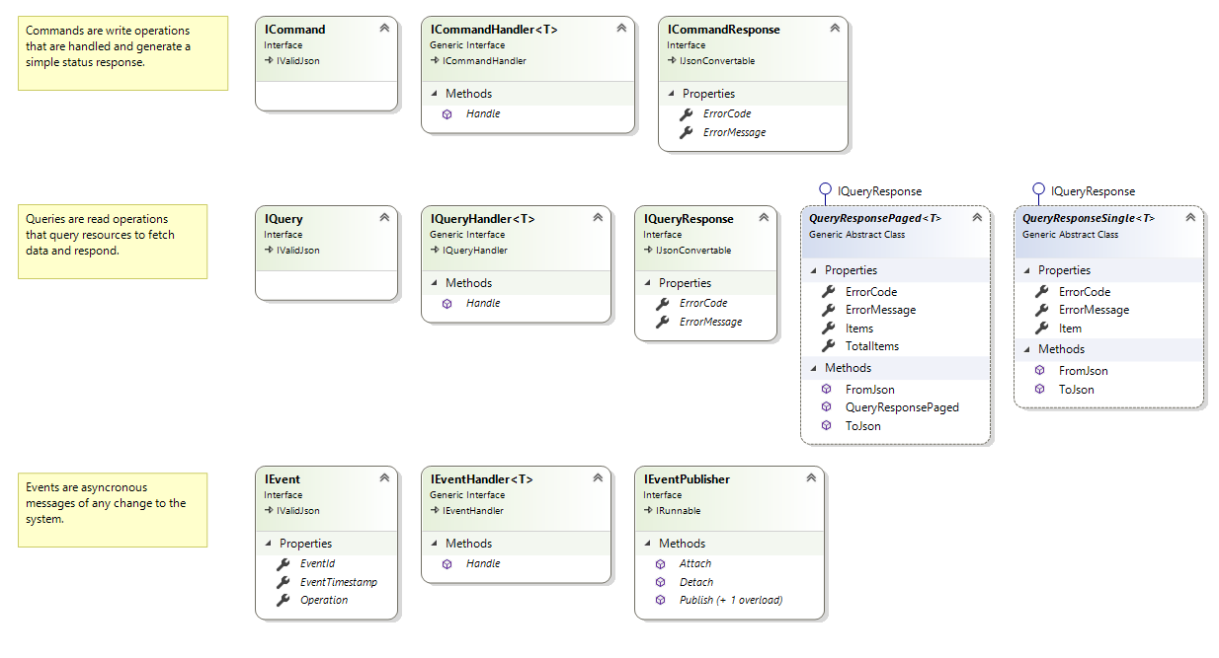
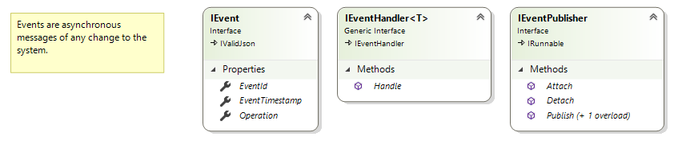
CQRS Code Diagram

Slide 6
Demo #1 – Pattern Code Definitions

Slide 7
Demo #2 – Game Logic

Slide 8
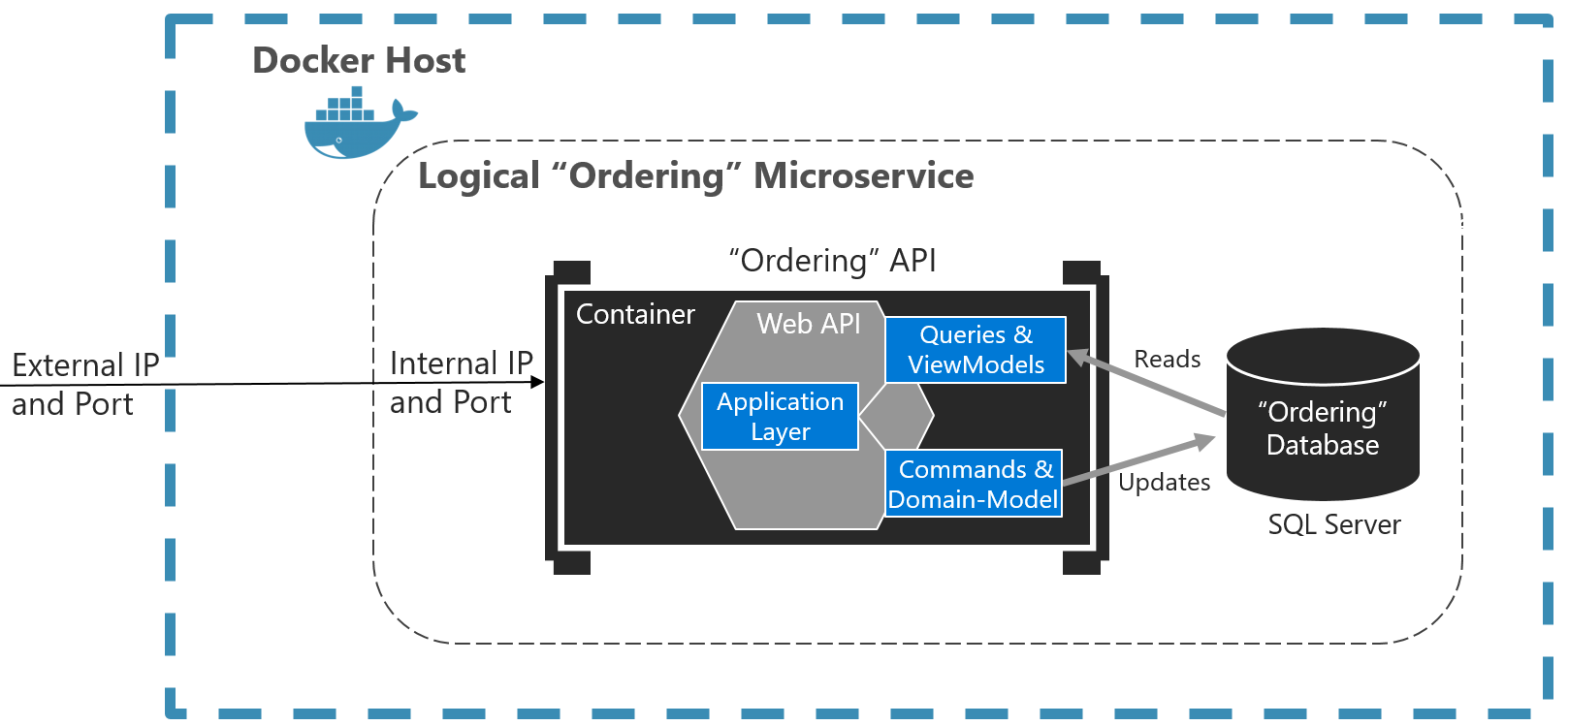
CQRS Microservices
Microservices with CQRS patterns
Single container can contain both Commands + Queries
https://docs.microsoft.com/en-us/dotnet/standard/microservices-architecture/microservice-ddd-cqrs-patterns/apply-simplified-microservice-cqrs-ddd-patterns

Slide 9
Demo #3 – CQRS Services

Slide 10
CQRS - Comparisons
CQRS Example
“RESTful” Example
Vue JS + Vuex
ASP.NET Core MVC
Micoservice + WebSockets
ASP.NET Core API
Game Engine
Game Engine
In Memory Data
Read Cache Data
In Memory Data

Slide 11
Demo #4 – REST

Slide 12
Demo #5 – Add Front End Applications

Slide 13
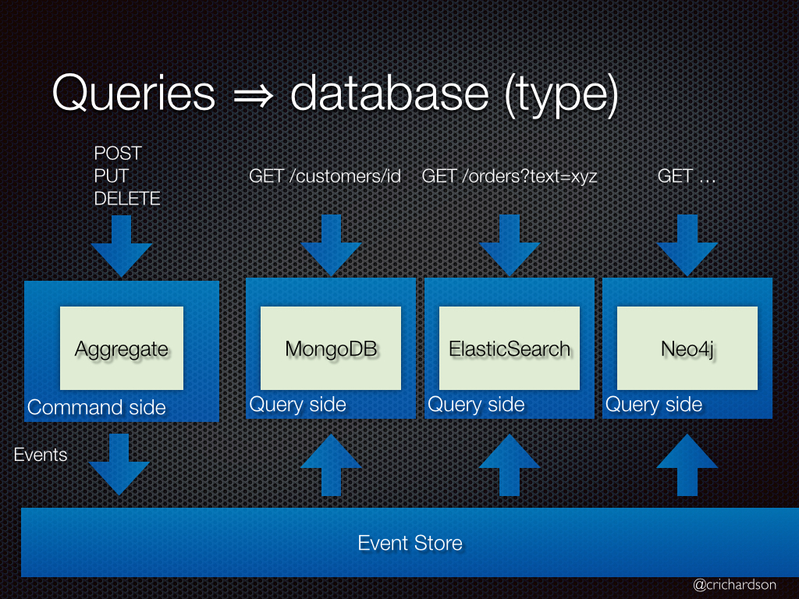
CQRS – Multiple Data Stores
Dedicated queries abstract the calls away from primary storage
Command (“Write”) operations only effect primary storage
Query (“Read”) operations can read from other data stores/caches
https://microservices.io/patterns/data/cqrs.html

Slide 14
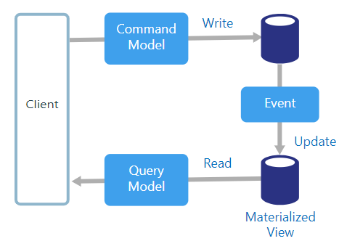
CQRS – Event-Driven Architecture
Events are used to synchronously or asynchronously update associated data stores/caches
Eventual consistency
Data is written strategically for effective reads
Materialized views and calculations are updated with each write
https://docs.microsoft.com/en-us/azure/architecture/guide/architecture-styles/cqrs

Slide 15
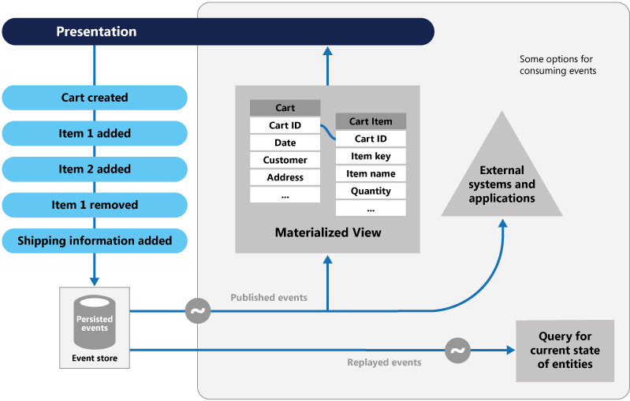
CQRS – A Step towards to Event Sourcing
Event Sourcing is enforcing all changes to application state is a sequence of event data
Reads are from materialized views of the event sequence
Great for replay – streaming options
Not required for the CQRS pattern
https://docs.microsoft.com/en-us/azure/architecture/guide/architecture-styles/cqrs

Slide 16
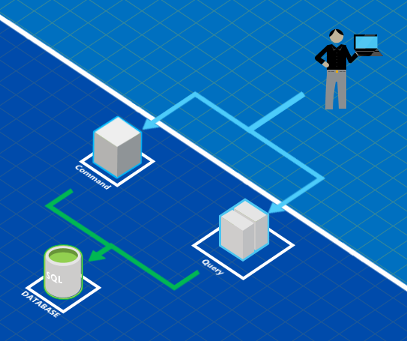
CQRS in the Cloud
CQRS Patterns apply to simple code structures as well as service / hardware / architecture design
Widespread virtualization, orchestration availability in the cloud allows for more flexible, elastic designs
Primary goal of separating read / writes allow for vastly different architectures
https://docs.microsoft.com/en-us/azure/architecture/guide/architecture-styles/cqrs
https://blogs.msdn.microsoft.com/azuredev/2017/03/09/cqrs-in-azure-part-1/

Slide 17
CQRS in the Cloud
Reads (Queries)
Highly distributed read caches
If hydrated by events, entire data store could start with nothing
Examples
SQL Server Availability Groups
redis cache as a data store
NoSql solutions
Writes (Commands)
Reads are migrated away to allow for more “append only” persistent write data stores
https://docs.microsoft.com/en-us/azure/architecture/guide/architecture-styles/cqrs
https://blogs.msdn.microsoft.com/azuredev/2017/03/09/cqrs-in-azure-part-1/

Slide 18
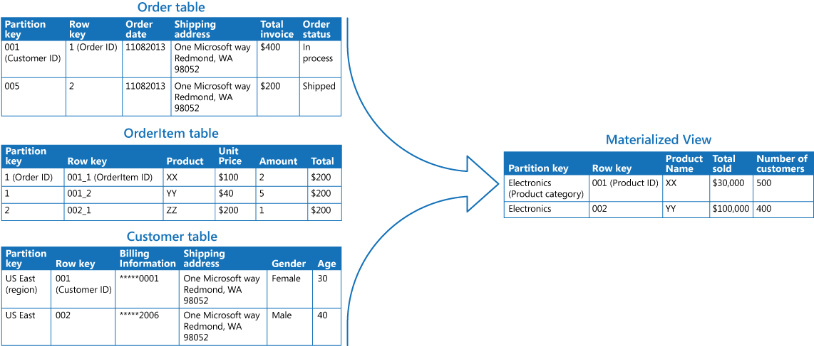
CQRS in the Cloud
Cloud Patterns
Materialized Views

Slide 19
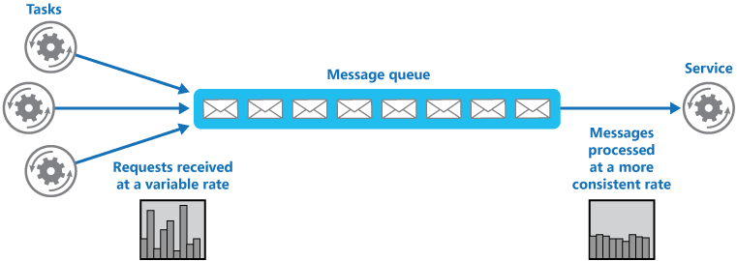
CQRS in the Cloud
Cloud Patterns
Queue-Based Load Leveling
Great for buffering write operations
Can facilitate handling exceptions

Slide 20
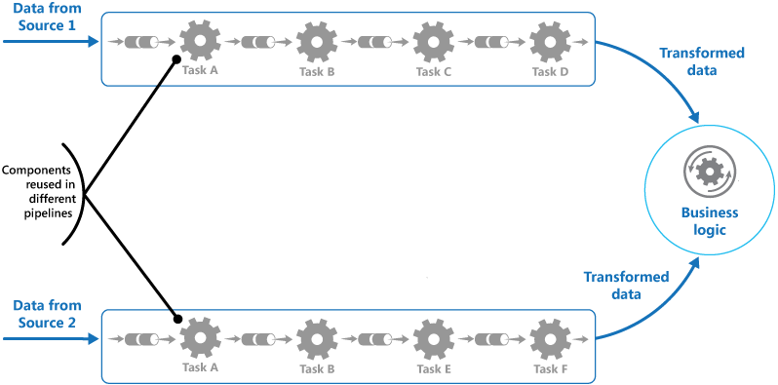
CQRS in the Cloud
Cloud Patterns
Pipes and Filters
ETL Processes
Pipeline can be workflow based

Slide 21
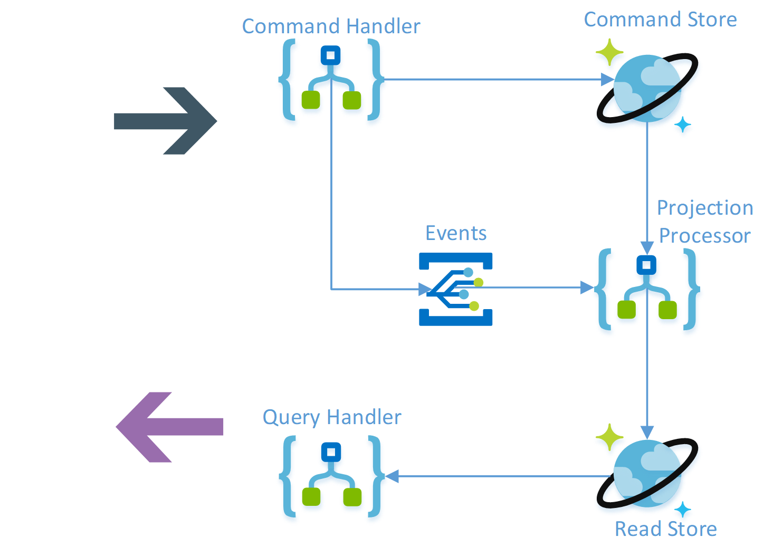
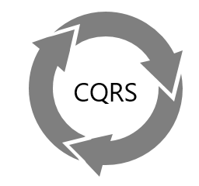
CQRS in the Cloud
Cloud Patterns
CQRS-Based Service Bus
Handles both Queries and Commands
Routes messages to correct consumer

Slide 22
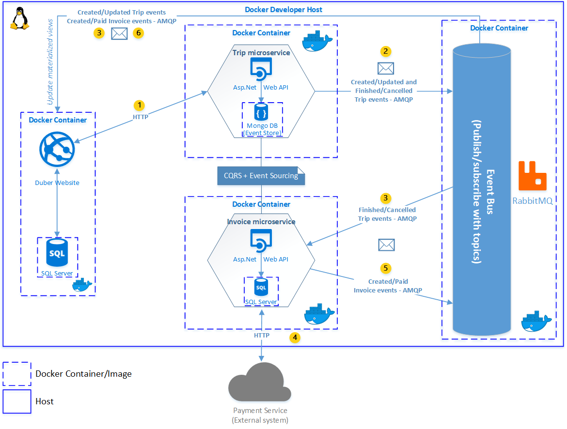
CQRS in the Cloud
Cloud Patterns
With Containers
Interchangeable Parts
CQRS does not have to be enforced across the entire system

Slide 23
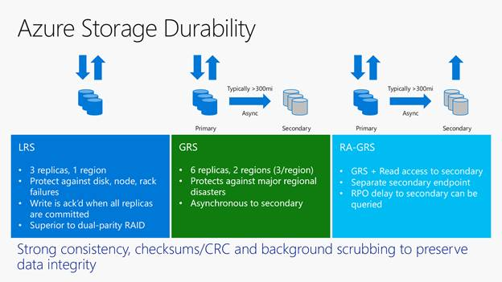
Azure Redundant Storage
Blog Storage should be considered as a possible replication pattern for CQRS’ read operations
Document Storage
Content / Video Providers
Types of Storage
Locally redundant storage, LRS
Zone redundant storage, ZRS
Geo redundant storage, GRS
Read access geo redundant storage, RA-GRS
For example:
Command will intake new document and write to single storage path.
Azure handles replication to:
Within the same region
Within the same zone
Global

Slide 24
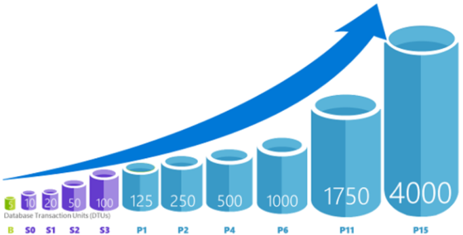
Azure Auto Scaling
With reads / writes in separate architecture paths, the elastic growth of the system can be separately controlled
Auto Scaling can provision new VMs, services, or increase / decrease the capacity of a resource – i.e. horizontal and vertical
For example:
Scale out to 10 instances on weekdays, and scale in to 4 instances on Saturday and Sunday.
Scale out by one instance if average CPU usage is above 70%, and scale in by one instance if CPU usage falls below 50%.
Scale out by one instance if the number of messages in a queue exceeds a certain threshold.

Slide 25
Azure Auto Scaling – Best Practices
A Resource can have only one autoscale setting
Architecture should design around this…
Scale Metrics
Processor
Threads
Memory
Disk IO, Free Space
Network IO
Incoming Request Bytes
Queue Size
You can also configure email and webhook notifications for scale actions…
$myRuleScaleOut = New-AzureRmAutoscaleRule `
-MetricName "Percentage CPU" `
-MetricResourceId …/virtualMachineScaleSets/$myScaleSet `
-TimeGrain 00:01:00 `
-MetricStatistic "Average" `
-TimeWindow 00:05:00 `
-Operator "GreaterThan" `
-Threshold 70 `
-ScaleActionDirection "Increase" `
–ScaleActionScaleType "ChangeCount" `
-ScaleActionValue 3 `
-ScaleActionCooldown 00:05:00

Slide 26
Define CQRS and System Design
Code Demos
CQRS Architectures
Comparisons to Other Patterns
Multiple Data Sources
Comparisons to Event Sourcing
Performance and Scalability in Azure
Learned so Far…

Slide 27
New Requirement – Fantasy Points
How will the new requirement effect our solutions?
CQRS
RESTful
What is the minimal effort to get this done?
How much of the system requires change?
If this feature added significant load to the system, would the current architecture gracefully handle it, or would we need to make changes?
Discussion

Slide 28
Demo #6 – Fantasy Points

Slide 29
Strategies – Serialization
High performance systems are heavily dependent upon serializing commands/queries across many endpoints
JsonConvert.SerializeObject() is not enough in most cases
Highly recommend abstracting serialization implementation
https://www.newtonsoft.com/json
https://blog.codinghorror.com/performance-is-a-feature/
Common Formats
JSON
BSON
Binary
Serialization Providers
Newtonsoft.Json
https://www.newtonsoft.com/json
Jil
https://github.com/kevin-montrose/Jil
ProtoBuf
https://developers.google.com/protocol-buffers/

Slide 30
Strategies – Serialization
Recommendations:
Small # of Messages
Small Bounded System
ProtoBuf
Large # of Messages
Multiple Consumers / Third Parties
Jil
Service Bus
BSON
https://codeclimate.com/blog/choose-protocol-buffers/
https://www.sitepoint.com/data-serialization-comparison-json-yaml-bson-messagepack/
This:
{
“property”: “”
}
Is Different:
{
“property”: null
}
Than This:
{
}

Slide 31
Strategies - Versioning
While encouraging distributed commands and queries, it is possible to have out-of-date requestors / consumers
Different versions could implement different business logic / validation
Highly recommend requiring version information on every command, query, event, and message.
https://www.infoq.com/news/2017/07/versioning-event-sourcing
In order to identify the version of any message, it is common to require header information on every message:
{
“name”: “”,
“version”: “1.0.0”,
“payload”: {
…
}
}
Or require version in the url:
http://tempuri.org/v1/resource

Slide 32
Strategies – Event Subscriptions
Highly recommend requiring subscriptions for events, rather than broadcast every event to every system
Could implement a layered approach to events.
Events are broadcasted to parent / inherited systems
Events are NOT broadcasted to sub-systems
Could require event handling acknowledgement
Commands could be setup to only return success when all subscribers return successfully
https://www.infoq.com/articles/microservices-aggregates-events-cqrs-part-2-richardson

Slide 33
Strategies – Hash-Based Read Caching
Perform hash lookup of query objects in cache stores
Does not require explicit knowledge / logic of each query – just the hash lookup value
https://www.infoq.com/articles/microservices-aggregates-events-cqrs-part-2-richardson
CQRS Query:
{
“name”: “MyQuery”,
“props”: {
“firstName”: “Jon”,
“lastName”: “Banta”
}
}
Generate Hash:
var hash = crc.Generate(query);
Lookup Response:
var queryResponse = redis.lookup(“MyQuery” + hash);

Slide 34
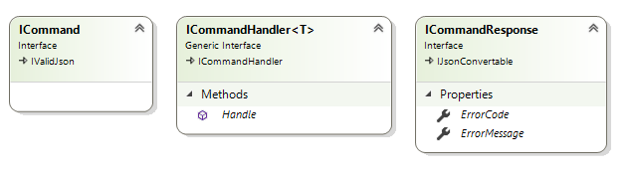
Strategies – Command Responses?
Highly debated issue
Commands can return values
Confirm validation message
Acknowledgement of completion
Version increment
maybe
Commands should not respond with any stateful data
In our example, we reply with ErrorCode and ErrorMessage only
https://martinfowler.com/bliki/CQRS.html

Slide 35
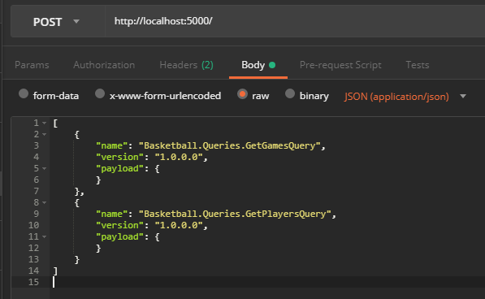
Strategies - Batching
Never limit a round trip between two endpoints to a single message
A single HTP request can define a series of messages and how they should be handled
Can be asynchronously or synchronously handled
Can define workflow parameters
Continue if…
If response then …
https://martinfowler.com/bliki/CQRS.html

Slide 36
Are you constantly changing your platform to meet new requirements?
Are you having difficulty releasing software in a timely manner?
Is the system brittle, difficult to test, and/or difficult to narrow down issues?
CQRS or a CQRS derivative could help…
Final Thoughts

Slide 37
.NET Core Containers
Deployment Strategies
Docker Swarm vs. Kubernetes
< 75 MB .NET Core Containers w/ Alpine Linux
Event Sourcing and Machine Learning using Prediction Data Models
Strategies for data sources purely sourced with event data
Running simulations and prediction models to make real time decisions
Neural Network Designs and Frameworks
TensorFlow
Securing Distributed Systems
Identity Provider comparisons
Azure AD, Auth0, Okta, etc.
Common methods for locking down your in house, or public application
JWT token design, strategies
Granular permissions across systems
Presentation Ideas

Slide 38


