Slide 1

Distribution system expansion planning optimization

Slide 2
Optimization objective and strategy
We start from a traditional approach:
Centralized point of view
Investment in substation and conductors
Minimization of the yearly cost given by:
amortized investment + operational cost
Subject to Power Flow equation together with budget and topology constraint

Slide 3
Investment options
Two voltage levels each with its own substations.
Their locations are optimized from a set of candidates
HV sub
MV sub
MV load
LV load

Slide 4
Physical model
We start from Distflow with conic relaxation
We proceed by linearizing the conic constraint:
Complex power (voltage assumed = 1 p.u.)
Substation limits

Slide 5
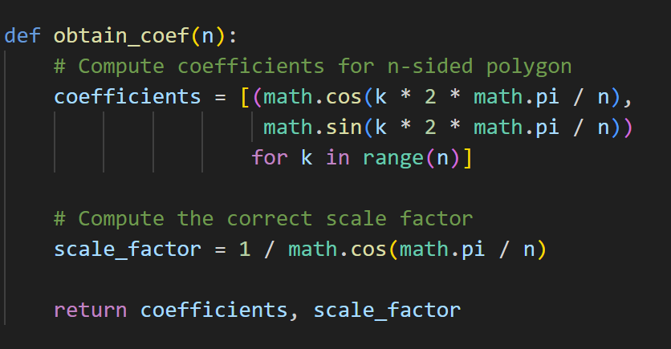
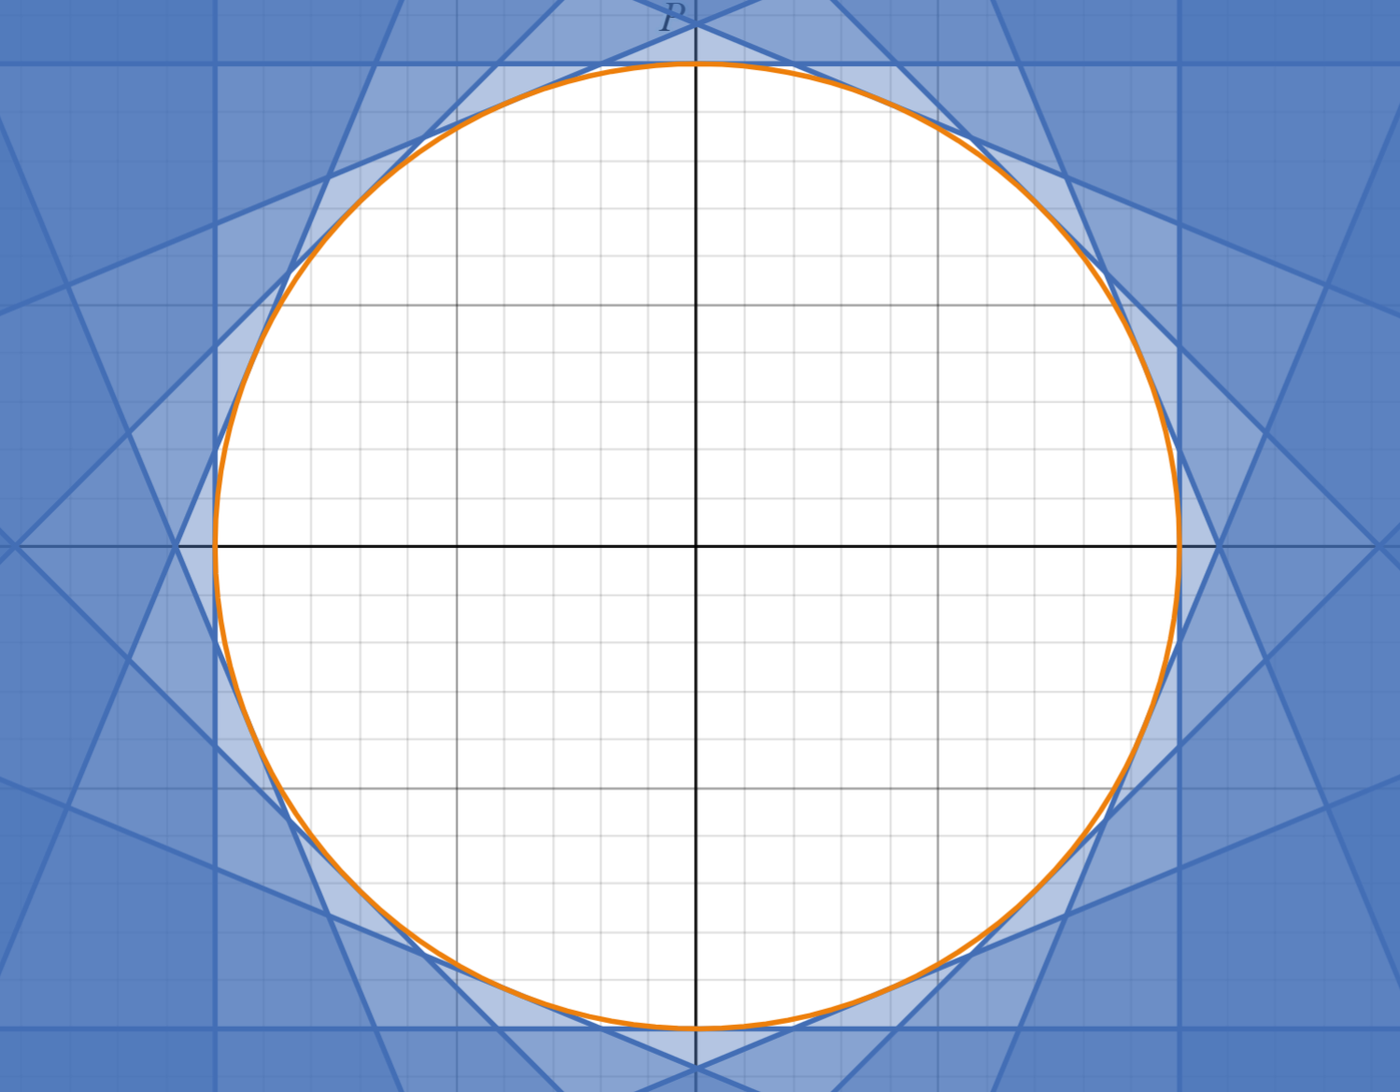
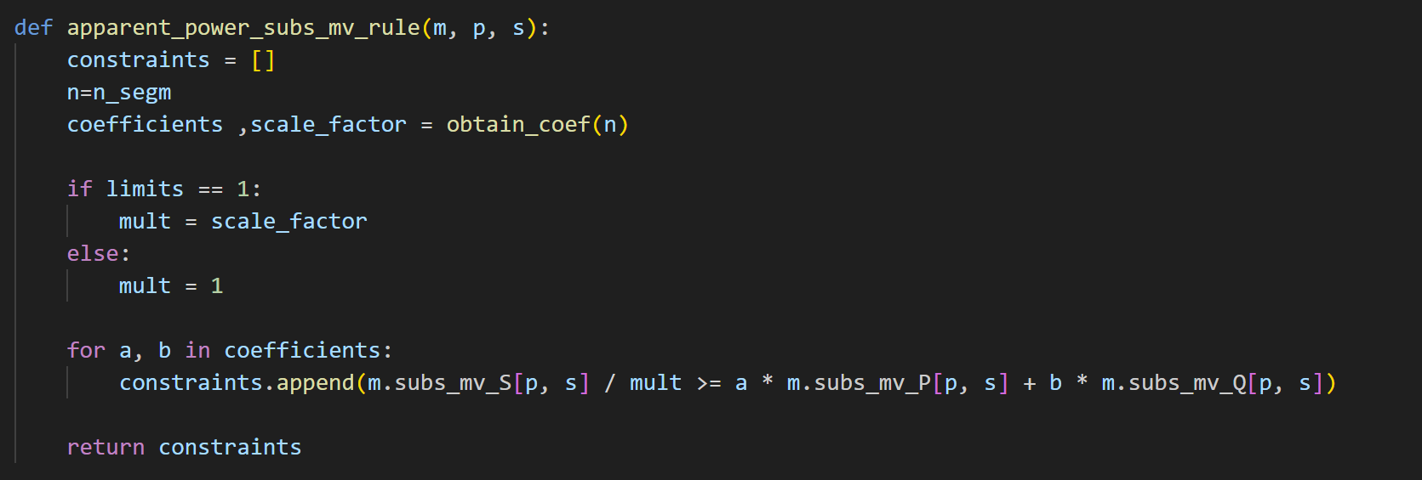
Substation limit linearization
 | CONIC | INT 8 | INT 16 | EXT 8 | EXT 16
HV capacity | 121.728 | 131.714 | 124.077 | 121.712 | 121.692

Slide 6
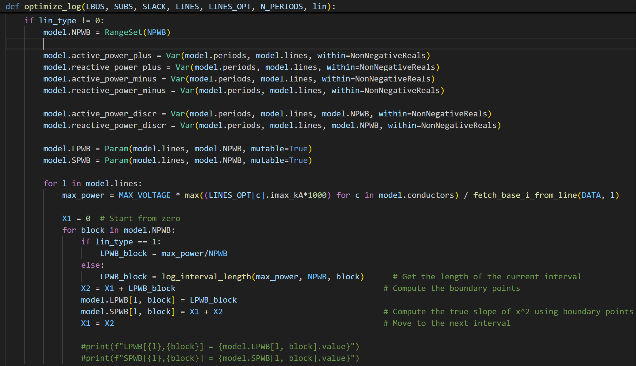
Power linearization

Slide 7
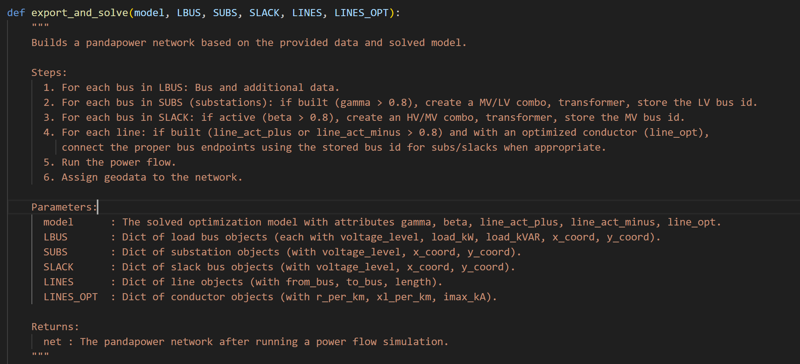
Power flow validation
To validate the proposed solution, we compare the operating points computed by the optimization with a complete AC power flow. To do so we build on panda power the proposed net.

Slide 8
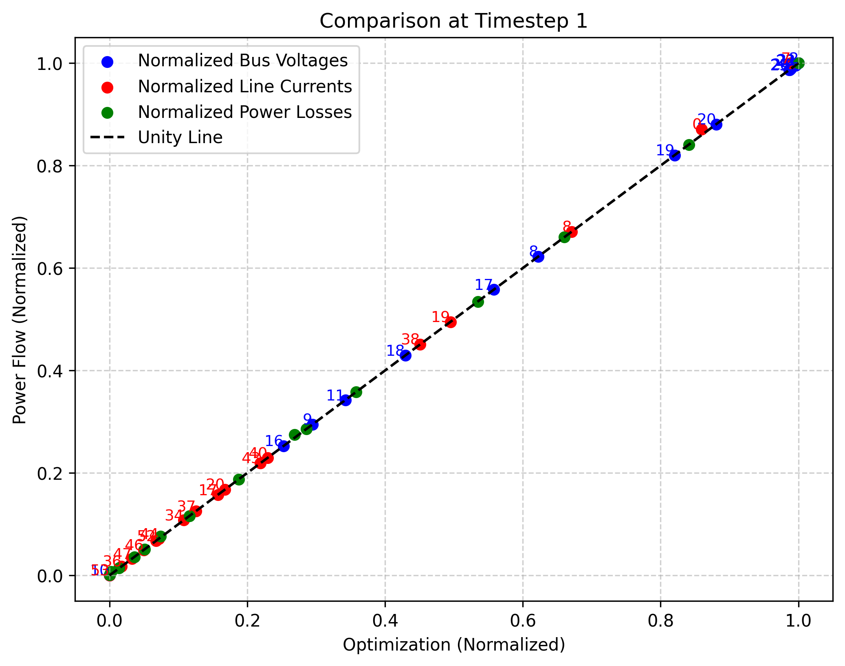
Conic constraint

Slide 9
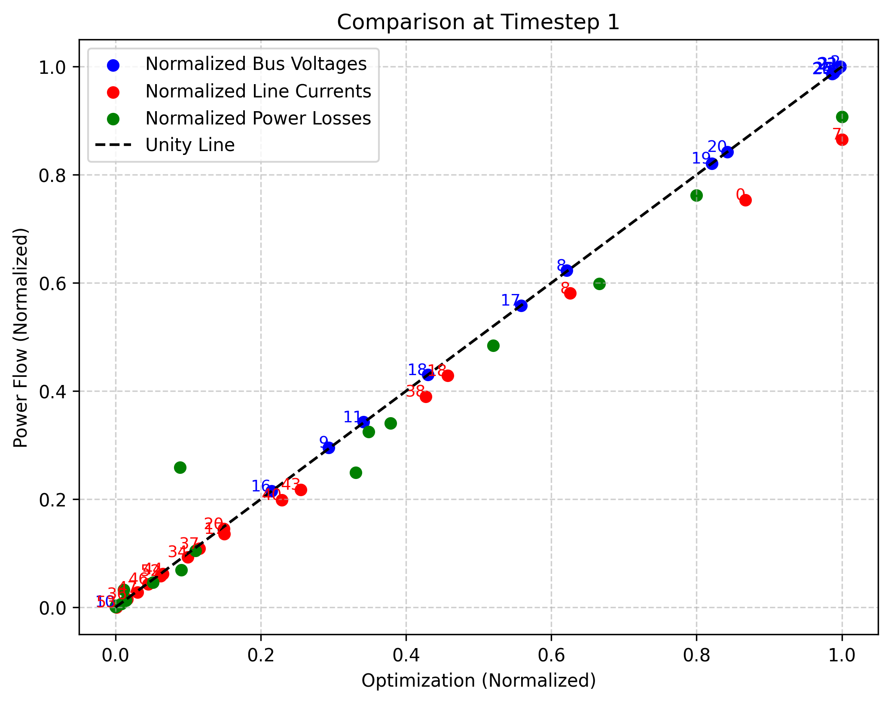
10 block linearized constraint

Slide 10
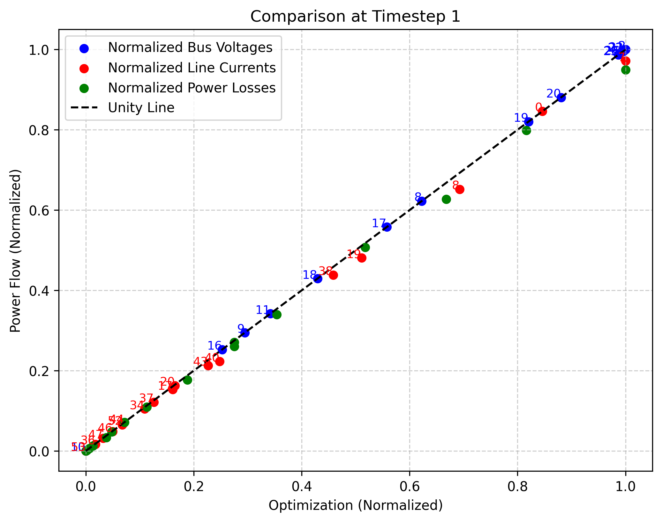
15 block linearized constraint

Slide 11

PV integration
→Integration of Renewable Energy Sources (RES)
PV is the only option considered.
Maximum installation depends on building surface
Two distinct investment PV & Inverter
Linearized capability curve

Slide 12
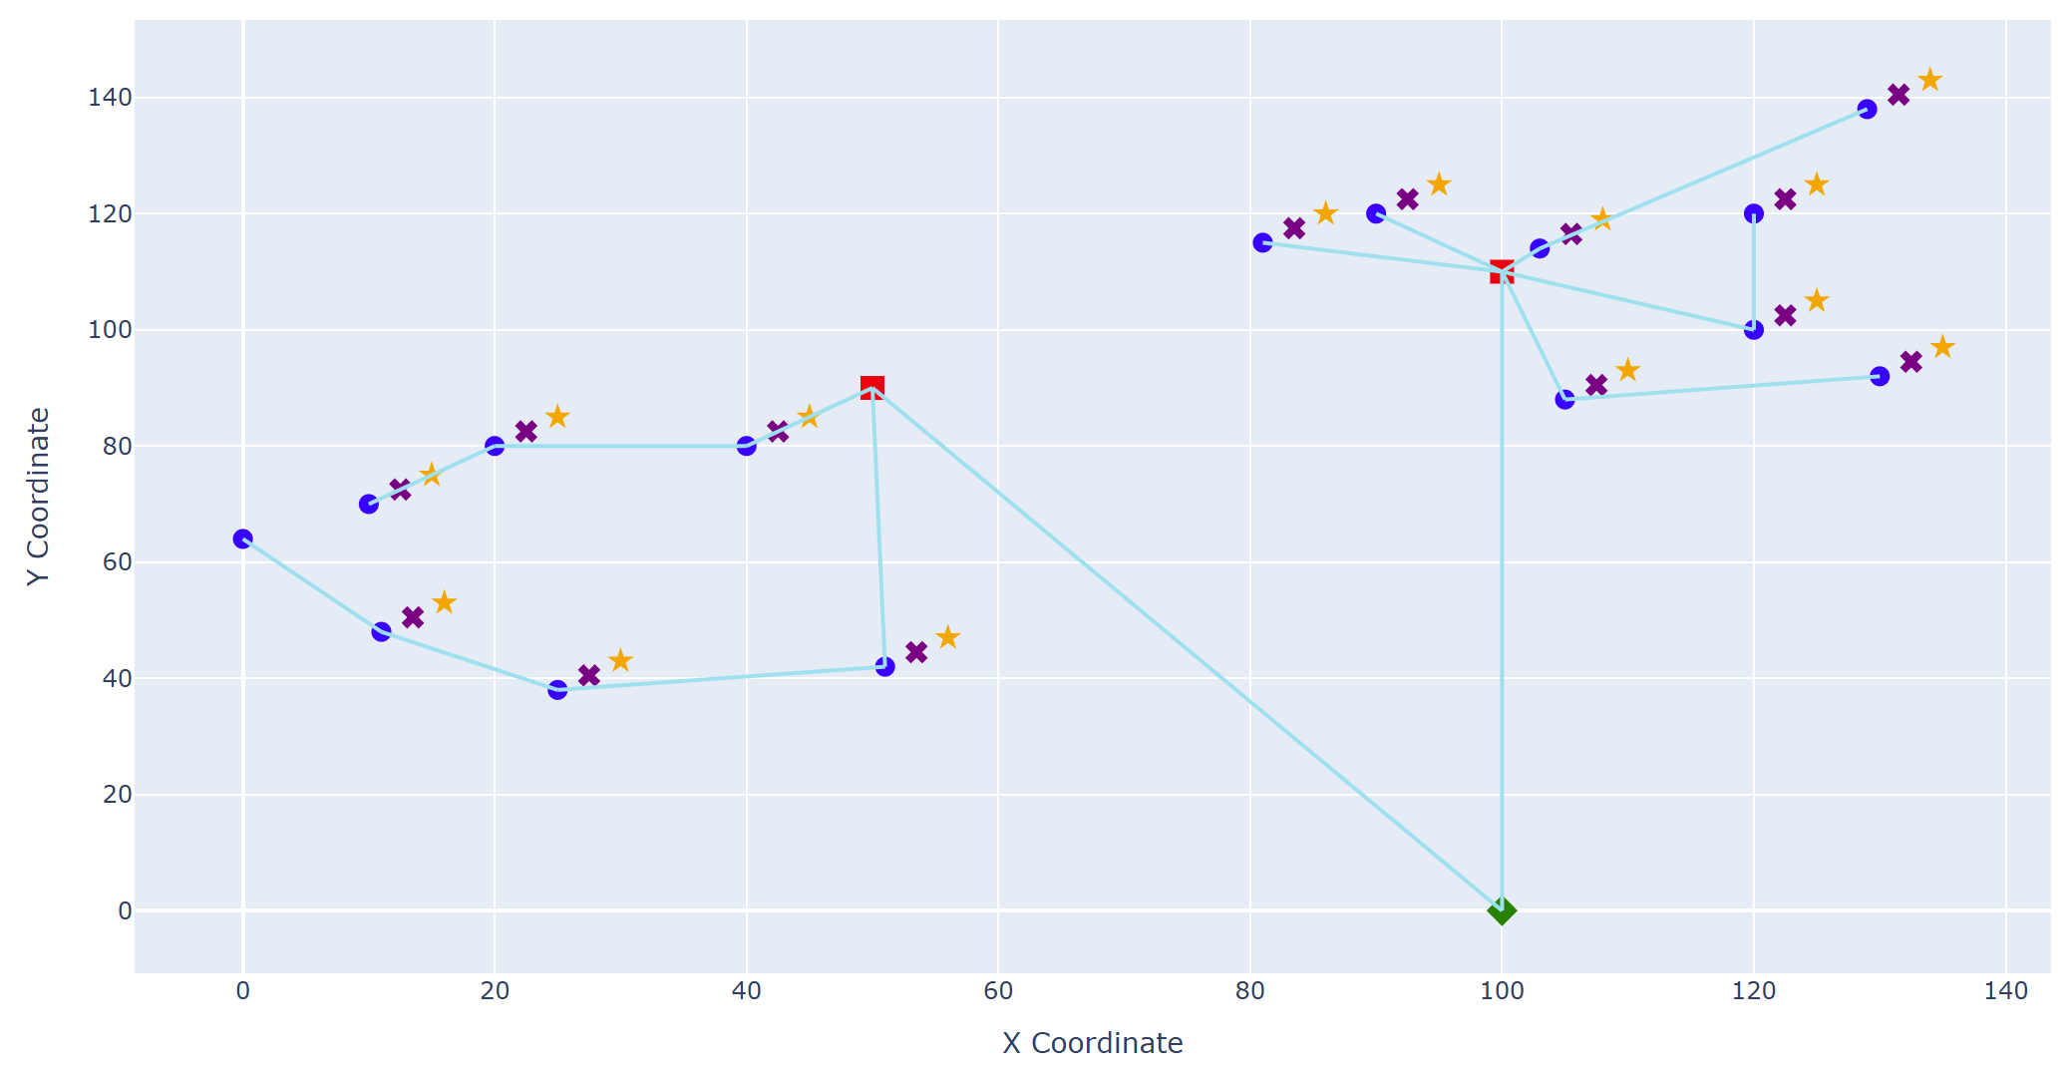
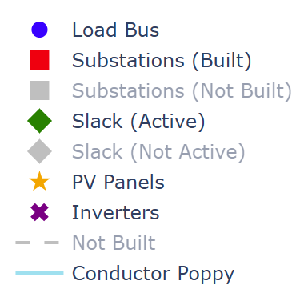
Visual function for dynamic plotting

Slide 13
Multistage approach
Assumptions:
Addition of fixed installation costs
Capacities of substations and PV are strictly increasing
Conductors costs must be defined to separate new installation and reconductoring
Backward propagation of stages

Slide 14
Topology update and storage
Fictitious Power for network topolgy
Vincoli di radialità graph based??
Implementation of storage
→ Tuning of Gurobi parameters

Slide 15
Representative days and increased load
→Representative days
→Load curve for increased consumption and EV +EHP adoption
→Modified storage logic (No soc variation between start and end of day)
Tolleranza sui limiti storage (disugualianza)
→Modified cost function with RD weights

Slide 16
Updates
Fixes:
Identified some bugs caused by tolerances → Storage needs fixing
Optimization is getting stuck around 1% gap → Why? Is the storage?
Goals:
Analysis of power-flow results in critical conditions
Improving load curves
Rescaling → Is it necessary?
Efficiencies on storage → I need P_charge & P_discharge

Slide 17
Updates
Single hybrid inverter
. DC bus between PV & Storage
. Inverter can inject reactive power
Reactive power should have a cost → Literature around 2€/MVAr → Every bus has PV +inverter but the oversizeing is greater at critical buses

Slide 18
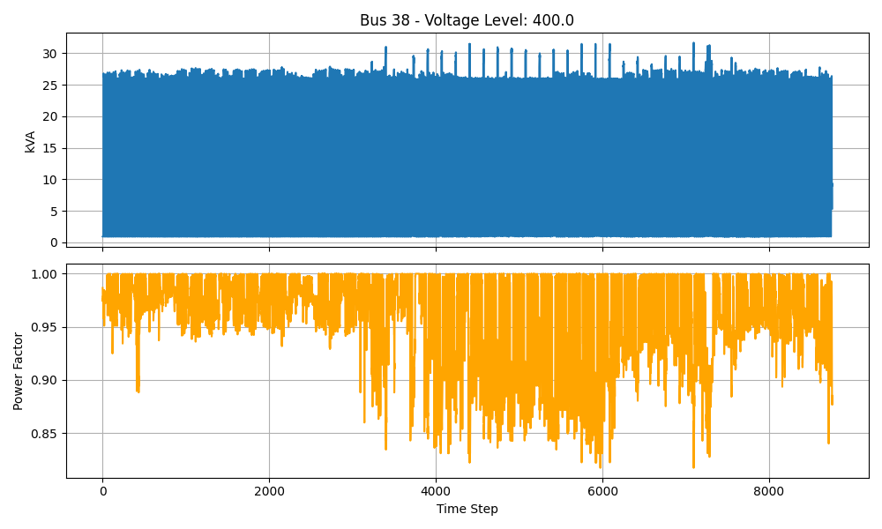
Analysis of load data

Slide 19
Full campus intractability
The problem is too big to solve on a full campus!
I can fix the best conductor →
Minimum spanning tree is forced to connect every substation

Slide 20
Next steps
Starting from obtained topology and line loading try to downgrade conductors
Dividing problem by district
Dividing MV and LV problems
Obtaining a gap with respect to the full problem

