Slide 1
Libosmscout
A C++ library
for
OpenStreetMap
for
offline rendering, routing, location and POI look up
on
mobile devices

Slide 2
Why offline
Use application without a central server
  No network, network unreliable or slow
  Network access is too expensive
You have a copy of the OSM DB on your device
  Rendering live on the device
  No need to provide a tile server
  More flexibility (change style sheets, filter data)

Slide 3
Why a library?
I needed a week for the first map to get drawn
I needed a few years to get the database small, the rendering and routing fast and the memory footprint small
I'm still not done yet

Slide 4
You must take care of...
data too big for main memory
relation parsing
build under Android, Linux, Mac, Windows, iOS/OSX
existing DB libraries not fast enough
coastlines
Karlsruhe schema
route description
islands
acess tag
location index
turn restrictions
style sheet
label placement
OSM ids are 64 bit
fast spartial index
multipolygon
platform independent data format
administrative
boundaries
blacklisting relation areas
roundabouts
optimize size of
data on disk
routing graph
bridges and tunnels
memory usage
should be <10MB
filter objects to draw
based on zoom
Multiple
projection
*.osm
*.osm.pbf
search for POIs
way joins/ends
oneway
objects close on map
should be close in file
reduce number of objects
layer tag
area/way rendering order
water/ground color
multiple drawing backends

Slide 5
Finding
There is need for more than one OSM app
Why implement all the stuff again and again?
If you want to build a cool app based on OSM, put your time into the app and reuse existing code that does the dirty OSM stuff for you

Slide 6
Introducing libosmscout
Written in C++
Licensed under LGPL with iOS Exceptions
Library/Framework to offer ready to use functions for map drawing, routing, POIs search and location search - based on OSM data
Does all the ugly stuff, just use some simple APIs
Works well under reduced resources as on mobile devices

Slide 7
Concept
Import *.osm or *.osm.pbf files on your development machine
Let the importer do some heavy analysis and tweaking of the data, finally getting a number of data and index files (database)
Test and tweak data and style sheet
Copy the database (or only parts of it) and style sheet(s) on your device for offline access

Slide 8
Layered and Service based
Use only parts (Classes - Database)
Add or exchange (Render, Services, Database)
Services
Database
Renderer
Data files and indexes
StyleConfig
Import
Type Config
Datatypes (Nodes, Ways, Areas, ...)
Classes (File access, Geo, Logging, ...)

Slide 9
Customizable
Import only the data your are interested in (influencing the size of the offline data)
Change the style sheet to draw only the things you are interested in, in the way you like it
Use configuration options to tweak renderer for different devices and resolutions
Add additional renderings like overlays or contour lines
Use routing profiles to influence routing

Slide 10
Supported platforms
Desktop
  Qt via Qt backend
  Gnome and Windows (and everything else) via cairo
  Mac OS X via cairo or better iOSX backend
iPhone, iPad via iOSX backend
Android via JNI or via Qt
Windows Phone (untested)

Slide 11
Libraries
libosmscout-import
Import
libosmscout-map-agg
libosmscout-map-cairo
libosmscout-map-iOSX
libosmscout
libosmscout-map
libosmscout-map-qt
libosmscout-map-svg
libosmscout-map-opengl

Slide 12
Import Results
types.dat
bounding.dat
Germany, NRW:
375 MB osm.pbf
=>641 MB
nodes.dat
areanode.idx
areas.dat
areaarea.idx
areasopt.dat
ways.dat
areaway.idx
waysopt.dat
location.idx
water.idx
intersections.dat
routefoot.dat
routebicycle.dat
routecar.dat
routefoot.idx
routebicycle.idx
routecar.idx

Slide 13
Main classes for integration
TypeConfig
Database
DatabaseParameter
LocationService
POIService
*Visitor
LocationSearch/Result
MapService
RoutingService
MercatorProjection
RouterParameter
StyleConfig
RoutingProfile
MapParameter
RoutingPostProcessor
AreaSearchParameter
MapData

Slide 14
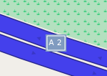

Style Sheet
ORDER WAYS
GROUP _route
GROUP highway_motorway
GROUP waterway_river, waterway_canal, waterway_drain
...
CONST
MAG stepsMag = block;
MAG labelPathsMag = veryClose;
...
// Label priorities
UINT labelPrioContinent = 1;
UINT labelPrioIsland = 1;
UINT labelPrioCountry = 2;
...
COLOR buildingColor = #d9d9d9;
COLOR buildingBorderColor = darken(@buildingColor, 0.3);
COLOR buildingLabelColor = darken(@buildingColor, 0.5);
...
[MAG continent-] {
[TYPE highway_motorway] {
[SIZE 20m 0.45mm:3px<] {
WAY#outline { color: darken(@motorwayColor,0.4); width: 20m; displayWidth: 0.5mm; priority: -1; joinCap: butt; }
WAY { color: @motorwayColor; width: 20m;}
}
[SIZE 20m <0.45mm:3px] WAY { color: lighten(@motorwayColor,0.3); displayWidth: 0.45mm;}
}
}

Slide 15
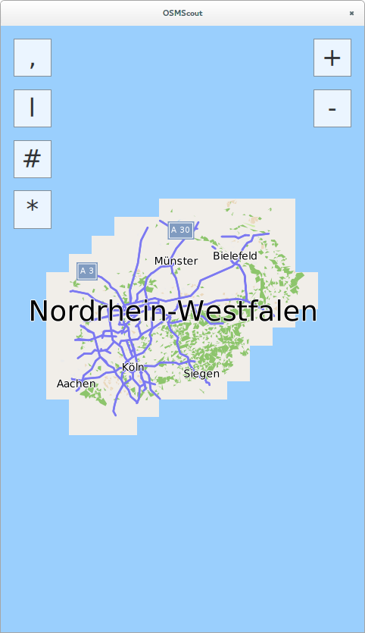
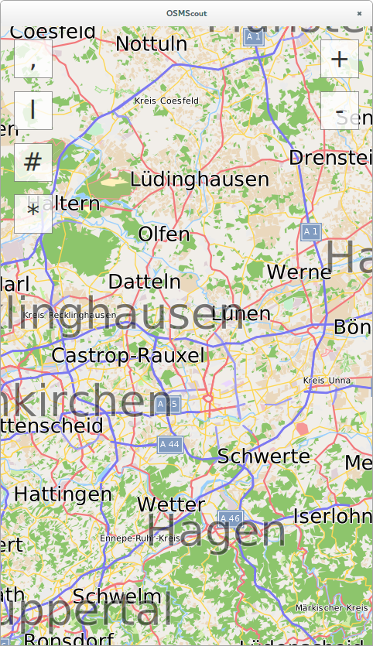
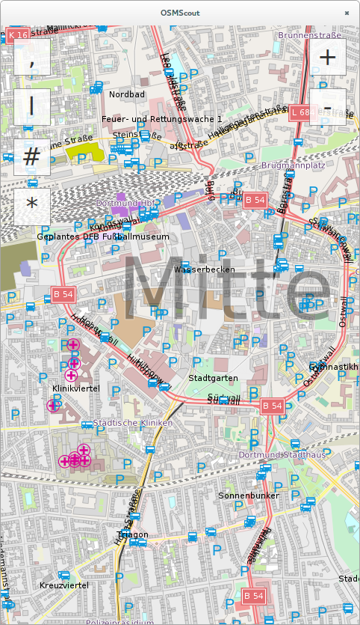
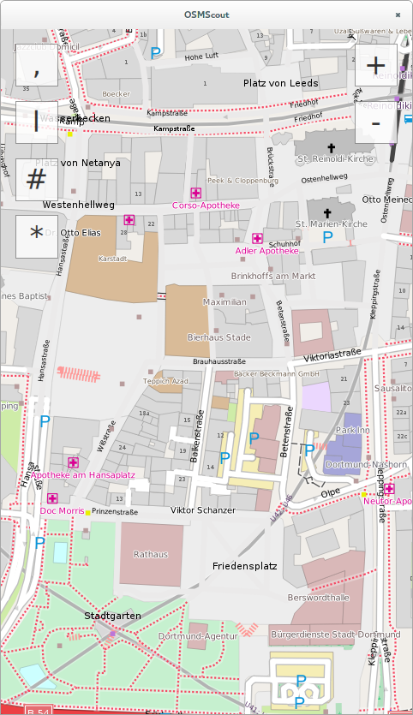
Rendering Example
Supports tile rendering
Various tuning options
Coastline rendering
Support for icons
DPI aware
Intelligent labeling
Supports unicode rendering
Way overlays (one way arrows)
Overlay labels
Custom extensions possible (own 3D rendering, contour lines)

Slide 16
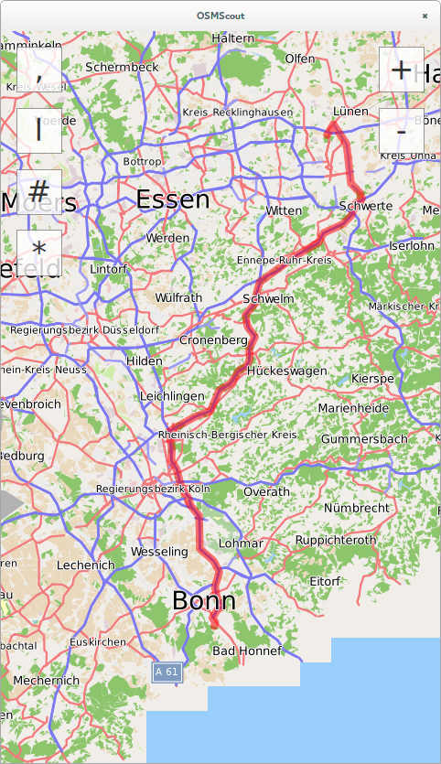
Routing Example
----------------------------------------------------
At| After| Time| After|
----------------------------------------------------
0.0km 0:00h Start at 'Start'
Drive along 'In den Hüchten'
0.1km 0.1km 0:00h 0:00h At crossing 'In den Hüchten'
Turn right into 'In den Hüchten'
0.1km 0.1km 0:00h 0:00h At crossing 'In den Hüchten', 'Rauher Dorn'
Turn left into 'Rauher Dorn'
0.4km 0.3km 0:01h 0:01h At crossing 'Am Birkenbaum', 'Evinger Straße (B 54)', 'Rauher Dorn'
Turn left into 'Evinger Straße (B 54)'
1.5km 1.0km 0:02h 0:01h At crossing 'B 54', 'Evinger Straße (B 54)'
Enter roundabout
1.5km 0.0km 0:02h 0:00h Leave roundabout (1. exit) into street 'Evinger Straße (B 54)'
3.0km 1.5km 0:03h 0:01h Way changes name from 'Evinger Straße (B 54)' to 'Dortmunder Straße (B 54)'
3.0km 0.0km 0:03h 0:00h At crossing 'B 236', 'Dortmunder Straße (B 54)'
Enter motorway 'B 236'
17.8km 14.9km 0:13h 0:09h Leave motorway 'B 236' into 'Berghofer Straße (B 236)'
18.4km 0.5km 0:13h 0:00h Way changes name from 'Berghofer Straße (B 236)' to 'Hörder Straße (B 236)'
19.8km 1.4km 0:14h 0:01h At crossing 'A3 Kön Frankfurt', 'Hörder Straße (B 236)'
Enter motorway 'A 1'
86.8km 67.0km 0:52h 0:38h Change motorway from 'A 1' to 'A 3'
99.5km 12.7km 0:59h 0:07h Way changes name from 'A 3' to 'A 3;A 4'
101.6km 2.1km 1:00h 0:01h Change motorway from 'A 3;A 4' to 'A 59'
104.9km 3.3km 1:02h 0:02h Change motorway from 'A 59' to 'A 59'
127.0km 22.1km 1:15h 0:13h Change motorway from 'A 59' to 'A 562'
130.8km 3.8km 1:17h 0:03h Leave motorway 'A 562' into 'A 562'
131.0km 0.2km 1:18h 0:00h At crossing 'A 562', 'August-Bebel-Allee', 'Nahum-Goldmann-Allee'
Turn left into 'August-Bebel-Allee'
131.6km 0.6km 1:18h 0:01h Way changes name from 'August-Bebel-Allee' to 'Martin-Luther-Allee'
132.1km 0.5km 1:19h 0:01h At crossing 'Godesberger Straße', 'Hochkreuzallee', 'Martin-Luther-Allee'
Turn right into 'Hochkreuzallee'
132.5km 0.4km 1:19h 0:01h At crossing 'Bernkasteler Straße', 'Hochkreuzallee'
Enter roundabout
132.6km 0.0km 1:19h 0:00h Leave roundabout (3. exit) into street 'Bernkasteler Straße'
132.8km 0.2km 1:20h 0:00h At crossing 'Bernkasteler Straße', 'Friesdorfer Straße'
Turn slightly right into 'Friesdorfer Straße'
132.8km 0.1km 1:20h 0:00h At crossing 'Am Buschacker', 'Friesdorfer Straße'
Turn left into 'Am Buschacker'
133.0km 0.2km 1:20h 0:00h At crossing 'Am Buschacker', 'Im Erlengrund'
Turn left into 'Im Erlengrund'
133.1km 0.1km 1:20h 0:00h At crossing 'Im Erlengrund', 'unnamed road'
Turn left into 'Im Erlengrund'
133.3km 0.1km 1:21h 0:00h At crossing 'Im Erlengrund', 'Promenadenweg'
Turn right into 'Promenadenweg'
133.3km 0.1km 1:21h 0:00h Target reached 'Target'
A*
Separate files for car, bicycle, foot
Routing description, extendable
Evaluates speed limits, surface quality, turn restrictions, one ways and a reasonable subset of access rights
Profile customizable, allows you to adapt routing algorithm during runtime

Slide 17
Location Search Example
Signal Iduna Park Dortmund
Signal Iduna Park
Dortmund
Regierungsbezirk Arnsberg
Nordrhein-Westfalen
Area 125403384
Parkplatz-A8 (Westfalenhallen / Signal-Iduna-Park)
Dortmund
Regierungsbezirk Arnsberg
Nordrhein-Westfalen
Area 124999397
Parkplatz-B1 (Westfalenhallen / Signal-Iduna-Park)
Dortmund
Regierungsbezirk Arnsberg
Nordrhein-Westfalen
Area 125208880
Signal Iduna Park
Dortmund
Regierungsbezirk Arnsberg
Nordrhein-Westfalen
Area 125403384
Promenadenweg 146
Bonn
Promenadenweg 146
Godesberg-Nord
Bad Godesberg
Bonn
Regierungsbezirk Köln
Nordrhein-Westfalen
Area 96128521
Promenadenweg
Friesdorf
Bad Godesberg
Bonn
Regierungsbezirk Köln
Nordrhein-Westfalen
Way 36479212
Promenadenweg
Schweinheim
Bad Godesberg
Bonn
Regierungsbezirk Köln
Nordrhein-Westfalen
Way 36462418
Way 36770219

Slide 18
Thanks!
Thanks to all the committer and users of libosmscout!
Thanks to the audience for listening!

Slide 19
Contact
Me: tim@framstag.com
http://libosmscout.sourceforge.net
Ask on the mailing list!

