Slide 1
unit tests for Service Layer
Adding the Project and Running Tests

Slide 2
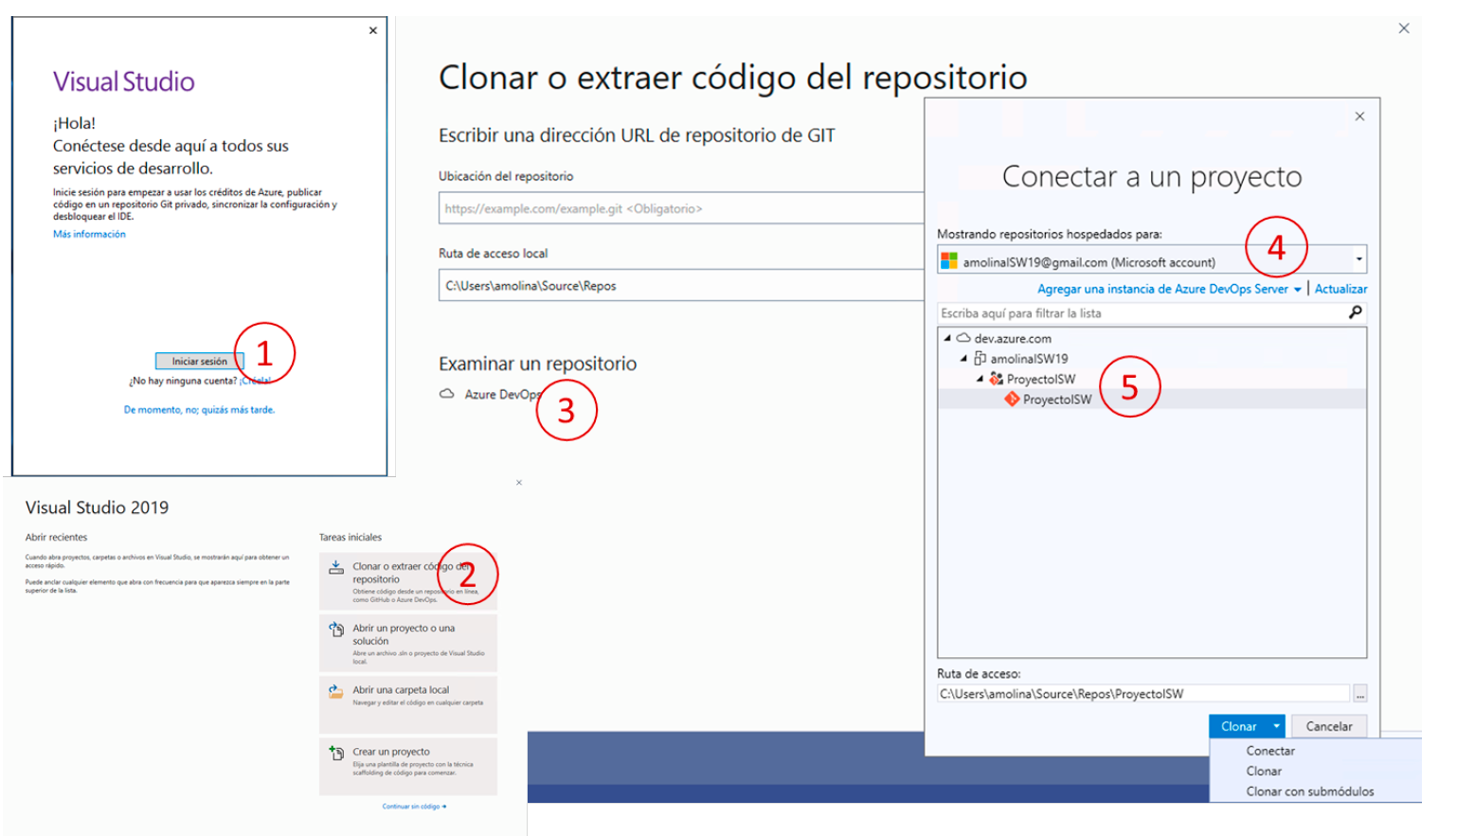
Get the project code: Clone
This step is only necessary in laboratory equipment
Access Visual Studio and connect to the project, cloning the repository

Slide 3
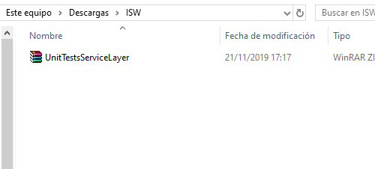
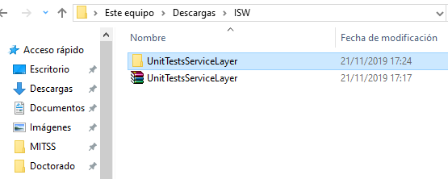
Get Testing project
In PoliformaT: Recursos>English>Laboratory> Testing>ServiceLayer
Fichero:
UnitTestsServiceLayer.zip
Unzip

Slide 4
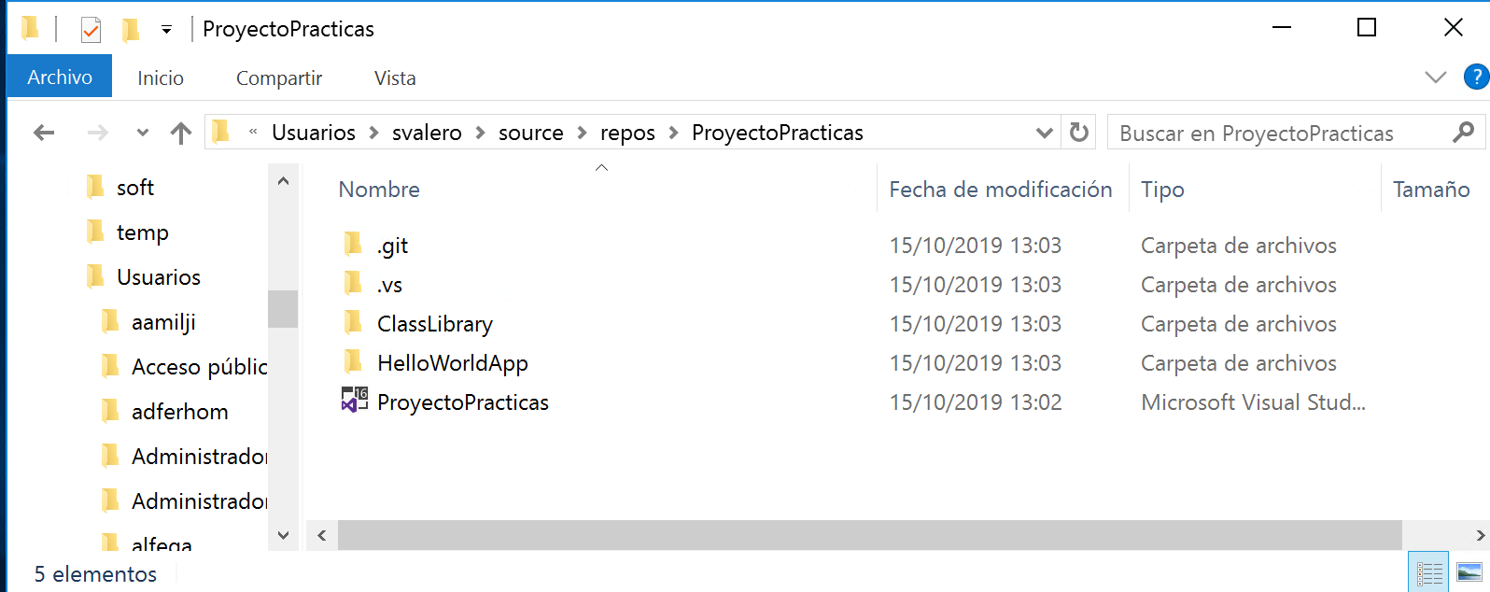
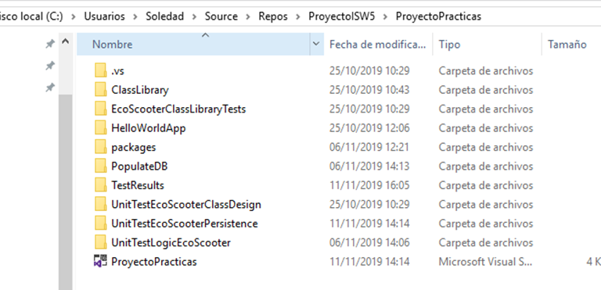
Copy the folder to the repository
Copy the folder inside the directory where the local repository of the project is stored
By default: C:\users\nombre_usuario\source\repos
Copy

Slide 5
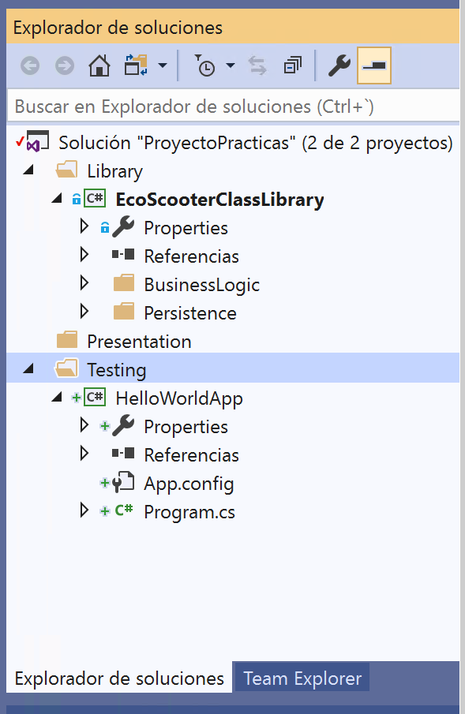
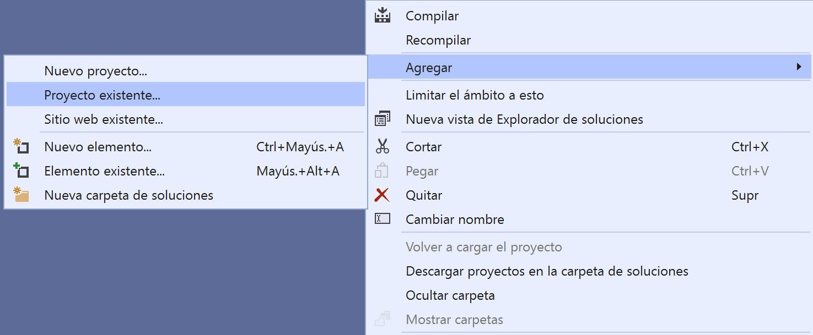
Add Test Project (I)
Open the project solution
Select Testing folder in the Explorador de soluciones tab
Right button:
Agregar>Proyecto existente…
1
2
3

Slide 6
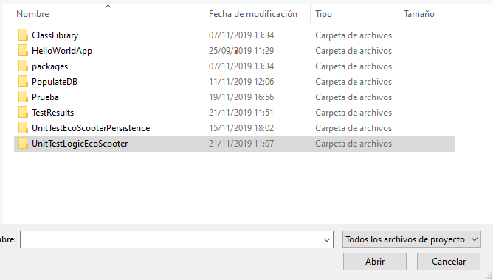
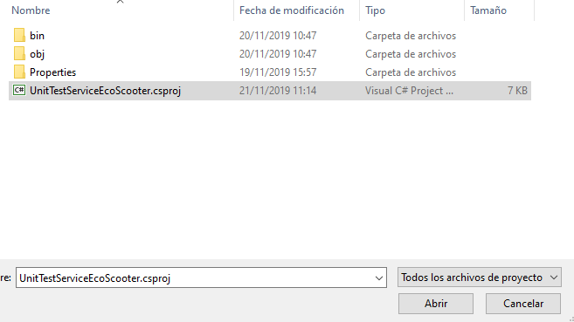
Add Test Project (II)
Within the local repository
Select the folder with the test project and press open
Select file with extension csproj
1
2
3
4

Slide 7
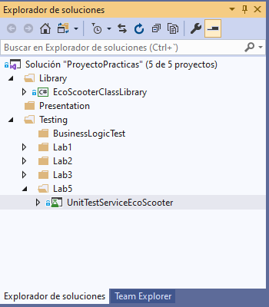
Add test Project (III)

Slide 8
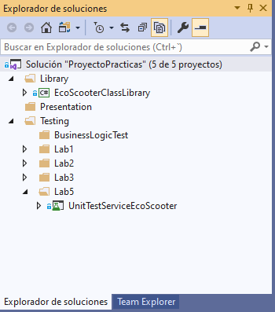
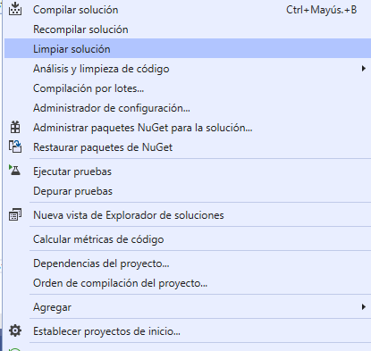
Configure Test Project (I)
Establish it as a start-up project
Clean it
1
2

Slide 9
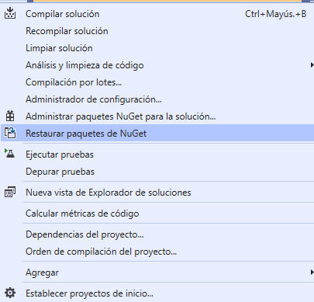
Configure Test Project (II)
Restore NuGet Packages
1
2

Slide 10
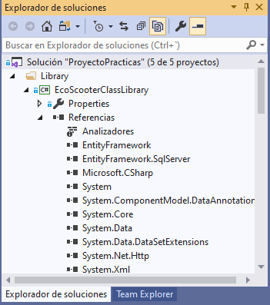
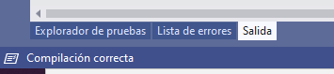
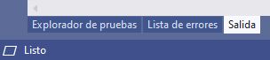
Configure Test Project (III)
Wait until this icon..
1
becomes:
Check if in the reference section there is not any warning icon (yellow) in the class library

Slide 11
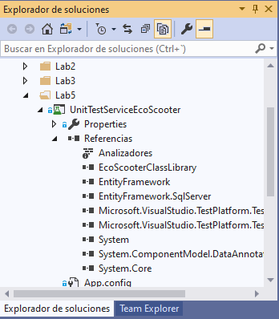
Configure Test Project(IV)
Check if in the reference section there is not any warning icon (yellow) in the testing project

Slide 12
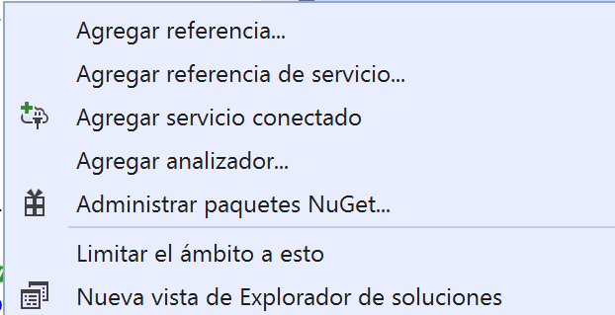
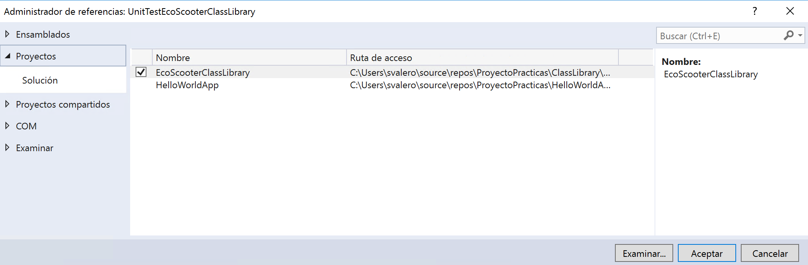
Configure Test Project(V)
Check if the class library is referenced
If not, add it again
2
1
3
4

Slide 13
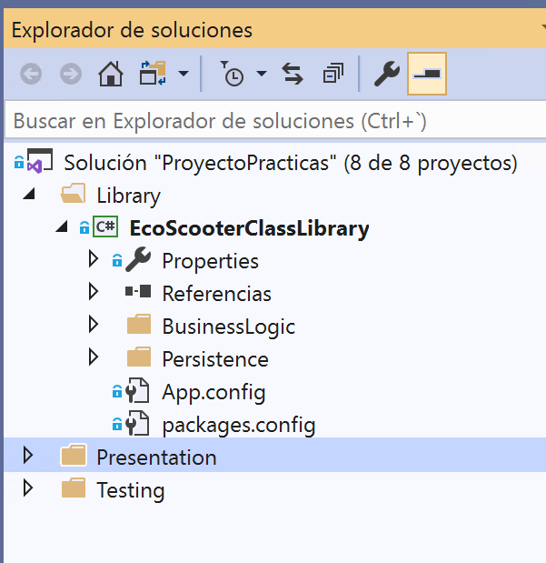
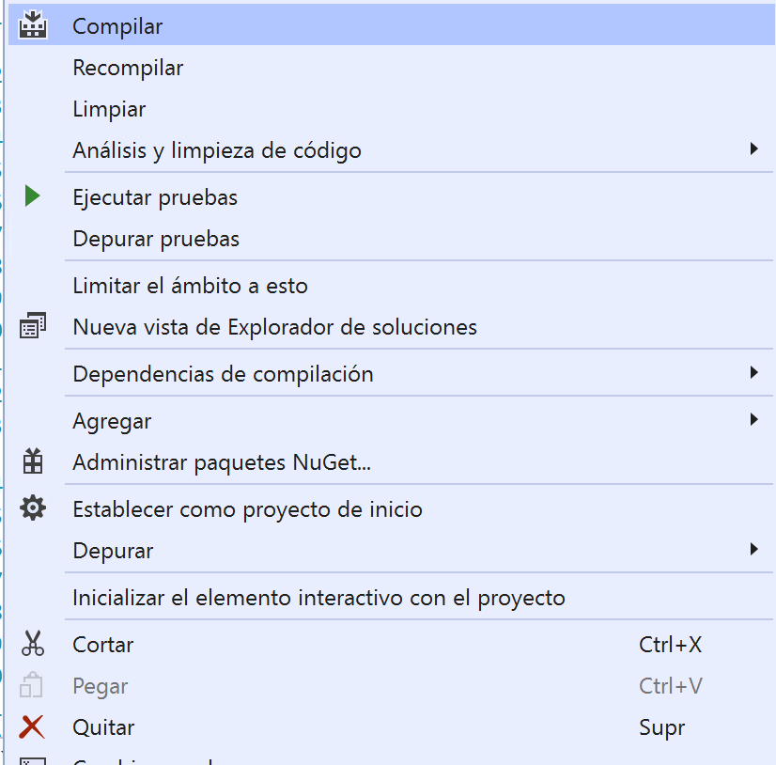
Configure Test Project(VI)
Compile the EcoScooterClassLibrary
1
2

Slide 14
Configure Test Project (VII)
Compile the test project
2
1

Slide 15
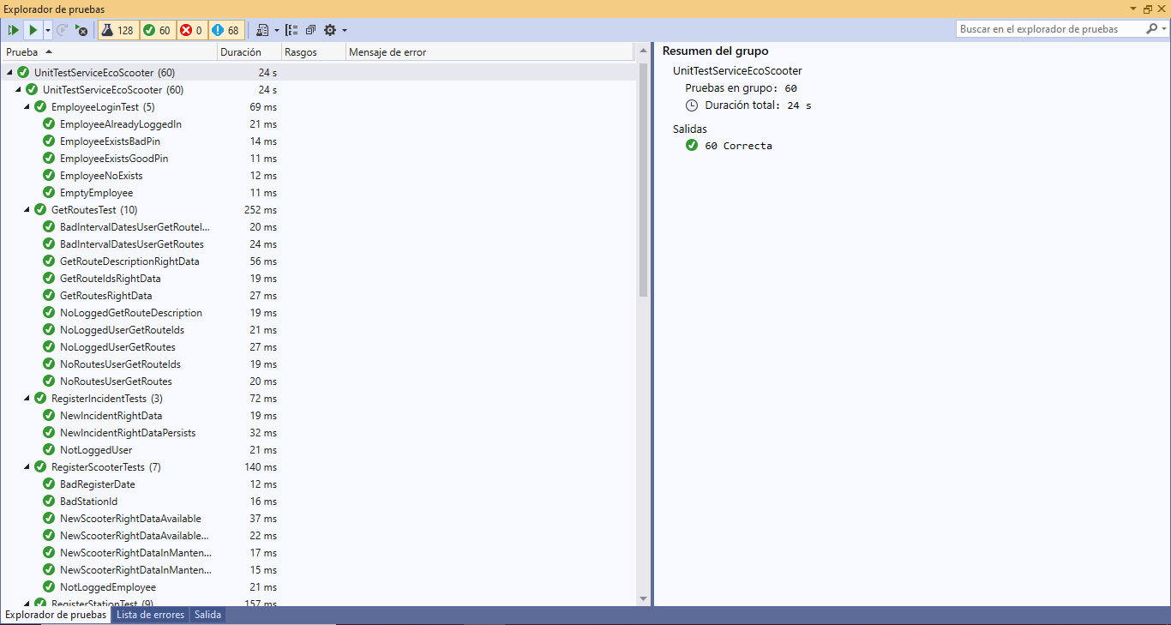
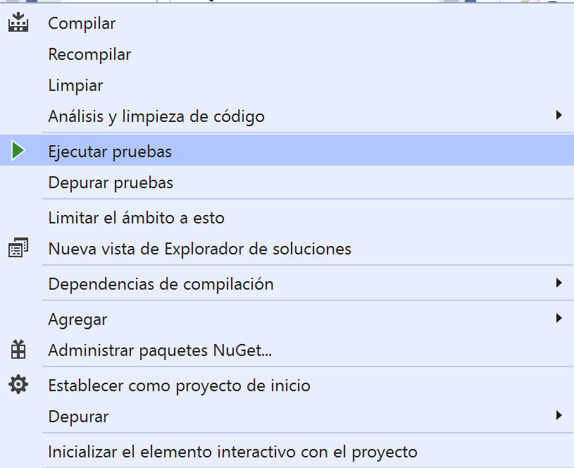
Running Tests (I)
Result of the test:
Green: code pass the test
Red: code doesn’t pass the test
1
2
Result of the selected test

Slide 16
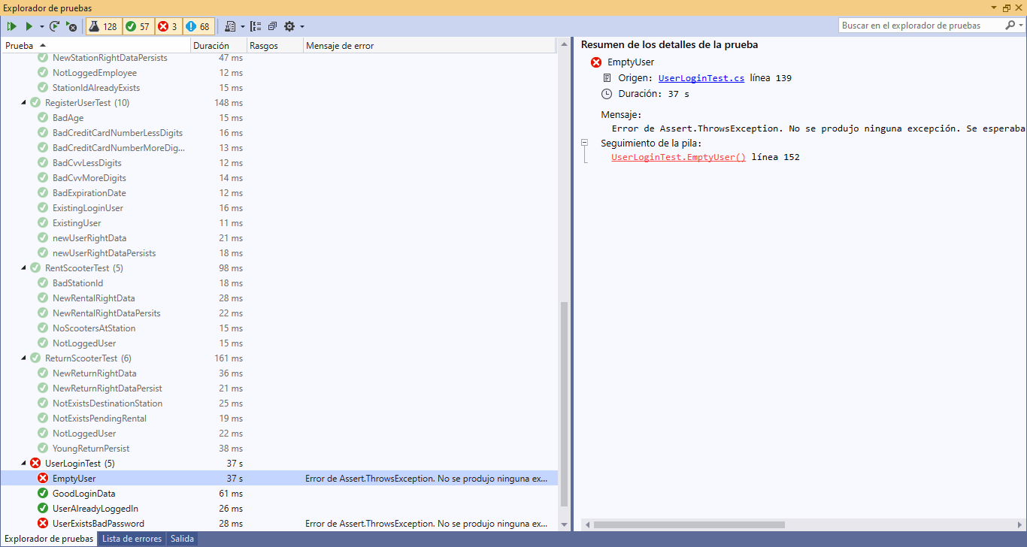
Running Tests(II)
Message informing of the possible cause of the error.
Added when programming the test
Line where the check that doesn't pass is.
Wrong test: some of the chekings it persforms are not met

Slide 17
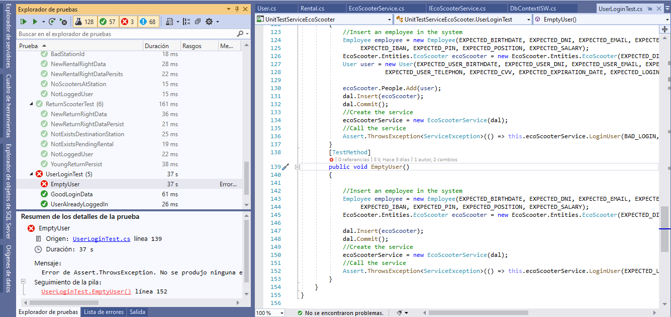
Running Tests(III)

