Slide 1
ELECTRIC CONSUMPTION RATE
PYTHON KHIVA LIBRARY

Slide 2
INTRODUCTION
This use case is going to be based on the analysis of the correct assignation of distinct electric consumption rates of 100 locals.
In order to do this analysis, a predictive modelling is going to be used.
The full use case is going to be based on a geographical research, features extraction (in order to identify the time series), a predictive modelling and similarity research to get conclusions about the correct use of the electric consumption rates.
It is supposed that the locals has the electric consumption rates corresponding to the kind of sub-industry which those locals have stablished.
In this use case, the KHIVA library has been used in order to re-dimension the data, extract the features and compose the features matrix for the predictive modelling and get the similarity between the locals of interest.

Slide 3
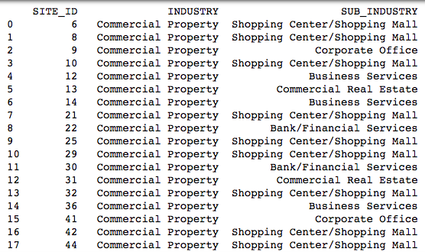
ELECTRIC RATES
Commercial Real Estate – Commercial Property
Shopping Center/Shopping Mall – Commercial Property
Business Services – Commercial Property
Bank/Financial Services – Commercial Property
Food Processing – Light Industrial
Manufacturing – Light Industrial
Other Light Industrial – Light Industrial
Grocer/Market – Food Sales & Storage
Primary/Secondary School – Education
Figure 1: Metadata

Slide 4
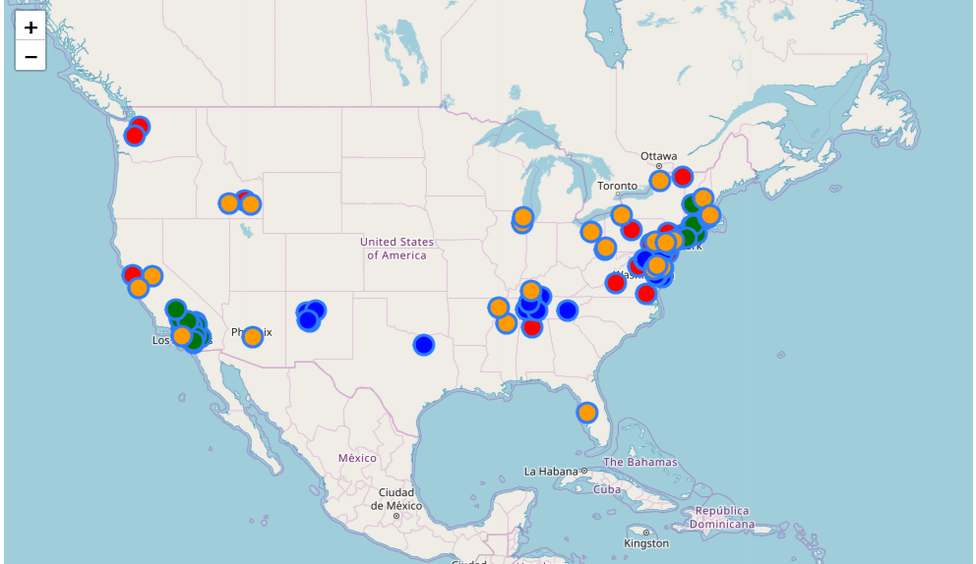
WHERE ARE THE LOCALS OF STUDY?
Commercial Property : Red
Education : Blue
Food Sales & Storage : Green
Light Industrial : Orange
Figure 2: Local locations organised by Industry

Slide 5
WHAT DATA ARE WE GOING TO DEAL WITH?
Data corresponding to electrical consumption during 2012 of 100 locals.
Data being collected each 5 minutes. 12 points per hour.
10,531,288 Data points in total.
Re-dimension of the time series of each local using Visvalingam algorithm. The target is going to simulate a data collection of 2 points per hour. Being the resulting data per local equal to 16,666.
1,666,600 Data points in total.

Slide 6
FEATURES EXTRACTION. FEATURES MATRIX & LABELS MATRIX
Features extracted:
Abs_energy
Absolute_sum_of_changes
Count_above_mean
Count_below_mean
First_location_of_maximum
First_location_minimum
Has_duplicates
Has_dupicate_max
Kurtosis
Last_location_of_máximum
Last_location_of_mínimum
Has_duplicate_min
Longest_strike_above_mean
Longes_strike_below_mean
15. Maximum
16. Mean_absolute_change
17. Minimum
18. Number_crossing_m
19. Mean
20. Median
21. Mean_change
22. Ratio_value_number_to_time_series_length
23. Skewness
24. Standard_deviation
25. Sum_of_reocurring_values
26. Sum_values
27. Variance
28. Variance_larger_tan_sdtandard_deviation
Performance: 12.84 seconds in extracting 28 features of 100 time series of 16,666 data points → 1,666,600 points in total.
Label matrix : Sub-industries (Electric consumption rate)

Slide 7
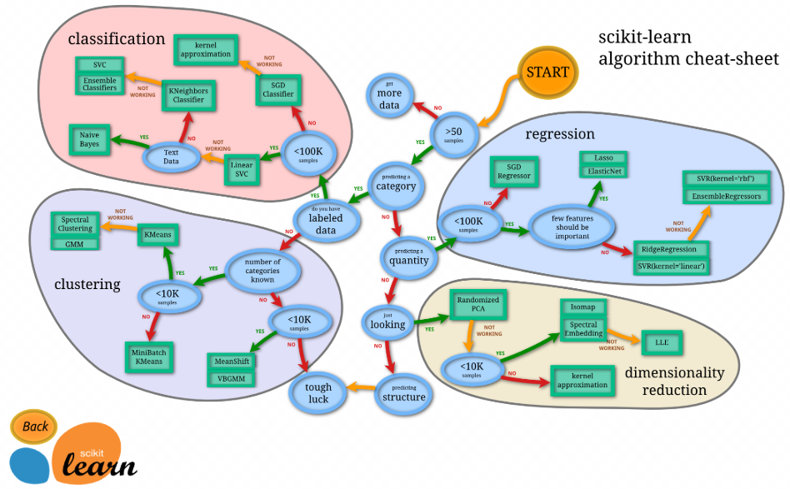
PREDICTIVE MODELLING
Pre-processing:
Shuffle
Scale of the Features Matrix
Model selection (Based on Scikit Learn recommendations) :
Figure 3: Model selection recommendation by Scikit-learn

Slide 8
PREDICTIVE MODELLING. RESULTS
Results:
TEST: ['Grocer/Market' 'Primary/Secondary School' 'Food Processing' 'Food Processing' 'Grocer/Market' 'Primary/Secondary School' 'Grocer/Market' 'Food Processing' 'Shopping Center/Shopping Mall' 'Shopping Center/Shopping Mall' 'Manufacturing' 'Primary/Secondary School' 'Shopping Center/Shopping Mall' 'Primary/Secondary School' 'Grocer/Market’]
PREDICTION: ['Grocer/Market' 'Primary/Secondary School' 'Food Processing' 'Food Processing' 'Grocer/Market' 'Primary/Secondary School' 'Grocer/Market' 'Food Processing' 'Shopping Center/Shopping Mall' 'Shopping Center/Shopping Mall' 'Food Processing' 'Primary/Secondary School' 'Primary/Secondary School' 'Food Processing' 'Grocer/Market’]
NUMBER OF ERRORS: 3
ERROR RATE: 20 %
ACCURACY: 80%

Slide 9
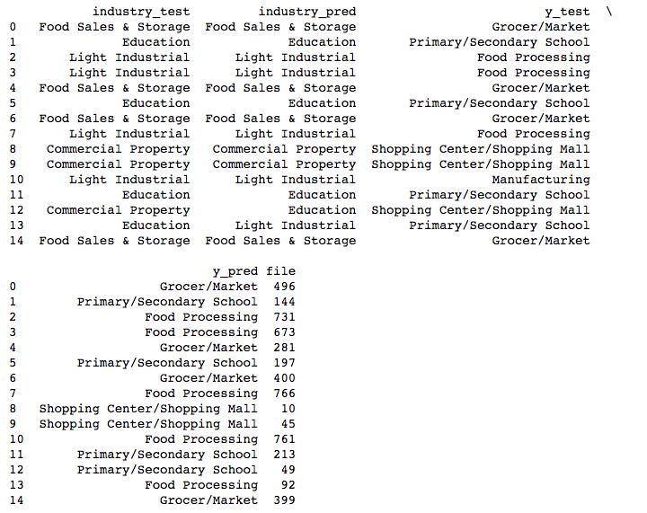
PREDICTION DETAILS
CASES OF STUDY
LOCAL 92 → Pred: Food Processing.
Test: Primary/Secondary School.
Different Industry.
LOCAL 49 → Pred: Primary/Secondary School.
Test: Shopping Center/Shopping Mall.
Different Industry.
LOCAL 761 → Pred: Food Processing.
Test: Manufacturing.
Same Industry.
Figure 4: Prediction and test comparisons.

Slide 10
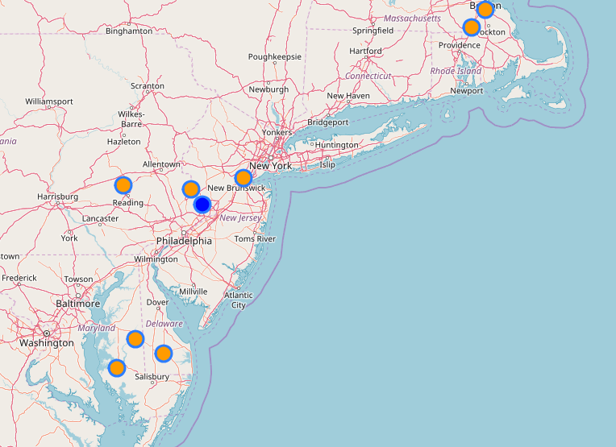
CASE I. GEOGRAPHICAL RESEARCH
LOCAL 92 → Pred: Food Processing.
Test: Primary/Secondary School.
Different Industries.
Figure 5: Location of the local 92 and the locals of Food Processing.

Slide 11
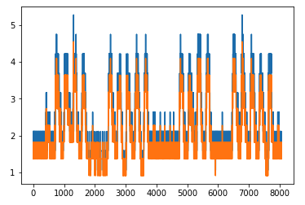
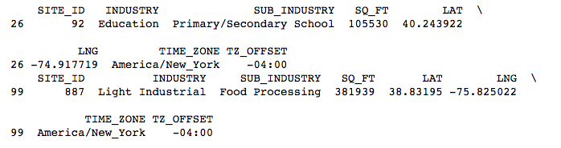
CASE I. QUICK SIMILARITY COMPARISON. FIRST MONTH
LOCAL 92 → Pred: Food Processing.
Test: Primary/Secondary School.
Different Industries.
Figure 6: First month of local 92 against local 887
Figure 7: Metadata of local 92 and 887.

Slide 12
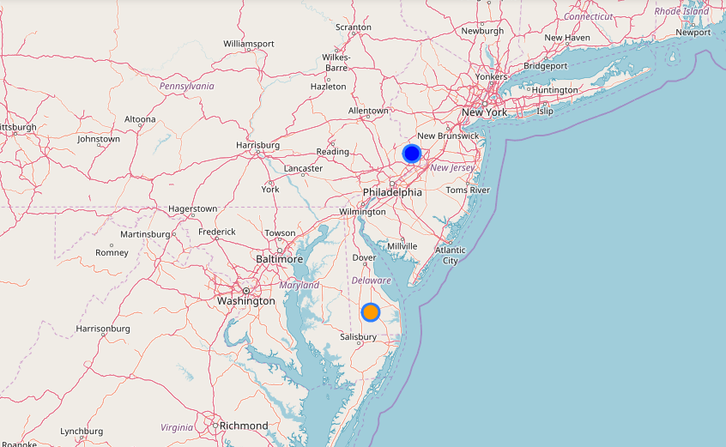
CASE I. CONCLUSIONS
LOCAL 92 → Pred: Food Processing.
Test: Primary/Secondary School.
Different Industries.
There is a behaviour so similar of those locals so, maybe an inspector should review those locals and get conclusions in order to change the electric consumption rate.
Let's see the ubication of those locals.
Figure 8: Locations of local 92 and local 887

Slide 13
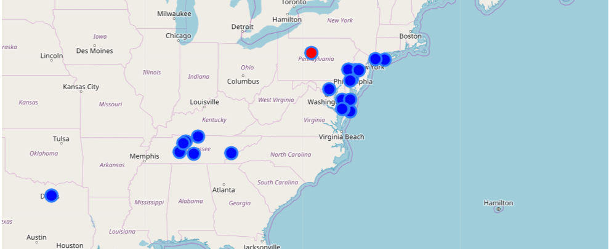
CASE II. GEOGRAPHICAL COMPARISON
LOCAL 49 → Pred: Primary/Secondary School.
Test: Shopping Center/Shopping Mall.
Different Industry.
Let's compare the ubication of this local and the Primary/Secondary Schools.
Figure 9: Location of local 49 against Primary/Secondary School locals.

Slide 14
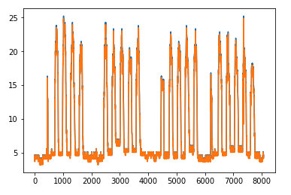
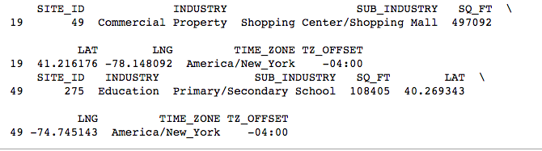
CASE II. QUICK SIMILARITY COMPARISON. FIRST MONTH
LOCAL 49 → Pred: Primary/Secondary School.
Test: Shopping Center/Shopping Mall.
Different Industry.
Figure 10: First month of local 49 against local 275
Figure 11: Metadata of local 49 and local 275

Slide 15
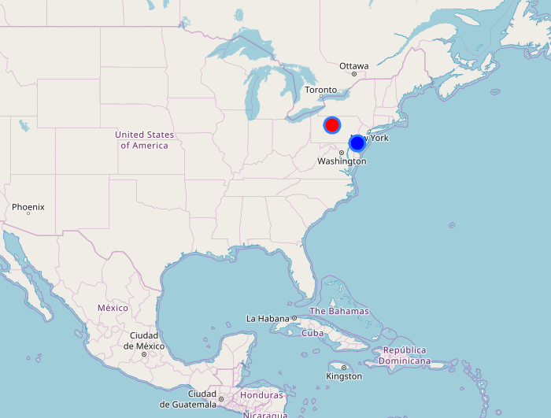
CASE II. CONCLUSIONS
LOCAL 49 → Pred: Primary/Secondary School.
Test: Shopping Center/Shopping Mall.
Different Industry.
The locals seems to have exactly the same behaviour, so an inspector should visit those locals and offer a solution, maybe another payment rate.
Figure 12:Locationof local 49(red) and local 275(blue).

Slide 16
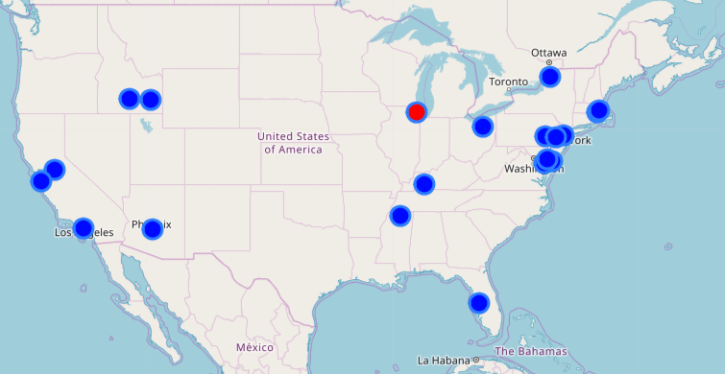
CASE III. GEOGRAPHICAL RESEARCH
LOCAL 761 → Pred: Food Processing.
Test: Manufacturing.
Same Industry.
Let's plot the ubication of this locals against the location of Food Processing locals.
Figure 13: Location of local 761 against Manufacturing locals.

Slide 17
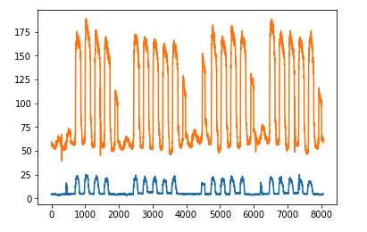
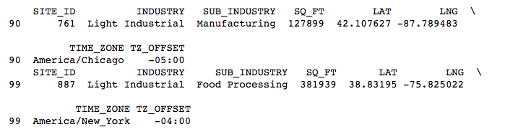
CASE III. QUICK SIMILARITY COMPARISON. FIRST MONTH
LOCAL 761 → Pred: Food Processing.
Test: Manufacturing.
Same Industry.
Figure 14: First month of local 761 against local 887.
Figure 15: Metadata of locals 761 and 887

Slide 18
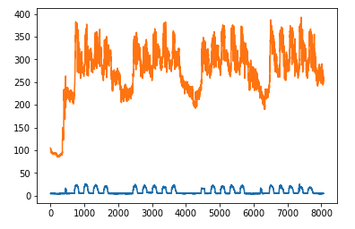
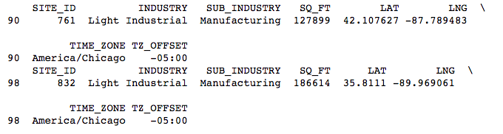
CASE III. QUICK SIMILARITY COMPARISON. FIRST MONTH
LOCAL 761 → Pred: Food Processing.
Test: Manufacturing.
Same Industry.
Those locals seems not to be extremely similar, so maybe there are not enough Manufacturing samples to train the model, or maybe the manufacturing locals has not a similar behaviour between them.
Let's compare this local with the rest of manufacturing locals.
Figure 16: First month of local 761 against local 832
Figure 17: Metadata of local 761 and local 832
The behaviours seems strange, so maybe we could offer another payment rate for this local for not be treated as a manufacturing local.

